Slide 1
Lesson 6
Cycling trips

Slide 2
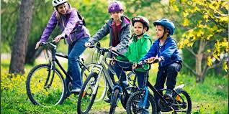
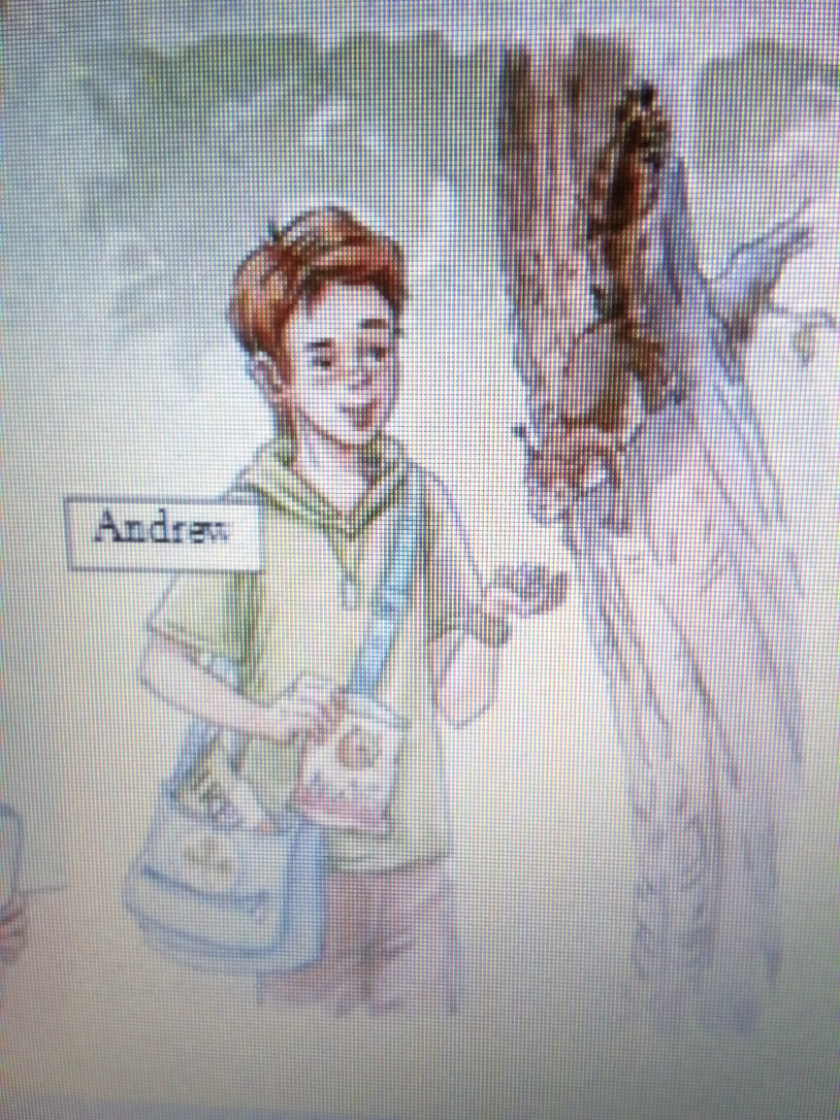
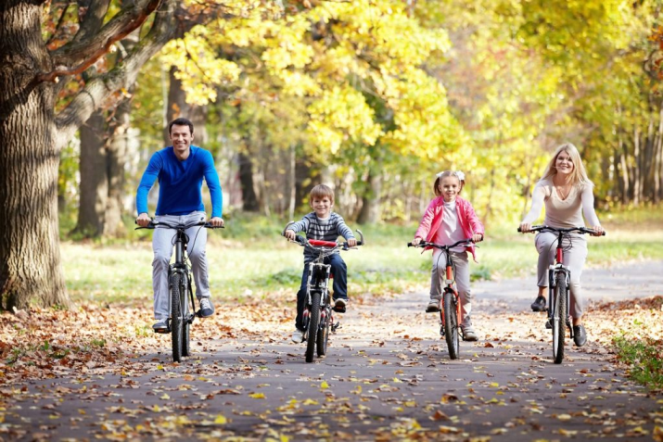
His hobby

Slide 3
Our aims
1) to discuss advantages and disadvantages of cycling trips
2) to express our opinions about cycling trips

Slide 5
The keys
Answer Peter’s questions.
1) Who did you…go / travel…with? – With my mum and dad.
2) How did you…travel….?- By car.
3) What …did….you do there? - We went swimming
4) --Did--- you like your trip? – Yes, I did.
5) What places did you…visit / see.? –Historical places

Slide 6
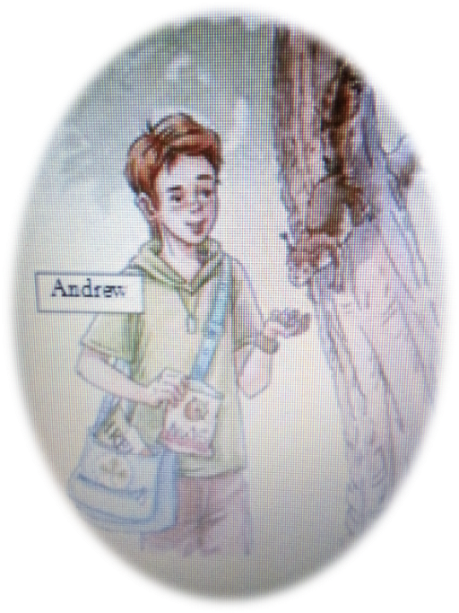

Slide 7
On the one hand cycling trips are….. on the other hand they are… You can……….

Slide 8
Рефлексия

Slide 9
Home task C. стр. 15 упр.26 ( перевод фраз) B. Стр. 14 упр. 23 A. стр. 14 упр. 24

