Slide 1
Урок
учителя английского языка
МБОУ «Лянторская СОШ №6»
Терещенко
Эллы Николаевны
2023 год

Slide 3
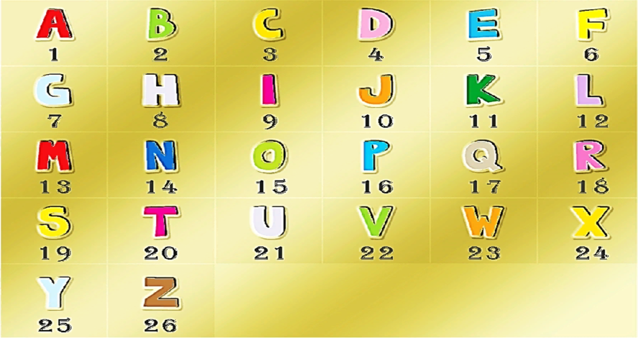
16 | 18 | 15 | 6 | 5 | 19 | 19 | 9 | 15 | 14 | 19

Slide 4
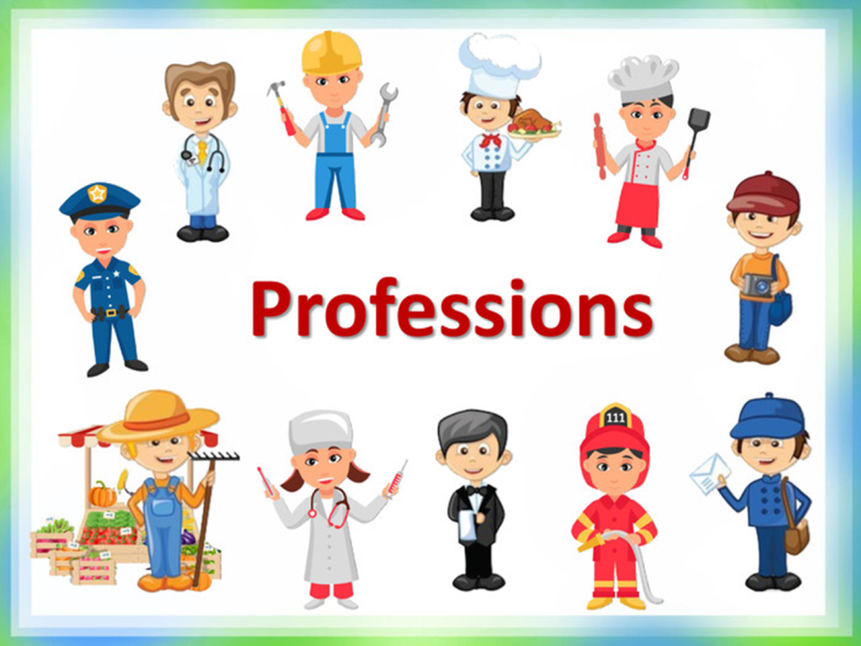

Slide 5
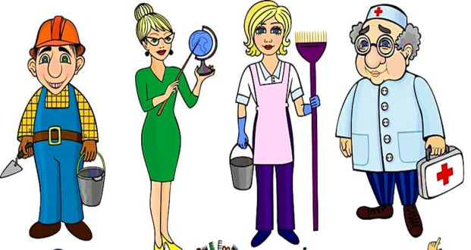
a teacher
an artist
a doctor
an architect
a policeman
a postman
a vet
a cook
a driver
an engineer
a farmer
a fireman
a pilot

Slide 6
Complete these poems
Говорила сыну мама:
Дедушка твой фермер-…
farmer,
А тебе, сын, стать важнее
Инженером, …….
engineer
Возражал ей папа: "Разве?
Много есть профессий разных.
Может больше будет прока
Если стать рабочим, …….
worker
Бабушка, услышав, села:
"Моряком он будет, …….
sailor.
Ну, а моряком не станет,
Значит, будет летчик, …….
pilot.
Дед вмешался: "Вы не правы!
Будет внук водитель, ………
driver.
Ничего, что он недавно,
Стать хотел пожарным, ….
fireman.
А захочет, так учтите,
Будет он учитель, ……...
teacher

Slide 7
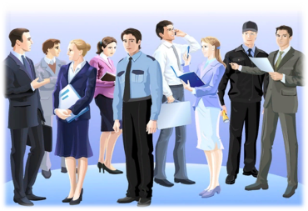

Slide 8
«Fill in the blanks» (am, is, are.)
1. My sister ………. a nurse.
2. You ………. a teacher.
3. They …………… drivers.
4. I ………. a fireman.
5. My parents …………. doctors.
6. Tom and Jon …………. pilots.
7. He ………. a good farmer.
8. We ………. vets.

Slide 9
«Tongue twisters»
When a doctor doctors a doctor,
Does the doctor doing the doctoring
Doctor as the doctor being doctored wants to be doctored or
Does the doctor doing the doctoring
Doctor as he wants to doctor?
Suzie, Suzie, working in a shoeshine shop.
All day long she sits and shines,
all day long she shines and sits,
and sits and shines, and shines and sits,.
Suzie, Suzie, working in a shoeshine shop.

Slide 10
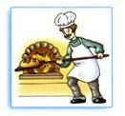
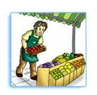
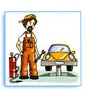
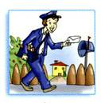
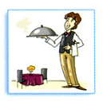
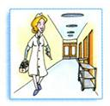
«Listening»
А
А
А
А
А
А

Slide 11
Answers:
1. I wear a white uniform. I help sick people. A nurse.
2. I take letters to people’s houses. A postman.
3. I sell fruit and vegetables. A greengrocer.
4. I bake bread and make cakes. A baker.
5. I work in a garage. I fix cars. A mechanic.

Slide 12
“Reading”
In England people can work as a Yeomen warder (popularly known as “a beefeater”).
The Beefeaters used to guard the Tower. The Tower of London is the main place of interest in England. Beefeaters have guarded the Tower since the reign of Henry VIII. To become a beefeater today you have to serve in the Army for at least 22 years.
Today beefeaters work mostly as guides. They show people around and tell stories about all the terrible things that have happened here. No one knows more about the history and secrets of the Tower than these famous men.
When they are guiding, they wear dark blue uniforms. On ceremonial occasions they wear red and gold tunics designed for them during the reign of Queen Elizabeth I.

Slide 13
True or False
1 “A beefeater” is a soldier of the British Army.
2 “Beefeaters” are the guards of the Tower.
3 The Tower is the main place of interest in the capital of England.
4 “Beefeaters” don’t know anything about the history of the Tower.
5 “Beefeaters” have two variants of their uniforms.
Key
1 F; 2 T; 3 T; 4 F; 5 T.

Slide 14
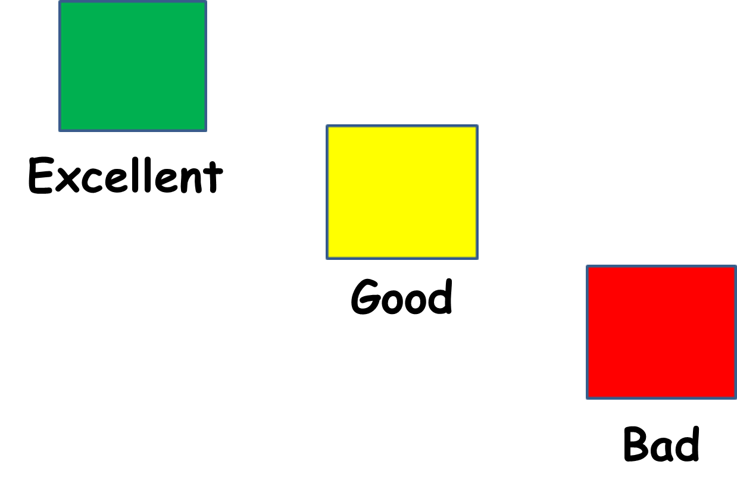

Slide 15
Write 5-6 sentences about professions in your family.

