Slide 1
Подготовка учащихся пятых классов к итоговой аттестации по английскому языку на примере урока
My home, my castle
Шехтер Екатерина Александровна

Slide 2
What are we going to talk about?
houses and rooms
your bedroom
furniture

Slide 3
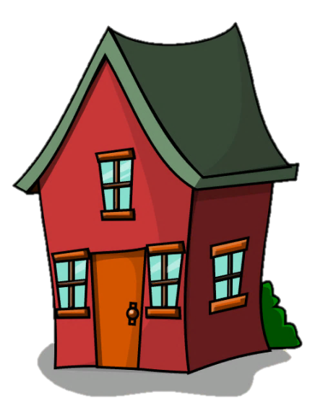
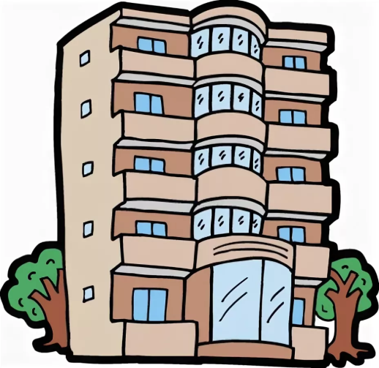
Where do you live?
a large building that is divided into apartments
a building that people, usually one family, live in
Is your flat/house big?
How many rooms are there?
What is your favourite room?
block of flats
house

Slide 4
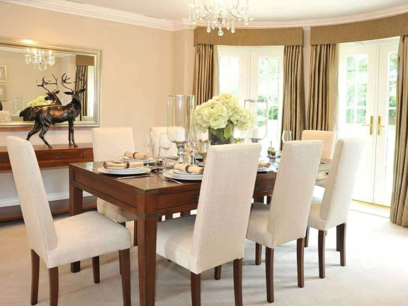
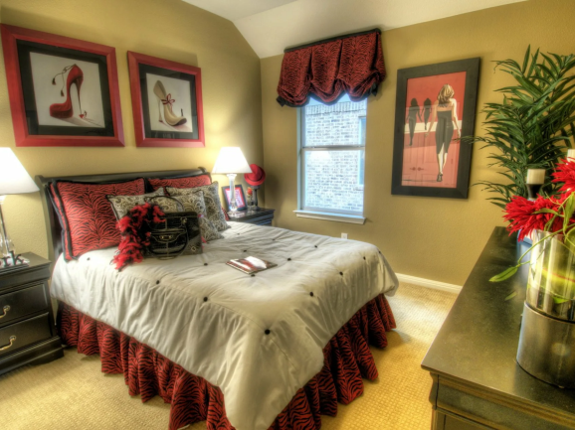
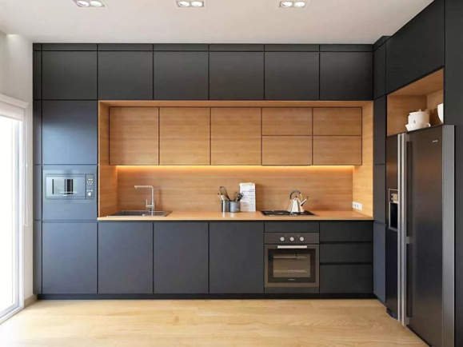
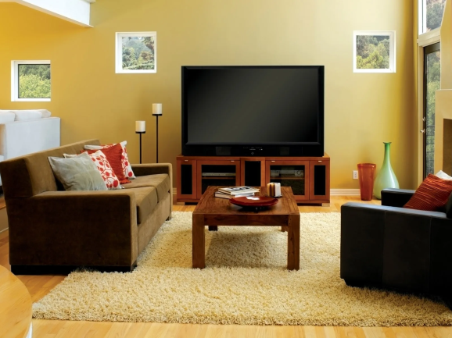
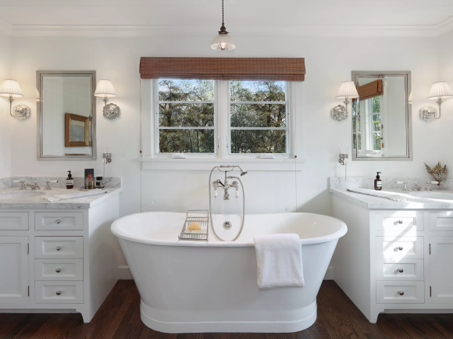
Ex. 1. Read the words and label the pictures. Then listen and check.
A
B
living room
kitchen
playroom
bathroom
attic
laundry room /ˈlɔːn.dri/
bedroom
hall
dining room
garden
garage
study
dining room
bedroom
C
D
hall
kitchen
E
F
living room
bathroom

Slide 5
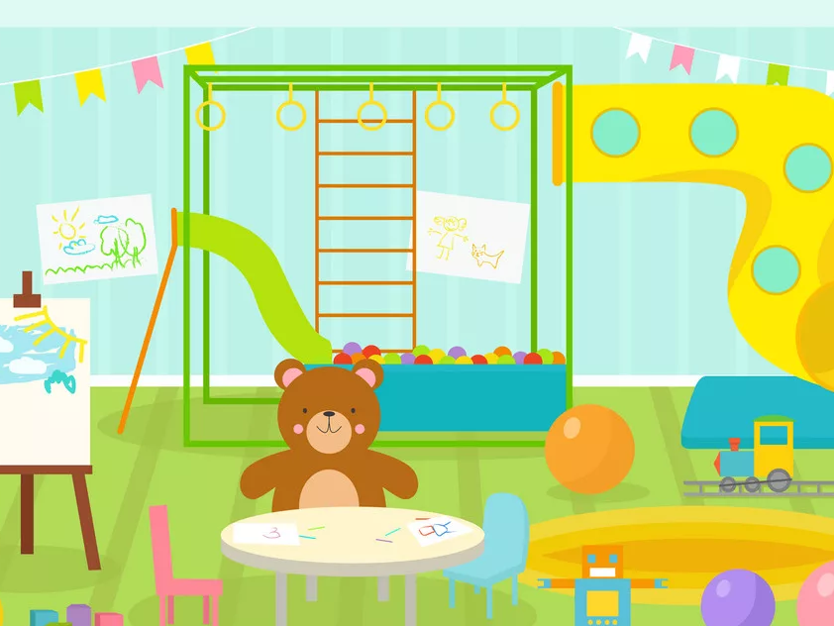
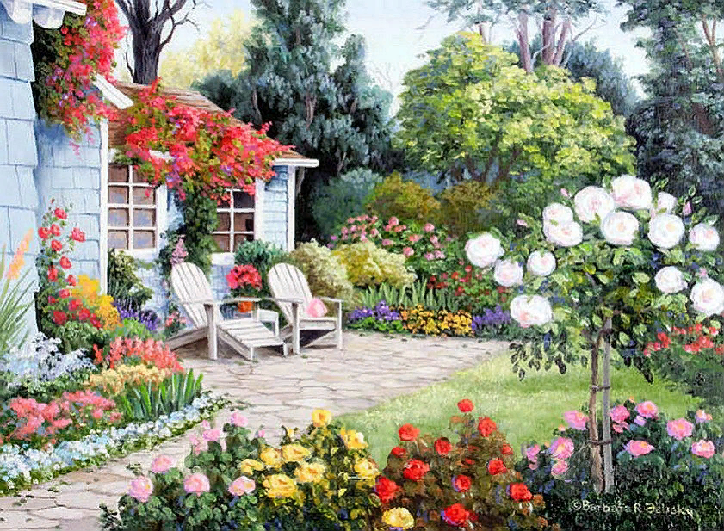
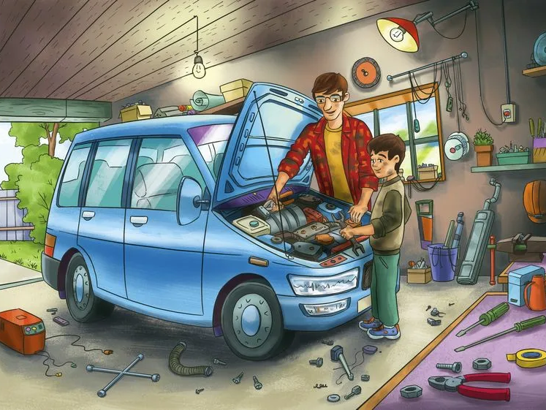
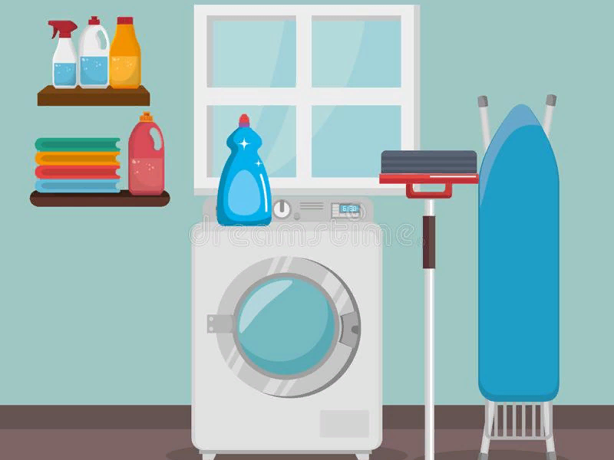
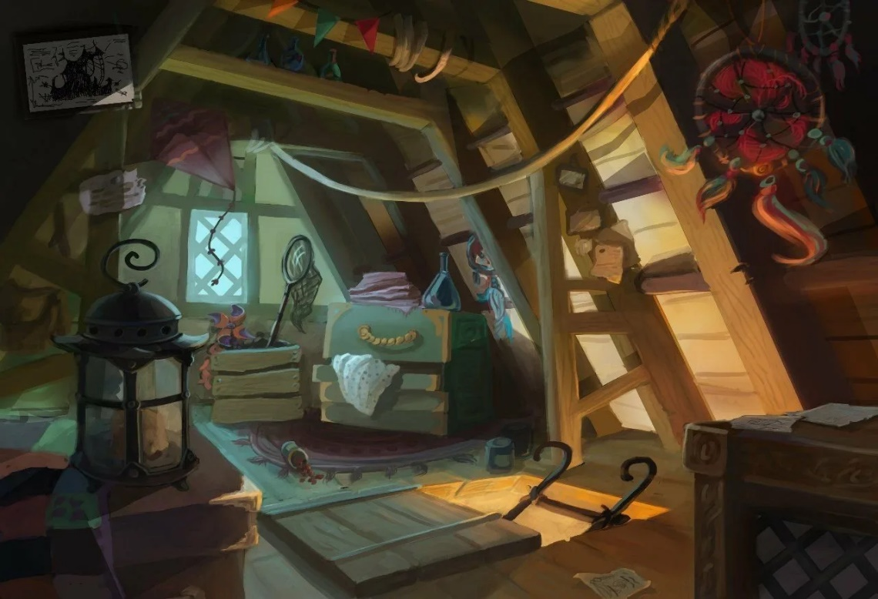
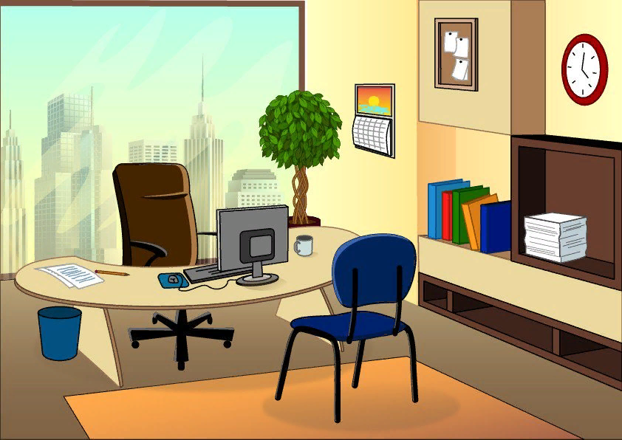
Do you know all these words? Let’s check.
living room
kitchen
laundry room
playroom
bathroom
attic
bedroom
hall
dining room
garden
garage
study
playroom
garden
garage
laundry room
attic
study

Slide 6
Label the rooms.
attic
1
bathroom
bedroom
6
2
living room
7
kitchen
3
dining room
4
hall
8
laundry room
9
study
5

Slide 7
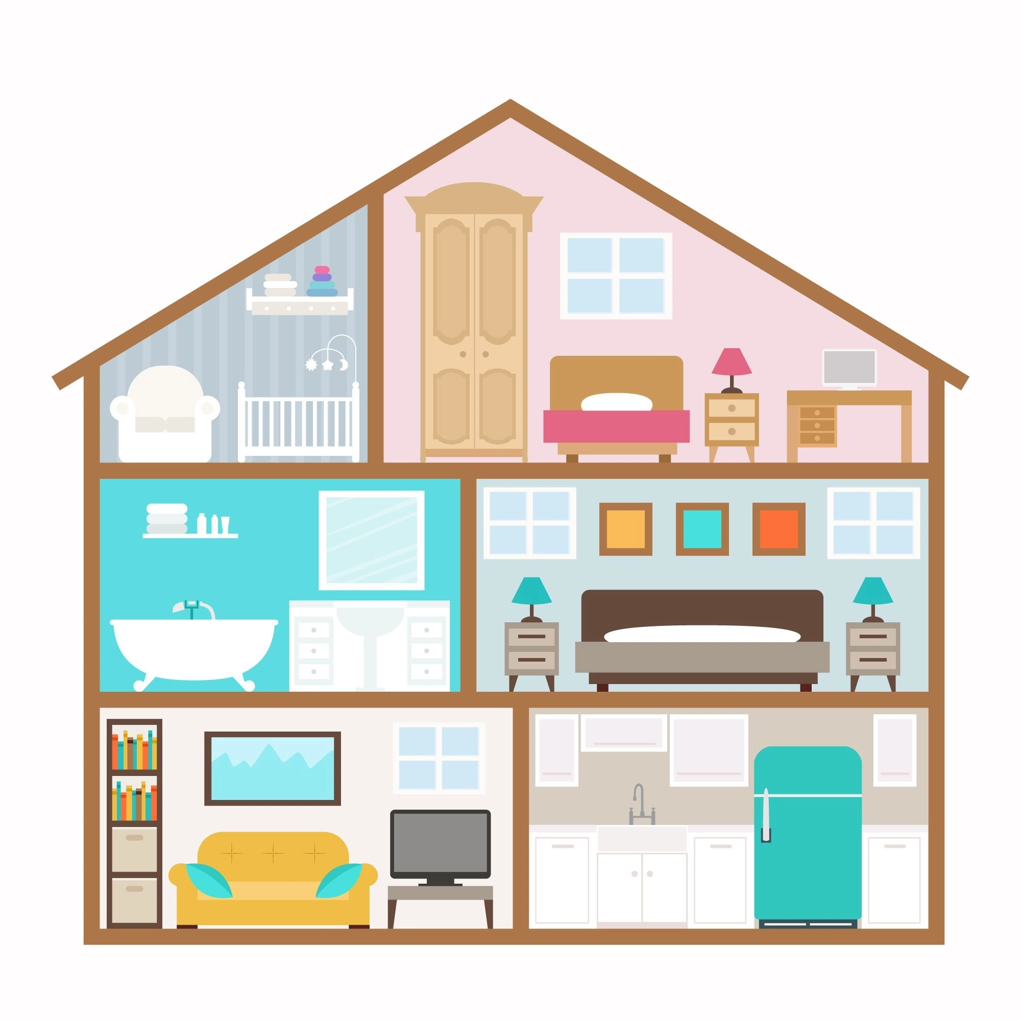
Описываем дома
Говорим название комнат и рассказываем, что в них находится с помощью конструкции There is / There are
Описываем цвет вещей: The sofa is yellow
Говорим, что в этой комнате люди делают: People sleep in this room

Slide 8
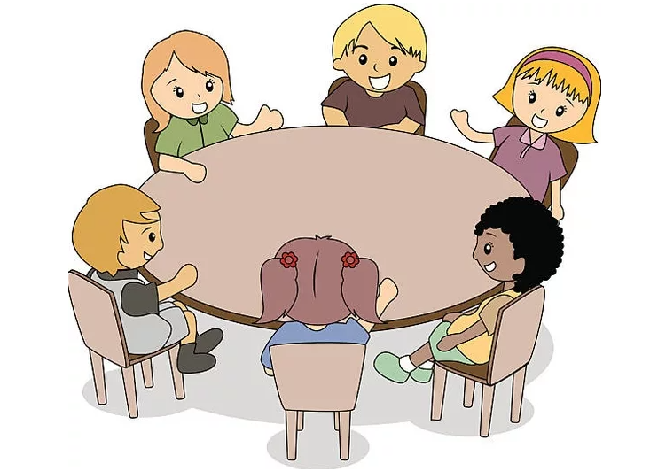
What is there on the table?
There is an ice cream on the table.
There is a car on the table.
There are two apples on the table.
There are three bananas on the table.

Slide 9
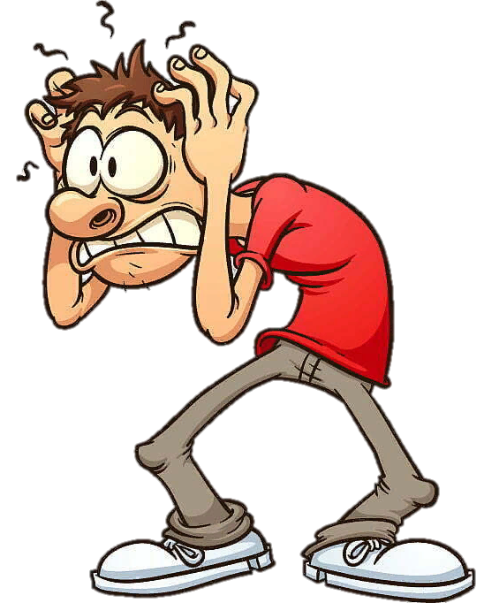
Where???
What???
There is…
There are…

Slide 10
There is a book on the table.
There are books on the table.

Slide 11
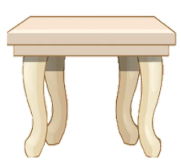
There is/are what? where?
There is an apple on the table.
There are two apples on the table.

Slide 12
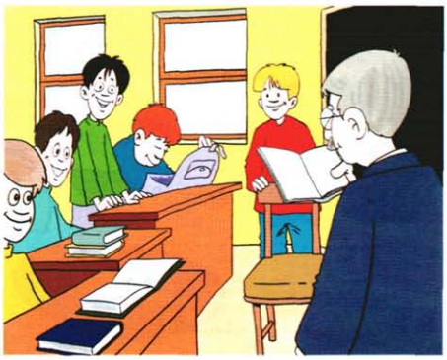
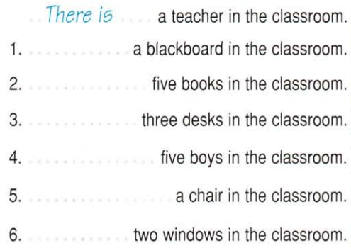
There is
There are
There are
There are
There is
There are

Slide 13
There is/are not what? where?
There isn’t an apple on the table.
There aren’t two apples on the table.

Slide 14
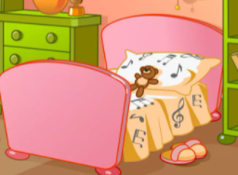
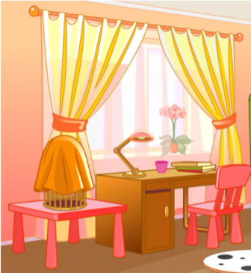
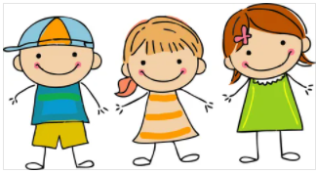
…………………… three books on the table.
…………………… a bed in the room.
…………………… two curtains in the room.
…………………… a chair in front of the table.
…………………… a clock on the desk.
…………………… a lamp on the desk.
…………………… a cage on the table.
…………………… a window in the room.
…………………… any toys in the room.
…………………… any children in the room.
There are
There isn’t
There are
There is
There isn’t
There is
There is
There is
There aren’t
There aren’t

Slide 15
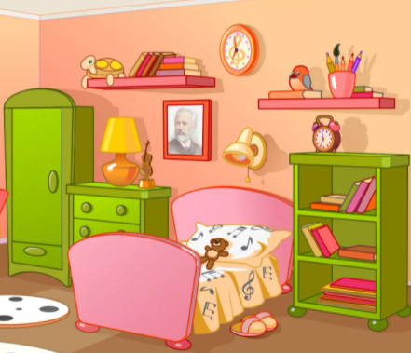
There is…
There are…
… in the room.
… on the bed.
… on the shelf.
… in the bookcase.
… on the wall.

Slide 16
Is/Are there what? where?
Is there an apple on the table?
Yes, there is.
No, there isn’t.

Slide 17
Is/Are there what? where?
Are there any apple on the table?
Yes, there are.
No, there aren’t.

Slide 18
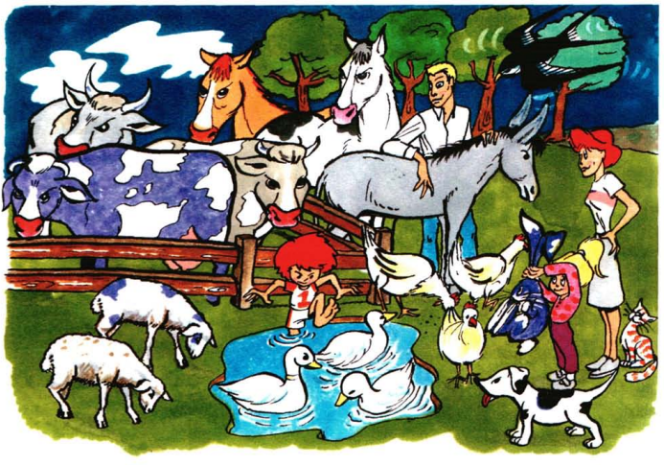
three sheep?
Are there three sheep?
No, there aren’t.
There are two sheep.
one cat?
three ducks?
one bird?
two dogs?
three trees?
three hens
two children?
two cows?
one horse?
one rabbit?
one donkey?
one man?
Is there one cat?
Are there three ducks?
Is there one bird?
Are there two dogs?
Are there three trees?
Are there three hens?
Are there two children?
Are there two cows?
Is there one horse?
Is there one rabbit?
Is there one donkey?
Is there one man?
Yes, there is.
Yes, there are.
Yes, there is.
No, there aren’t.
No, there aren’t.
Yes, there are.
Yes, there are.
No, there aren’t.
No, there isn’t.
Yes, there is.
Yes, there is.
Yes, there is.
There is one dog.
There are four trees.
There are three cows.
There are two horses.

Slide 20
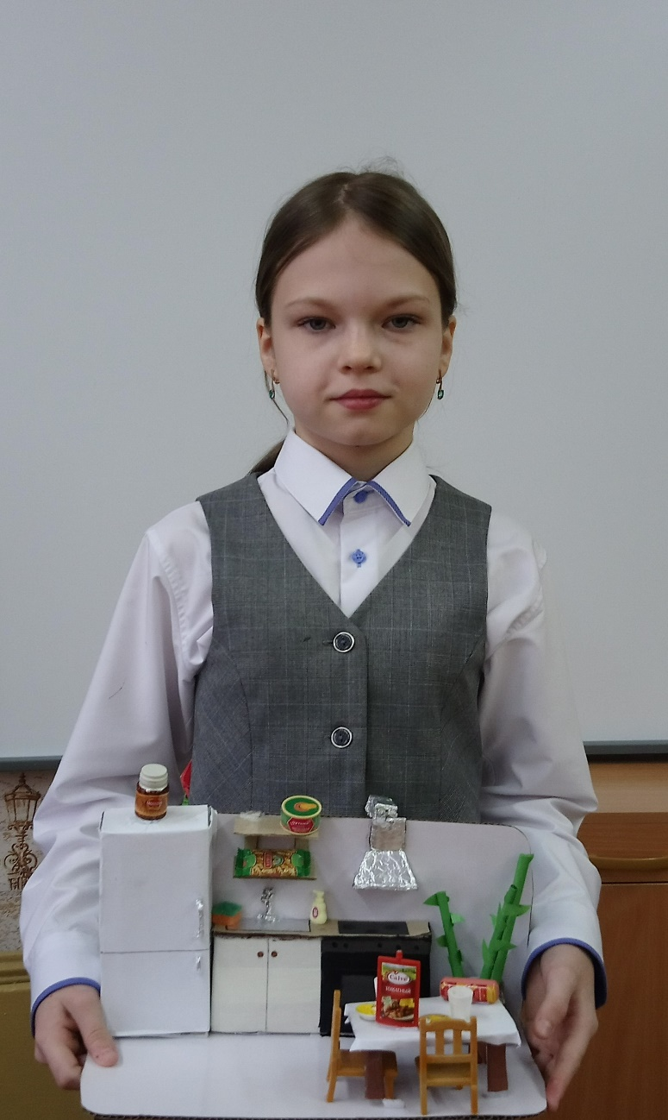
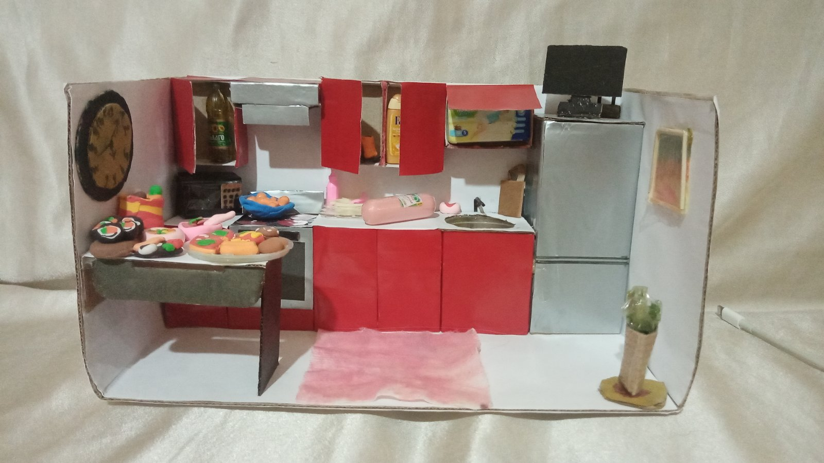
Подведение итогов

Slide 21
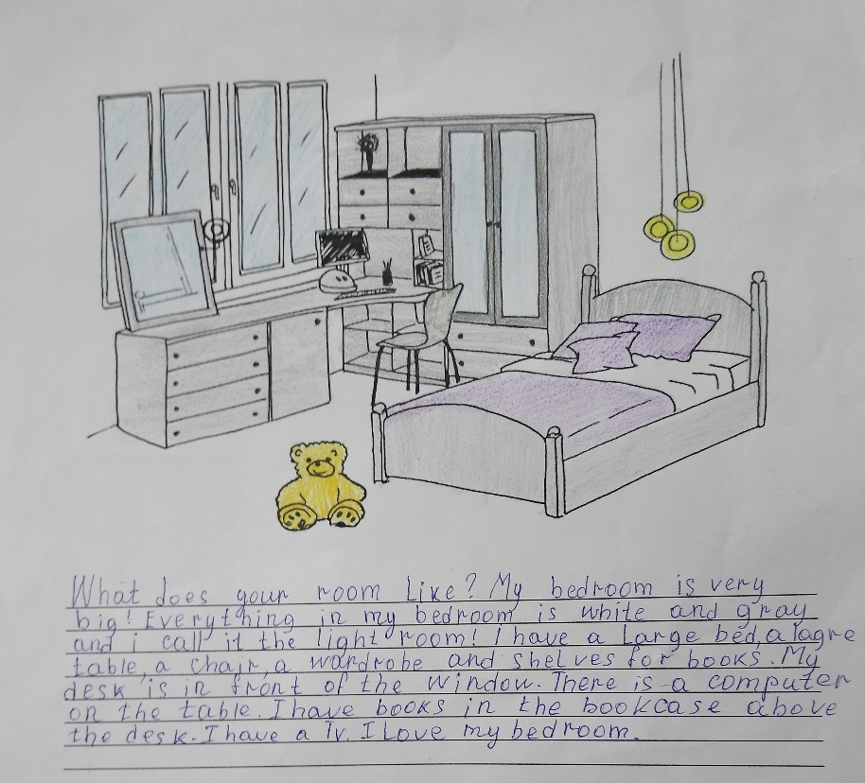
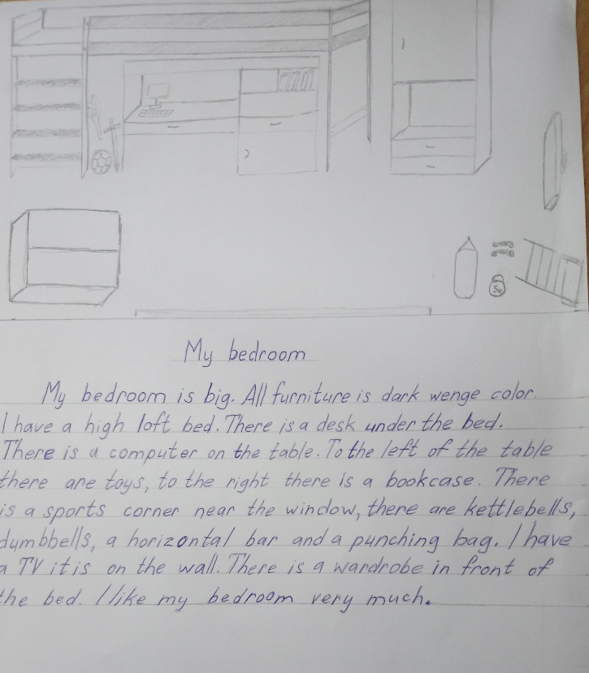
Письмо
Письменный рассказ о любой комнате в доме

Slide 22
Благодарим за внимание!
ШМО иностранного языка шк. №70

