Slide 1
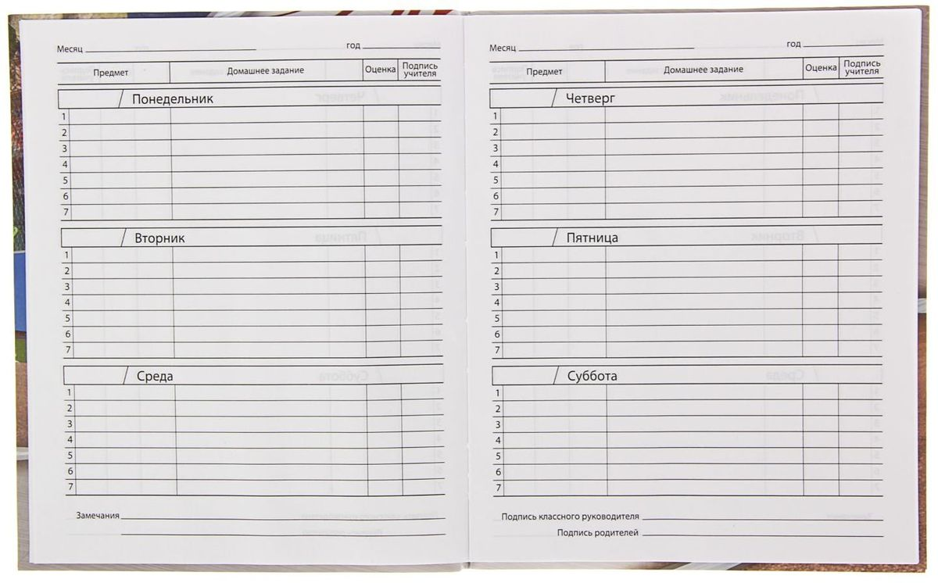
The days of the week
?
?
?
?
?
?

Slide 2
The days of the week
?
?
Monday
Thursday
?
?
Tuesday
Friday
?
?
Wednesday
Saturday
Sunday

