Slide 1

Winter Olympic Games

Slide 2

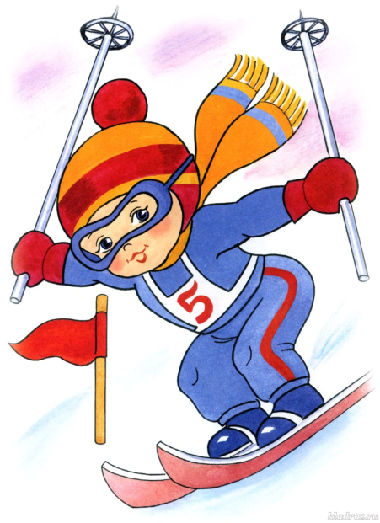
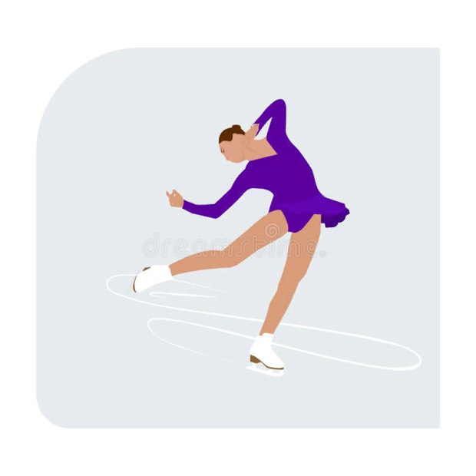
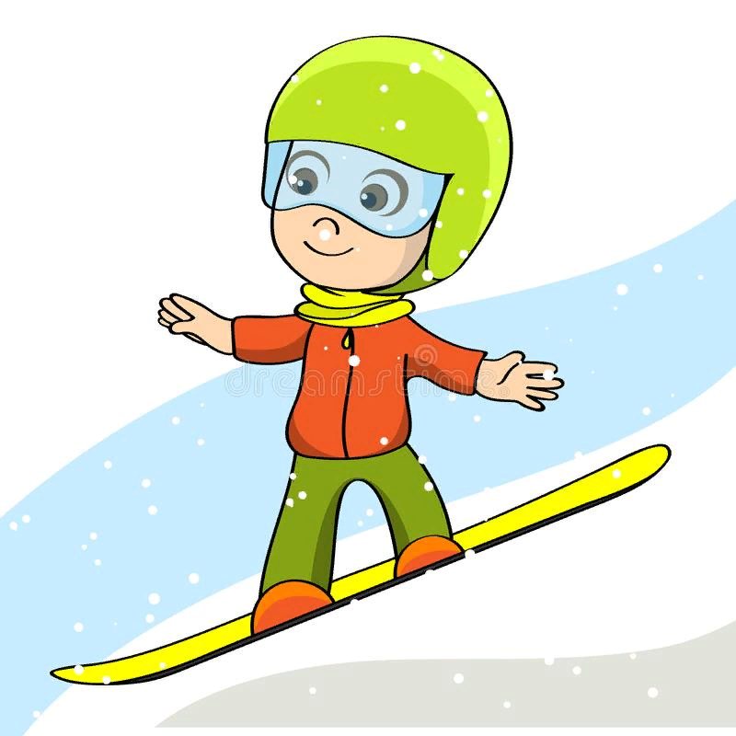
Winter Olympic Games

Slide 3

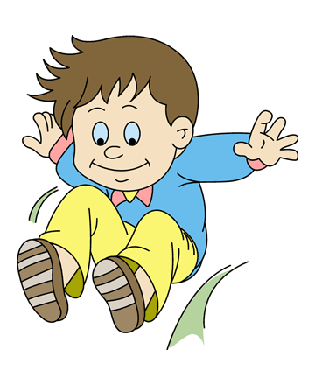
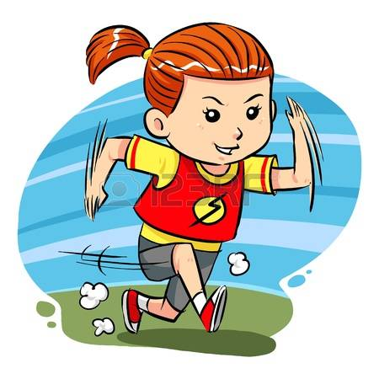


Summer Olympic Games

Slide 4


Slide 5
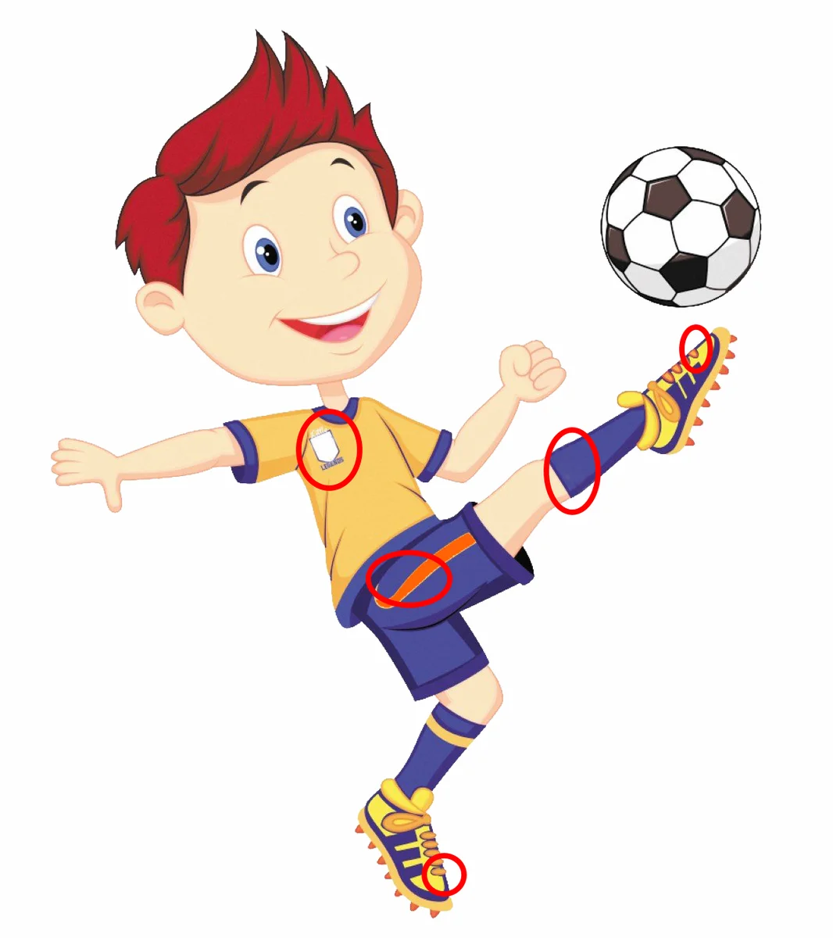

Slide 6


Slide 7
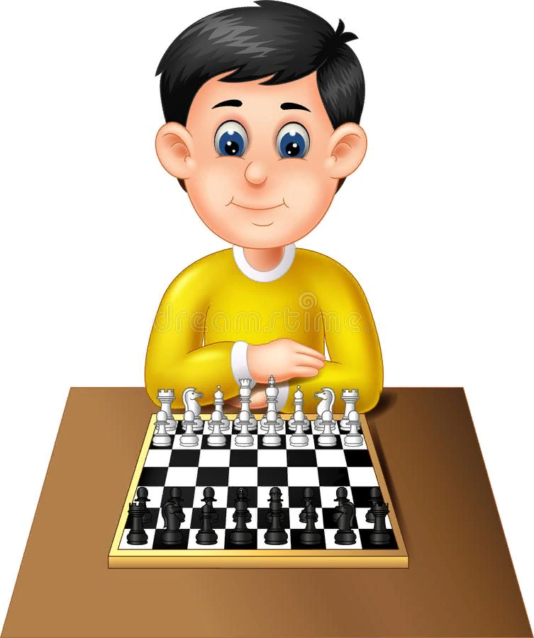

Slide 8


Slide 9


Slide 10


Slide 11


Slide 12


Slide 13


Slide 14


Slide 15


Slide 16
Чтение буквы Ee
[I:] | [e]
read, ten, see, pen, please, get, he, she, green, text, greet, pet, tree, set.

Slide 17
Вставьте пропущенные буквы:
sw_m, r_n, j_mp, pl_y, footb_ll, sk_p, sk_te, sk_, fl_, s_ng, k_nd, go_d, sm_rt,

Slide 18
Вставьте пропущенные буквы:
sw_m, r_n, j_mp, pl_y, footb_ll, sk_p, sk_te, sk_, fl_, s_ng, k_nd, go_d, sm_rt,

Slide 19
Напишите слова, в которых есть указанные звуки
[ɪ], [æ], [ʌ], [e], [k], [ks], [t], [dʒ], [ð]

Slide 20
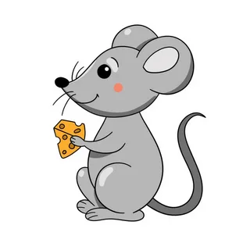
A riddle game
It is grey. It is small. It can run. But it can’t jump.

Slide 21

A riddle game
It is green. It is funny. It can swim and jump. But it can’t fly.

Slide 22
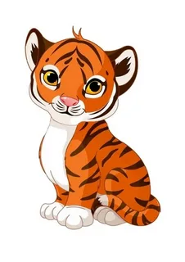
A riddle game
It is red. It can run and jump. But it can’t swim.

Slide 23
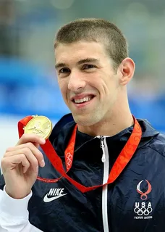
A Famous Sportsman
What’s your name?
How old are you?
Have you got a mother?
What is her name?
Can you play tennis?
Can you ski?
Have you got a sister?
Is your brother kind?

Slide 24

Игра «Интервью»
What’s your name?
How old are you?
Have you got a mother?
What is her name?
Can you play tennis?
Can you ski?
Have you got a sister?
Is your brother kind?

Slide 25
Good-bye, boys and girls!
The end

