Slide 1
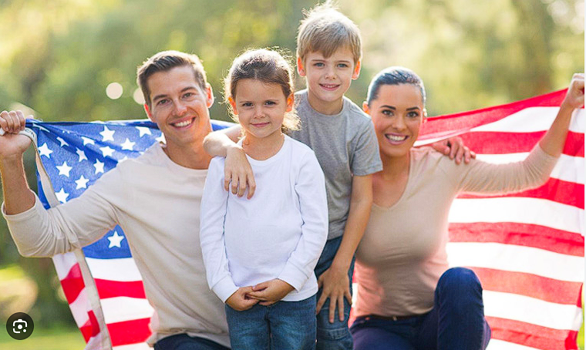
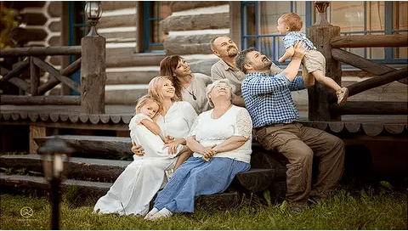
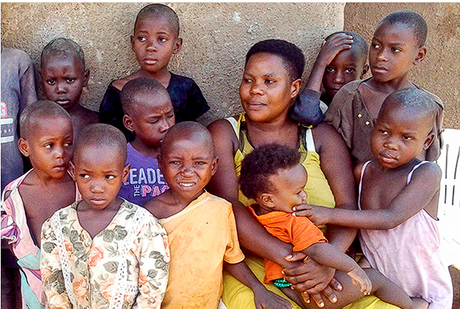
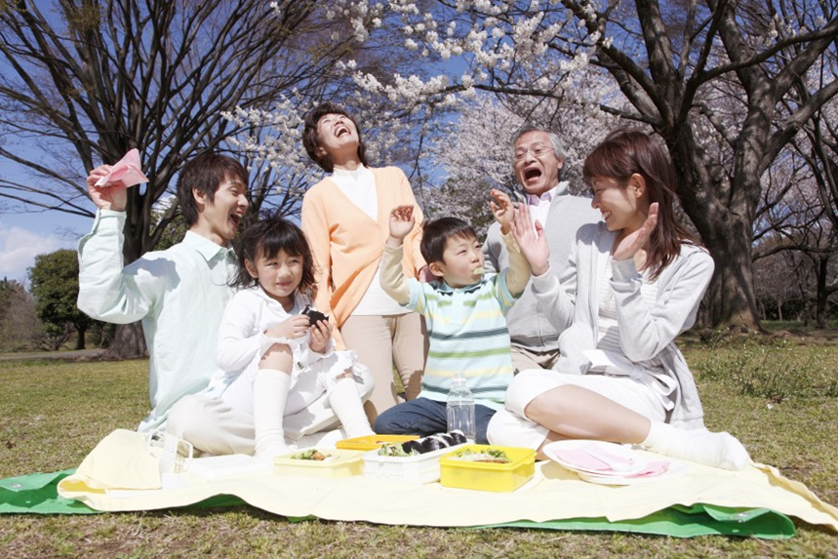
"Family values and traditions of various countries of the world"
Author: English teacher of
School №606
Saint Petersburg
Bogdanova Natalia
Stanislavovna

Slide 2
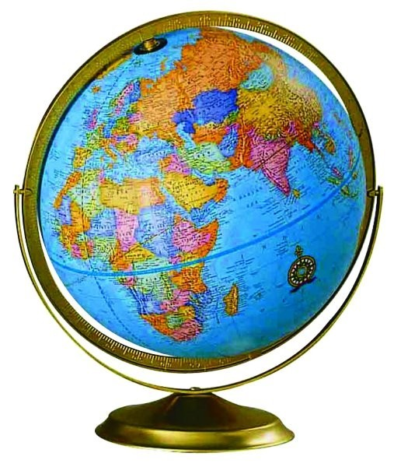
Peculiarities(characteristic features of something) of

Slide 3
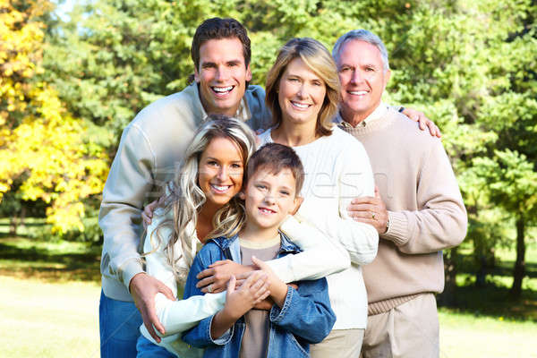
Peculiarities of family relationships around the world

Slide 5
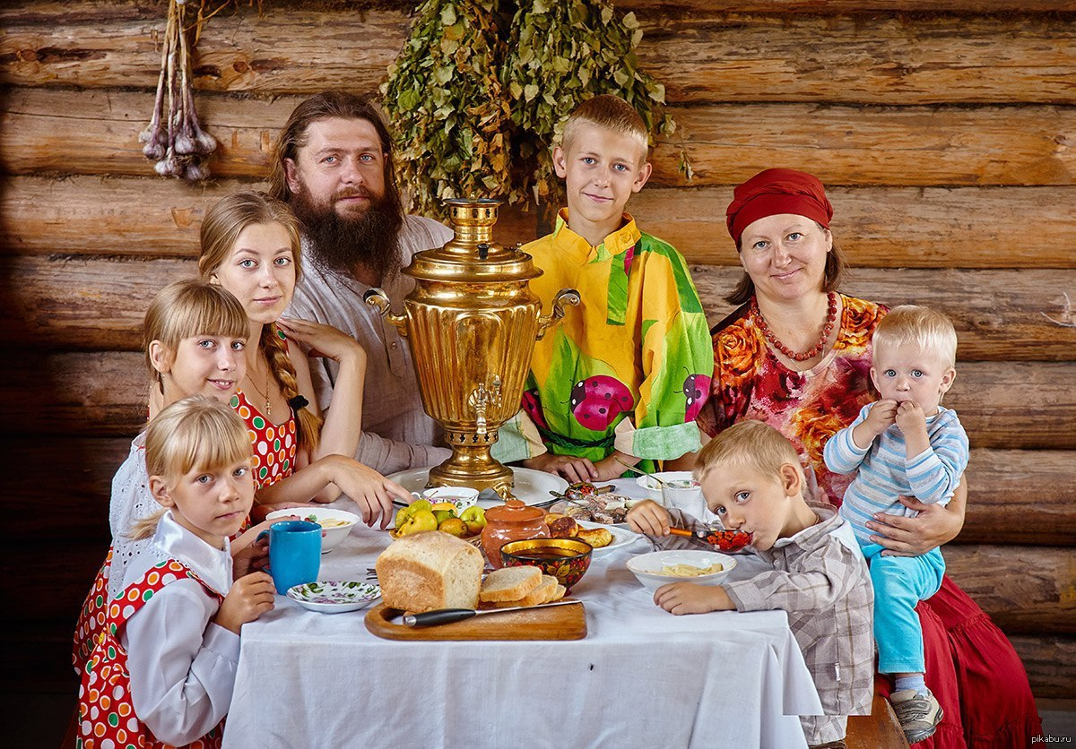
Family Values

Slide 6
Have you ever thought about your future families?

Slide 8
The model of your future family

Slide 9
Moral concepts
honesty
trust
patience
responsibility
love
care
assistance
sympathy
attention
support
forgiveness
humanity
faithfulness
understanding

Slide 11
Nuclear Family

Slide 13
Single Parent Family

Slide 15
Extended Family

Slide 17
Childless Family

Slide 19
Step Family

Slide 21
Grandparent Family

Slide 23
Patriarchal [peɪtrɪˈɑːkəl]Family; Democratic Family

Slide 24
Kinds of families:
Patriarchal [peɪtrɪˈɑːkəl]( прил. Патриархальный) Family
Few divorces;
Large family;
Permanent place of living;
Woman sits at home and keeps the household;
Wife depends on her husband economically;
The man is the head of the family
Democratic Family
a).Many divorces;
b).Small family;
c).Frequent change of place to live, mobility;
d).The woman is busy at home and works outside the house;
e).A Wife and a husband are equal

Slide 25
Family values of different countries
Family values | Russia | Britain | The USA | Japan
1.Having one marriage in a lifetime
2.Mutual upbringing of children
3.Accommodation with elderly parents
4.Helping with babysitting
5. Paying for children's education
6. Having equal rights of spouses
7.Having a man as the head of the family
8. Upbringing of early children’s independence
9. Financial sufficiency
10.Good family relationships (including respect and affection)
11.Cherishing family customs and traditions
12.Love to the motherland
13.Rational using of money
Family values of different countries
Family values | Russia | Britain | The USA | Japan
1.Having one marriage in a lifetime
2.Mutual upbringing of children
3.Accommodation with elderly parents
4.Helping with babysitting
5. Paying for children's education
6. Having equal rights of spouses
7.Having a man as the head of the family
8. Upbringing of early children’s independence
9. Financial sufficiency
10.Good family relationships (including respect and affection)
11.Cherishing family customs and traditions
12.Love to the motherland
13.Rational using of money

Slide 26
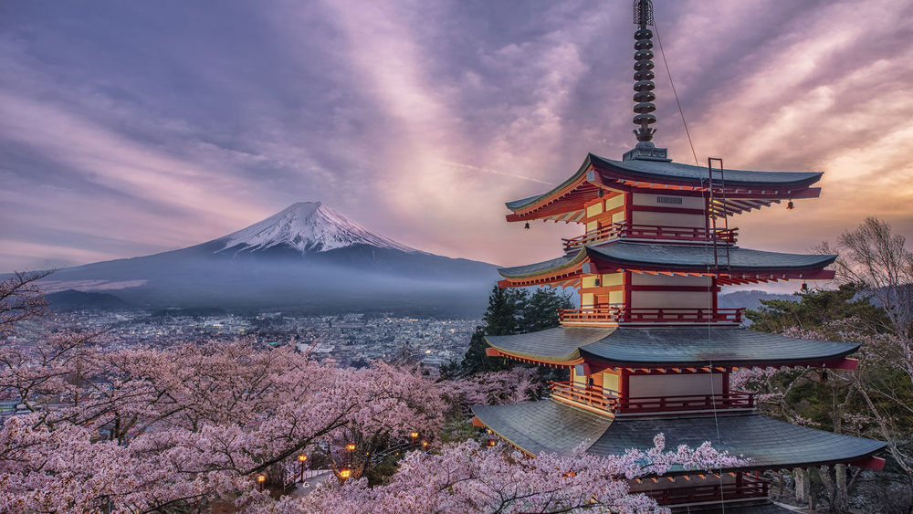

Slide 30
Questionary
(My Future Family)
1. What is a family?
2. At what age do you want to have your own family?
By 18 years old
From 18 to 20 years old
From 20 to 25 years old
From 25 to 30 years old
After 30 years old
It’s difficult to answer
3. What kind of family would you like to have? Why?
4. Do you want to have your own family similar to the parents’ one?
a) Yes, I do.
b) Rather want, than don’t want.
c) Rather don’t want, than want.
d) No, I don’t.
5. What are “Family Values”?
6. What family values do you want to take to your future family?
7. Use 3 words to say briefly: what is a family for you?

Slide 31
At the lesson I was active | At the lesson I was passive
I liked the way I worked at the lesson | I didn’t like the way I worked at the lesson
I understood the material of the lesson well | I don’t think I understood the material of the lesson well
I came to the conclusion that the main family values are the same in different countries | I came to the conclusion that the main family values are different in different countries
I think this lesson was useful for me because I managed to imagine the model of my future family. | In don’t think this lesson was useful for me as I didn’t manage to imagine the model of my future family.

Slide 32
Family is …

Slide 33
Thank you for your attention!

