Slide 1
What is our topic?

Slide 2
Qualities starting with “C”

Slide 3
Make a list of stolen things!

Slide 4
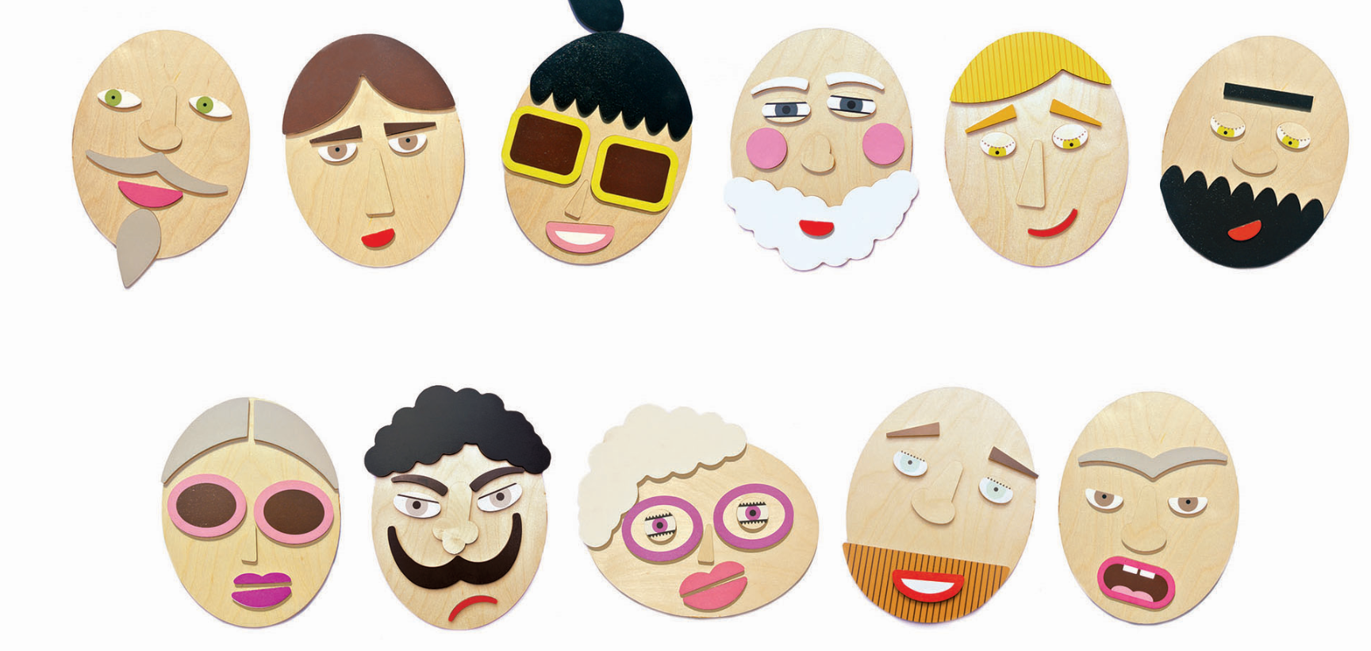
Make a composite sketch of the criminal !

Slide 5
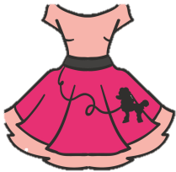
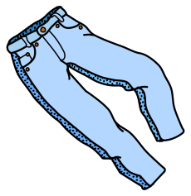
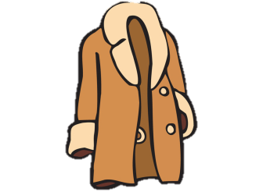
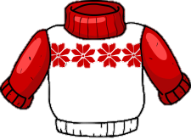
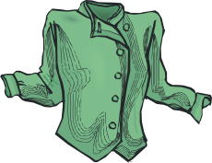
Find the pieces of evidence !
blouse
jeans
jacket
T-shirt
boots
sweater
skirt
dress
coat

Slide 6
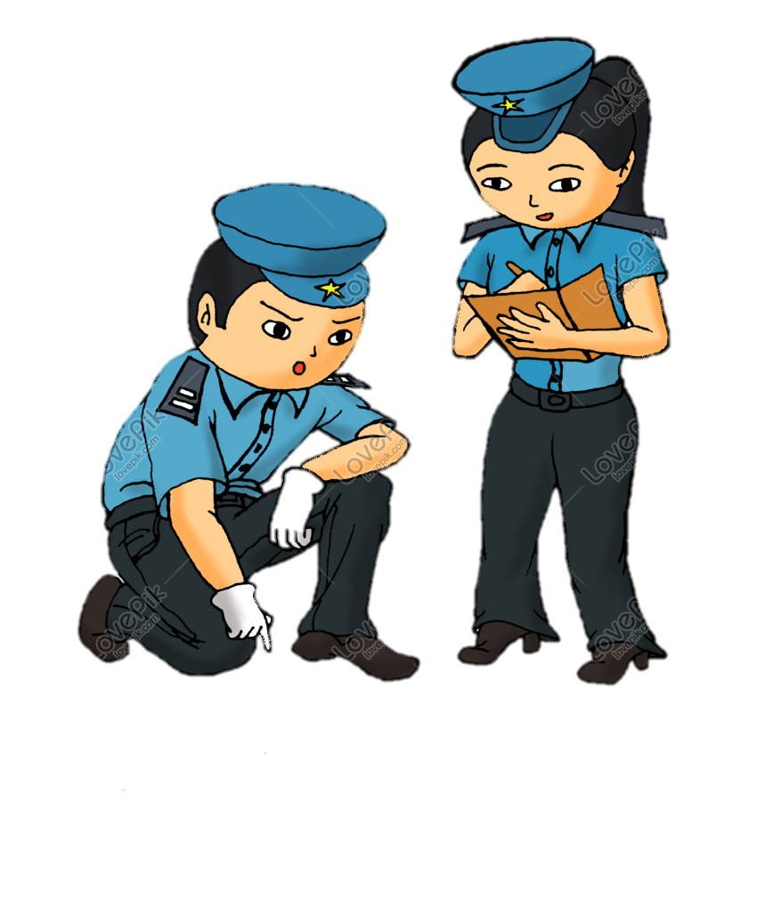
Collect the information
about the robber!

Slide 7
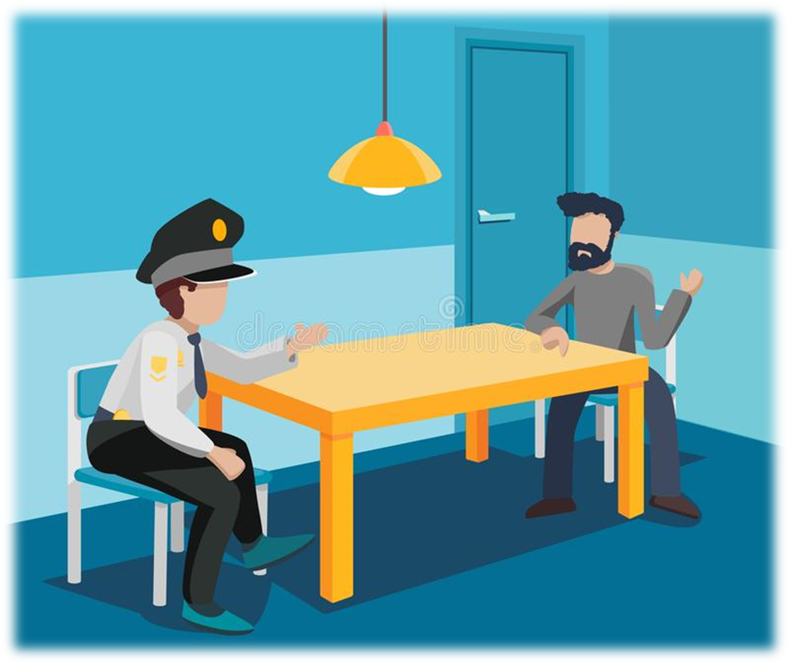
Check the alibi of the suspect!

