Slide 1
МБОУ «СОШ №2 ИМ.СВИДЕРСКОГО А.Г.» города Бахчисарай Республики Крым
ОТКРЫТЫЙ УРОК АНГЛИЙСКОГО ЯЗЫКА
3-Б КЛАСС
ДАТА: 27.11.2023
УЧИТЕЛЬ: Абдуллаева Л.Ш.

Slide 2
What is the theme of our lesson? Try to guess it!

Slide 3
13-25 6-18-9-5-14-4-19’ 8-15-2-2-9-5-19
Use the code above to know the theme of the lesson

Slide 4
“My friends’ hobbies”

Slide 6
The children are playing a game

Slide 7
The boy is driving a car

Slide 8
She is making a sandcastle

Slide 9
He is painting a picture

Slide 10
I am watching TV

Slide 12
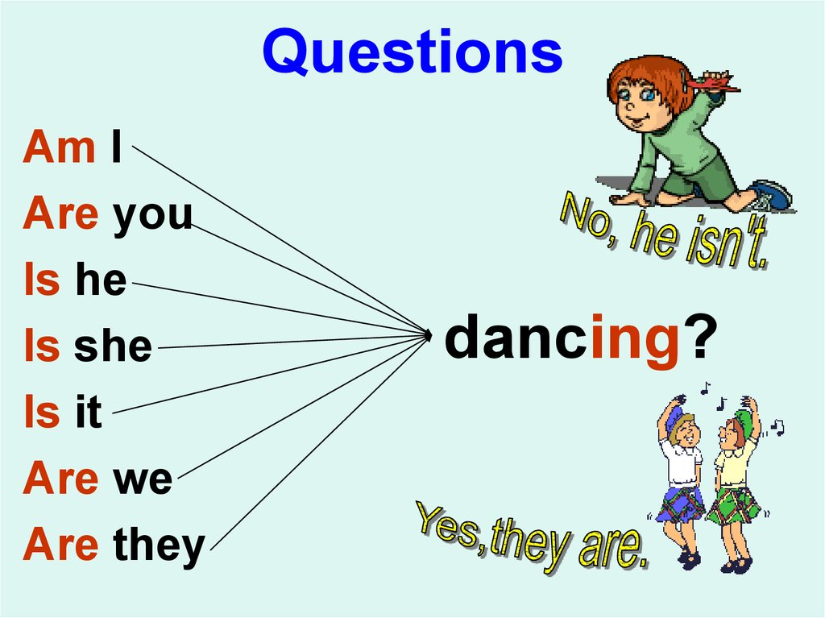

Slide 14
Good job!
Thanks for your attention!

