Slide 1
Good morning, boys and girls!
How are you?
Who’s away today?

Slide 3
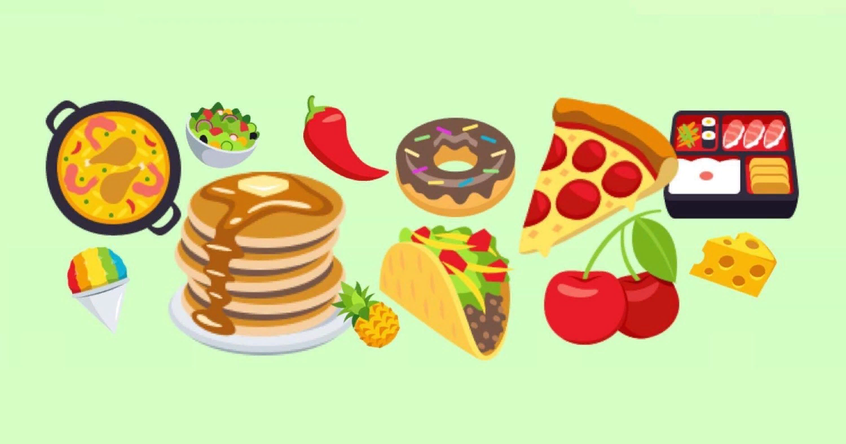
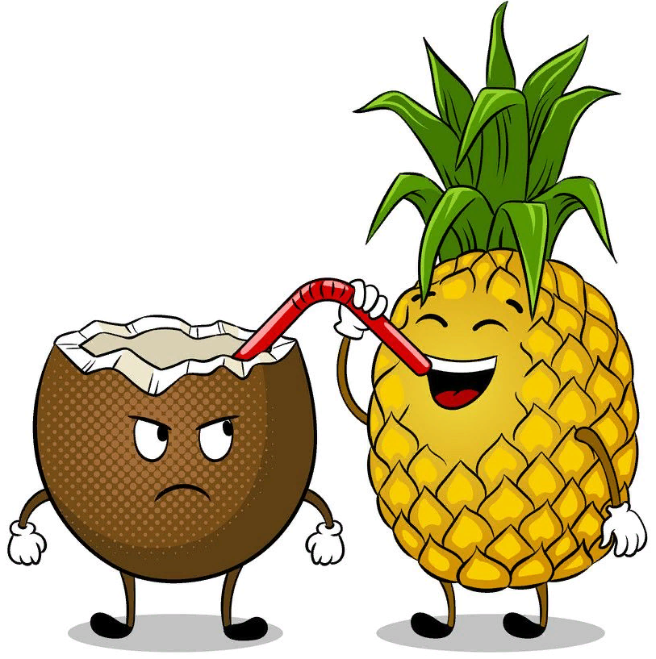
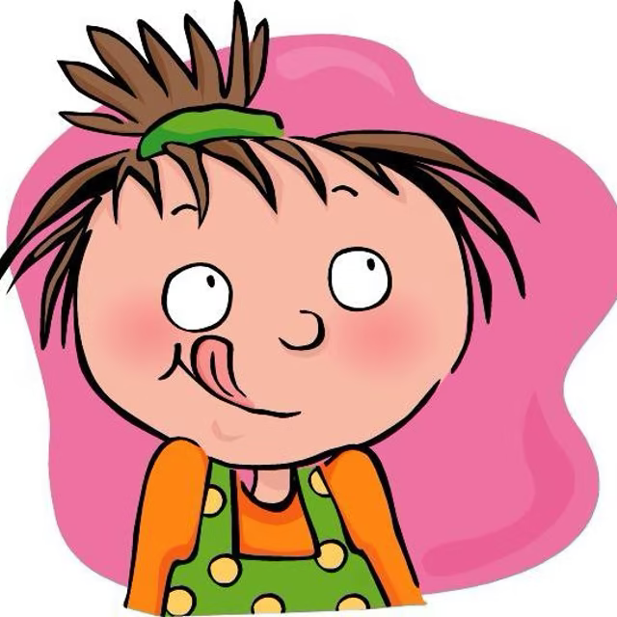
Open your books at page 41. This is Module 3.
What does the word ‘tasty’ mean?
Let’s go!

Slide 4
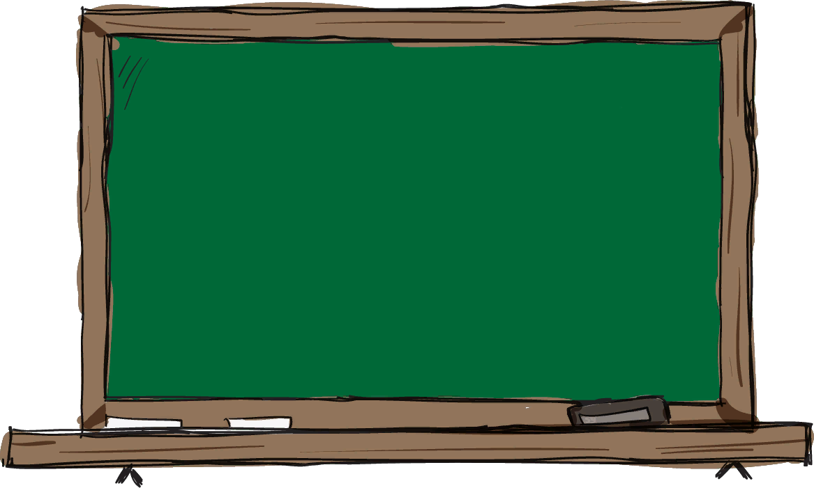
Look at the phonetic sign. What sound is it for?
[ɔ:]
ball, four, horse, daughter,
tall, bought, lord, warm, or,
wall, draw, small, all

Slide 5
Tongue Twister Challenge
Dora’s daughter is taller
than Nora’s daughter,
Nora’s daughter is shorter
than Dora’s daughter.

Slide 6
Look at the nouns. Which of them are countable or uncountable?
Milk, a mango, salt, a lemon, olive oil, sugar, chocolate, jam, an apple, a tomato, a coconut.

Slide 9
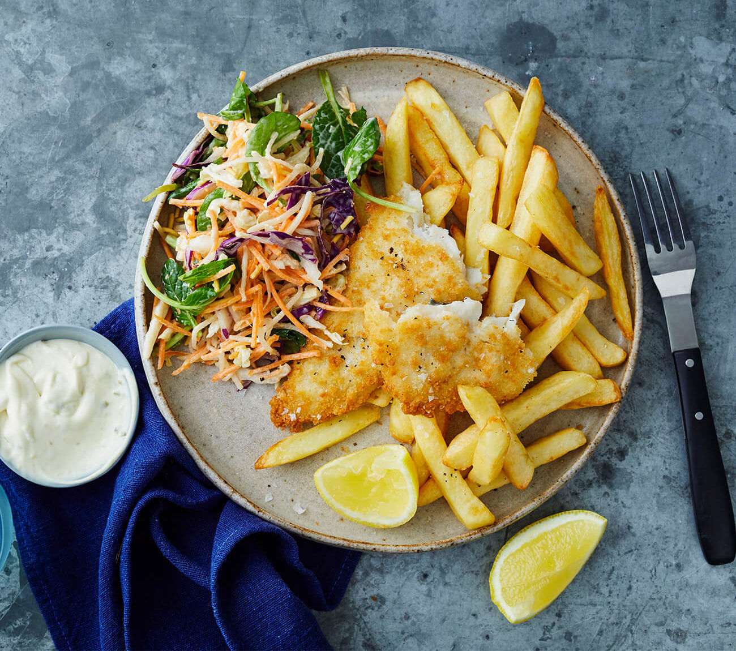
Guess the cuisine

Slide 10
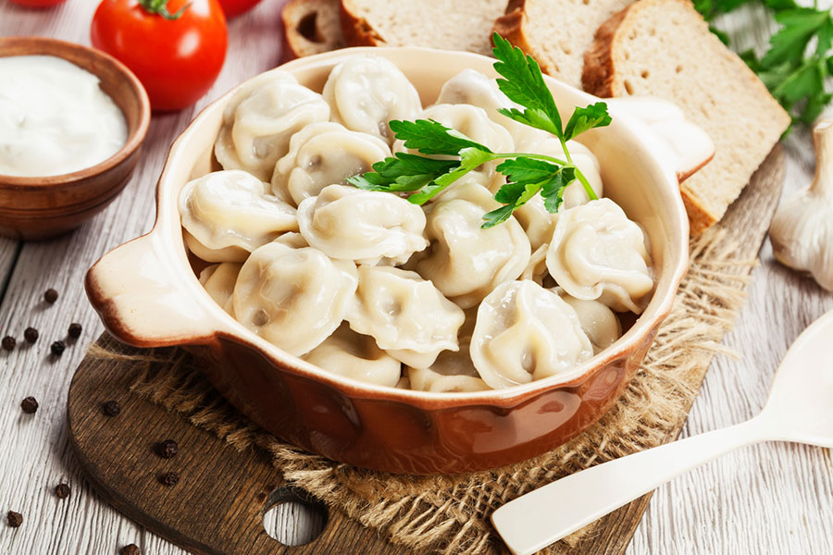
Guess the cuisine

Slide 11
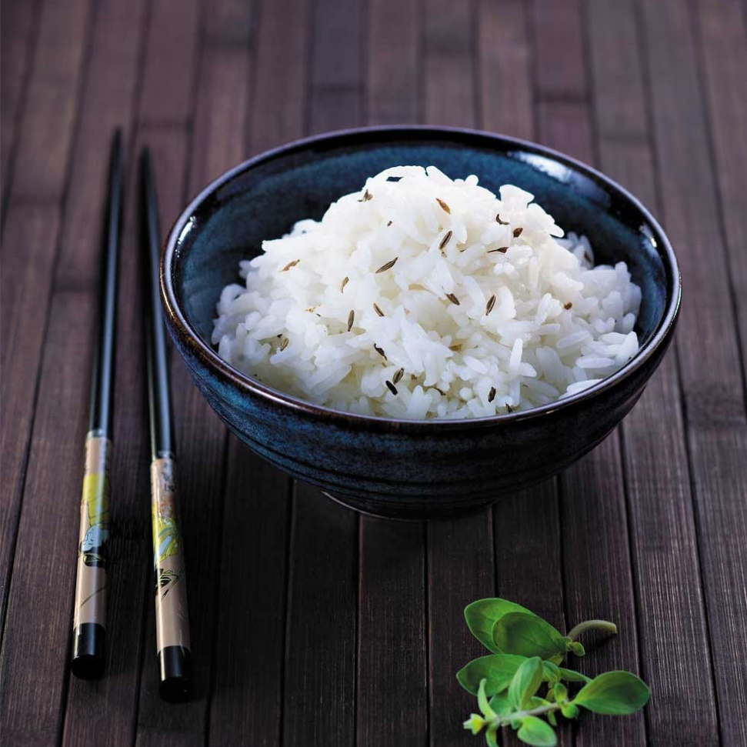
Guess the cuisine

Slide 12
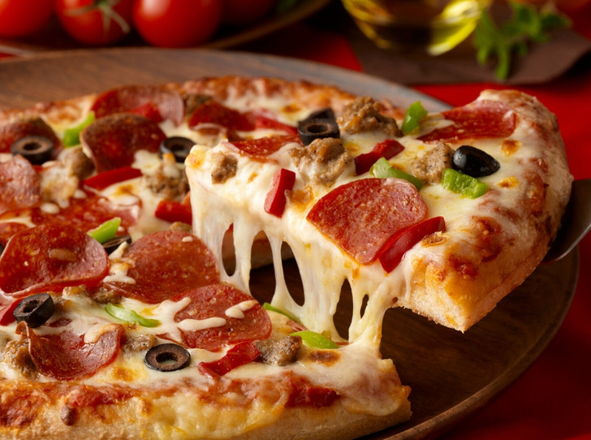
Guess the cuisine

Slide 13
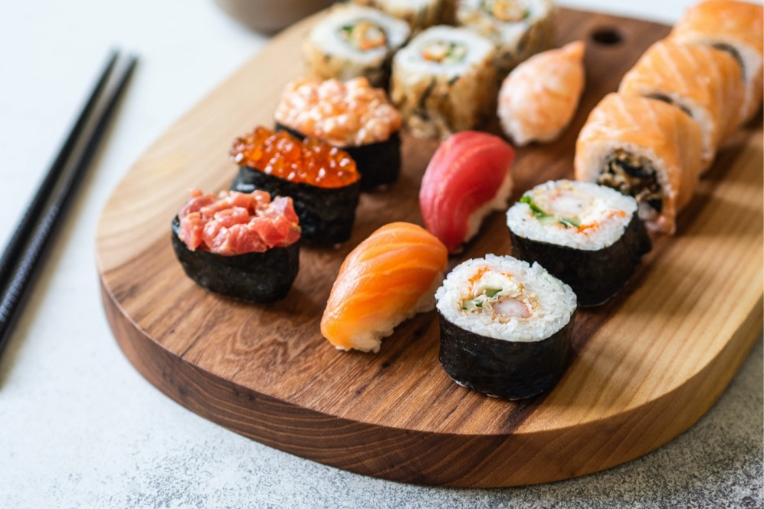
Guess the cuisine

Slide 14
6.There aren’t many tomatoes.
7.There aren’t any eggs.
8.There isn’t any olive oil

Slide 15
We’ll finish for today. Bye-Bye!
Your homework: WB p.50, ex. №1-4

