Slide 1
Презентация «Holidays in Britain”
к внеклассному мероприятию
по английскому языку
«Рождественские соревнования»
Подготовила
Волошина О.К.

Slide 2
smart
witty

Slide 3
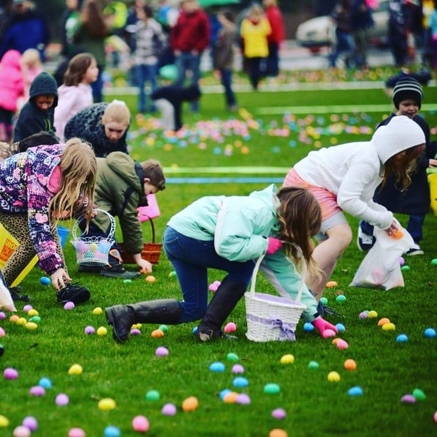

Slide 4
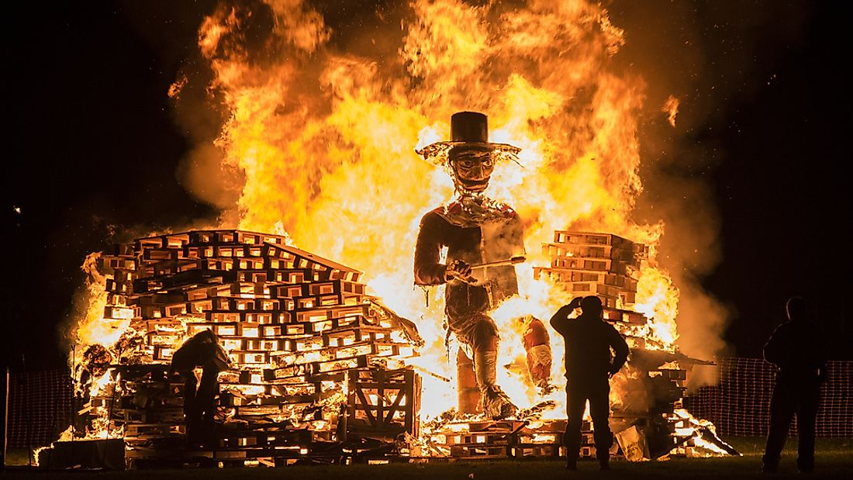

Slide 5
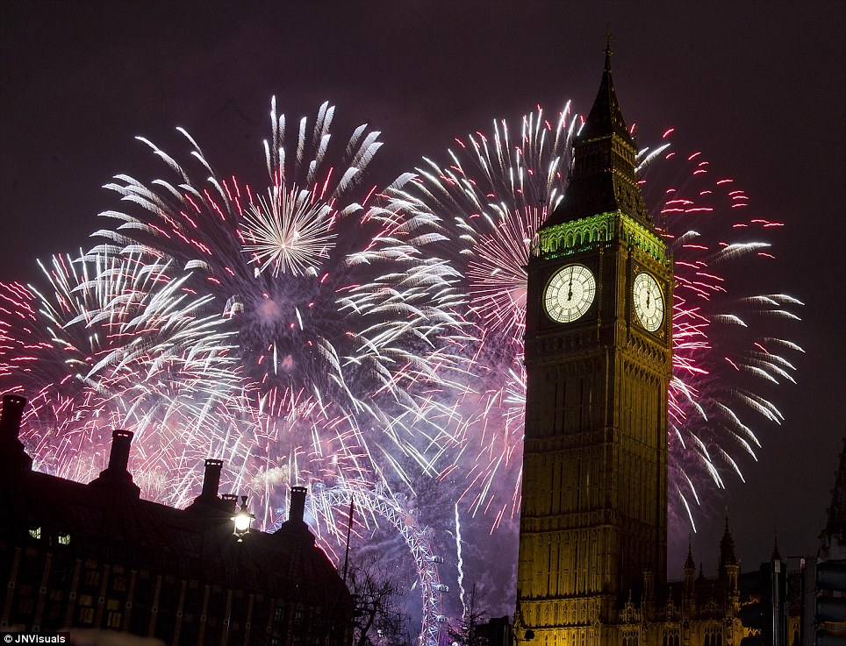

Slide 6
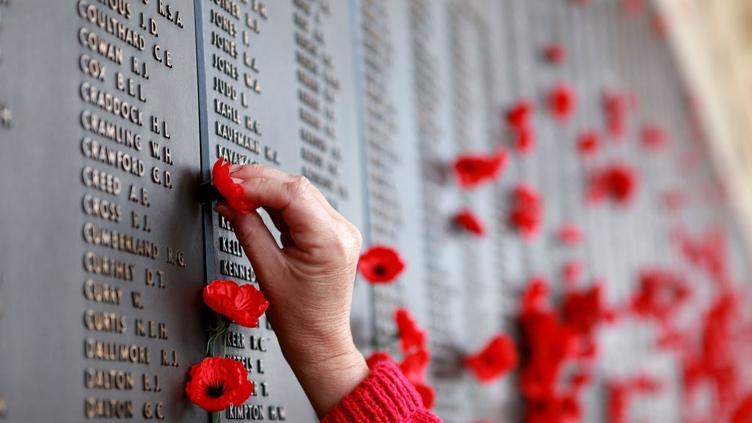

Slide 7
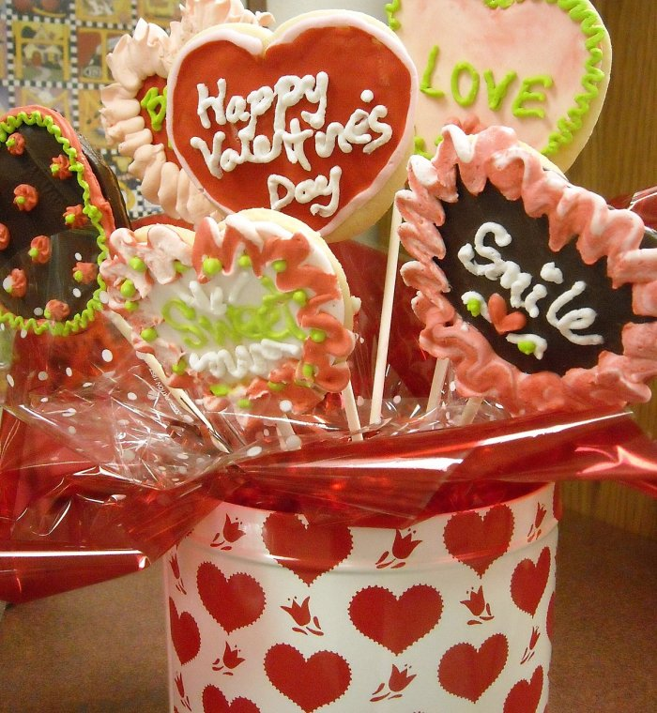

Slide 9
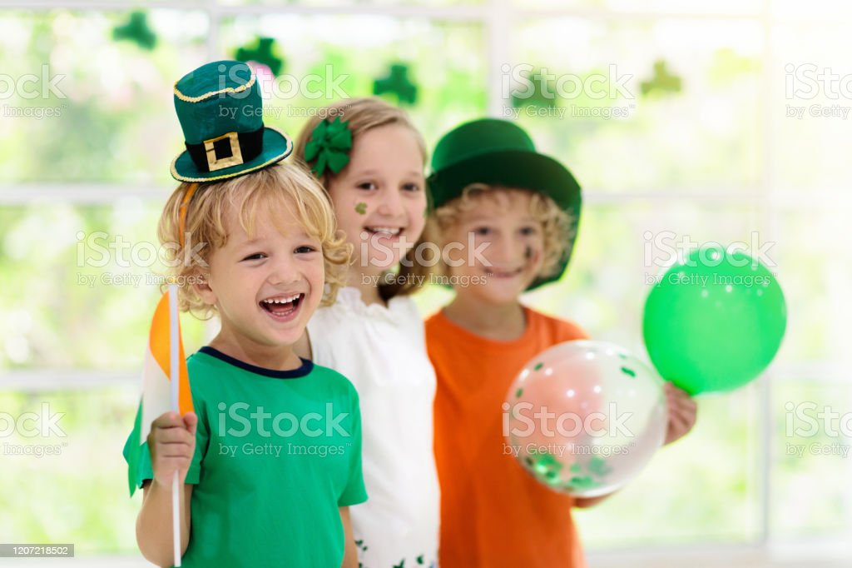

Slide 10
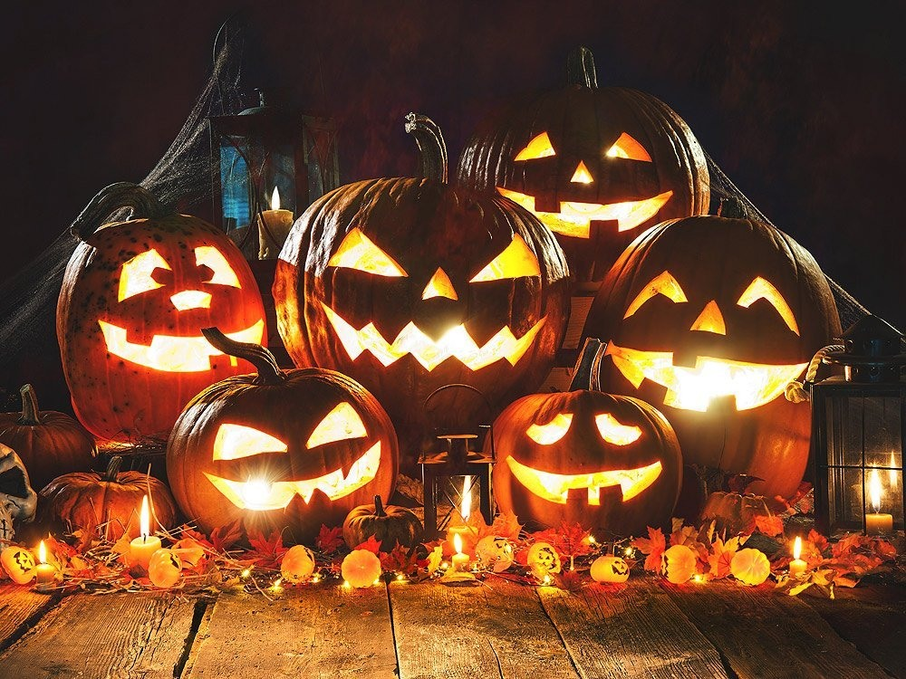

Slide 12
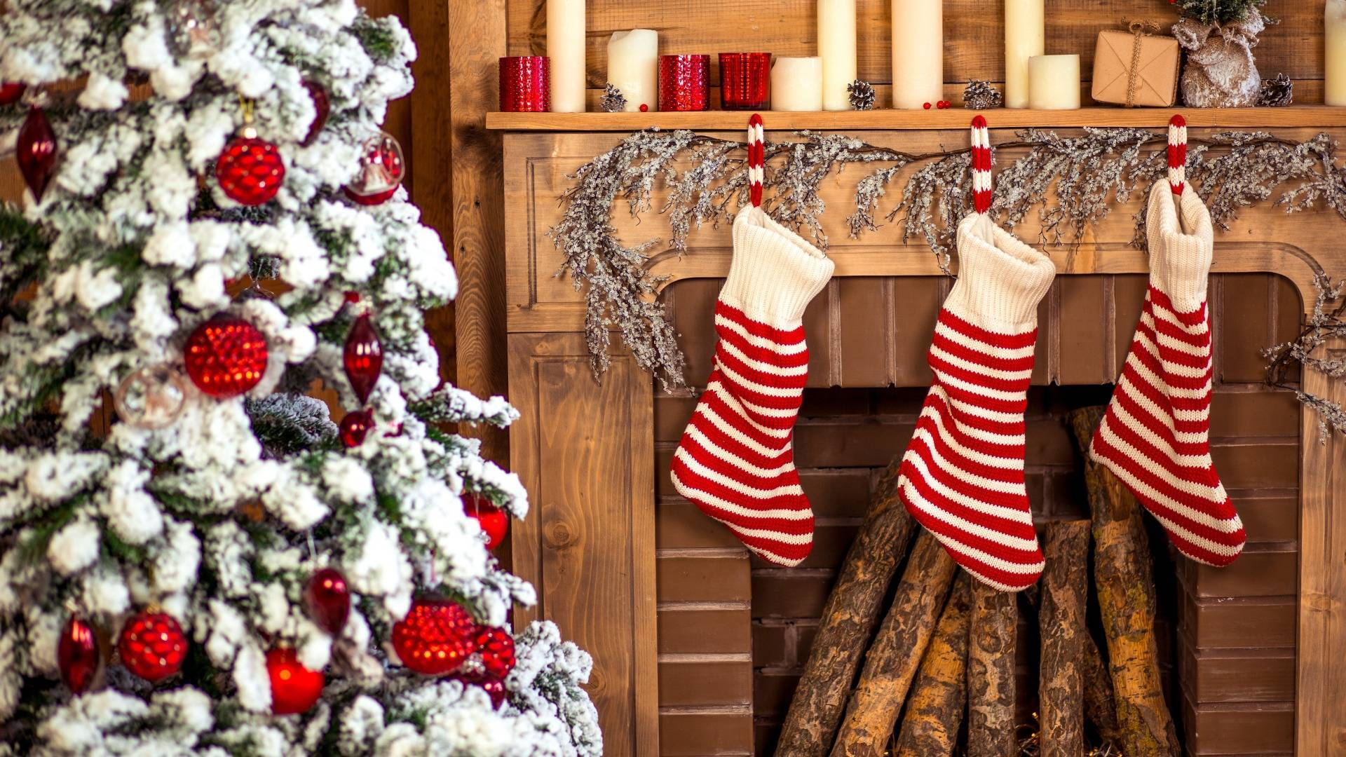

Slide 13
This day in the morning people eat hot cross buns and have tea.
Children think that a Bunny brings baskets with sweets for them and hides coloured eggs.

Slide 14
Pumpkin faces are special symbols of this day.
Children go to the houses and say “Trick or treat” to everyone.

Slide 15
British children give their Moms
flowers and do all the house
Chores this day.

Slide 16
This is the most important
winter holiday in Britain.

Slide 17
This day people send cards
and special gifts like
chocolate and staffed toys
for people who they love.
The symbol of this
day is a heart.

Slide 18
This holiday is also called
Bonfire night. People make fires
and fireworks in the streets.

Slide 19
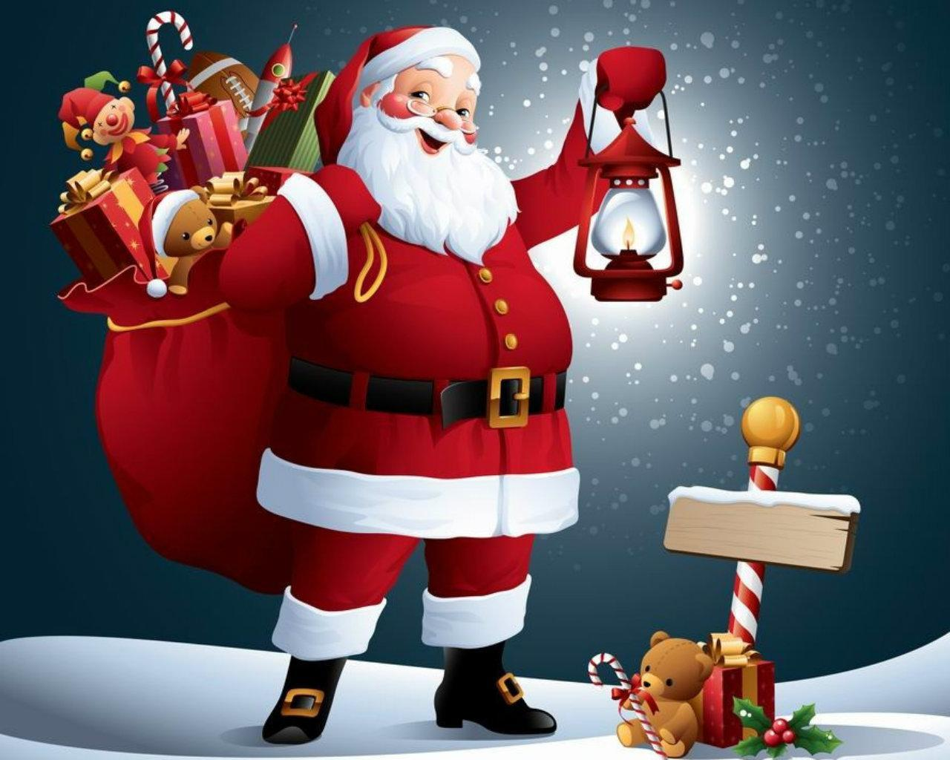

Slide 20
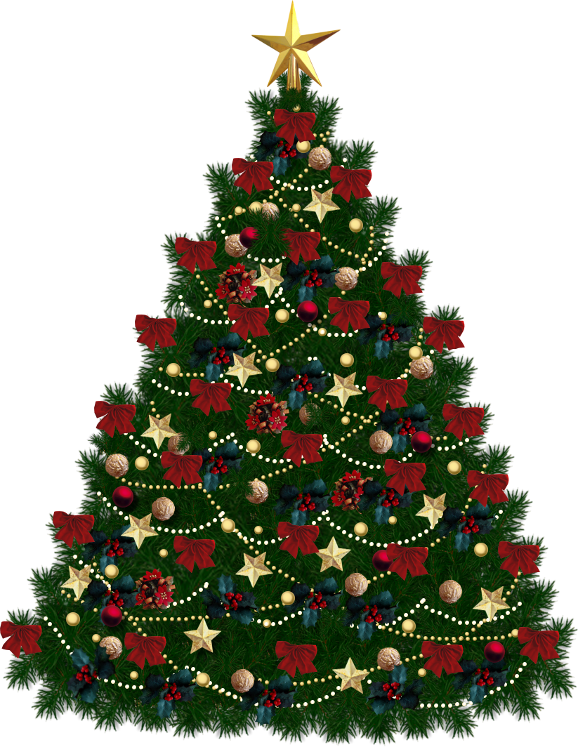

Slide 21
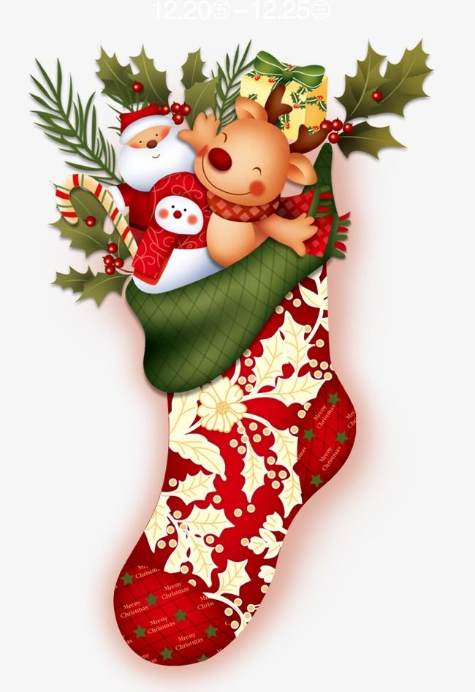

Slide 22
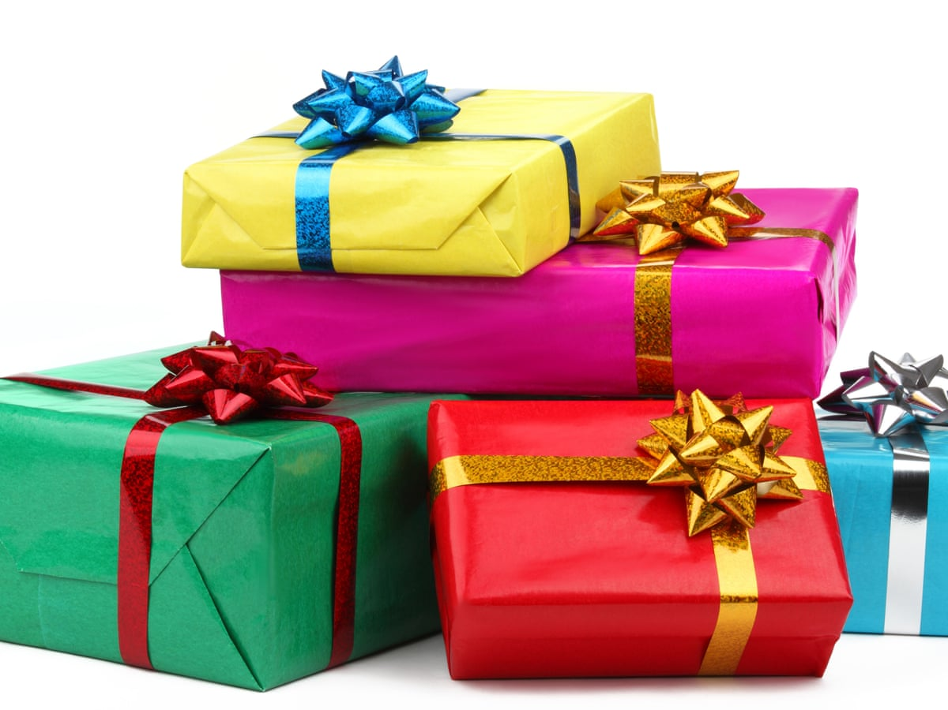

Slide 23
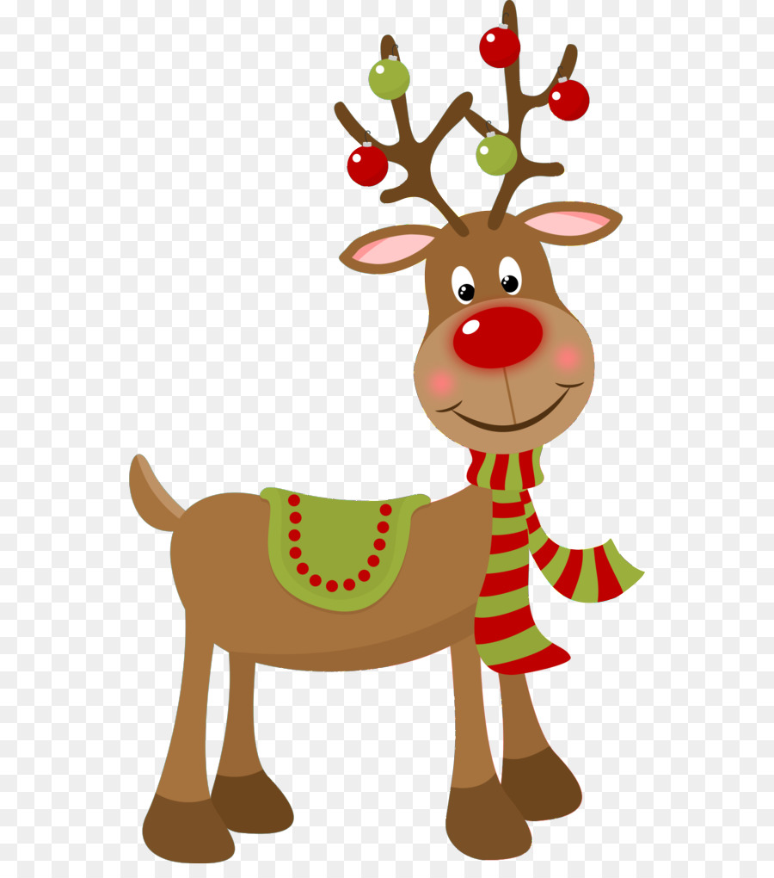

Slide 25
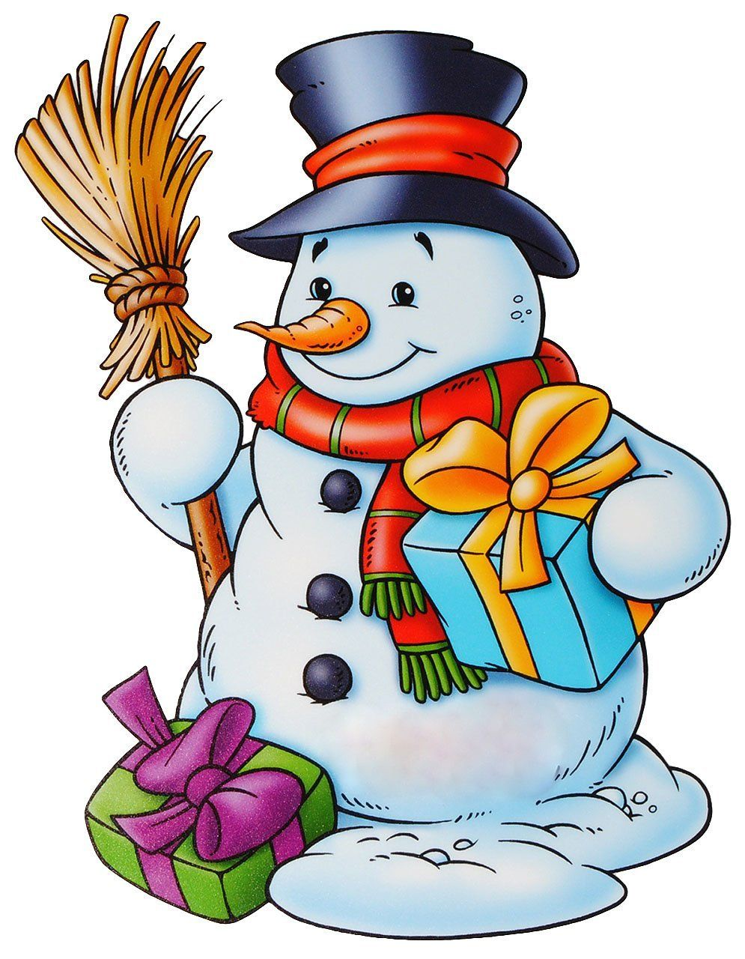

Slide 26
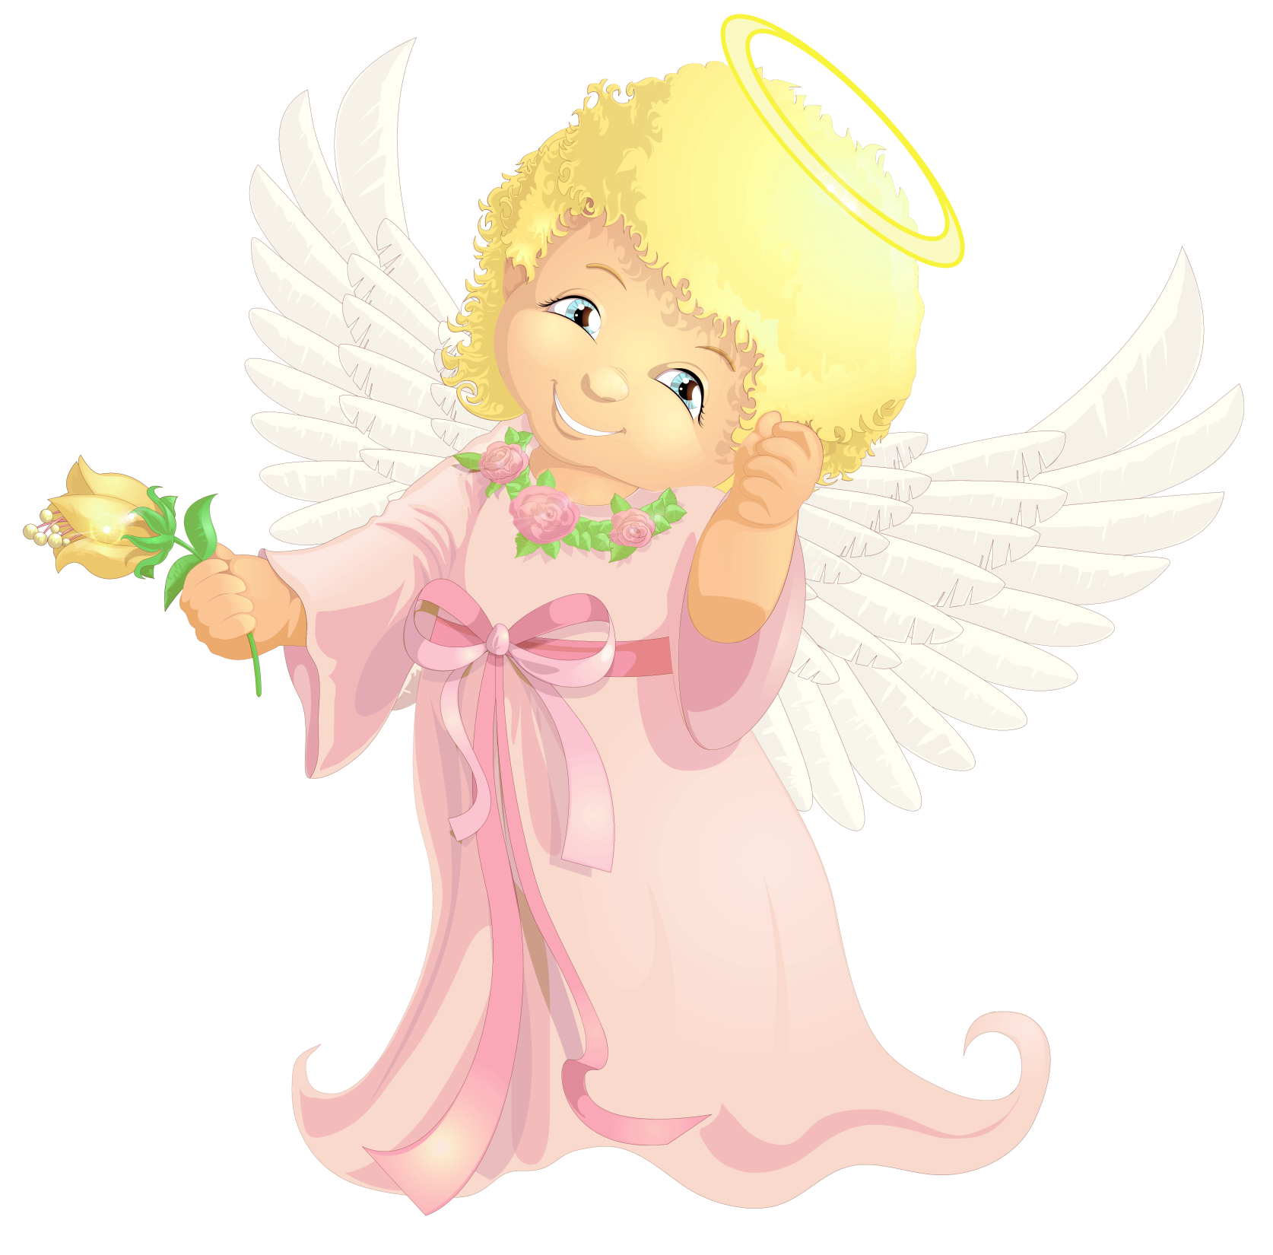

Slide 27
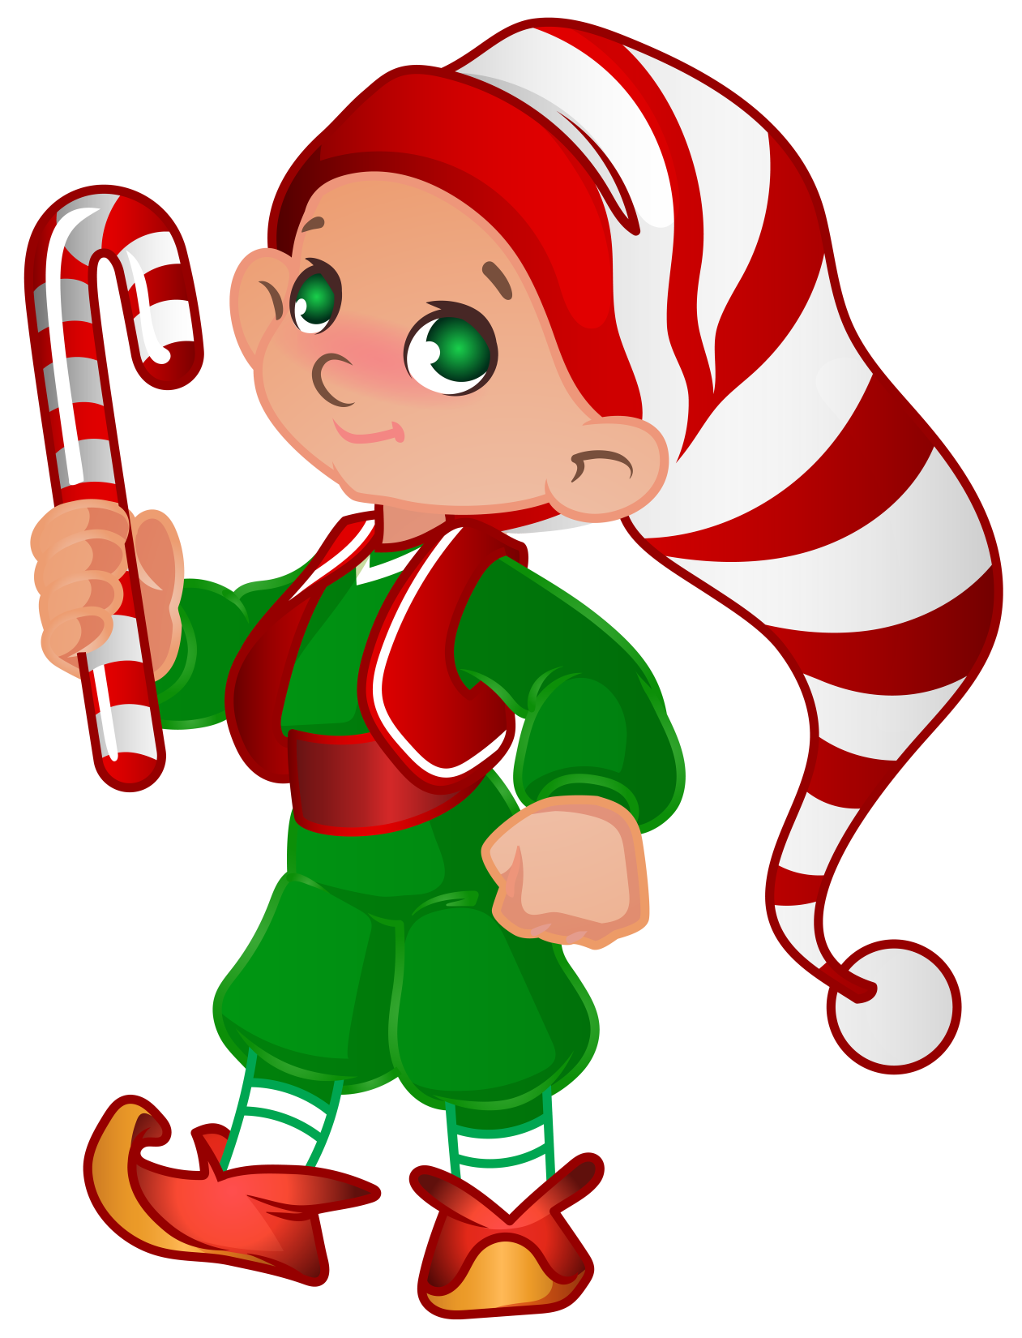

Slide 28
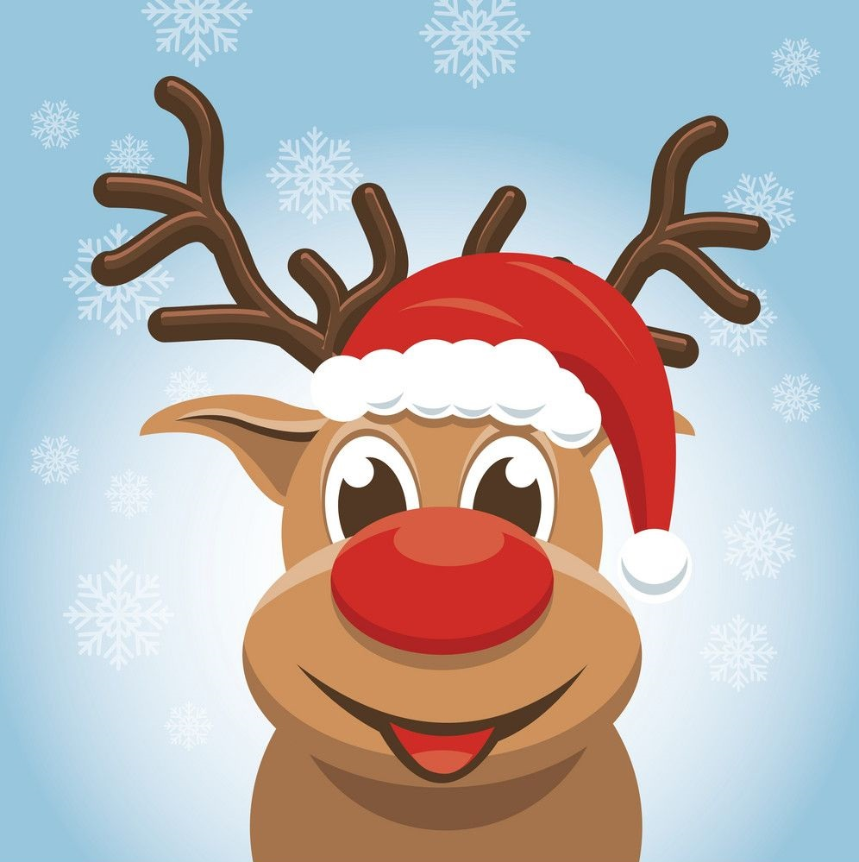
Hello! I’m Rudolf.
I’m Santa’s chief reindeer. Look at my nose. It’s very red. I live at the North Pole with Santa for most of the year. It’s very cold here. On Christmas Eve (24th December) I help Santa. We take presents to good children. Santa has a big sleigh to carry all the presents. We fly through the air very fast. May be we’ll bring a present for you!
What colour is the nose of Rudolf?
What kind of animal is he?
Where does Rudolf live?
What is Rudolf’s job?
How does Santa take the presents to children?

