Slide 1
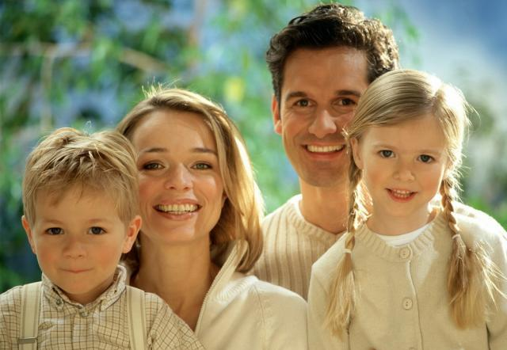
Family is a little world created by love

Slide 3
Try to guess what we’ll talk today about.
This is my father.
This is my mother.
This is my brother Paul.
This is my sister.
This is my grandmother.
How I love them all.

Slide 4
Read the transcriptions of thе words and translate them.
[a:nt]
[‘mʌðə]
[‘fa:ðə]
[‘grænmʌðə]
[‘grænpa:]
[‘brʌðə]
[ni:s]
[ʌŋkl]
[kʌzn]
брат
[‘nevju:]
бабушка
мама
племянница
тётя
племянник
папа
двоюродные брат
или сестра
дедушка
дядя

Slide 5
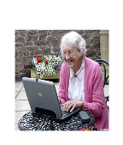
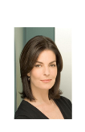
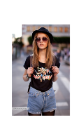
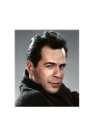
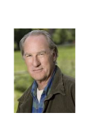
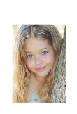
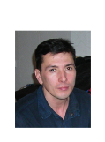
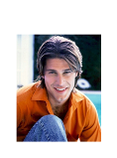
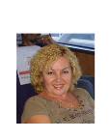
Match the pairs
a grandmother
a son
a mother
a sister
an uncle
a grandfather
a daughter
a father
a brother
an aunt

Slide 6
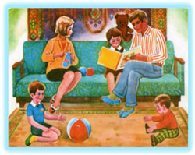

Slide 7
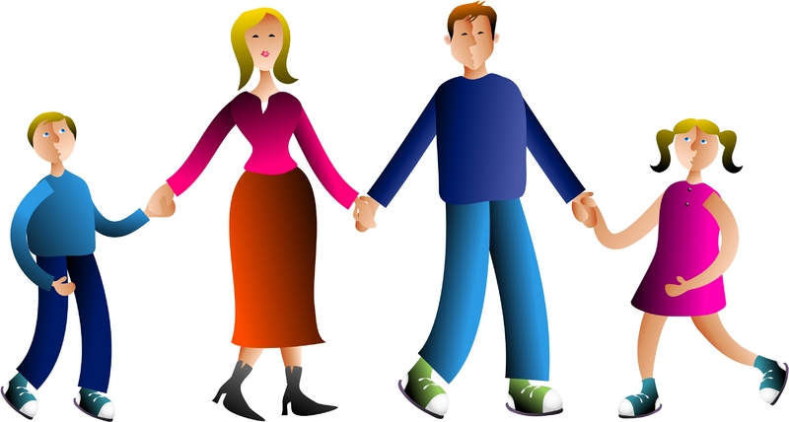
6.What is a family?

Slide 8
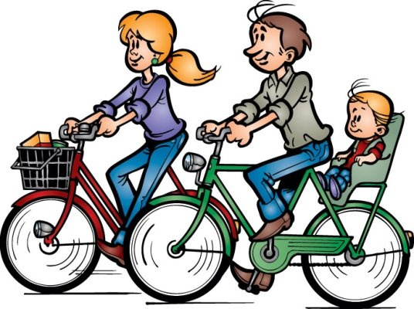
What is a family?
Who is a family?
One and another makes two is a family,

Slide 9
Baby and father and mother: a family, Parents and sister and brother: a family.

Slide 10
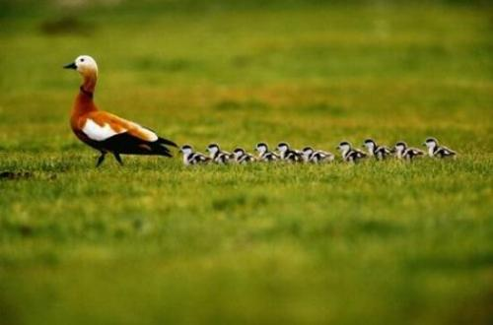
All kinds of people can make up a family,
All kinds of mixtures can make up a family.

Slide 11
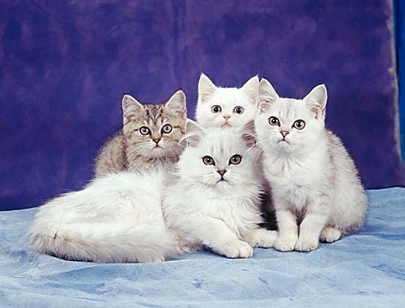
What is a family? Who is a family?

Slide 12
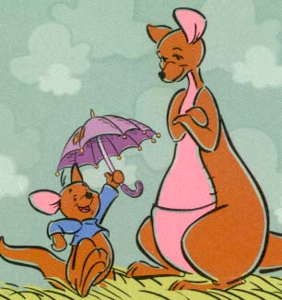
The children that lived in a shoe is a family! A pair like Kanga and Roo is a family! A calf and a cow that go moo is a family!

Slide 13
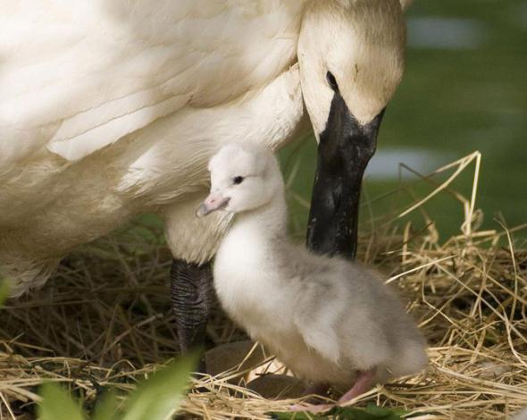
All kinds of creatures can make up a family,

Slide 14
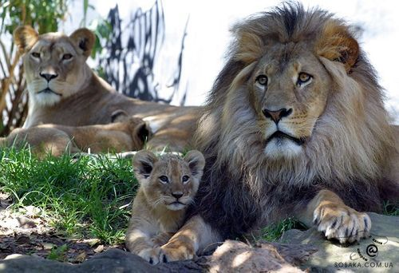
All kinds numbers can make up a family.

Slide 15
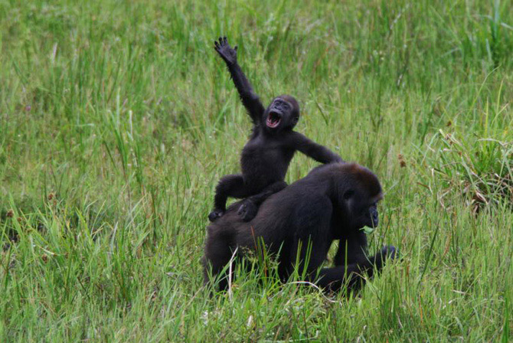
All of your family plus you is a family.

Slide 16
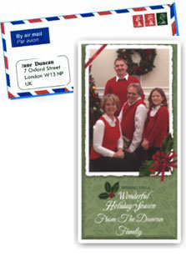

Slide 17
Meet my family

Slide 18
9.Listen to the song and relax. “The family song”

Slide 19
Find as many words as you can in this puzzle? Go down and across
D A U G H T E R
W H E R E B S F
Y O A R F R I A
S U U M A O S M
O N N O T T T I
N C T T H H E L
N L T H E E R Y
K E I E R R H E
S W A R X M W S

Slide 20
CHECK YOUR ANSWERS
D A U G H T E R
W H E R E B S F
Y O A R F R I A
S U U M A O S M
O N N O T T T I
N C T T H H E L
H L T H E E R Y
K E I E R R H E
S W A R X M W S

Slide 21
Join the parts of the words.
MOTHER
BROTHER
GRANDMOTHER
HUSBAND
WIFE
PARENTS

Slide 22
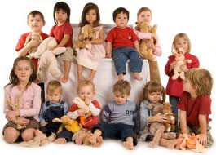
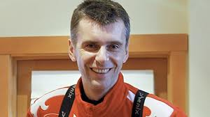
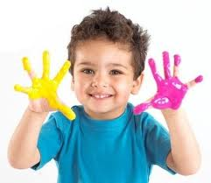
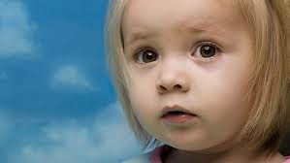
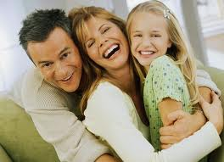
Match the word and the picture
Children
Uncle
Aunt
Son
Daughter
Family

Slide 23
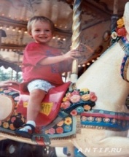
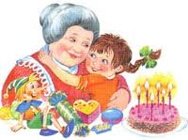
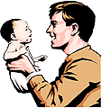
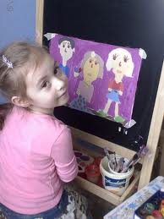
Find the opposites
Daddy
Sister
Granddad
Wife
Uncle
Nephew

Slide 24
Thank you for attention!

