Slide 1
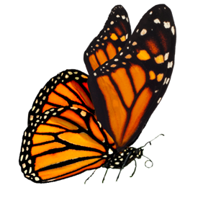
Spread the word
Учитель: Кобзева Наталья Александровна 14.12.2023

Slide 2
What do the animals have in common?

Slide 3
1 Listen to a radio interview about monarch butterflies and choose the correct answer A, B, C or D.
2 Answer the questions about the monarch butterfly:
Why is it in danger?
What is the possible solution to the problem according to the speakers?
Источник : Focus 3

Slide 4
Think of a memorable slogan. Suggest the best ways to help endangered animals survive.

Slide 5
Thank you for your attention

