Slide 4
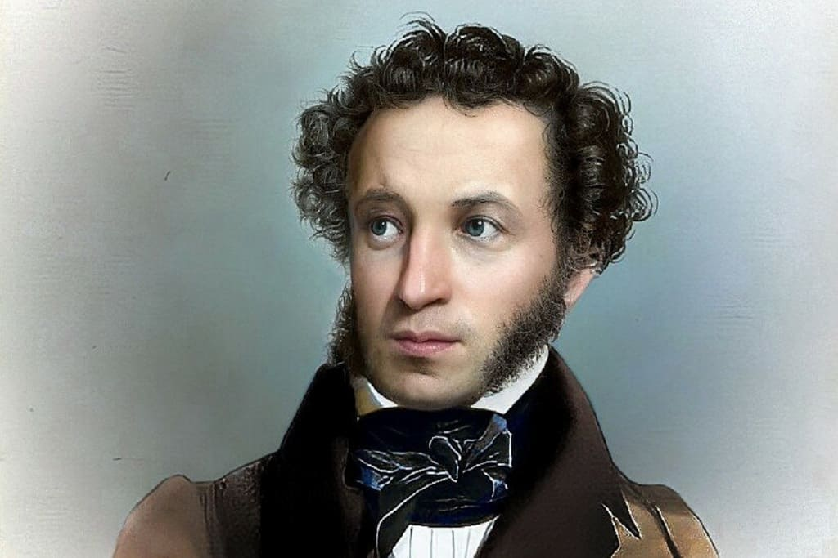

Slide 5
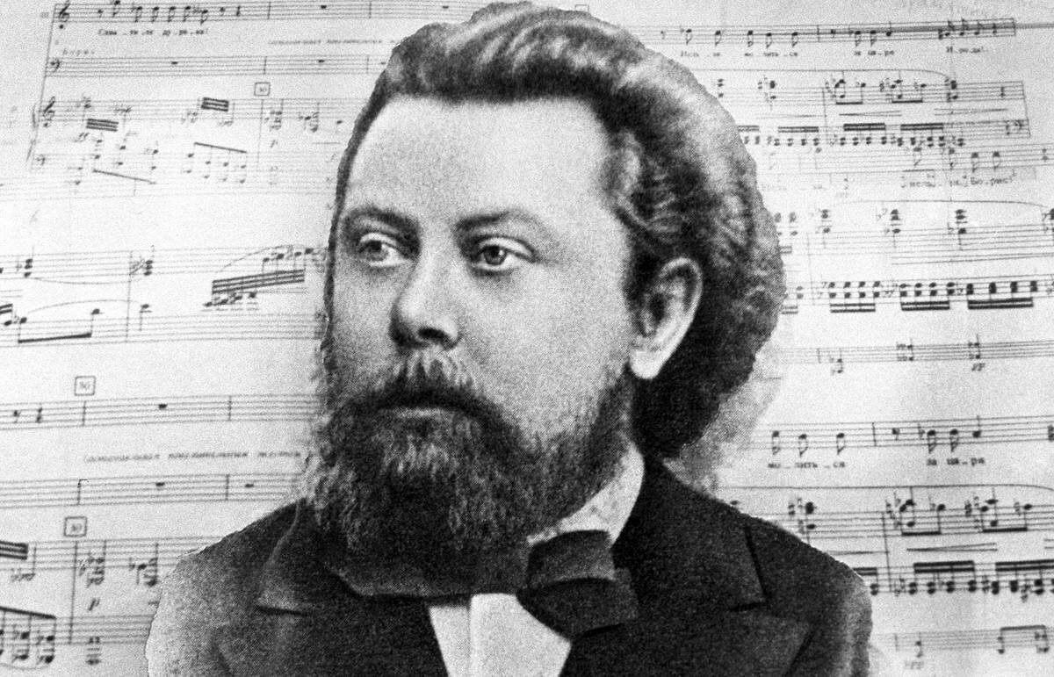

Slide 6
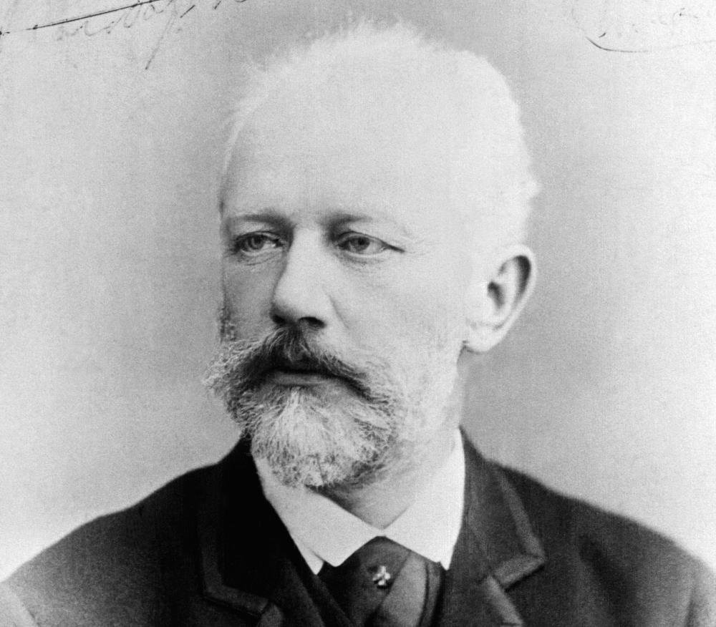

Slide 8
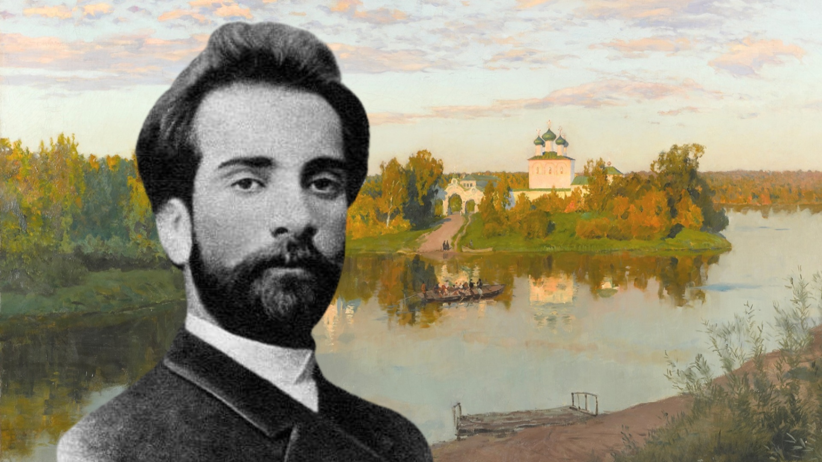

Slide 9
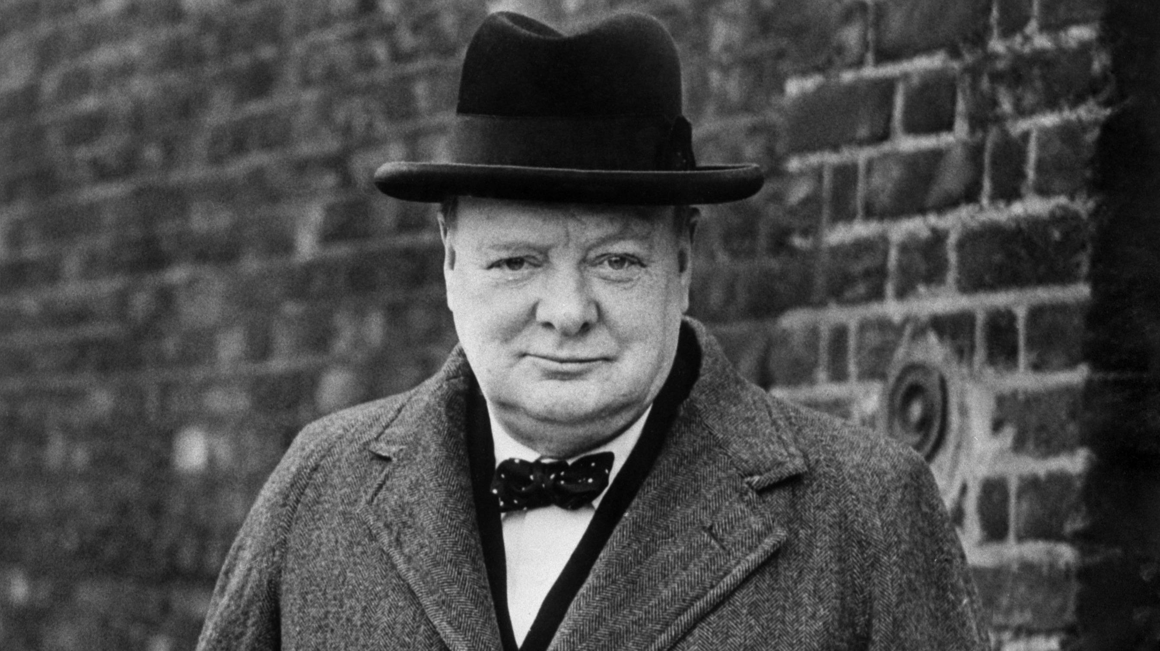
« Russia is a riddle wrapped in a mystery inside an enigma» Россия - это загадка, окутанная тайной внутри загадки…

Slide 10
I
draw Russia

Slide 11
The purpose of the lesson: - to know more about Russia - to proud of Russia - to tell about Russia

Slide 12
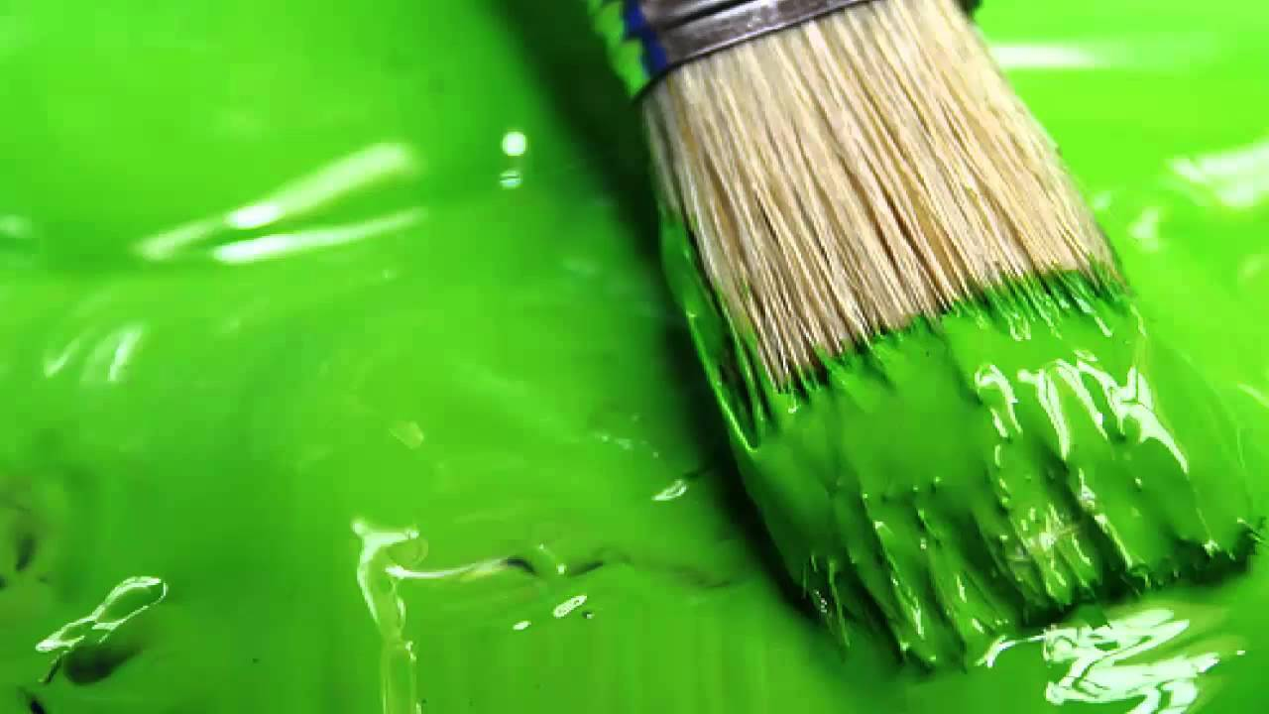
landscapes

Slide 14
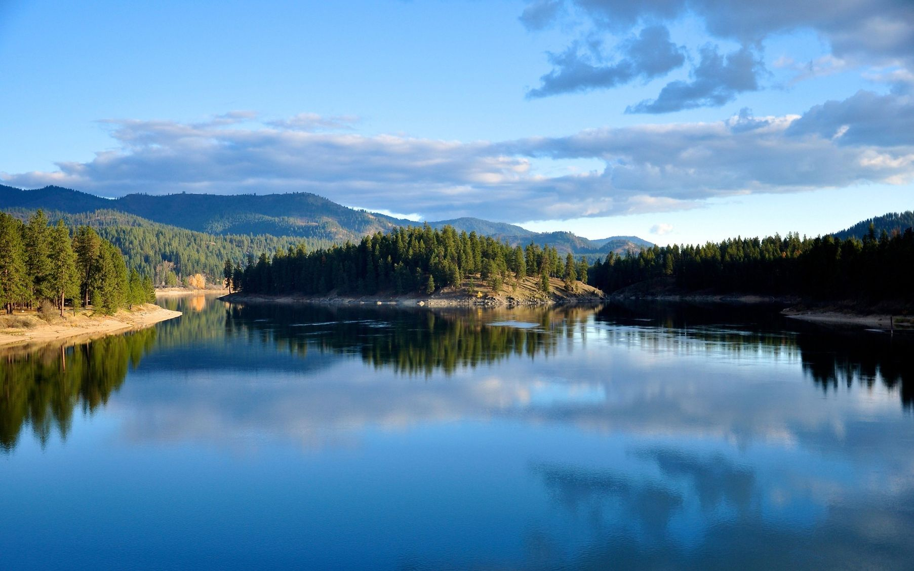

Slide 15
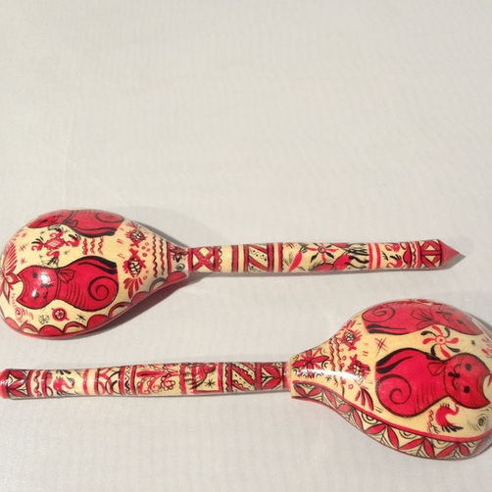
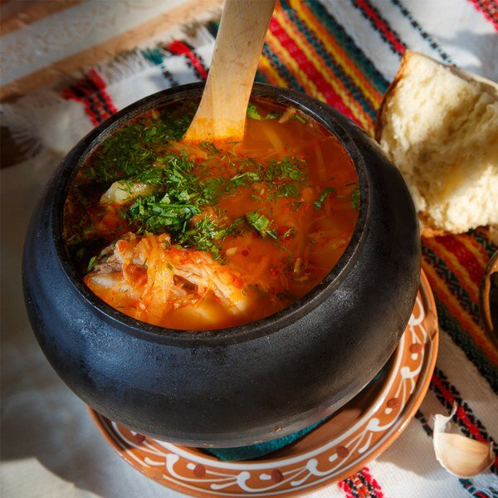
souvenirs

Slide 16
ukha
shchi
borscht
okroshka
kholodets
kvass
kisel
blinis
smetana
pelmeni
matryoshka
valenki
balalaika
wooden spoon
samovar
icons

Slide 17
SHAMAN

Slide 18
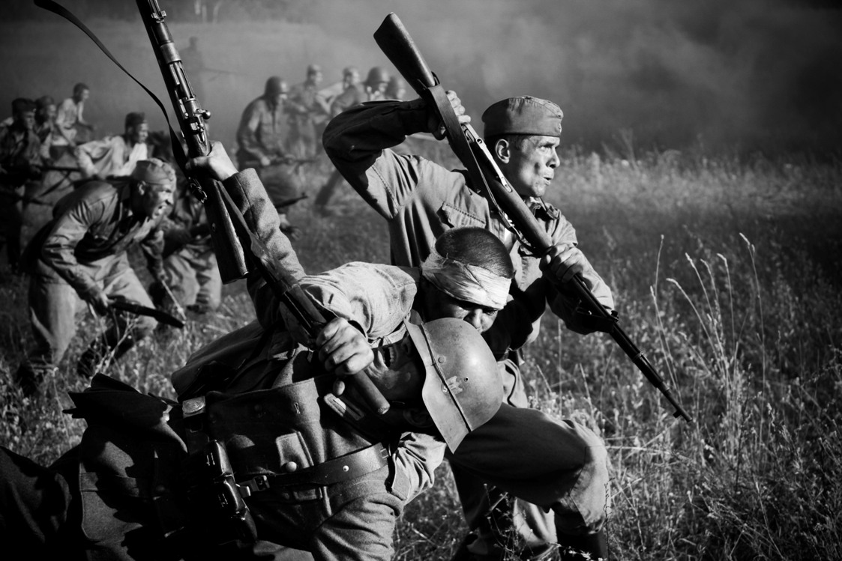
Let’s get up!

Slide 19
to defend

Slide 20
We’ll remember the soldiers

Slide 21
Russia is my soul

