Slide 1
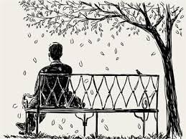

Slide 3
Can we do it immediately?
Why?

Slide 4
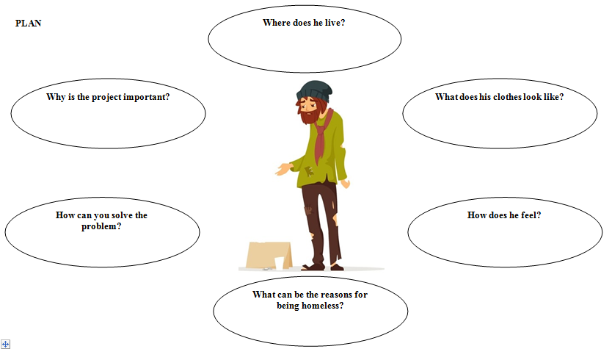

Slide 6
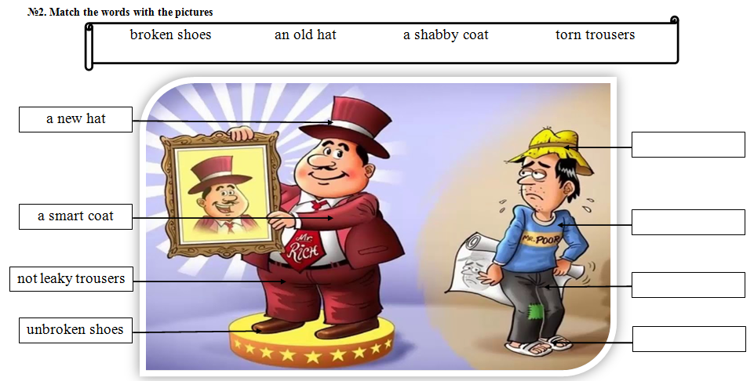
an old hat
a shabby coat
torn trousers
broken shoes

Slide 7
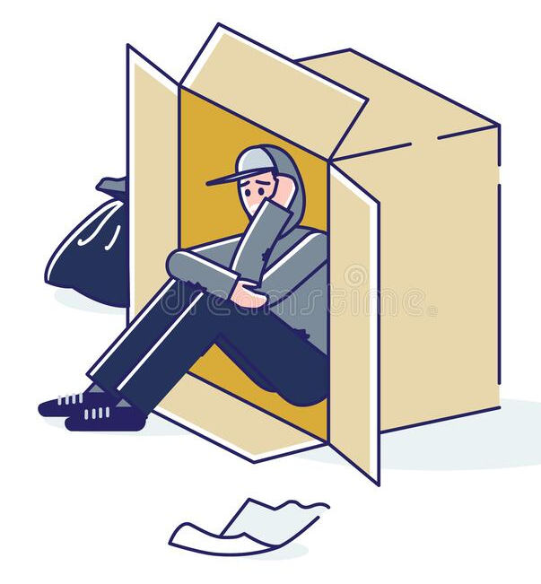
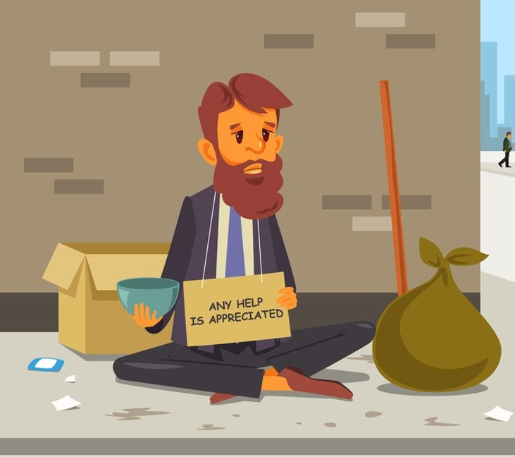
Listen to the speakers and try to hear the reasons for becoming homeless
 | Interviewer 1 | Interviewer 2 | Interviewer 3 | Interviewer 4
Reason
I don’t want to work
I spent money on
clothes
I trusted people
The plant was closed
I don’t want to
change
I lost my job
I spent too much
I don’t want to work
The plant was closed
I spent money on clothes
I don’t want to change
I trusted people
I spent too much
I lost my job

Slide 8
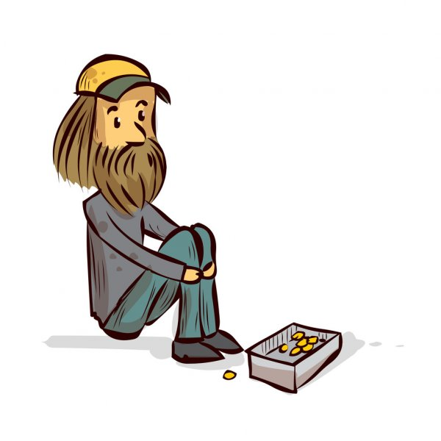
One day a homeless person comes to you. He says that he has lost his job, he has no place to live. BUT! He wants to change his life!
What will you do?
What will be your reaction?

Slide 9
I am glad to meet you again! Please give me several minutes to get ready for listening to you! I must take some documents to see that you mention all the necessary points. You have got the same tables as I remember. Please listen to your partners. I will return in 3 minutes. Get ready!
Thanks a lot for your projects! All of them are very interesting and I need some time to think which one to choose. To make it easier please send me your projects so I can read them.

Slide 11
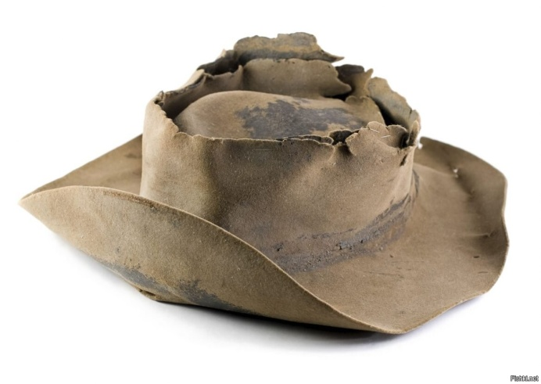
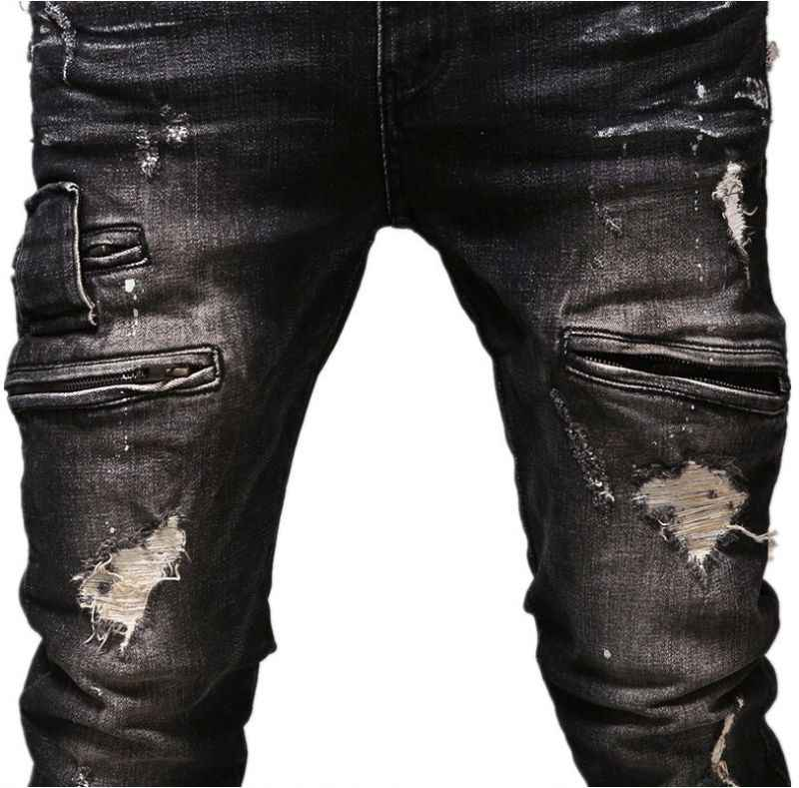
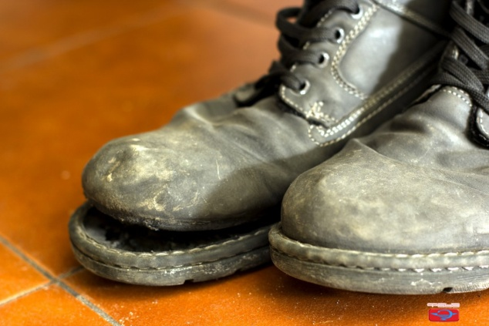
Imagine that you are all wearing old hats, shabby coats, torn trousers and broken shoes.
How can you explain you broken shoes?
How would you feel?

