Slide 2
Describe the picture
What does the term ‘square-eyed generation’ mean?
Does this picture describe today’s teens?

Slide 3
anti-social – антиобщественный
couch potato [kaʊʧ pəˈteɪtəʊ] – бездельник, лежебока
unfair – несправедливый
unwind [ˈʌnˈwaɪnd] – расслабиться
blare – громко играть
catchy – легко запоминающийся
predictable – предсказуемый
admit – признавать
addict – человек, зависимый от какой-либо привычки
incredible – невероятный
mall – торговый центр

Slide 4
not social or friendly; unwilling to meet people
people who spend a lot of time sitting on the couch and watching TV
relax
making a loud noise
easy to remember
obvious what is going to happen
sb who likes a certain activity and spends a lot of time doing it
amazing
large shopping centres
couch potatoes
blaring
catchy
addict
incredible
malls
anti-social
unwind
predictable

Slide 5
Watch the video. What hobbies are mentioned?
MUSIC | FRIENDS | SPORTS | CINEMA/ THEATRE/ CONCERTS

Slide 6
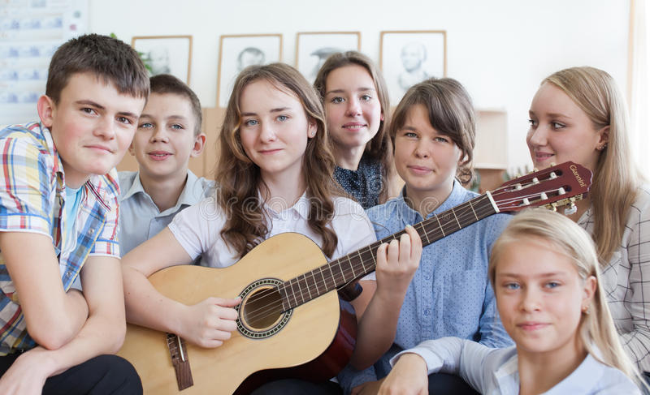
Watch the video. What hobbies are mentioned?
MUSIC | FRIENDS | SPORTS | CINEMA/ THEATRE/ CONCERTS
writing music
playing music
listening to music
playing the guitar
playing in my band

Slide 7
Watch the video. What hobbies are mentioned?
MUSIC | FRIENDS | SPORTS | CINEMA/ THEATRE/ CONCERTS
going out with friends
hanging out with mates
chilling out with friends
having friends over for supper
going to pubs, clubs
socialising
going for a pint
eating pies

Slide 8
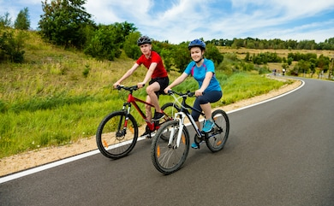
Watch the video. What hobbies are mentioned?
MUSIC | FRIENDS | SPORTS | CINEMA/ THEATRE/ CONCERTS
doing sports
playing sports
cycling
bowling
playing tennis
playing loads of football

Slide 9
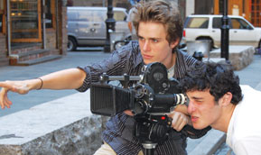
Watch the video. What hobbies are mentioned?
MUSIC | FRIENDS | SPORTS | CINEMA/ THEATRE/ CONCERTS
going to the cinema
going to bands/ gigs
making films
watching films
going to the theatre
drama

Slide 10
Entertainment

Slide 11
How important is the television in your house?
How many hours a week do you watch the box?
How much time do you spend playing computer games/ surfing the net/using your mobile phone?
What else do you prefer doing in your free time?

Slide 12
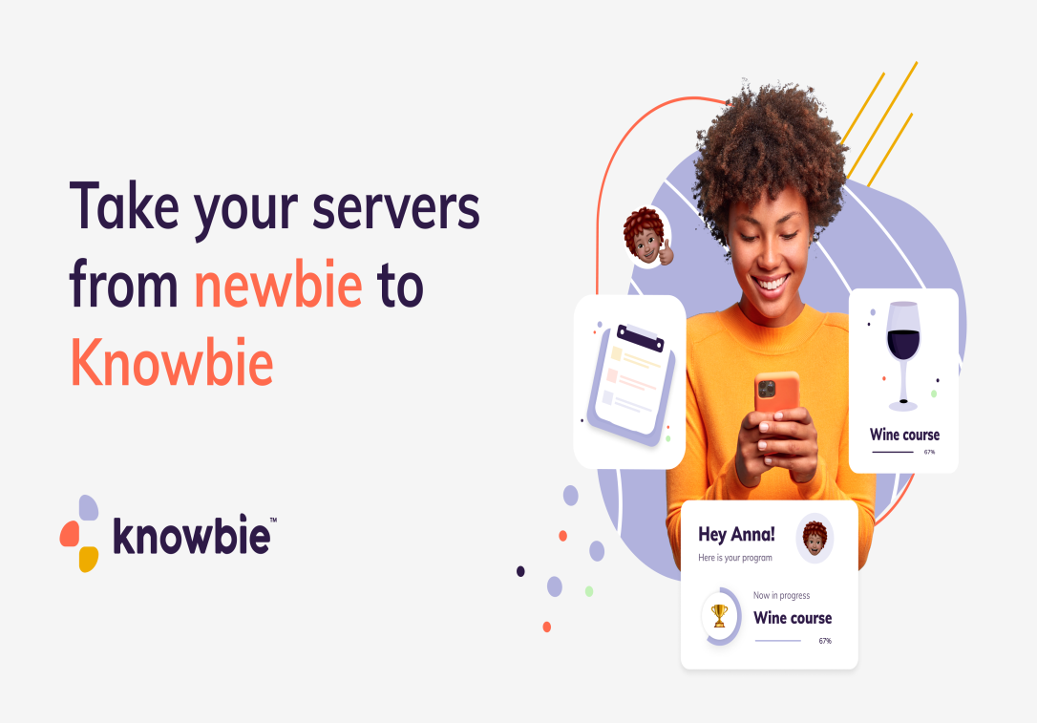
Word formation
-bie suffix
newbie – a new, unexperienced user or participant
knowbie – an experienced Internet user

Slide 13
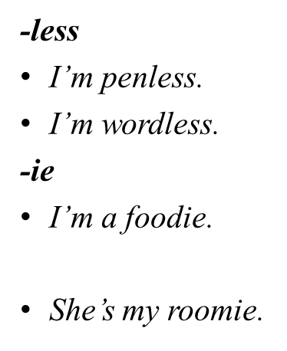

Slide 14
SUMMER 2024
Me
Not me

Slide 15
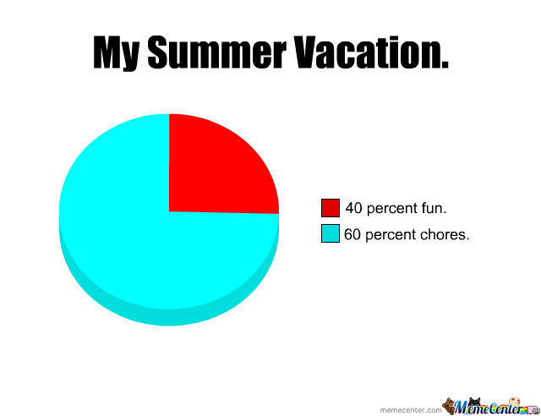
SUMMER 2024
Me
Not me

Slide 16
SUMMER 2024
Me
Not me

Slide 17
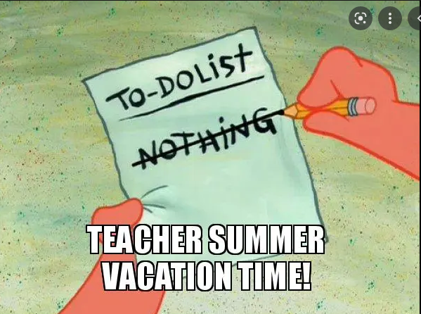
SUMMER 2024
Me
Not me

