Slide 2
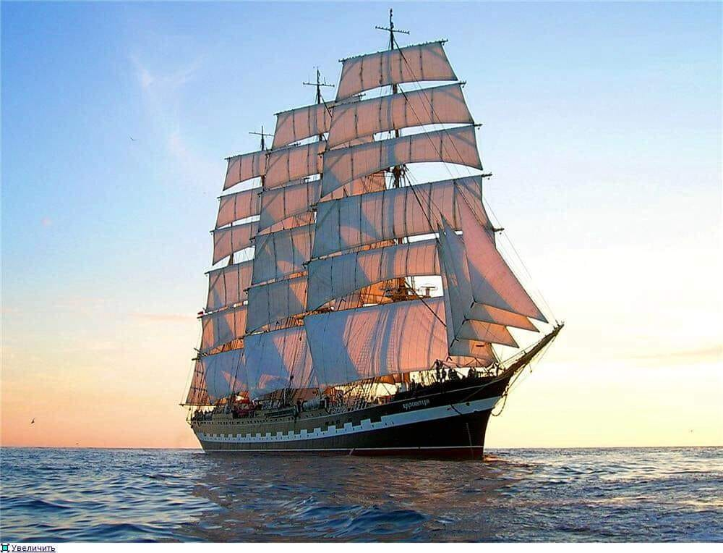

Slide 3
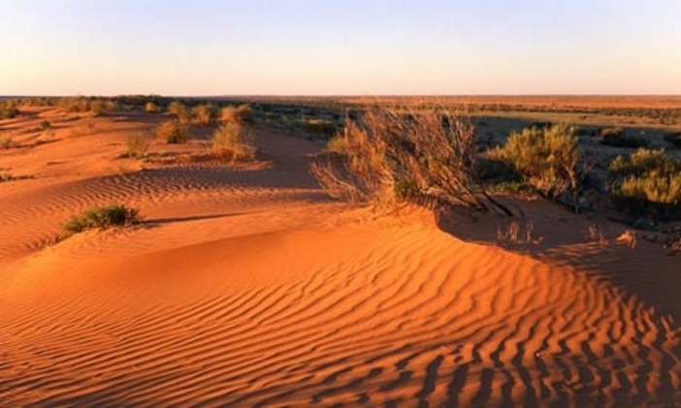
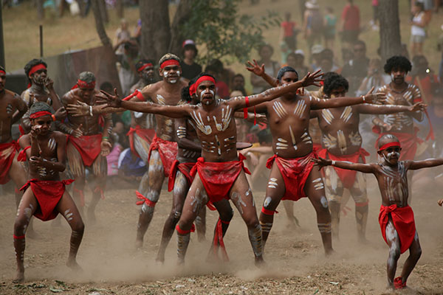
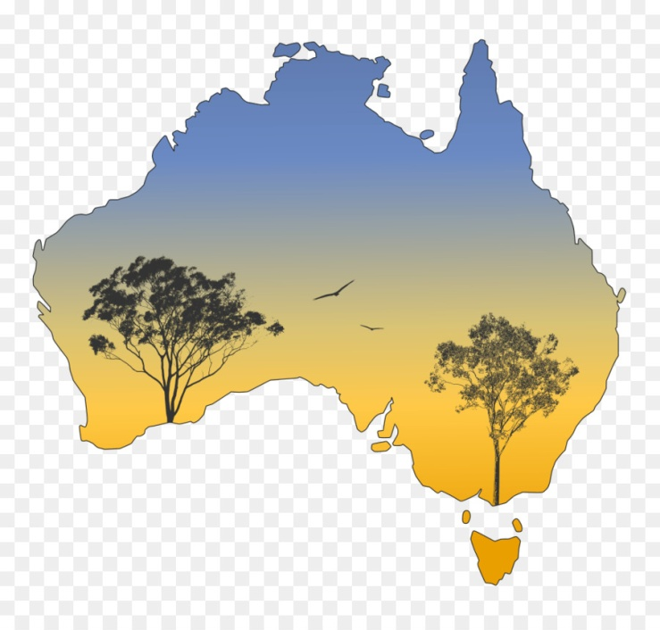
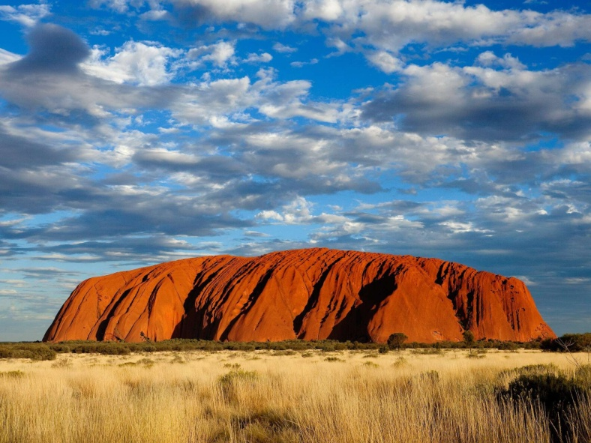
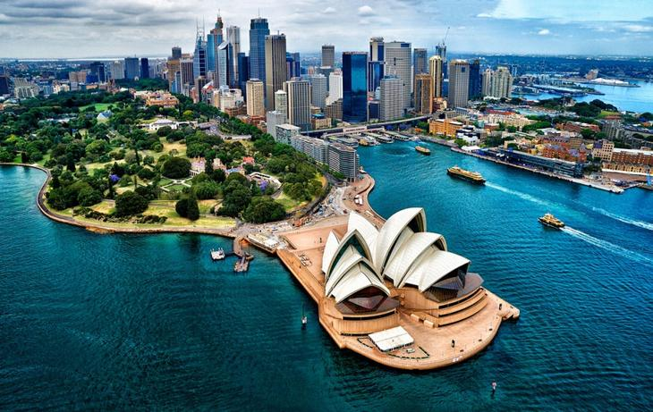

Slide 4
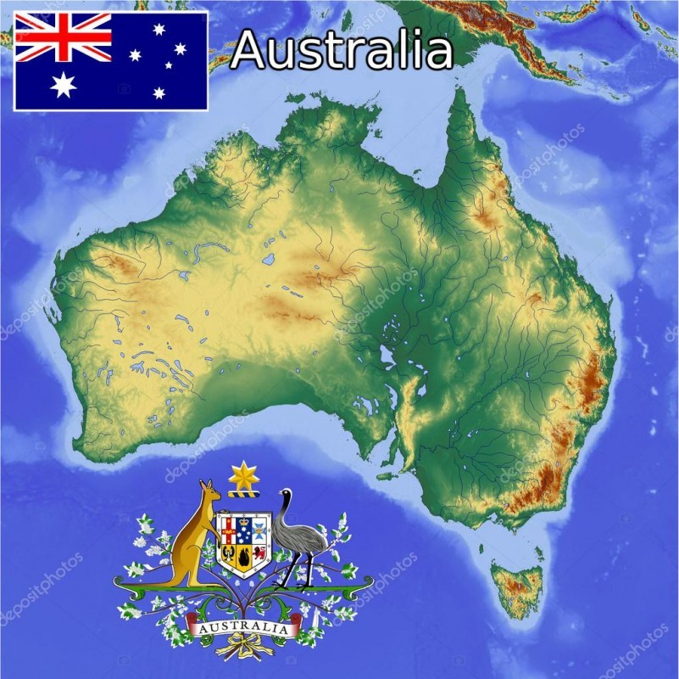

Slide 5
Questions
Words
Exercises
Australia
English

Slide 8
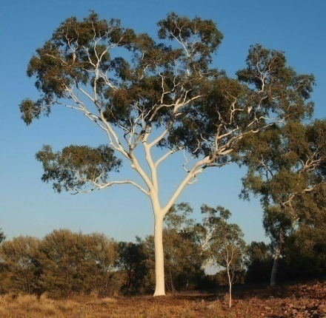
platypus [ˈplætɪpəs] - утконос duckbill [ˈdʌkbɪl] - утконос koala [ kəʋ'ɑ:lə ] - коала kangaroo [ˌkæŋgəˈruː] - кенгуру echidna [ɪˈkɪdnə] – ехидна emu ostrich [ˈiːmjuː ˈɒstrɪʧ] – страус Эму kookaburra [ˈkʊkəbʌrə] – кукабара eucalyptus [juːkəˈlɪptəs] trees - эвкалиптовые деревья

Slide 9
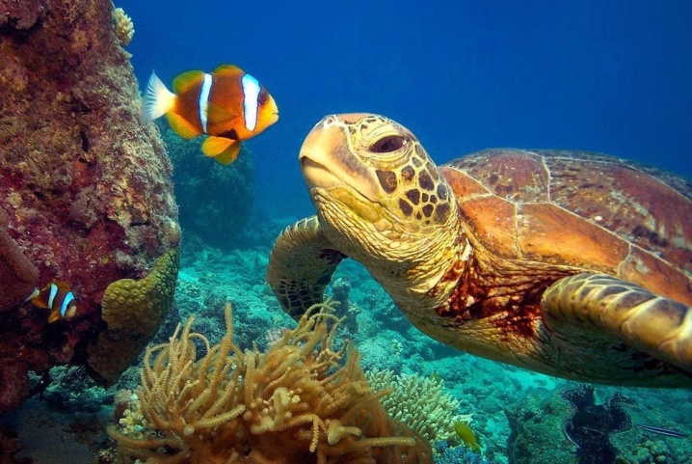
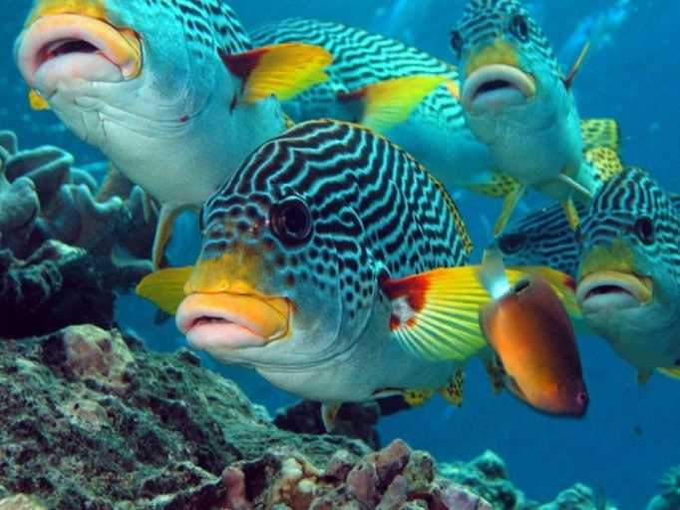
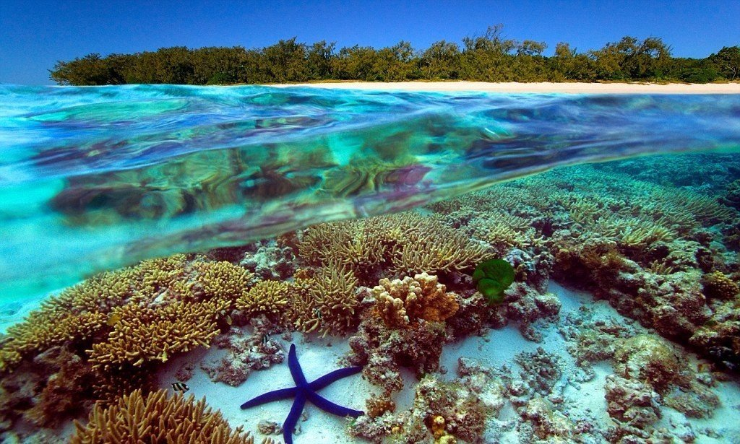
The Great Barrier Reef
It is a unique natural garden under the sea! There is no place on the Earth with so great variety of life. You can see 1500 different kinds of fish and more than 350 kinds of corals there.

Slide 10
We had (to have) a very beautiful Christmas tree last year.
Have you ever spoken (to speak) English to a foreigner?
The other day we went (to go) to picture gallery.
I know that Columbus discovered (to discover) America but I don’t remember when he did (to do) it.
I have never been (to be) to The USA.

Slide 11
I like the lesson because …..
I don’t like the lesson because……
It was interesting and useful. It was boring.
I found out something new. The tasks were difficult.
The tasks were easy. It wasn’t‘ useful for me.
I feel positive emotions because…………..
I feel negative emotions because…………..
I was active. I didn’t answer the questions.
I worked hard. I didn’t relax.
I was emotional. I was tired.

