Slide 2
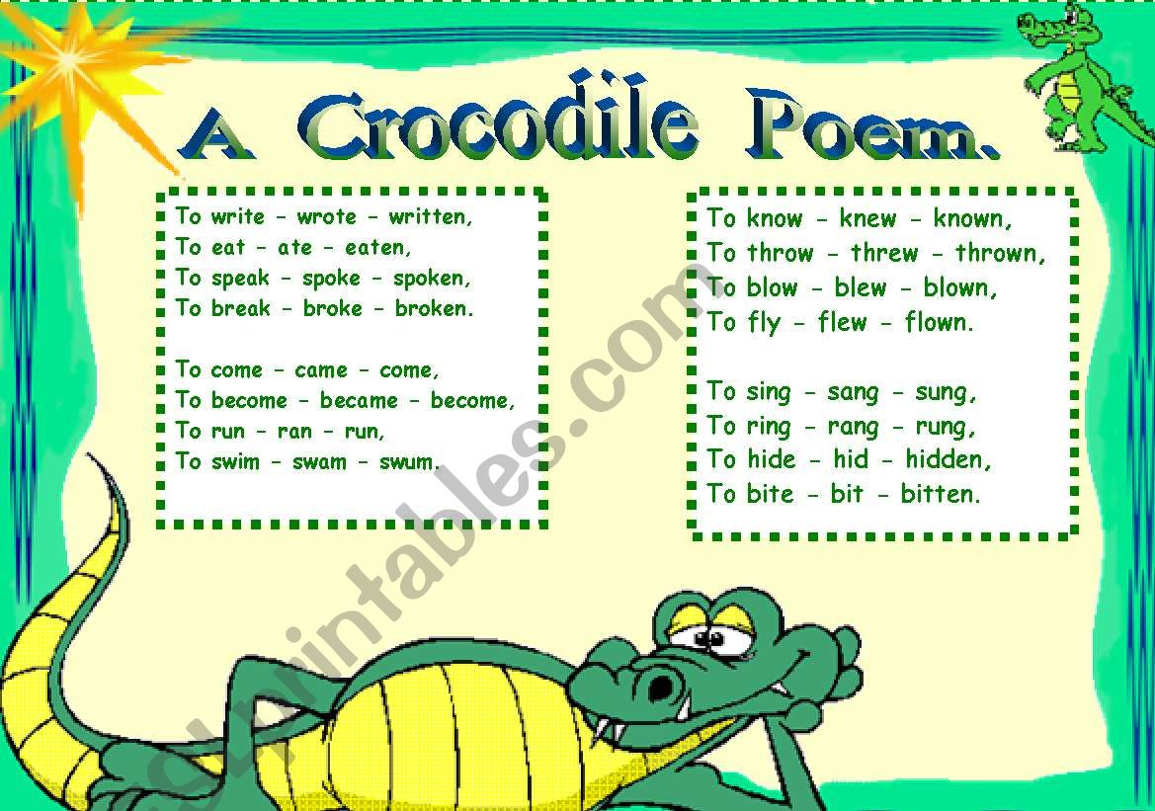

Slide 3
Yesterday I __________ (buy) a beautiful balloon. I ________ (bring) it home and _______ (begin) to blow up my balloon. It was so beautiful!

Slide 4
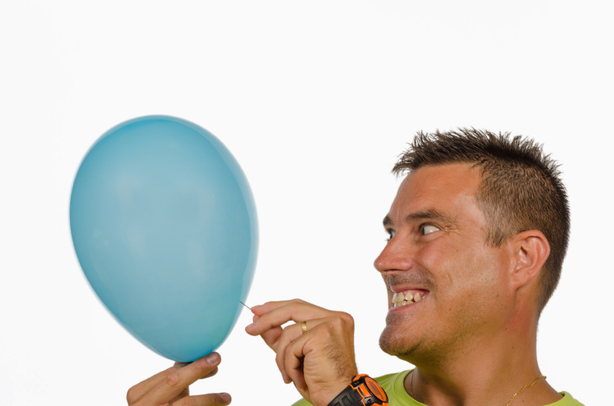
Two hours later an angry man __________ (come) to my house. He burst my balloon.

Slide 5
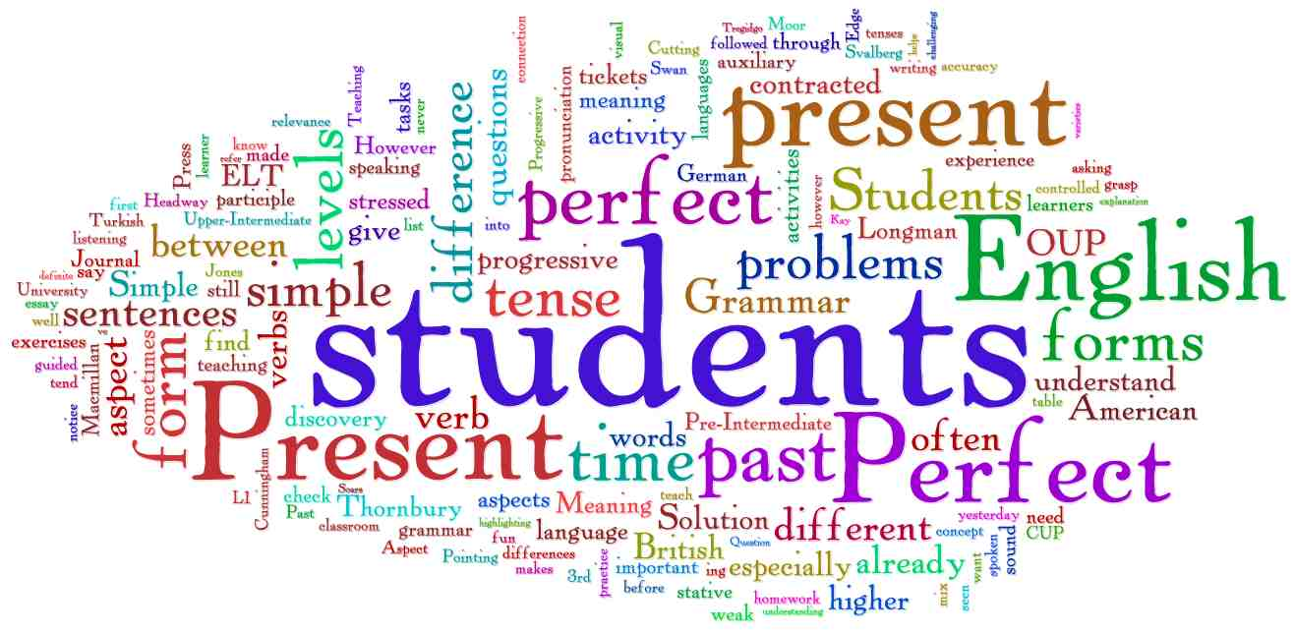

Slide 7
Yesterday an angry man burst my balloon. I have already burst my balloon.

Slide 8
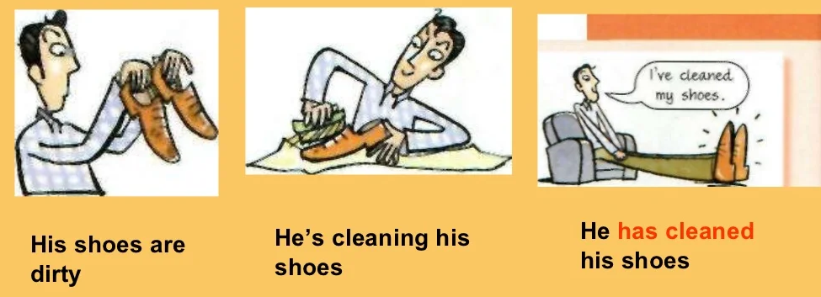

Slide 9
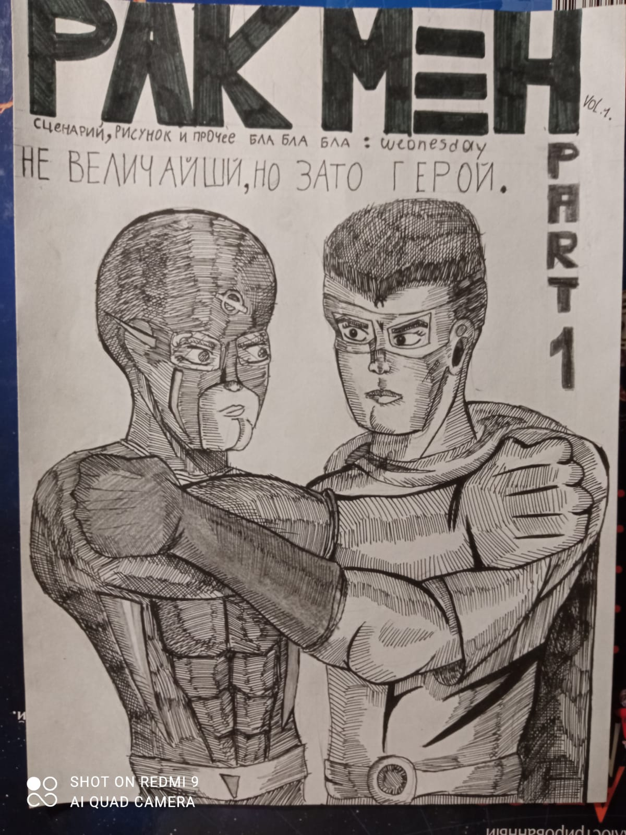
Find the difference
Alexander Pushkin wrote a lot of interesting books.
Alexander Gorbachev has written some funny comic books.

Slide 11
Signal words of Present Perfect

Slide 12
Let’s do some exercises
I … fed my dog.
She … watered the flowers.
Mike … swept the floor.
They … helped their parents.
The boy … cleaned his room.
My mother … gone shopping.
Children … helped their parents.

Slide 14
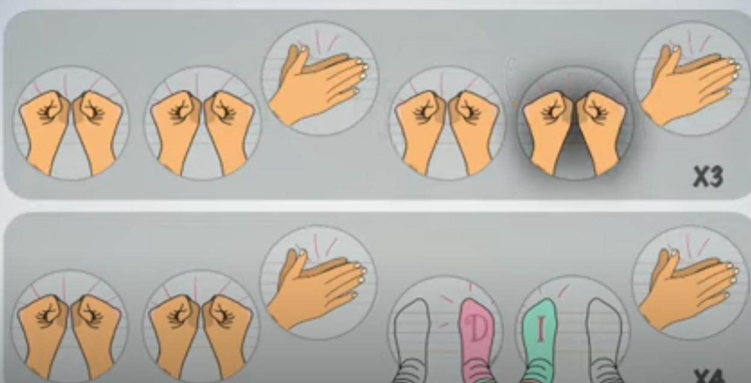

Slide 16
4. Circle the correct item

Slide 17
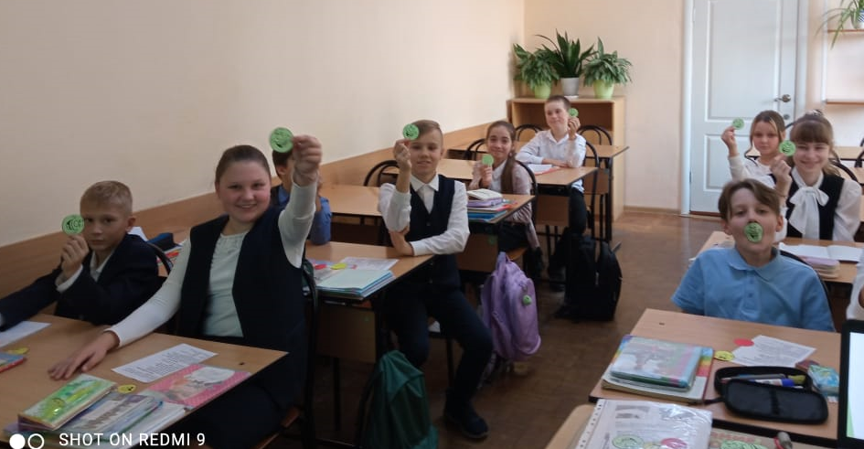
My work at the lesson Name: __________________________
1. In the lesson I was 2. The results of my work 3. The lesson was 4. In the lesson I was 5. The information I’ve got is | active / passive satisfy / don’t satisfy me short / long / interesting / boring not tired / tired clear / not clear

Slide 18
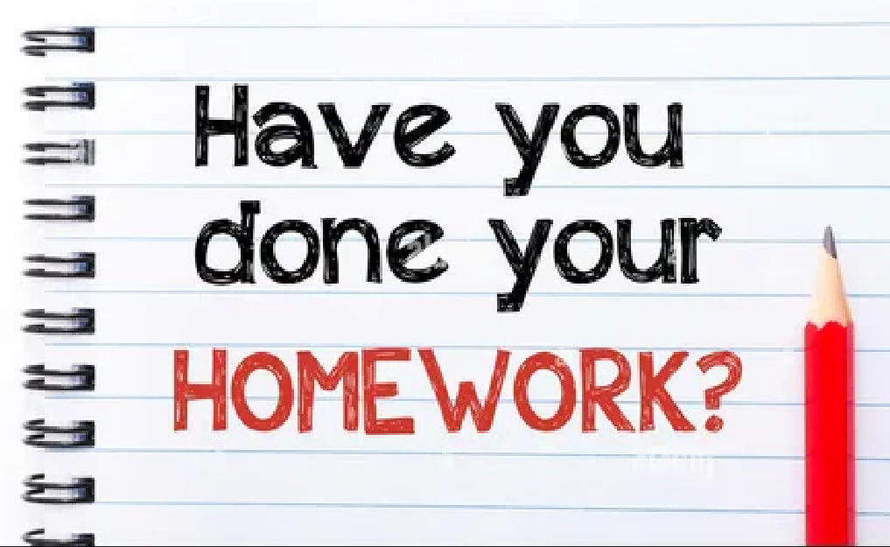
https://learningapps.org/view4773932
https://learningapps.org/view8562281
https://learningapps.org/view7630317
Worksheet: Grammar rule
Worksheet: ex. 5, 6

