Slide 1
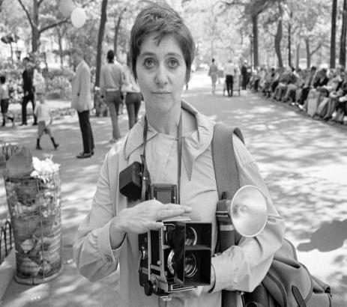
Diane Arbus (1923-1971)
American photographer
“The photo is a secret about the secret.”

Slide 2
The plan of describing a photo
Who/what and where (when – season and weather).
Who is doing what. (Present Continuous!)
What the people look like.
Clothes.
Mood and feelings.
Personal attitude.

Slide 3
Who?
What (occupation)?
A boy
A girl
A man
A woman
A pupil
A student
A teacher
A doctor
An engineer
A policeman
A pilot
A cook
A vet
A shop assistant
…………

Slide 4
WHERE?
in the room, at home, in the office, in the garden, by the river,
in the mountains, in the park, at school, in the classroom,
at the seaside, at the supermarket, at the airport, in the library,
in the field, in the forest
inside | outside
In the room At home In the office At school In the classroom At the supermarket At the airport In the library | In the garden By the river In the mountains In the park At the seaside In the forest In the field

Slide 5
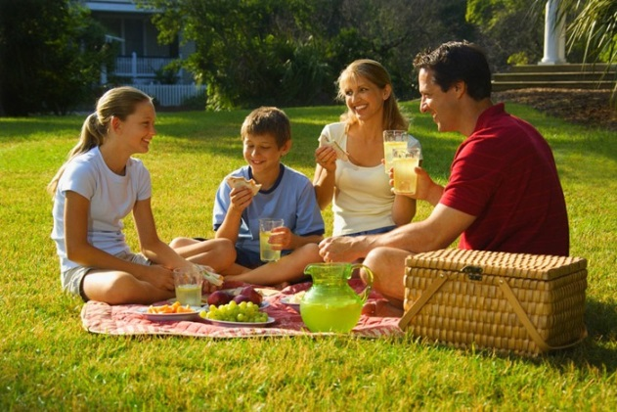
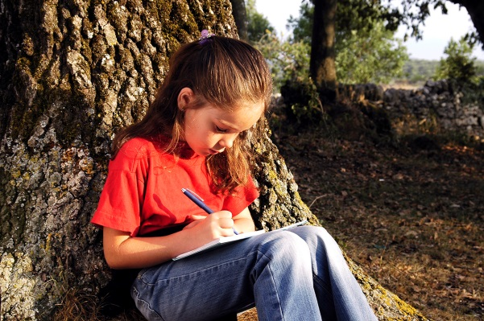
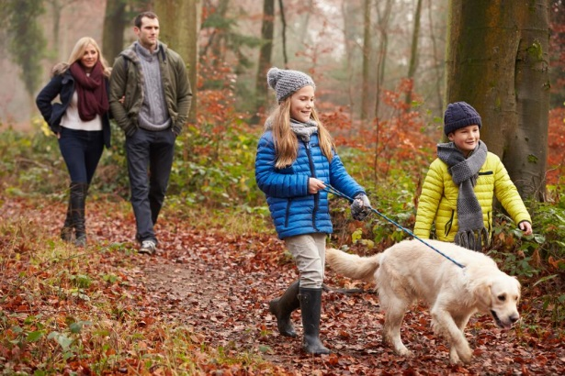
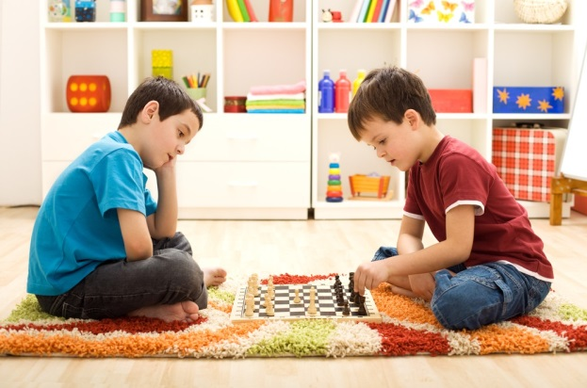
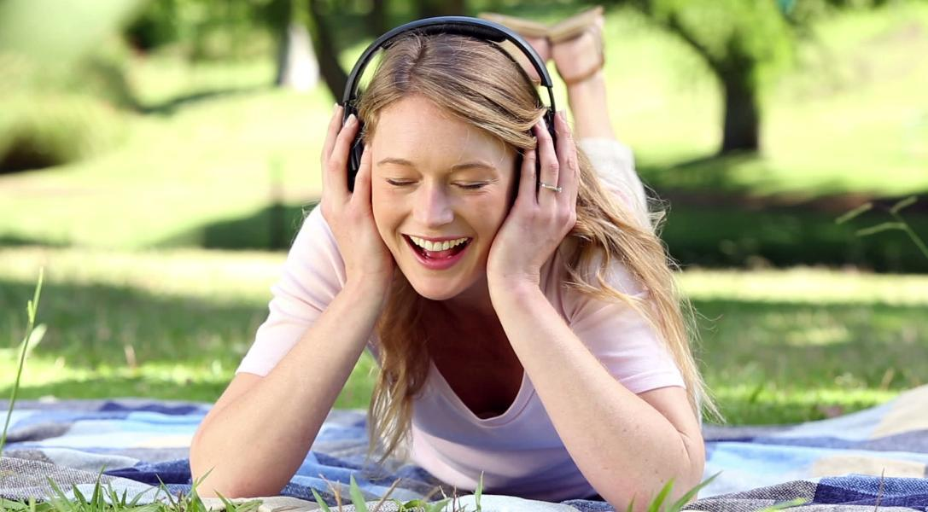
Catch a mistake!

Slide 6
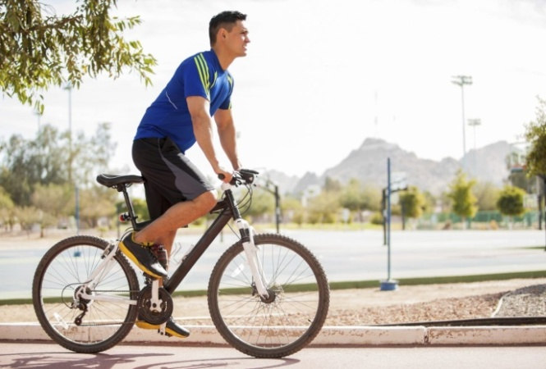

Slide 7
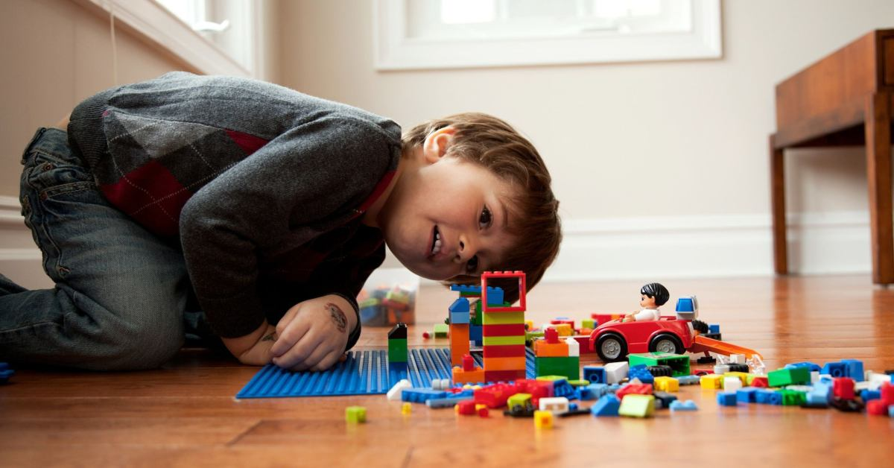

Slide 9
for your work !

