Slide 1
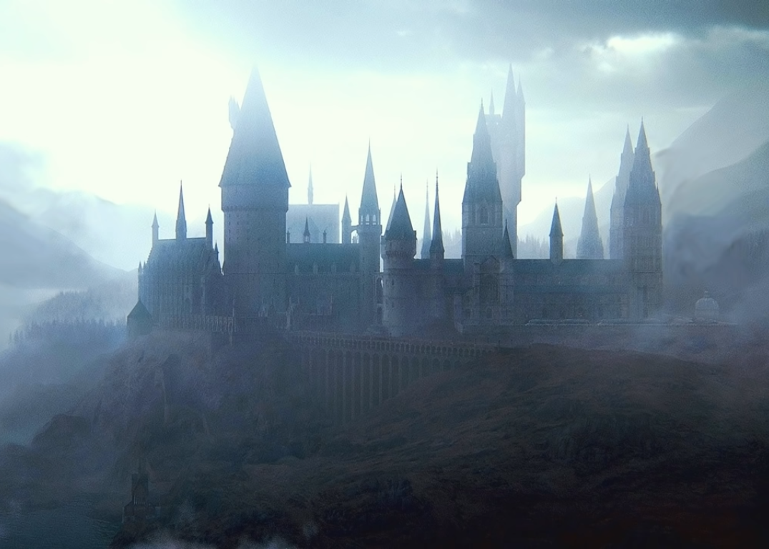
?

Slide 2
Dear students of 6A form!
With a great pleasure we would like to invite you to the ceremony of choosing a faculty at our school of magic!
To get here you have to say the spell PORTUS all together.
Can’t wait to see you at Hogwarts!
Best Regards, Harry, Ron and Hermione

Slide 4
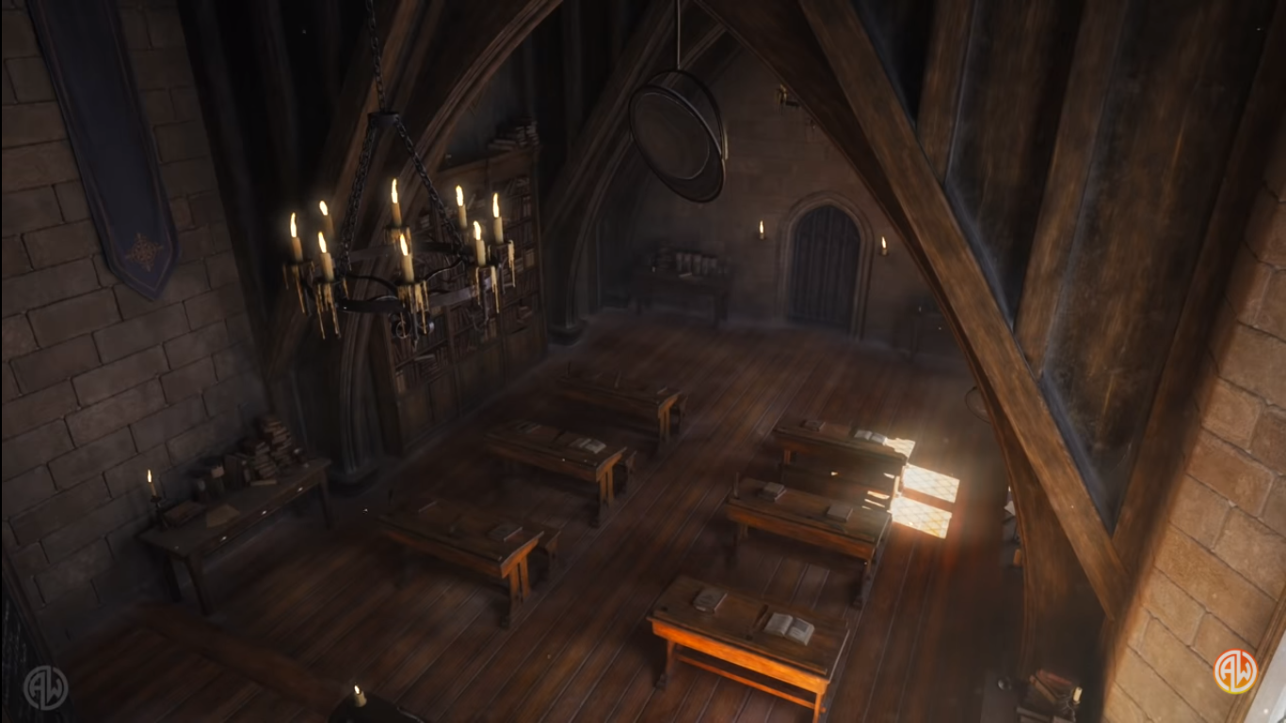

Slide 5
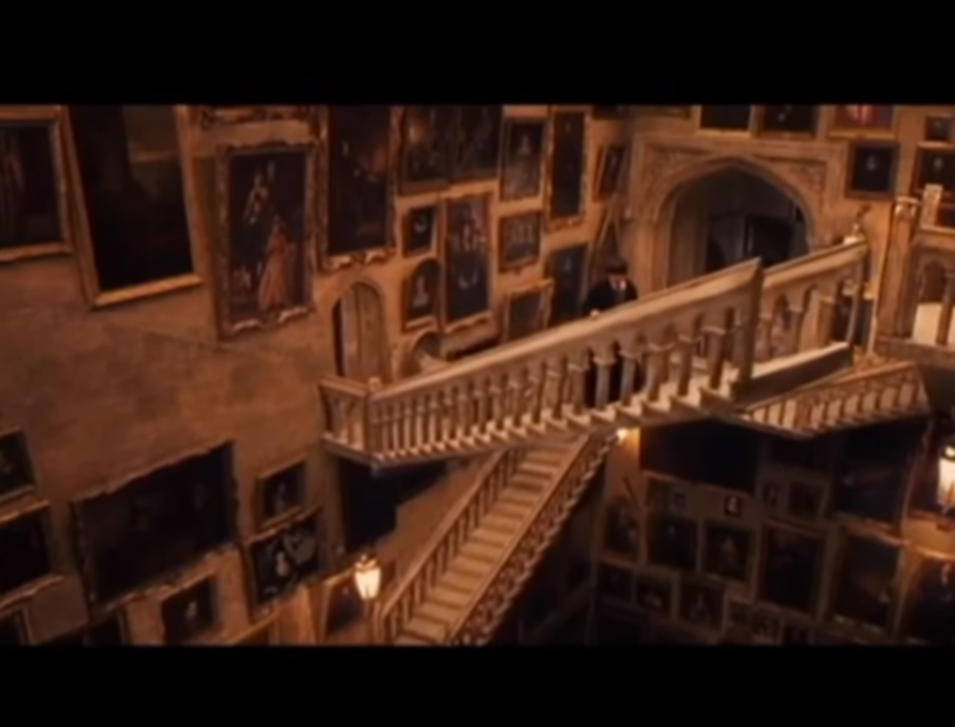

Slide 6
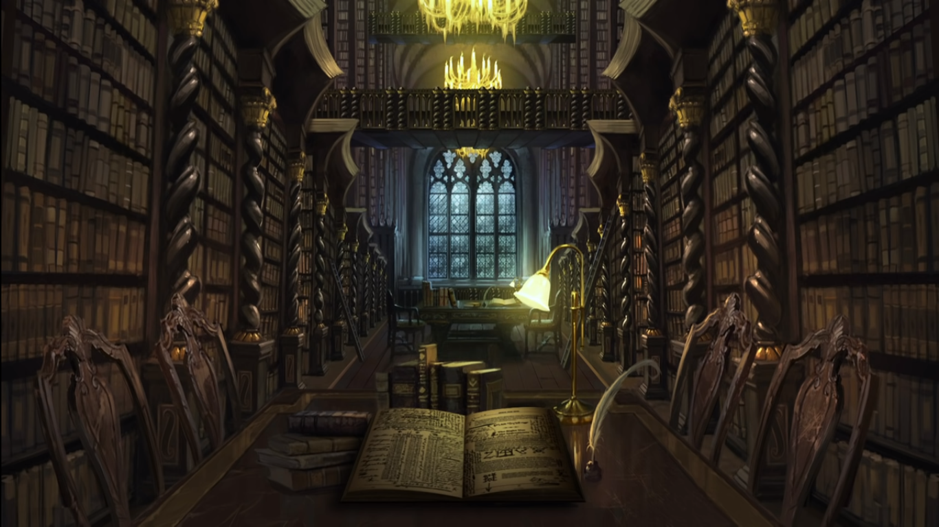

Slide 7
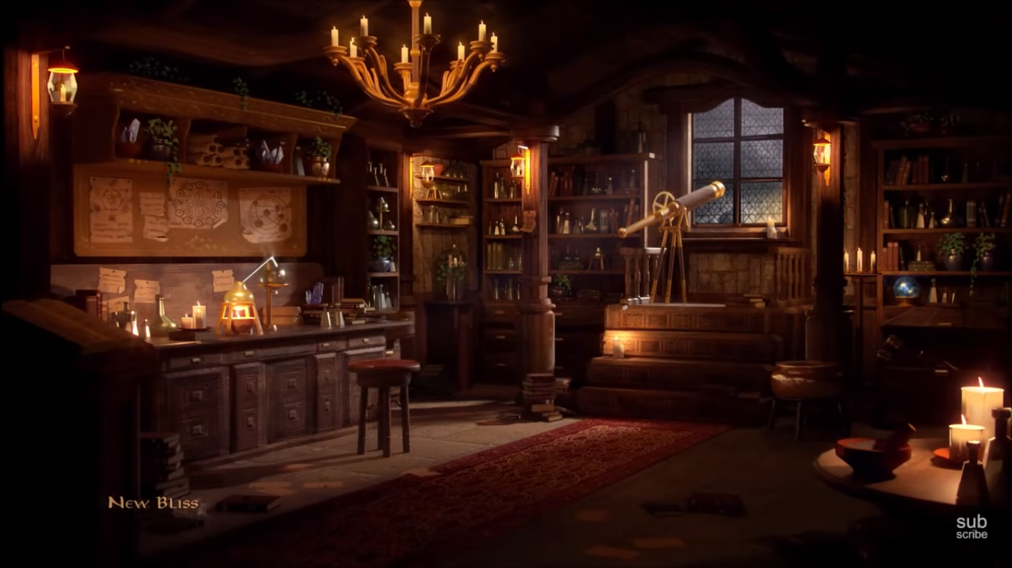

Slide 8
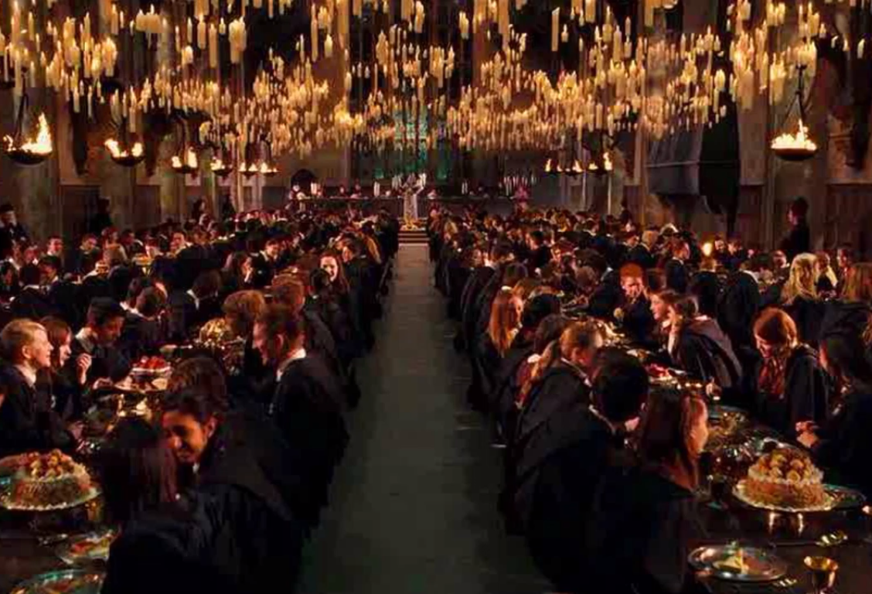

Slide 9
Students:
Noble
Brave
Determined

Slide 10
Students:
Cunning
Ambitious
Powerful

Slide 11
Students:
Honest
Stubborn
Hardworking

Slide 12
Students:
Smart
Funny
Easy-going

