Slide 2
«Hobby and activities»

Slide 3
Hobby – something that you enjoy doing when you are not working.
For example Mike’s hobbies include reading and chess.

Slide 4
Ex.4 p.30
1. С
2. E
3. A
4. B
5. D
6. F

Slide 5
1.Emily: What do you do in your free time?
Nick: I like to play sports. And what about you?
Emily: In my free time I like to draw.
2 Ron: Do you prefer playing football or playing board games?
Dave: Well, I’m not keen on playing football. I prefer board games

Slide 6
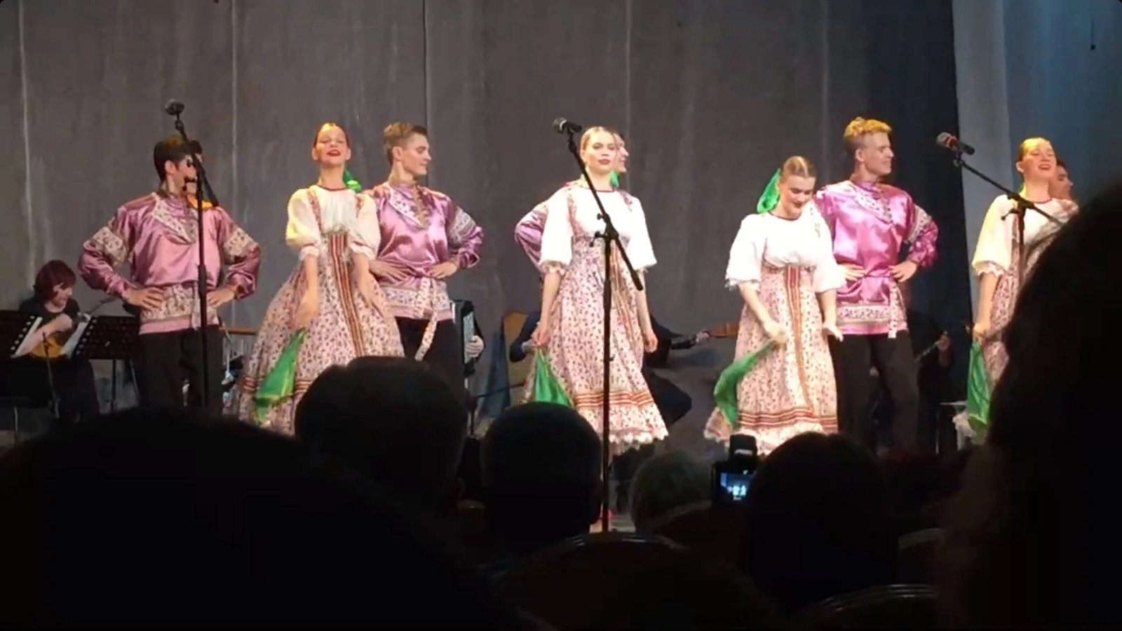
Dancing

Slide 7
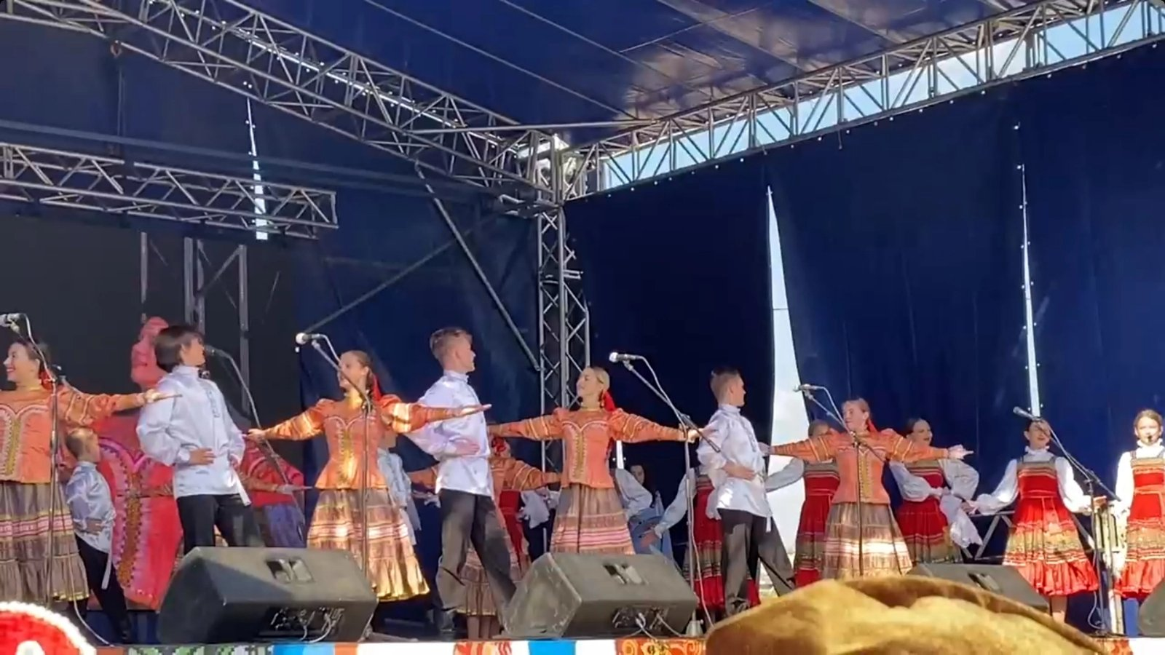

Slide 8
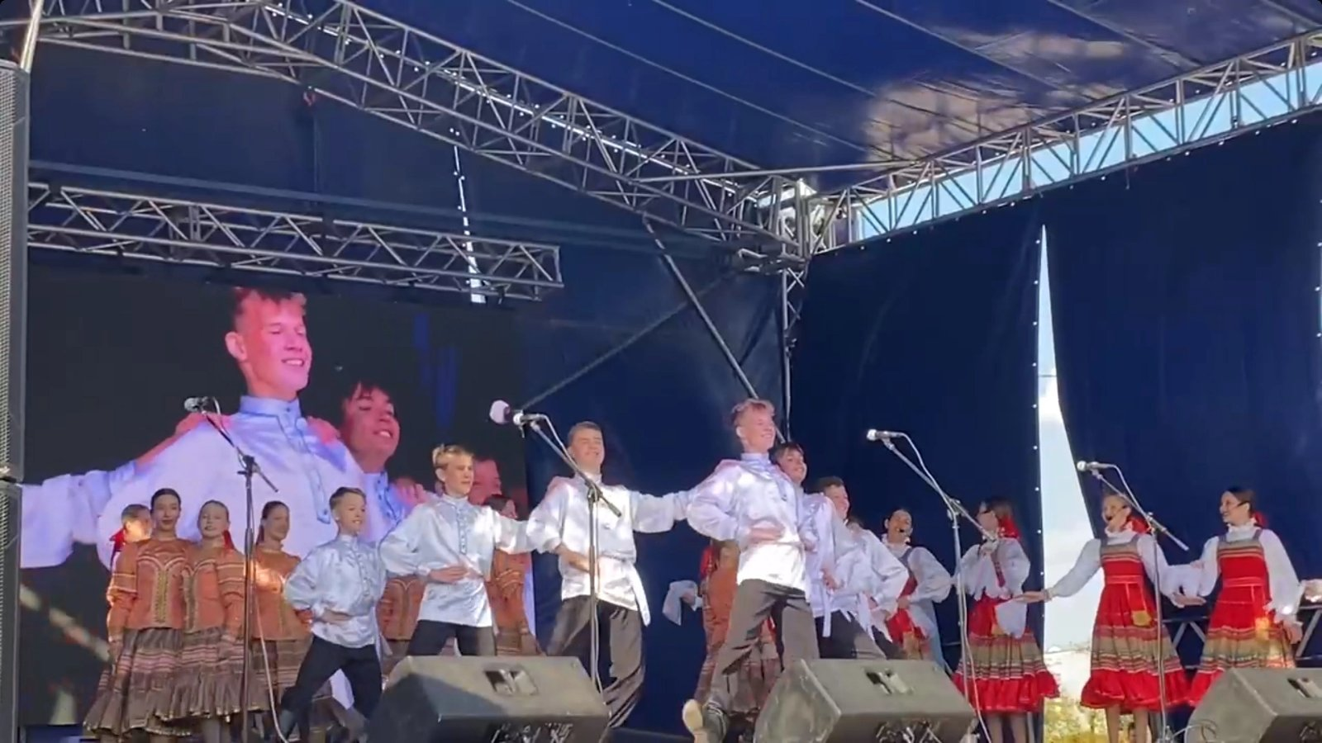

Slide 9
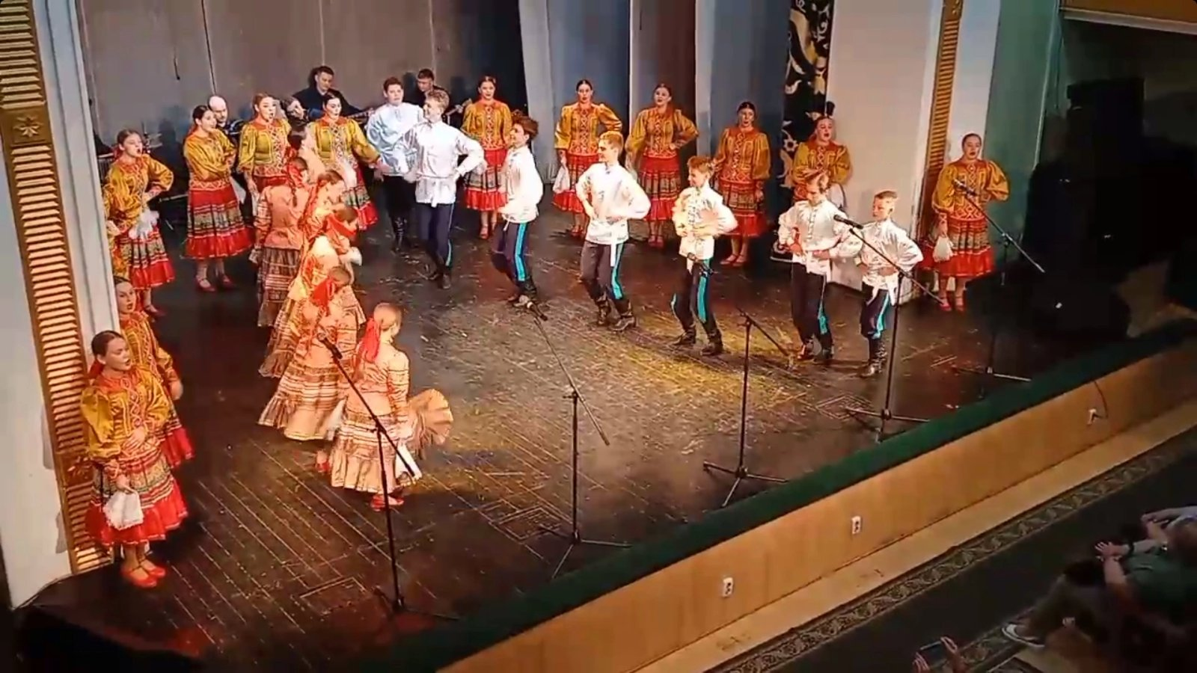

Slide 10
Do you like the lessons?
The most interesting for me was…
The most difficult for me was…

Slide 11
homework
Используя лексику составить связной текст по теме «Мое хобби»
Повторить ЛЕ по теме.

Slide 12
Thank you for your attention!!!

