Slide 1
present
Continuous
Tense
Настоящее длительное
время
Презентация учителя английского языка
Богдановой Марины Владимировны
МОУ «Брилинская школа»

Slide 2
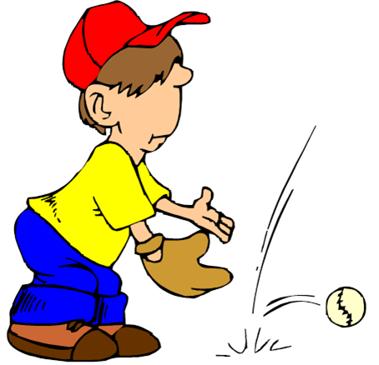
The Present Continuous Tense
The Present
Continuous Tense
The Present
Simple Tense
habitual, regular
action
continuous action
taking place right now
Mike plays baseball
every weekend.
Mike is playing
baseball now.

Slide 3
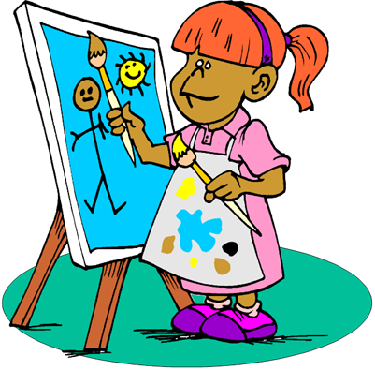
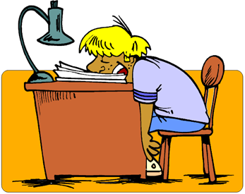
The Present Continuous Tense
am
is
are
I am
I`m
he is
he`s
to be
Ving
you are
you`re
we are
we`re
she is
she`s
they are
they`re
Mary
is painting now.
Look!
Nick is sleeping.

Slide 4
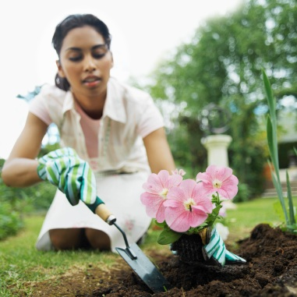
Когда мы употребляем
Present Continuous Tense
Present continuous обозначает
длительное действие, которое совершается
в настоящее время, в момент речи.
Сейчас она сажает розу.
She is planting a rose now.
В данный момент панда кушает.
Panda is eating at this moment.

Slide 5

The Present Continuous Tense
I am waiting for the bus
at the moment.

Slide 6


The Present Continuous Tense
The girls
are dancing now.
dance

Slide 7
Adding –ING to the Verbs
V
-e
+ing
согл.
+ing
Vкратк.гласн.согл.
dance - dancing
sit - sitting
take - taking
get - getting

Slide 8
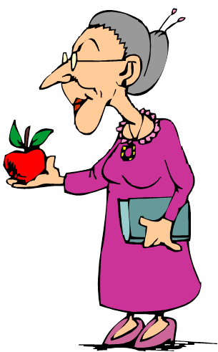

Adding –ING to the Verbs
My Granny
is taking me to school
at the moment.
(take)

Slide 9

Adding -ING to the Verbs
I am sitting
at the lesson now.
(sit)

Slide 10

Choose AM, IS, ARE
is
Pasha … doing
a test now.

Slide 11
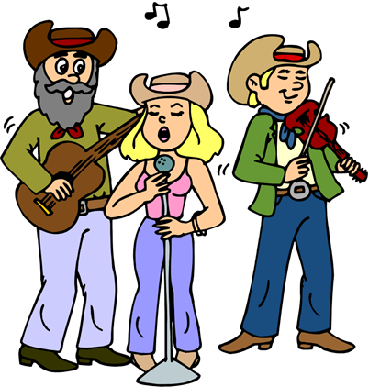
Choose AM, IS, ARE
Listen!
They … singing.
are

Slide 12
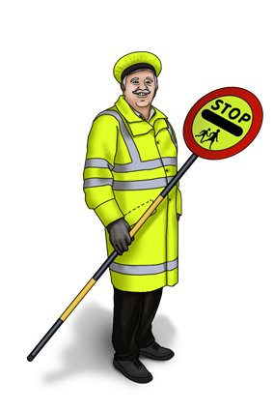
Speech Signals
now
сейчас
at the moment
в данный момент
Look!
посмотри(те)
Listen!
послушай(те)

Slide 13
GOOOD LUCK!

