Slide 1
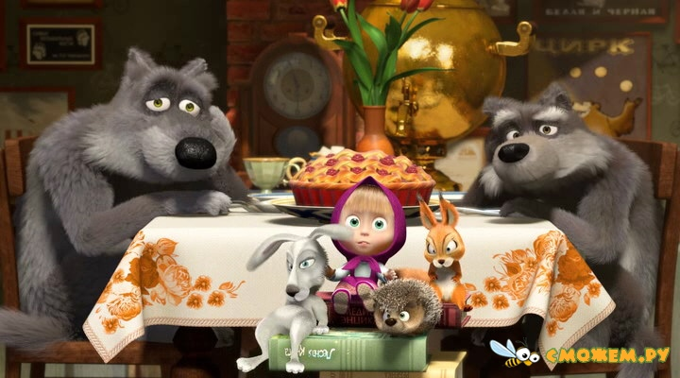
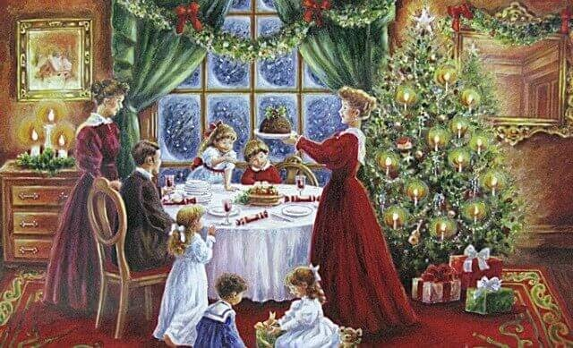
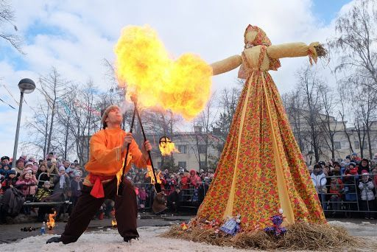
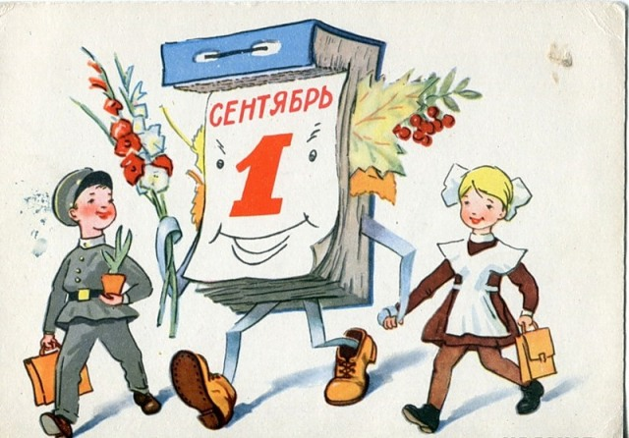
Celebrations
How do you like to celebrate special events?
What is your favourite celebration?

Slide 2
Special
occasions
Wedding reception
first New Year’s party
first School Day
School leaving party

Slide 3
What is the goal of the lesson? How can we achieve it?
At the end of the lesson we will be able to…
To make a video about a special Day
Create a story about a special day
Revise grammar
(Past Simple)
Learn new words on the topic
Revise words on the topic Holidays

Slide 4
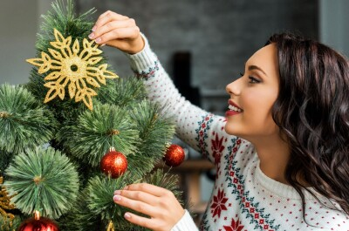
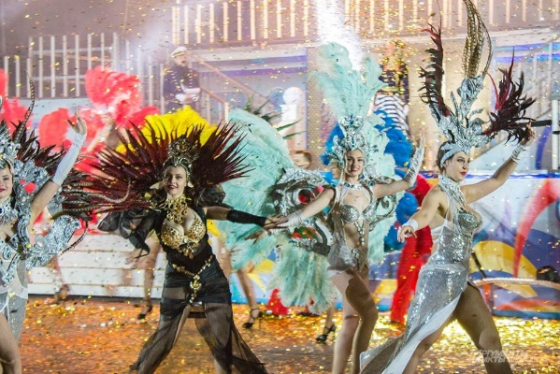
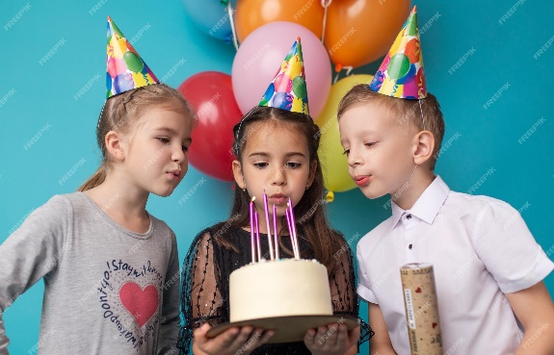
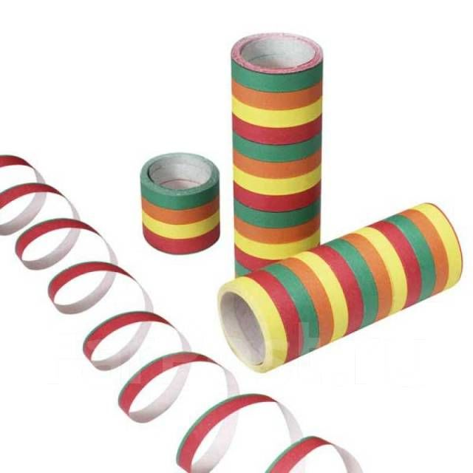
Match the pictures to the phases. Then use the phrases to describe the picture.
Match the pictures to the phases. Then use the phrases to describe the picture.
Birthday
Christmas
Carnival
1
2
3
Pull crackers, exchange gifts/cards, decorate trees, sing carols, eat special meal
Dress up, wear masks, watch street parades, throw streamers
Blow out candles, receive gifts/cards, have a party, eat a special cake, take pictures, make a toast

Slide 5
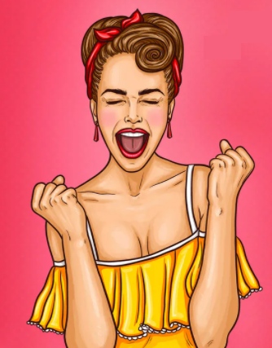
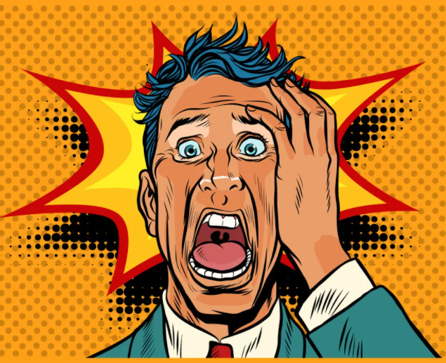
How do you think the people in the pictures feel?
surprised (didn’t know about the …)
excited
nervous
Thrilled to go to the … (it is so much fun)
thrilled
Enthusiastic (Christmas has arrived)
enthusiastic
surprised
Impatient (to open the presents)
impatient
nervous (take part in the street parade)
Excited (people are watching them)

Slide 6
egorova.7807@mail.ru
Start your story with «It was one of my best days in my life»
Make 10-12 sentences
Use new vocabulary
Talk about feelings
Use linking words and, but, then, after that, so, because ……
Use Past Simple

