Slide 2
Aa

Slide 3
Dd

Slide 4
Mm

Slide 5
Pp

Slide 6
Ss

Slide 7
Ww

Slide 8
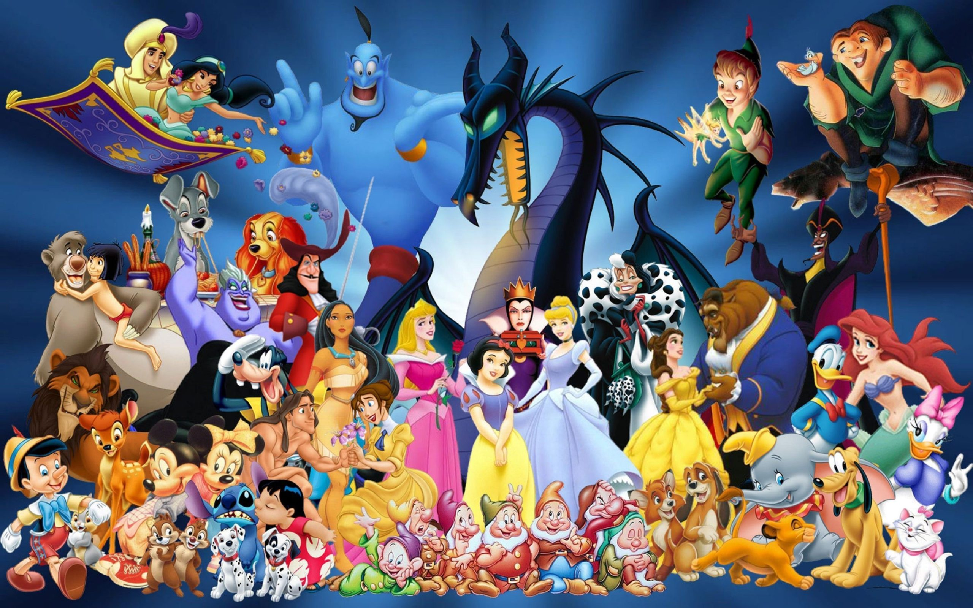

Slide 9
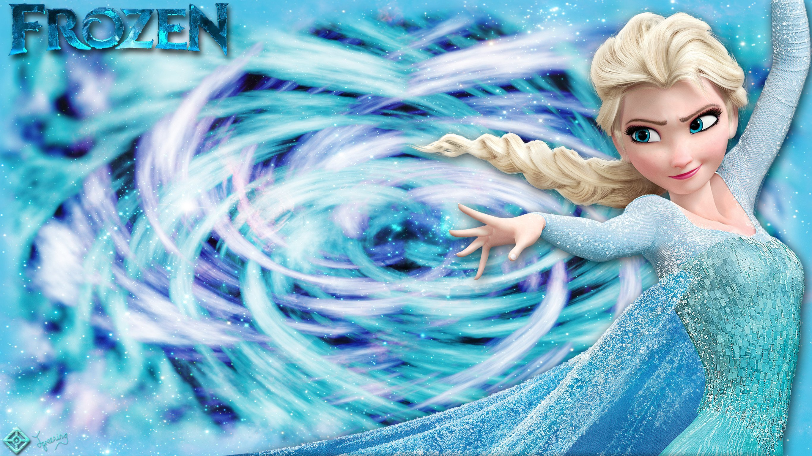

Slide 10
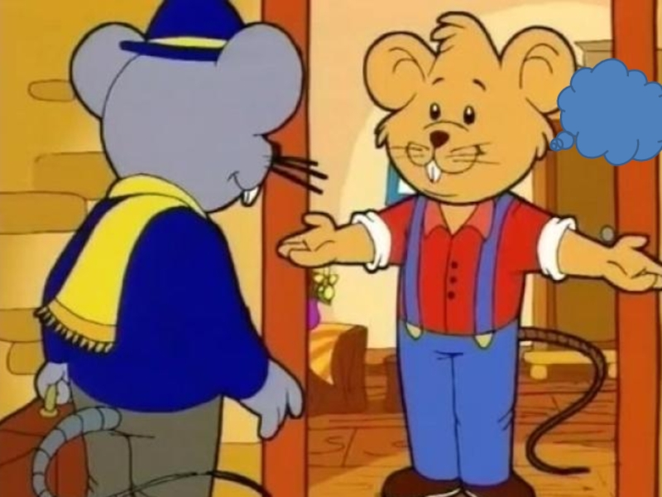

Slide 11
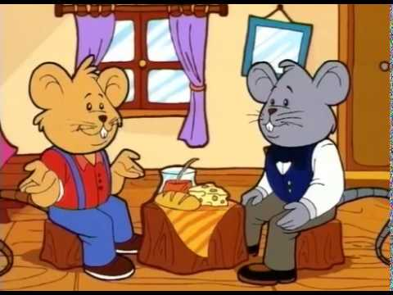

Slide 12
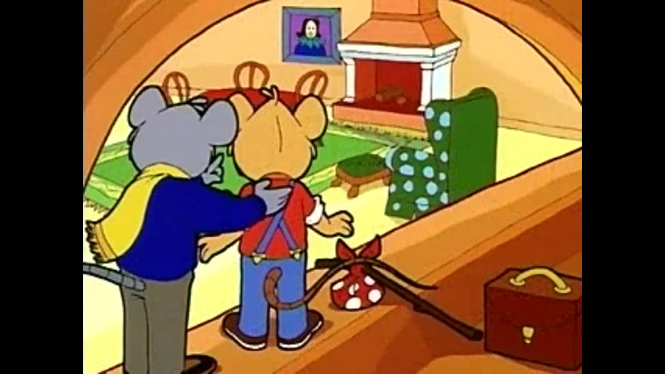

Slide 13
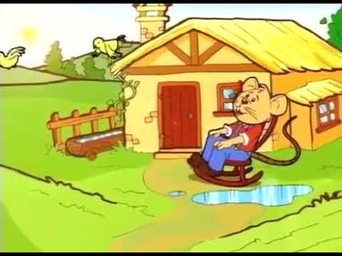

Slide 15
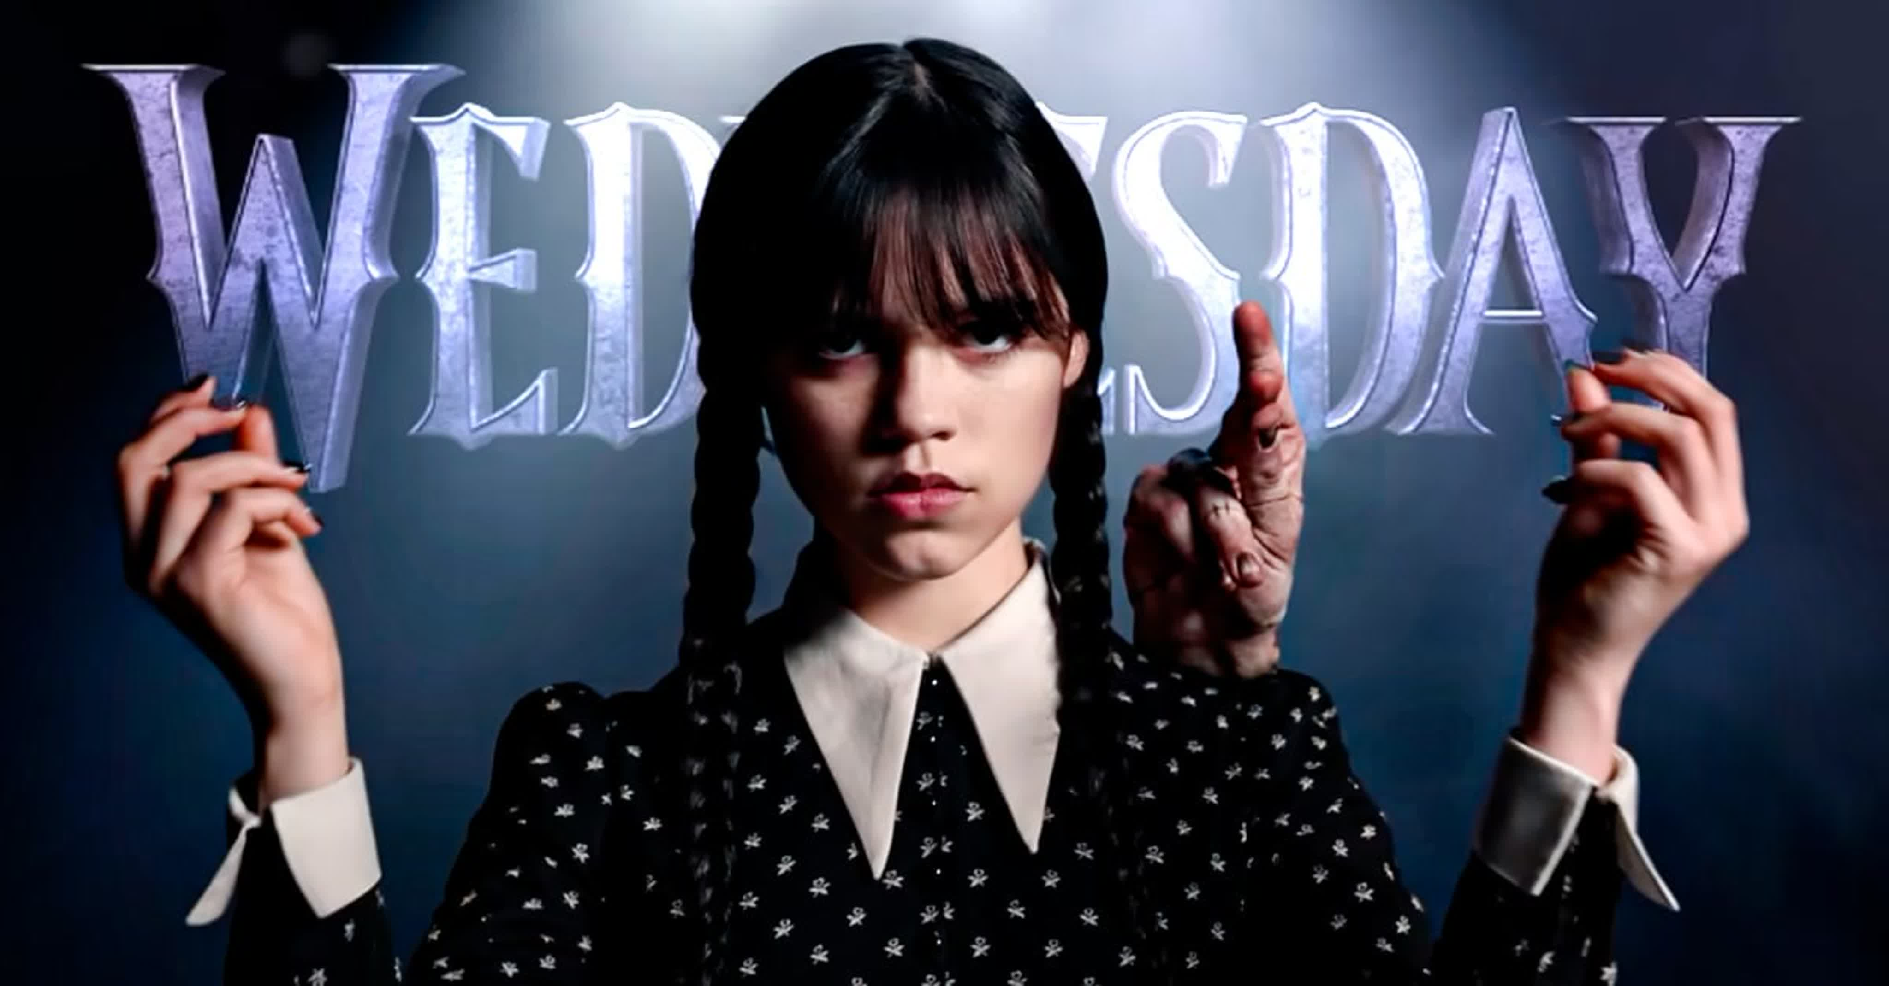

Slide 16
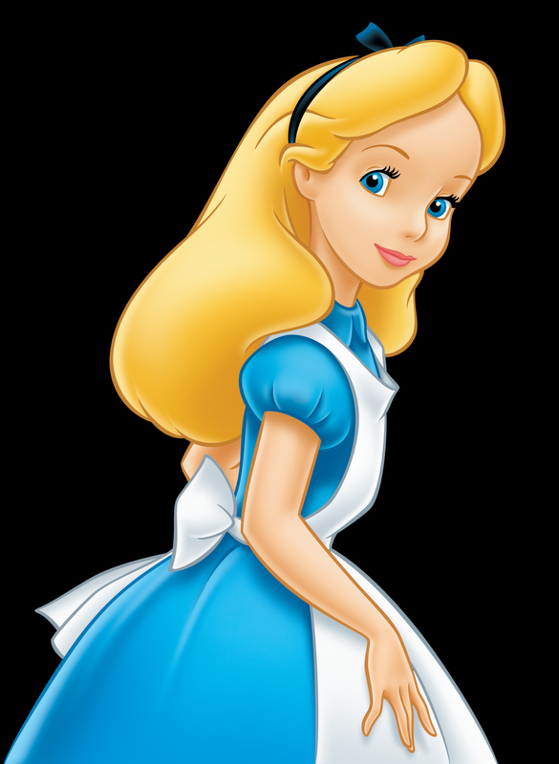
She follows a talking rabbit down a hole and into a fantasy world?
Alice

Slide 17
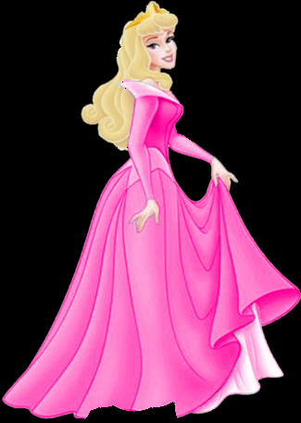
What is the name of the princess who fell asleep on her 16th birthday?
Sleeping Beauty

Slide 18
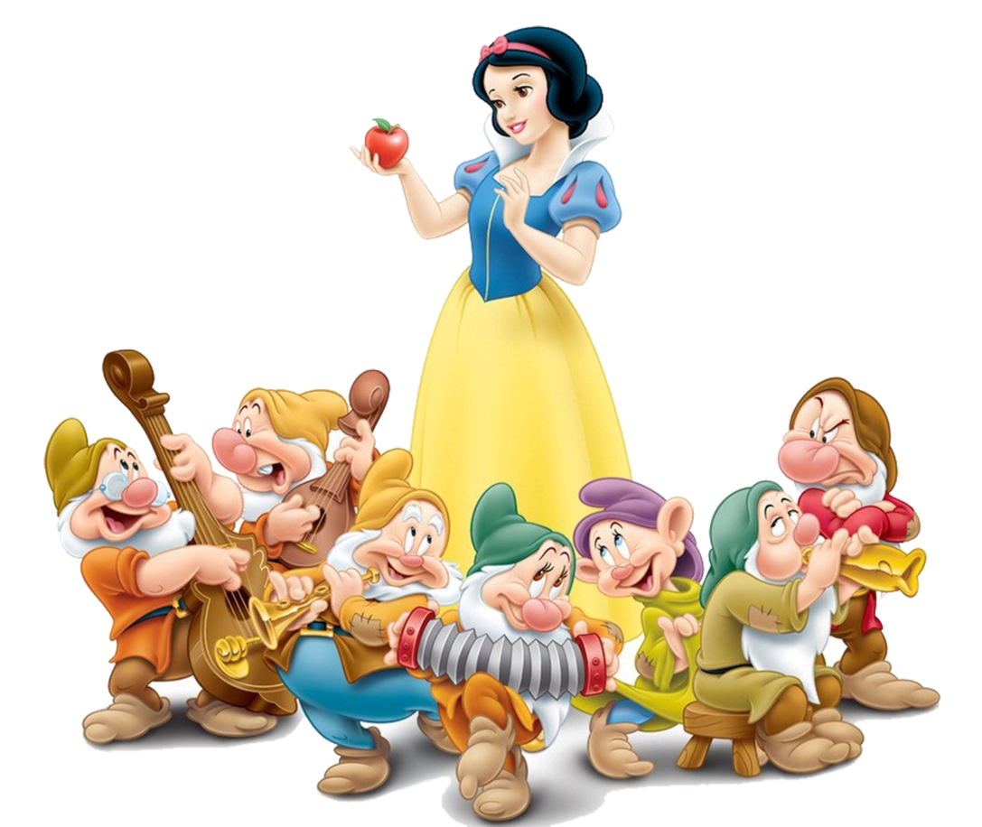
She is a beautiful girl. She is slim. She has got dark hair and lovely eyes. She wears a long blue and yellow dress. She is very kind and has a lot of friends. She lives in the forest.
Snowhite

Slide 19
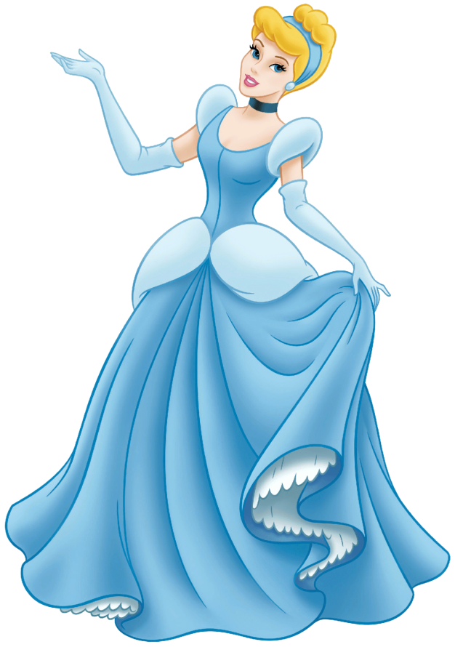
She is pretty. She has got fair hair and beautiful lips. She is slim and wears a long blue dress. She is kind and not lazy. She can do everything about the house and she can dance well.
Cinderella

Slide 20
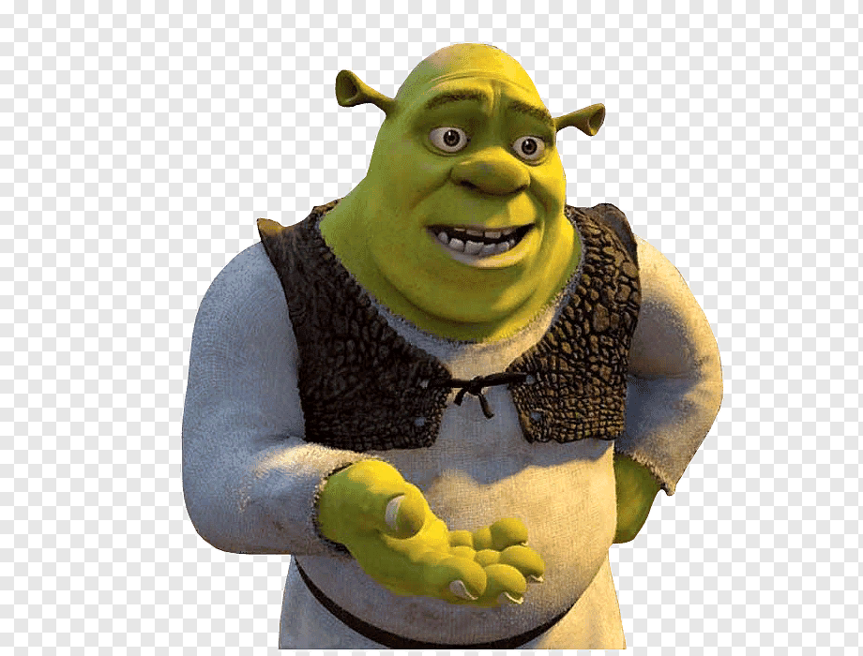
He is an orch. He is very big and strong. His skin is green.
Shrek

