Slide 1
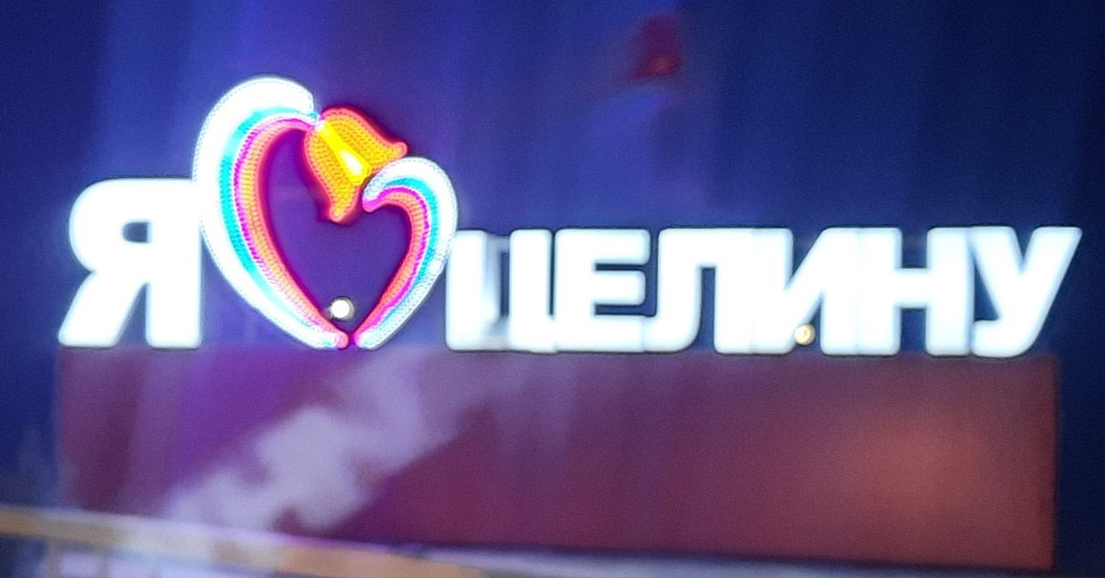
My country. My hometown.
Учитель – Буцкая Анна Альбертовна

Slide 2
Фонетическая зарядка
[æ] – capital, many, and, can
[ei] – famous, favourite, space, spaceship
[a:] – park, far
[׀] – is, it, this, village, Kremlin
[i:] – green, see, tree, beach, these

Slide 3
Речевая зарядка
- Where are you from?
-What is the capital of Russia?
- Where do you live?

Slide 4
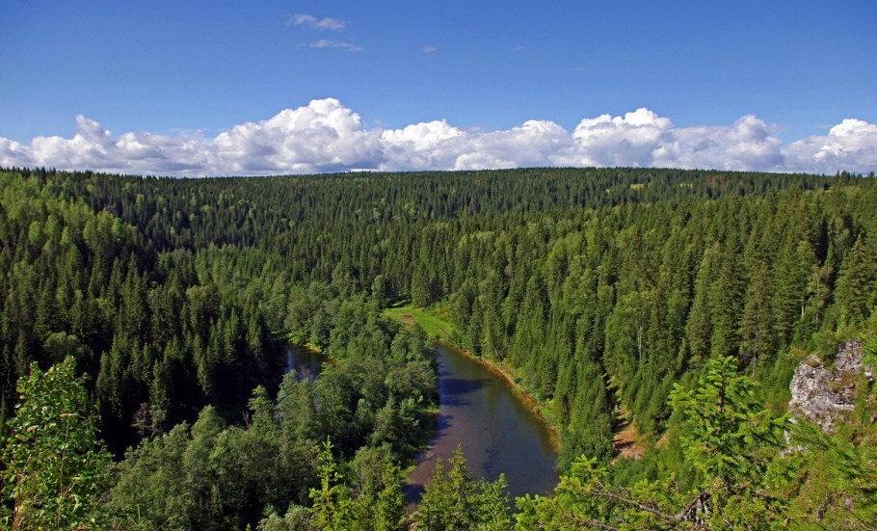
Знакомство с новыми словами.
taiga [ˈtaɪgə] тайга
forest [ˈfɒrɪst] лес
mountain [ˈmaʊntɪn] гора
museum [ mjuːˈzɪəm] музей

Slide 5
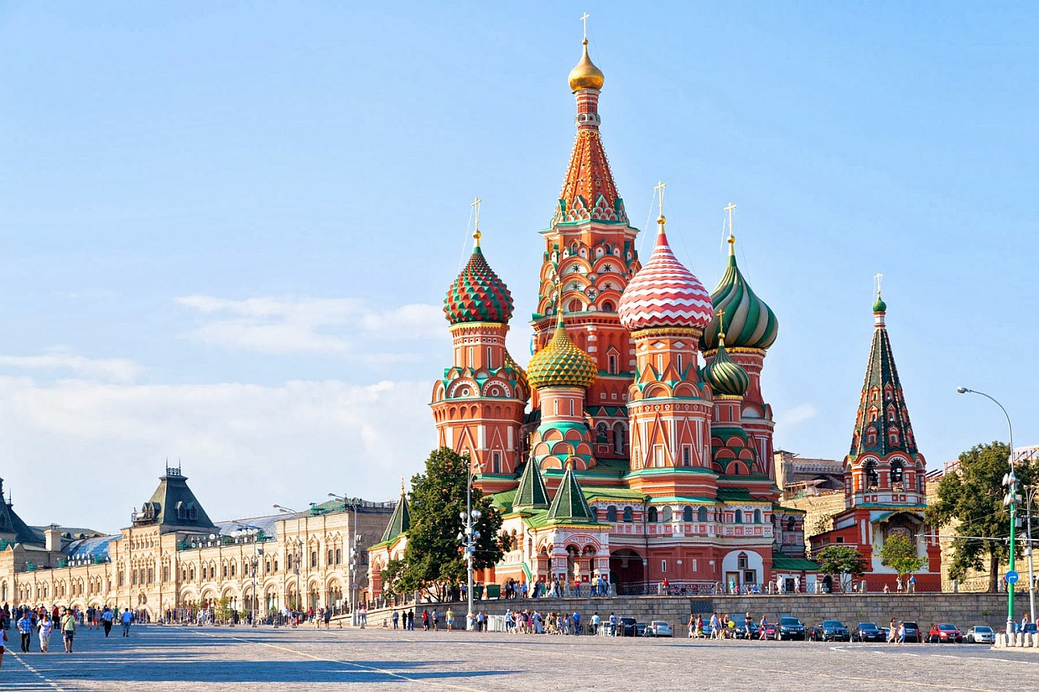
Расскажи о городе России It is … (название города). … (название города) is famous for its….(чем знаменит).

Slide 6
It is … . … is famous for its… .

Slide 7
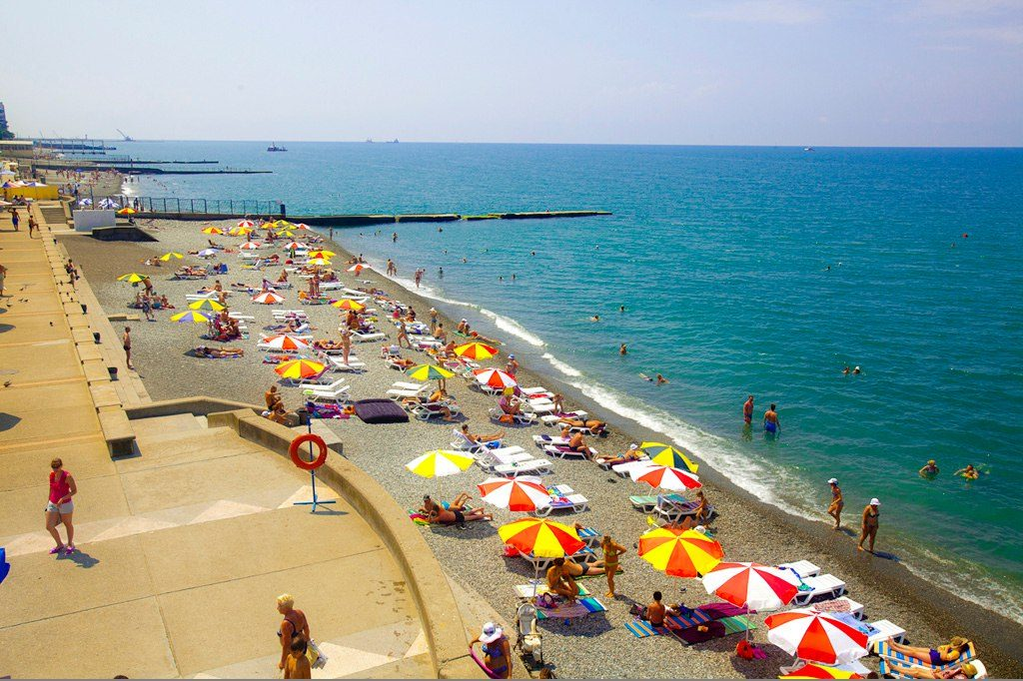
It is … . … is famous for its… .

Slide 8
It is … . … is famous for its… .

Slide 9
My hometown ( Мой родной город). I live in Tselina.

Slide 10
We have got …

Slide 11
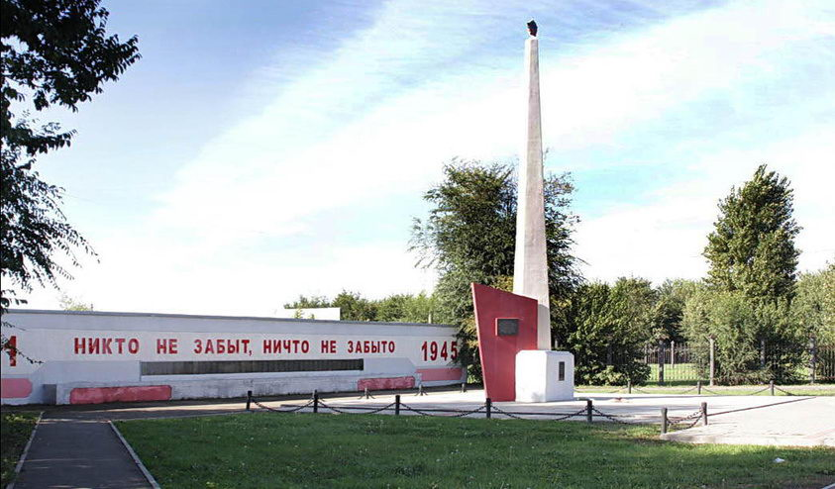
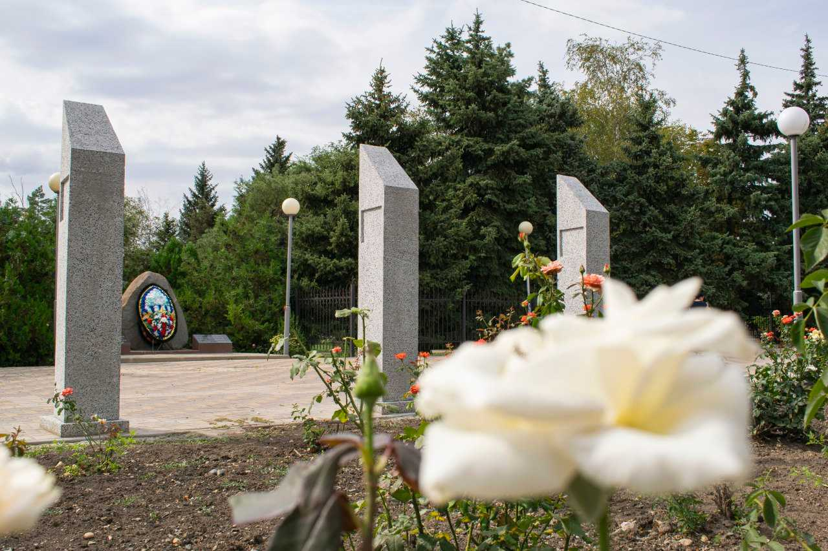
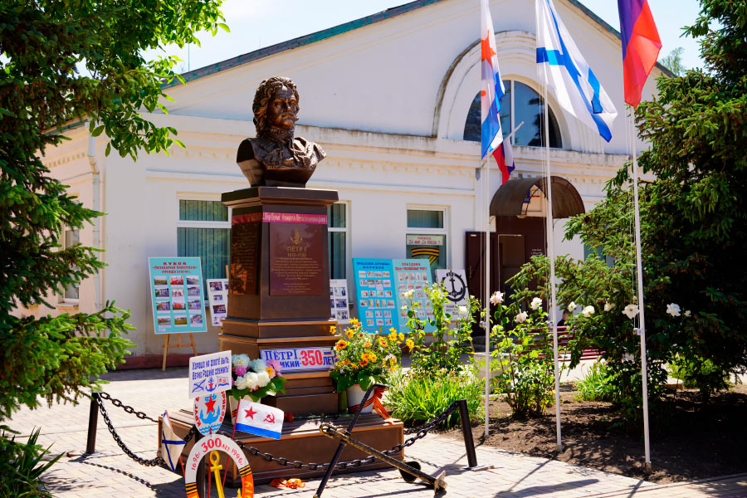
There are a lot of…

Slide 12
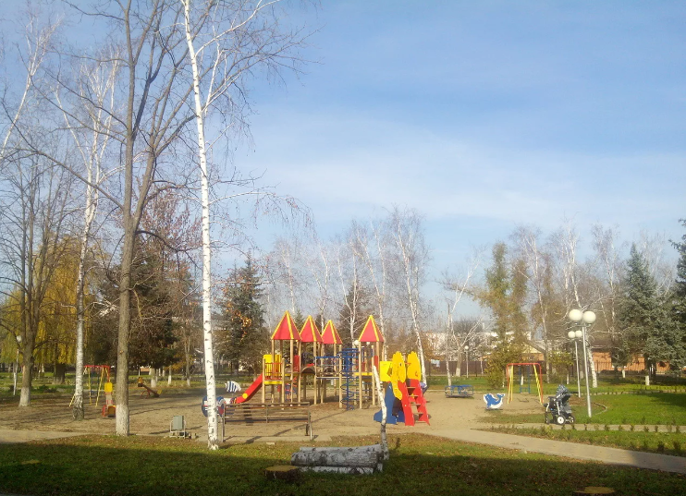
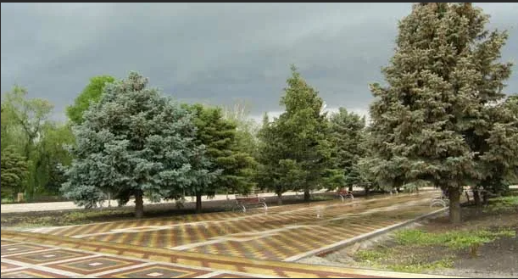
Tselina is famous for its …

Slide 13
My hometown.
I live in Tselina. It is nice and big.
We have got an interesting museum.
There are a lot of monuments.
Tselina is famous for its parks.

