Slide 1
Fill in the missing letters
s__gar
coc___nut
oliv___ oil
flou_
pineap_le
s_lt
l_mon
t_mato

Slide 2
Much/ Many/
A lot

Slide 3
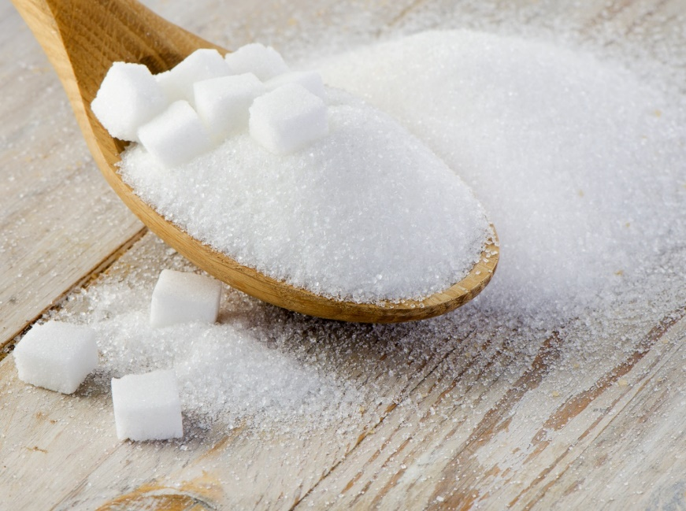
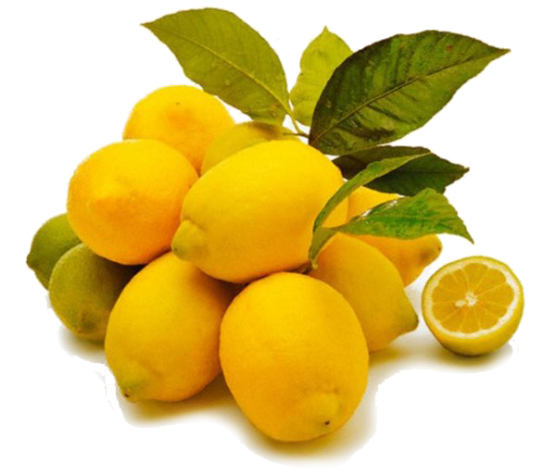
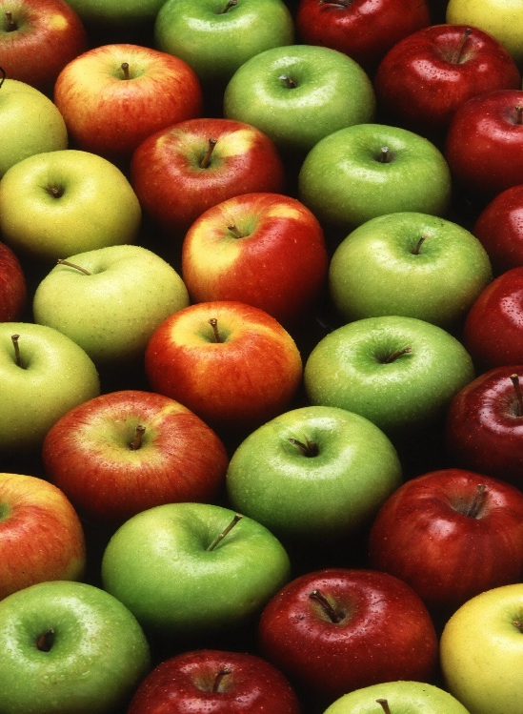
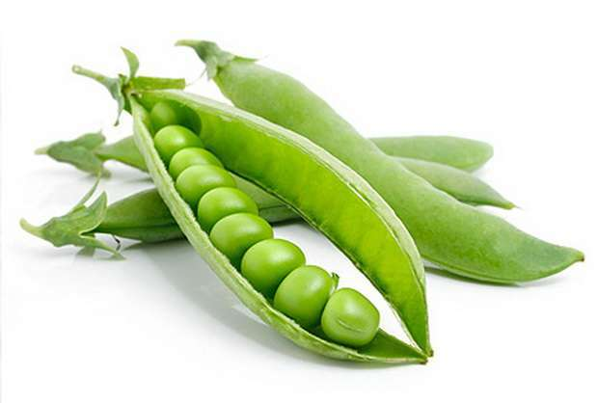
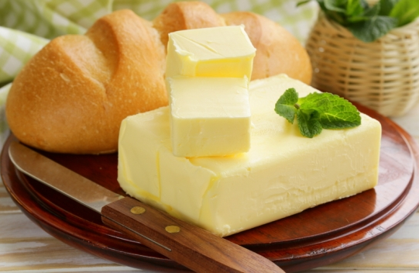
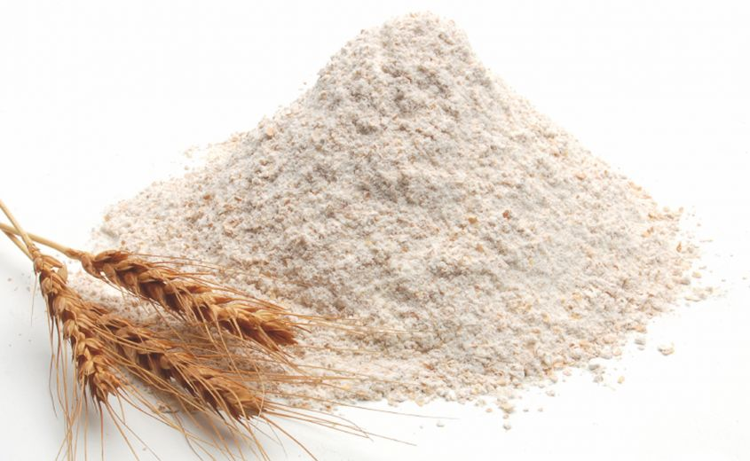
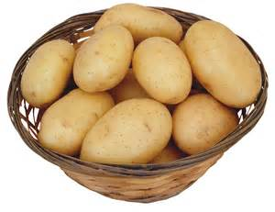

Slide 4
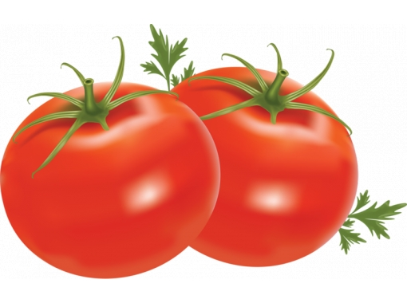
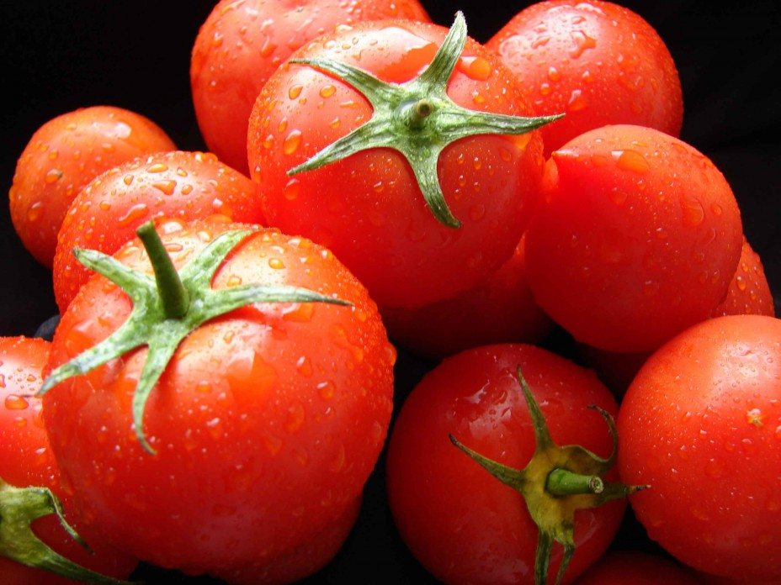
How many tomatoes are there?
Not many
A lot

Slide 5
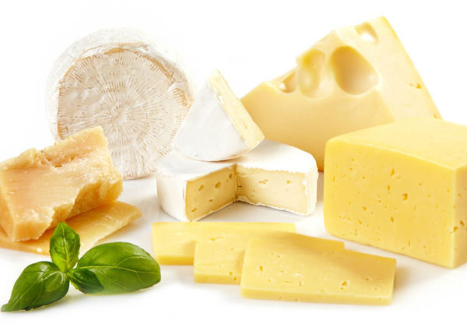
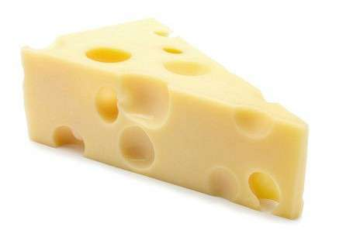
How much cheese is there?
Not much
A lot

Slide 6
How much bread is there?
Not much/ A lot
How many eggs are there?
Not many/ a lot

Slide 7
many
How mangoes are there?
How eggs are there?
How sugar is there in the cake?
How salt is there on the shelf?
How olive oil is there?
How pineapples are there in the box?
many
much
much
much
many

