Slide 1
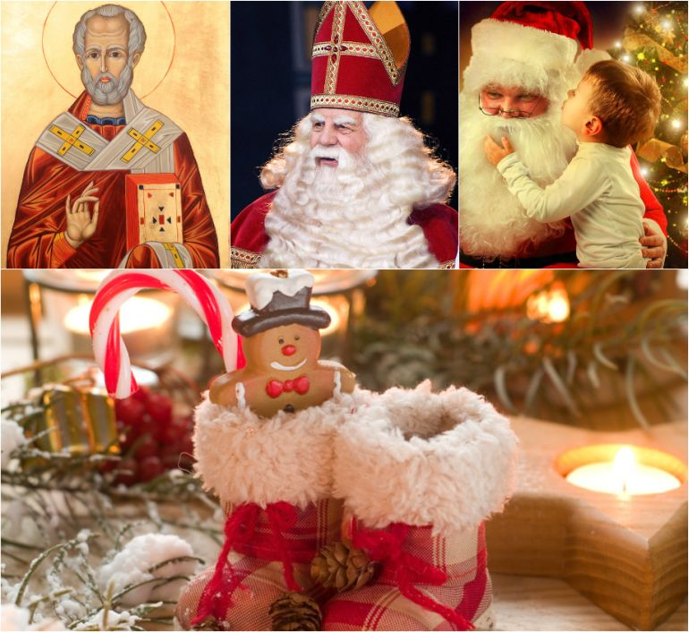
Viele Traditionen sind in Deutschland, in England und in Russland ähnlich.
Wie sind sie?
Many traditions in Germany, England and in Russia are the same. What traditions do you know?

Slide 2
Was feiert man im Dezember?
What holidays do we celebrate in December?

Slide 3
Der Nikolaustag
Saint NicHolas Day

Slide 4
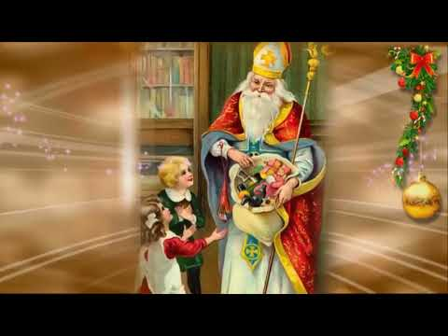
Welche Assoziationen habt ihr mit dem Wort «Nikolaustag»?
What are your associations with St. Nicholas’ Day?

Slide 5
Eine Tradition der Nikolaustag zu feiern, kommt vor vielen Jahrhunderten. The tradition of celebrating Saint Nicholas Day was a long time ago.
In Deutschland feiert man der Nikolustag am 6. Dezember.
Nikoluas war ein Bischof und lebte in Asien.
Er half armen Menschen.
Heutige Nikolaus ist als Schutzheiliger und Freund der Kinder.
Jungen und Mädchen stellen Stiefel vor die Tür und warten auf ihn.
In England St.Nicholas Day is celebrated on December 19
Nicholas was a bishop and lived in Asia.
He helped poor people
Today Nicholas is a saint patron and children’s friend.
Girls and boys put their boots behind the door and wait for him.

Slide 6
Eine Tradition der Nikolaustag zu feiern, kommt vor vielen Jahrhunderten. The tradition of celebrating Saint Nicholas Day was a long time ago.
In ________ feiert man der Nikolustag am _____ Dezember.
Nikoluas war ein _______und lebte in______.
___ half armen Menschen.
Heutiger Nikolaus ist als Schutzheiliger und ______ der Kinder.
Jungen und Mädchen stellen ________ vor die Tür und warten auf ihn.
In _______ St.Nicholas Day is celebrated on December ____
Nicholas was a ______ and lived in ______.
He helped poor _______.
Today Nicholas is a saint patron and children’s _______.
Girls and boys put their ________ behind the door and wait for him.

Slide 7
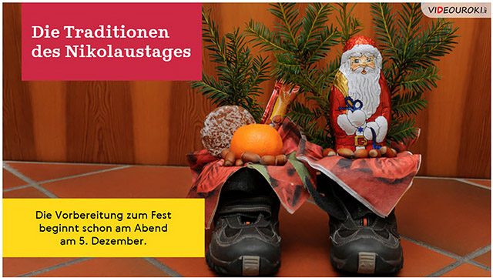
TRADITIONS OF ST. NICHOLAS DAY

Slide 8
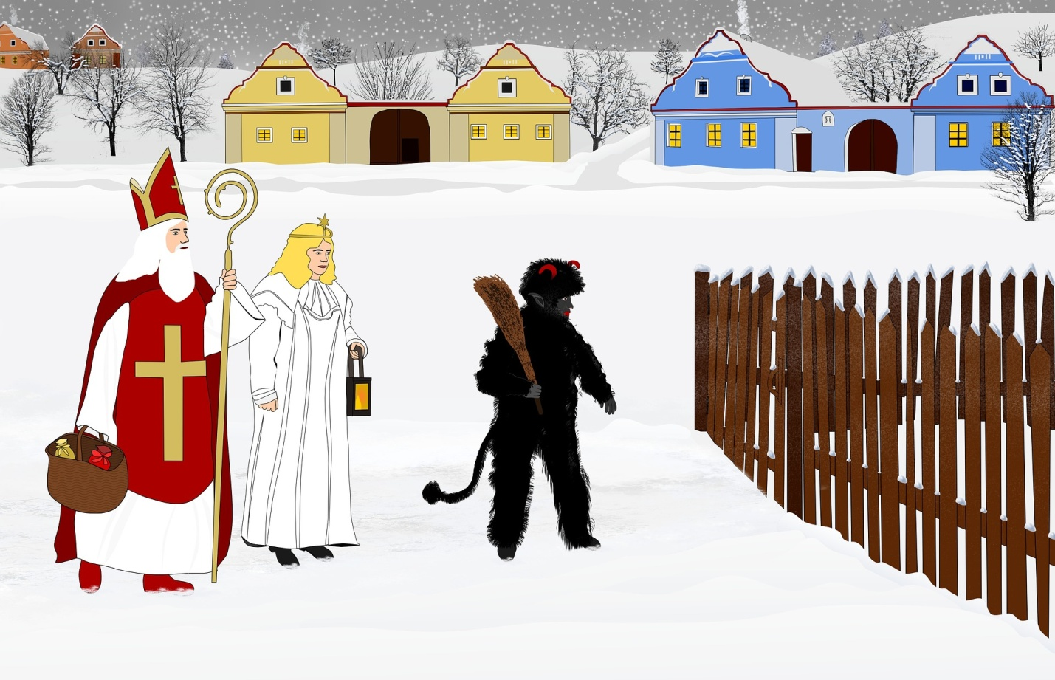
Aber der heilige Nikolaus kommt nicht allein. Knecht Ruprecht und Engel sind bei ihm.
Saint Nicholas doesn’t come alone. He goes with his servant Rupreht and an angel.

Slide 9
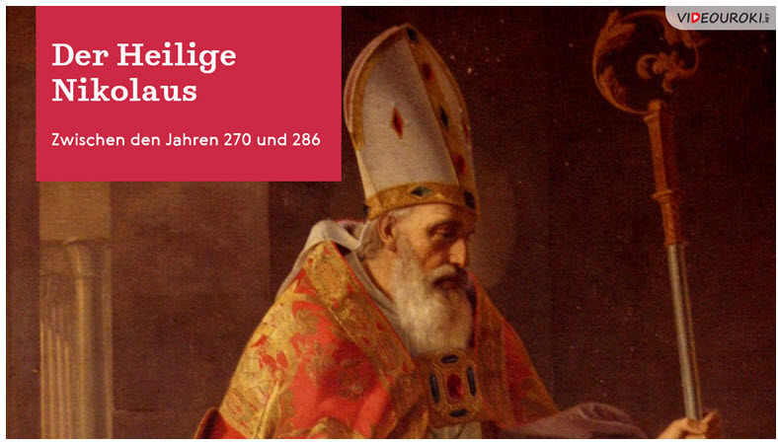
In ancient times, Nicholas gave children bread, nuts, fruits and clothes. Today the tradition has not changed. As a rule, for obedience kids get sweets or toys. All little children of Germany and great Britain put out their polished shoes for the passing Nicholas to put something special in. He brings gifts only to obedient children, but those who have not listened to their parents for a year can get a rod or a nutshell in their boots.

Slide 10
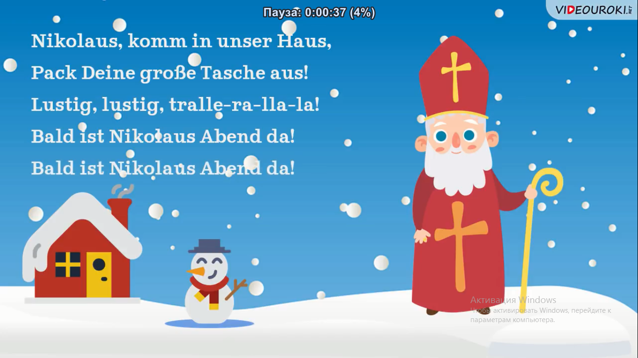
In Deutschland kennt jedes Kind ein Gedicht von Nikolaus!(физминутка)

Slide 11
Jolly Old Saint Nicholas
Jolly old Saint Nicholas,
Lean your ear this way,
Don't you tell a single soul
What I'm going to say.
Christmas Eve will soon be here,
Now you dear old man,
Whisper what you'll bring to me,
Tell me if you can.
When the clock is striking twelve,
When I'm fast asleep,
Down the chimney with your pack,
Softly you will creep.
All the stockings you will find,
Hanging in a row,
Mine will be the shortest one,
You'll be sure to know.
Johnny wants a pair of skates,
Susie needs a sled,
Nelly wants a storybook --
One she hasn't read.
As for me, I hardly know,
So I'll go to rest;
Choose for me, dear Santa Claus,
What you think is best.
What you think is best!

Slide 12
Nikolaus - Quiz
Wann feiert man der Nikolaustag in Deutschland ?
When is St.Nicholas Day celebrated in Britain?
Am 31. Dezember
Am 6. Dezember
Am 19.Dezember
On December 31
On December 6
On December 19

Slide 13
Nikolaus - Quiz
Wann feiert man der Nikolaustag in Russland?
When is St.Nicholas celebrated in Russia?
Am 26.Dezember
Am 6. Dezember
Am 19. Dezember
On December 26
On December 6
On December 19

Slide 14
Nikolaus - Quiz
Wer war der Heilige Nikolaus?
Who was Nicholas ?
der Bischof
der Musiker
der Seemann.
A bishop
A musician
A sailor

Slide 15
Nikolaus- Quiz
Wohin legt der Heilige Nikolaus Geschenke für Kinder?
Where does Nicholas put the presents?
auf das Bett
unter das Tannenbaum
in die Stiefel
On the bed
Under the Christmas Tree
In boots (stockings)

