Slide 1
Презентация на тему «Whatever the weather…»
К учебнику English 6, В.П. Кузовлев

Slide 2
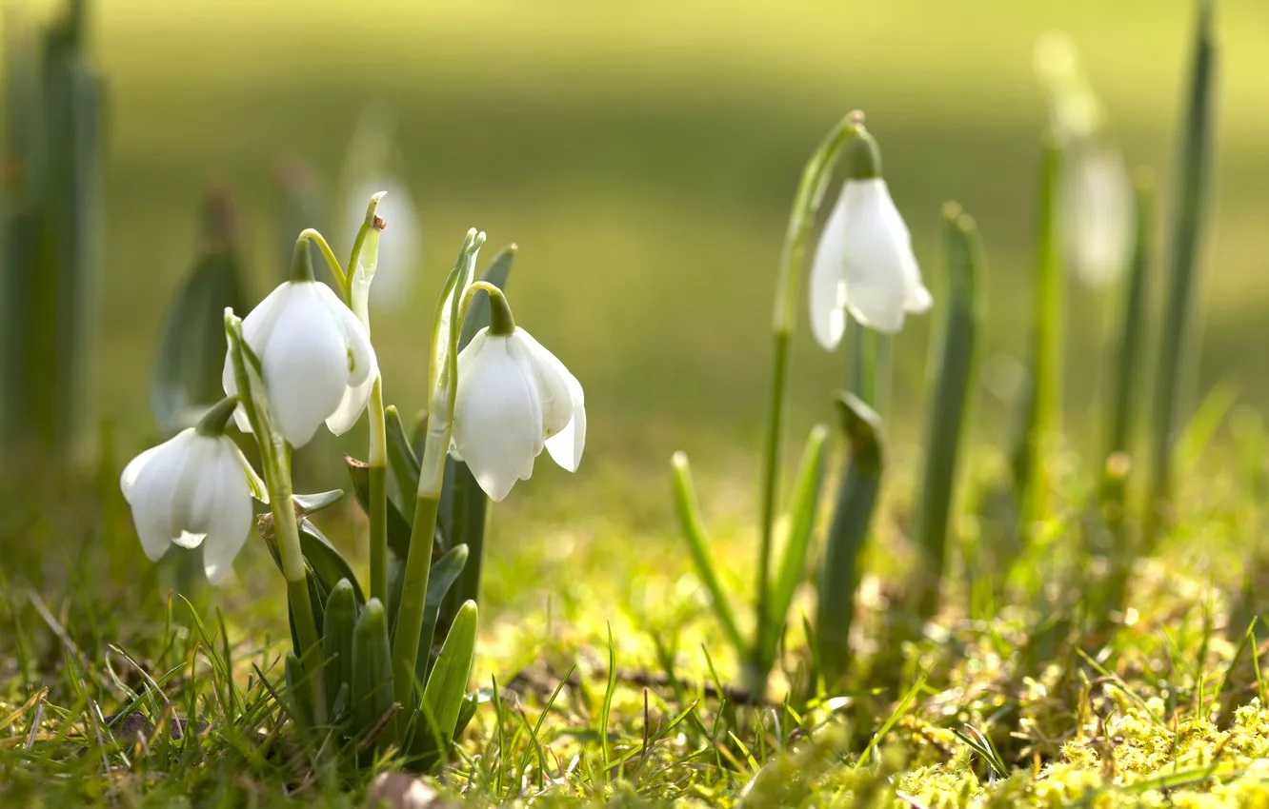
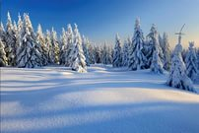
What is the weather like?
Spring
Summer
Autumn
Winter

Slide 3
What is the weather like in your region?
Spring is\ isn’t….
Summer is\isn’t…
Autumn is\ isn’t ….
Winter is\ isn’t ….
Warm - теплый
Mild – мягкий, умеренный
Severe – суровый
Wet - влажный
Terrible - ужасный
Frosty - морозный
Windy - ветреный

Slide 4
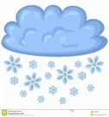
What do you like and dislike about the weather?
Rainy
Sunny
Hot
Warm
Snowy
Cloudy
Foggy
Stormy

Slide 5
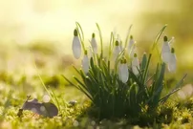
What is the weather like in different seasons in your town?
There are different ways of talking about the weather. Fill in the gaps.
It is…
The spring months are…
It is….in spring.
It….in spring.
I like/dislike it when it/it is….in spring

Slide 6
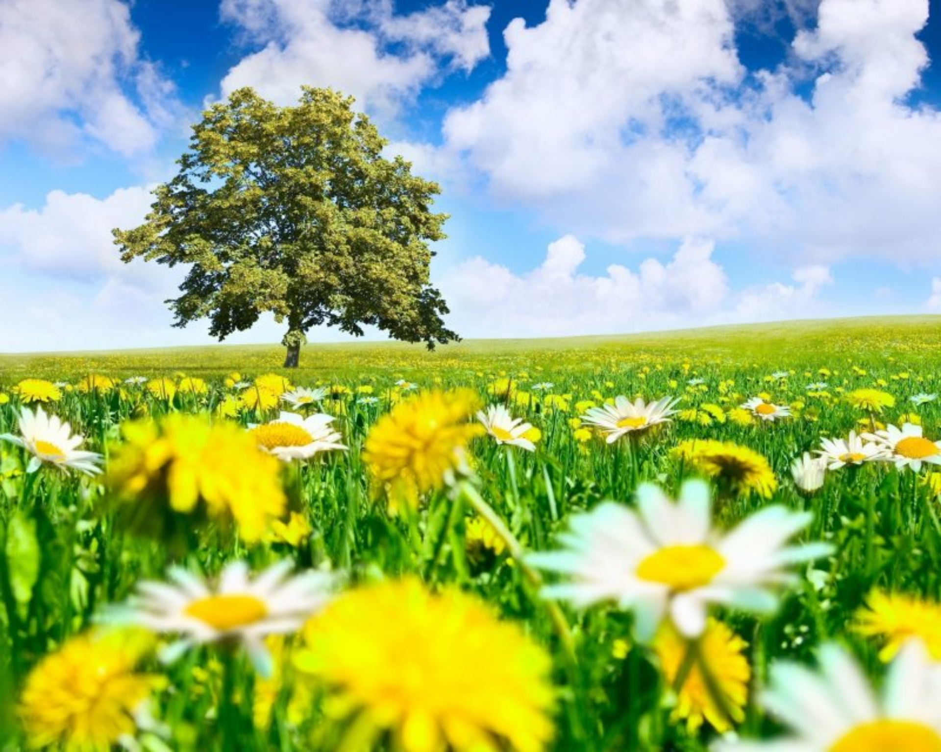
There are different ways of talking about the weather. Fill in the gaps.
It is…
The summer months are…
It is….in summer .
It….in summer .
I like/dislike it when it/it is….in summer .

Slide 7
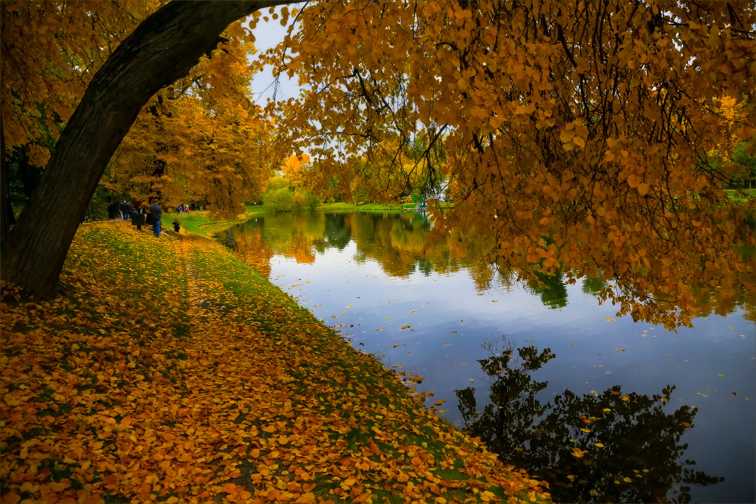
There are different ways of talking about the weather. Fill in the gaps.
It is…
The autumn months are…
It is….in autumn .
It….in autumn .
I like/dislike it when it/it is…. in autumn.

Slide 8
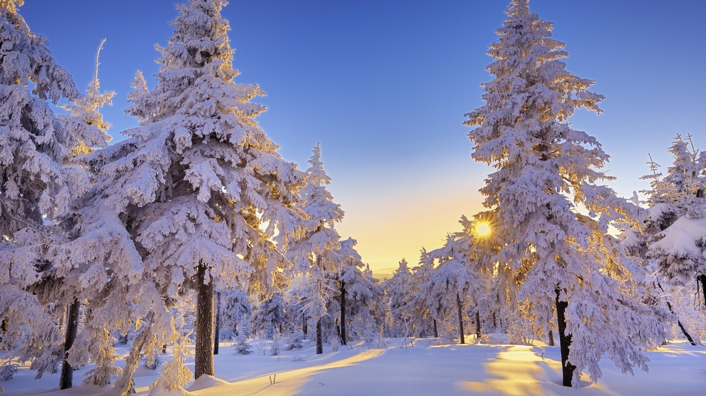
There are different ways of talking about the weather. Fill in the gaps.
It is…
The winter months are…
It is….in winter .
It….in winter .
I like/dislike it when it/it is…. in winter.

