Slide 1
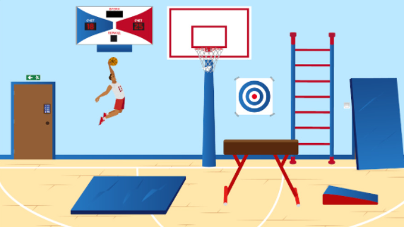
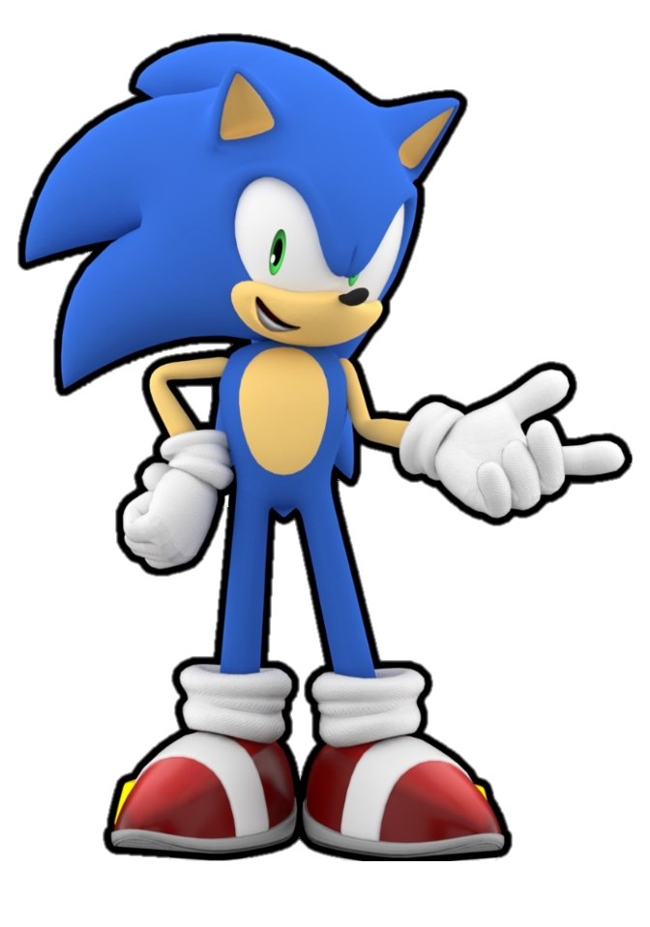
Hey, guys!
Today is a special day for me and my friends. It’s an international holiday and we celebrate it by playing soccer, volleyball, basketball, doing exercises and eating only healthy food. Can you guess what holiday I’m talking about?
I came here to the gym to get some equipment for the celebration, but the trainer’s cabinet is locked… I really need something from there for the party. Our trainer loves riddles and puzzles so the hints might be hidden somewhere here. Could you help me to get the code? Please!

Slide 2
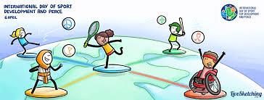
The International Day of Sport for Development and Peace (IDSDP), which takes place annually on 6th April presents an opportunity to recognize the positive role that sport and physical activity play in communities and in people’s lives across the globe.

Slide 3
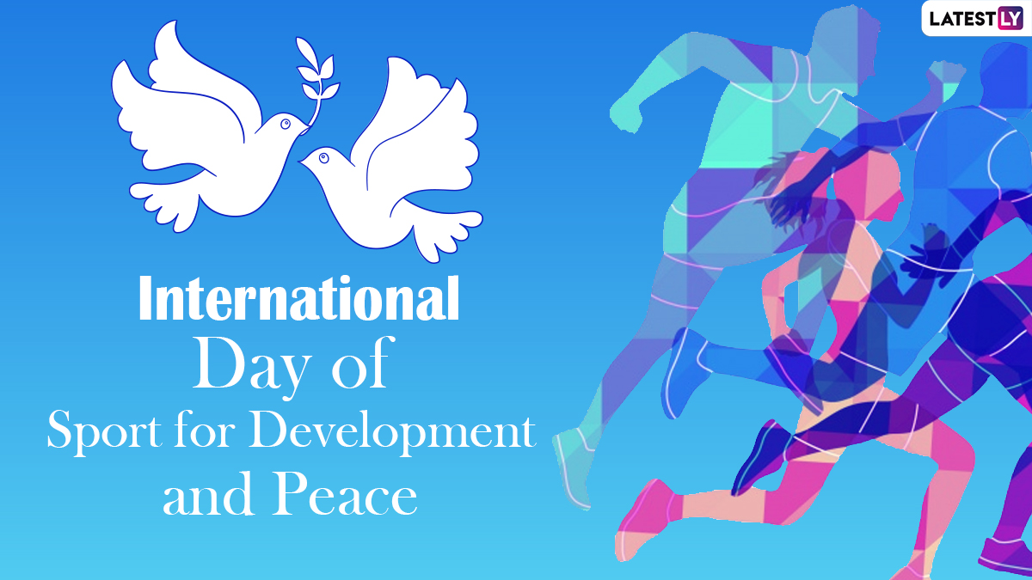
“Sport has the power to change the world; it is a fundamental right and a powerful tool to strengthen social ties and promote sustainable development and peace, as well as solidarity and respect for all”

Slide 4
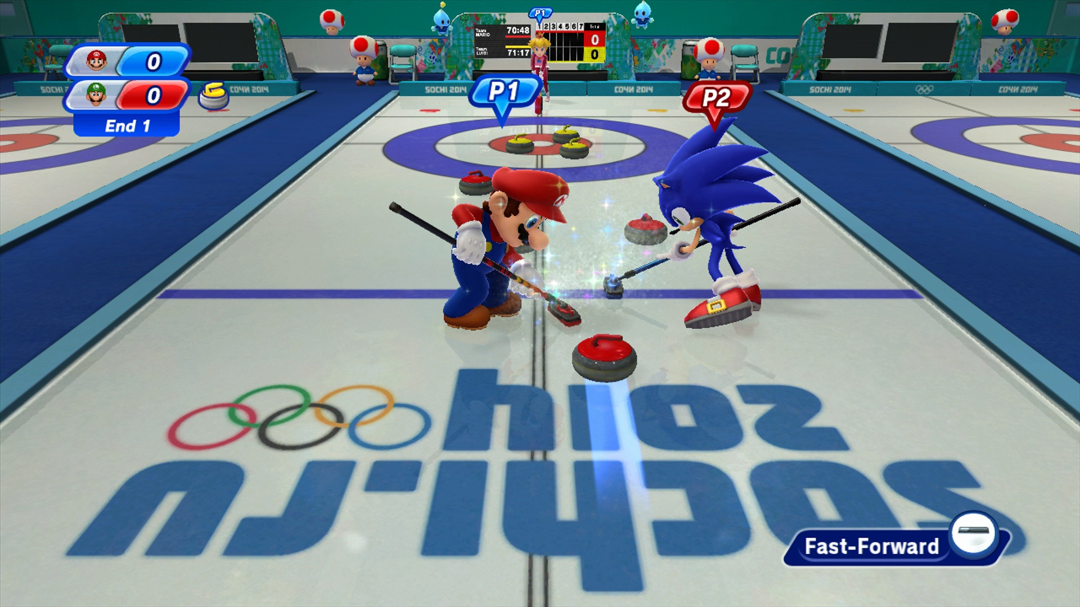

Slide 5
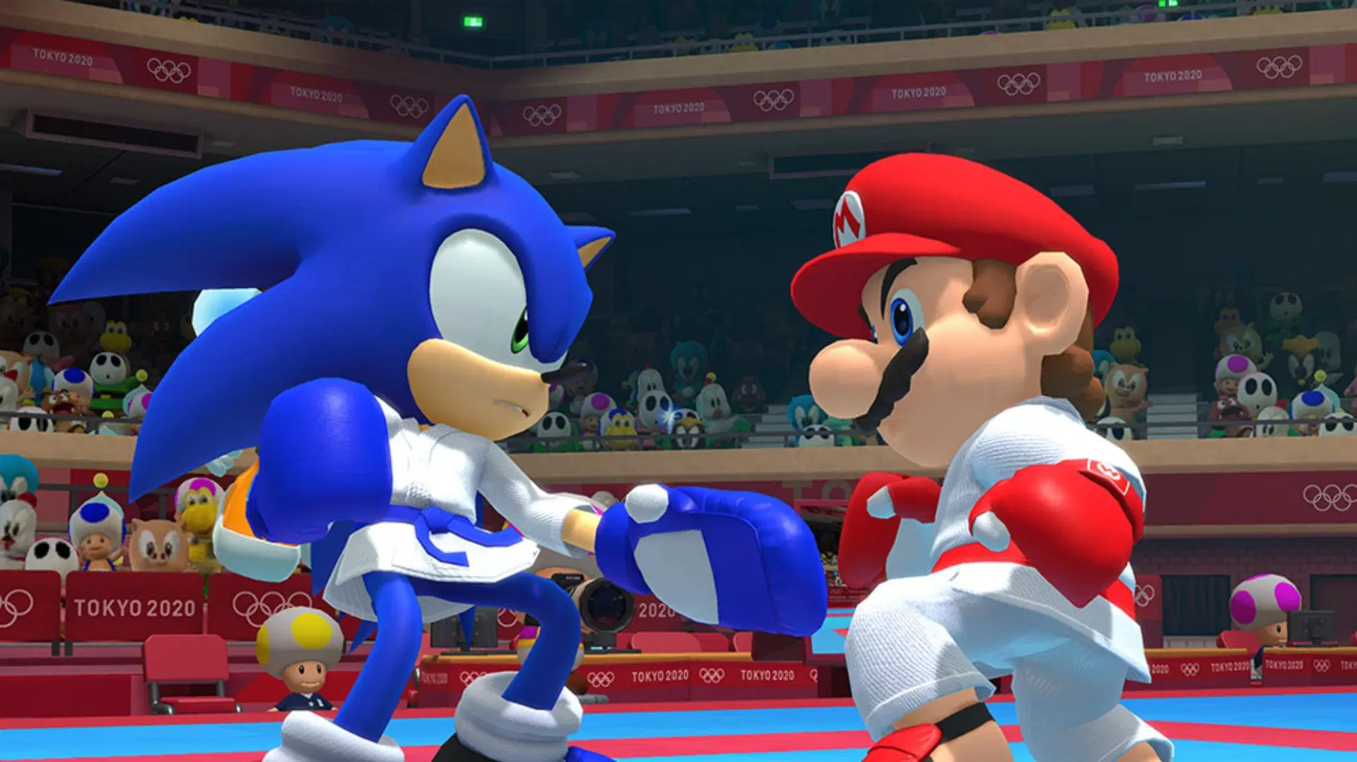

Slide 6
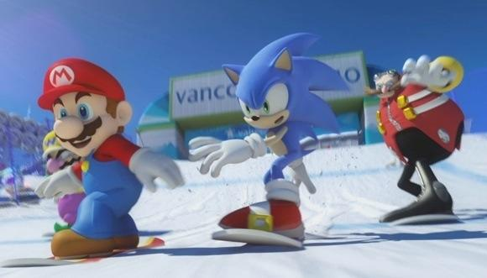

Slide 7
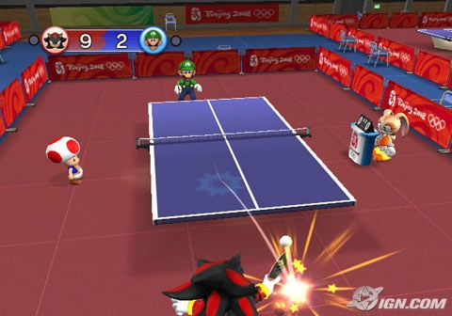

Slide 8
