Slide 1
School Yesterday And Today
The importance of school in the life of a teenager

Slide 2
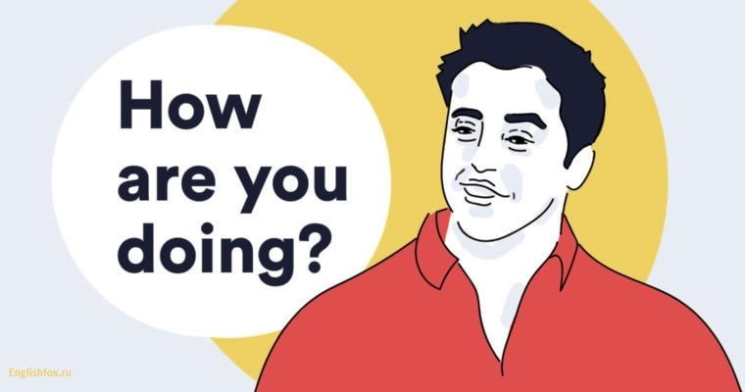
I’m super, thank you!
I’m quite OK, thank you!
What about you?
I’m great, thank you!
I’m so-so because I’m tired …so much homework!
I’m happy, thank you!

Slide 3
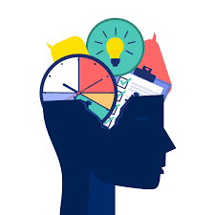
What ways of obtaining new knowledge exist now?

Slide 4
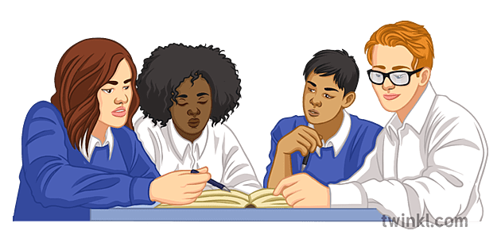
WORK IN GROUPS → ask the following questions:
1. What ways of obtaining new knowledge existed before?
2. How does the school help people gain new knowledge?
3. What are the pros and cons of a modern school?

Slide 5
The youngest children start their education in a crèche /kreʃ/, where they mostly play but also do some early learning activities. After that, they may go to a nursery school. Between the ages of five and 11, children attend primary school, where they learn the basics of reading, writing, arithmetic, etc. For most children, secondary education begins when they enter a comprehensive school or a more traditional grammar school (to which they gain admission by sitting an exam). The famous UK public schools are in fact private, fee-paying schools. Between the ages of 11 and 18, young people take a wide range of subjects in arts, sciences and technical areas. In the UK, pupils can leave school at the age of 16, although many young people choose to remain in full-time education until the age of 18. (In England it is compulsory for young people to continue with some form of education or training until they are 18 [they must do it], even if they also have a job.) From 16 to 18 young people may study at secondary school or at a sixth-form college, aft er which they may go on to higher education.

Slide 6
Fill the gaps in this life story of a British woman.
Amy first went to her local ___ school at the age of five. The year before that she attended a __ , but her parents didn’t send her to a ____ when she was very small. When Amy was ready to go on to secondary school, she passed a special exam and so gained ___ to her local ___ school. Her friends didn’t do that exam. Like most children, they went to a 6 school. Only a few children from very rich families go to famous ___ schools and Amy only knew one girl from her class at primary school who did. At the age of 16, Amy went on to ___, where she is currently studying English, History and Maths. Her ambition is to go on to __ and become a teacher.

Slide 7
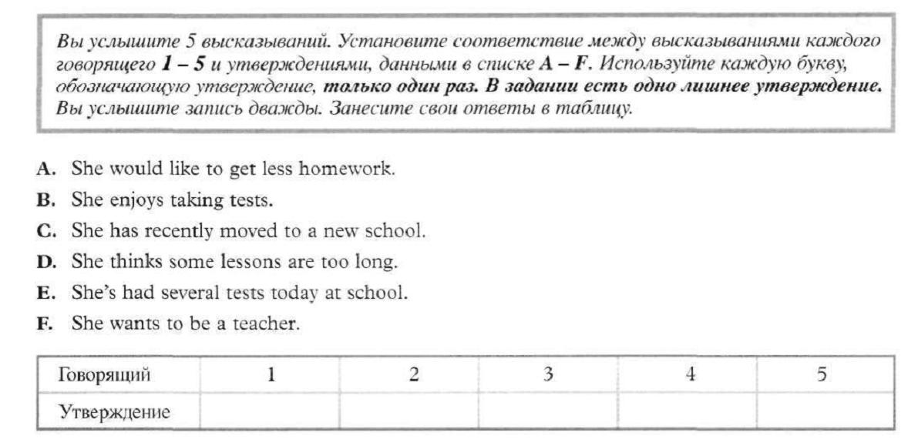

Slide 8
Alternative math short film

Slide 9
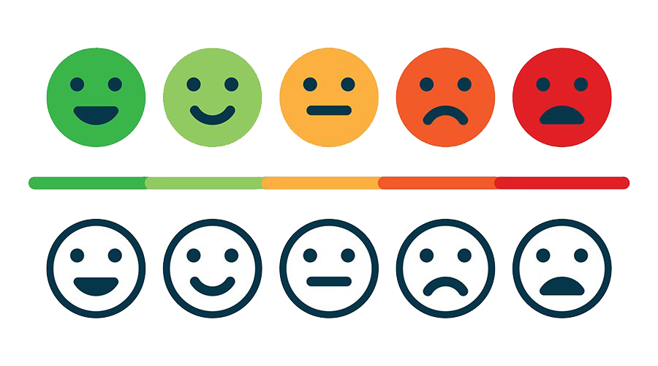
So, tell me what you have learnt today?

Slide 10
Make a chart in English for the education system in your country. Is it the same as in the other countries or are there differences? Discuss this topic with your classmates.

Slide 11
Thank you for the lesson!

