Slide 2
Let`s read the letter

Slide 4
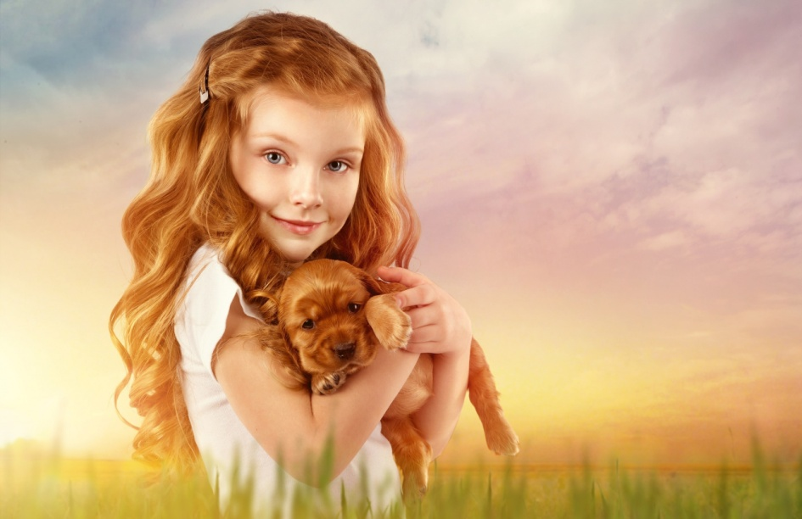
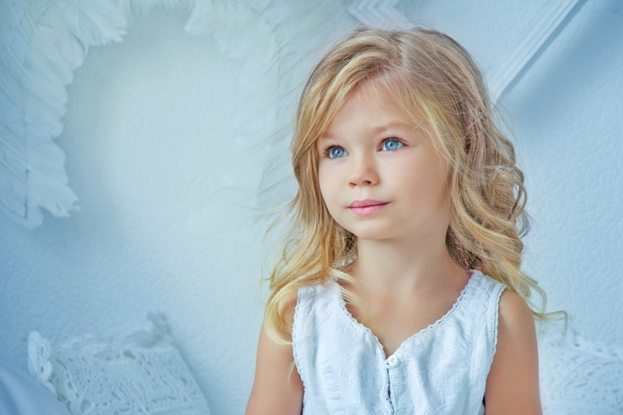
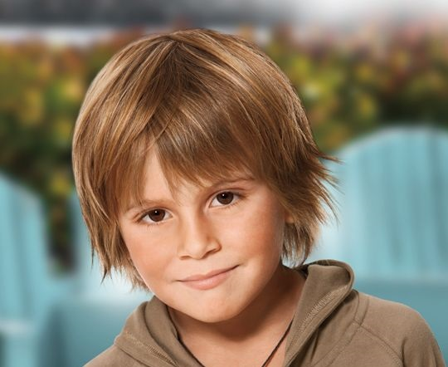
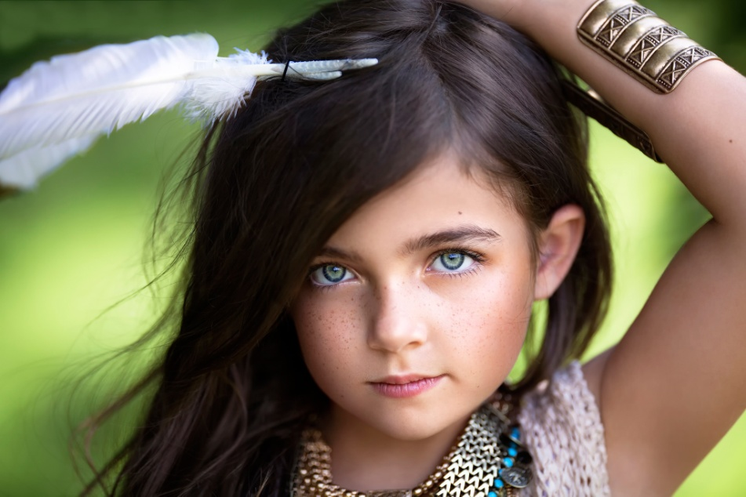
APPEARANCE

Slide 6
Ear

Slide 7
Nose

Slide 8
Mouth

Slide 9
Arm

Slide 10
Foot Feet

Slide 11
Leg

Slide 12
Hand

Slide 13
Finger

Slide 14
Eye

Slide 15
Hair

Slide 18
Let's relax

Slide 19
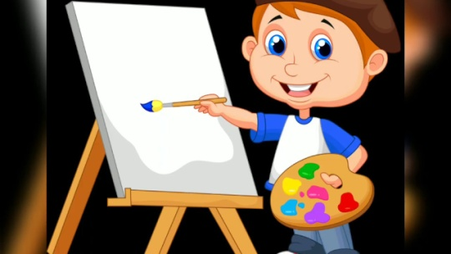
Draw the picture
It has got one face It has got four ears It has got three eyes It has got one body It has got three arms It has got four legs It has got one nose It has got one mouth

Slide 20
- She has got black hair
- She has got a big nose
-She has got small ears
-She has got small black eyes
- She hasn`t got a tail

Slide 21
- he has got black hair
- he has got a big nose
-he has got small ears
-he has got small black eyes
- he hasn`t got a tail

Slide 22
- She has got black hair
- She has got a big nose
-She has got small ears
-She has got small black eyes
- She hasn`t got a tail

Slide 23
- he has got black hair
- he has got a big nose
-he has got small ears
-he has got small black eyes
- he hasn`t got a tail

Slide 24
I have got black ______. I have got big_____.
I have got small ______. I have got small black____. I haven`t got a _______.

Slide 25
I have got black hair. I have got big nose.
I have got small ears. I have got small black eyes. I haven`t got a tail.

Slide 27
Я затрудняюсь в употреблении слов по теме «Appearance».
Я знаю слова по теме «Appearance» и у меня не возникает затруднений с их употреблением

Slide 28
APPEARANCE

