Slide 1
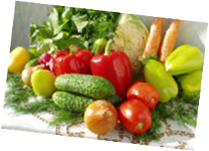
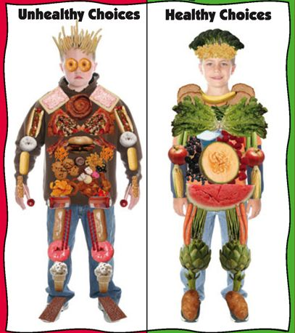
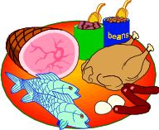
We Are What We Eat !

Slide 2
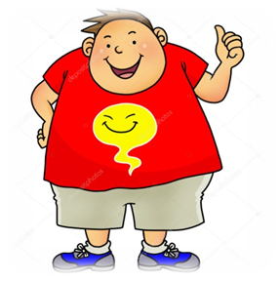
Reading Comprehension: Going on a Diet.
1.Аnswer the questions:
What was Oliver’s problem?
What happened to him?
How did he feel?
What did he plan?
Did he lose weight?
2.Circle (True) or (False). And then correct mistakes:
1. Oliver had a weight problem. True False
2. He has been eating healthy food for a long time. True False
3. He tried to lose weight. True False
4. One day, Oliver will lose weight. True False

Slide 3
(Quantitative pronouns) many/much. a lot of, (a) few, (a) little

Slide 4
1. Underline the correct word.
1) They’re going away for a few / a little days.
2) I think you’ve put too many / too much sugar in your tea.
3) How many / much time have we got left?
4) Do you know much / many foreign people? — No, I don’t. I know very few / a few.
5) He’s got little / a little time. He can play football.
6) We’ve got little / a little coffee. It’s not enough for all of us.
7) There are a few / few sweets in the box. It’s almost empty.
8) I’ve got few / a few apples. I can make some juice.

Slide 5
1. Underline the correct word.
1) They’re going away for a few / a little days.
2) I think you’ve put too many / too much sugar in your tea.
3) How many / much time have we got left?
4) Do you know much / many foreign people? — No, I don’t. I know very few / a few.
5) He’s got little / a little time. He can play football.
6) We’ve got little / a little coffee. It’s not enough for all of us.
7) There are a few / few sweets in the box. It’s almost empty.
8) I’ve got few / a few apples. I can make some juice.

Slide 6
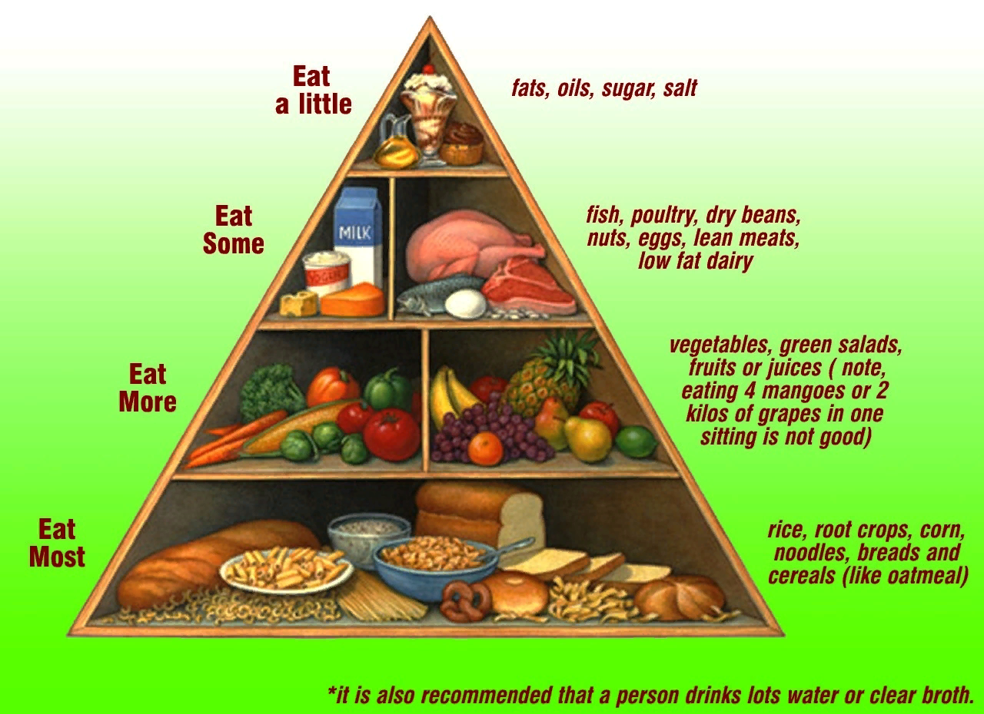

Slide 7
Are you a healthy kid?
I think I’m a healthy kid,
because I often…
But I think, I should (must)….more.
And I shouldn’t…
I don’t think I’m a very healthy kid,
because I…
I think I shouldn’t…
I should (must)…to be healthier.

Slide 8
Reflection
Name : | excellent | good | so-so
We can speak English…..
We have worked ….
The lesson was….
Now we know that to have a healthy diet is….

Slide 9
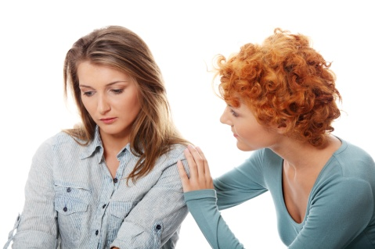
Our health depends on us.
We should care about our health.

