Slide 1
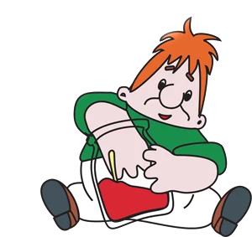
Hello children!
ENGLISH LESSON
FORM 3
Учитель английского языка
Исакджанова Гульнора Николаевна
МОАУ «ООШ№90» с.Краснохолм

Slide 2
CODE
2
9
18
20
8
4
1
25

Slide 3
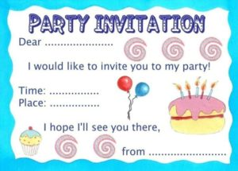
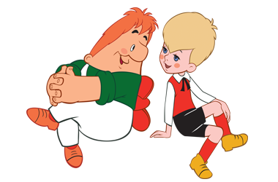
B
I
R
T
H
D
A
Y

Slide 4
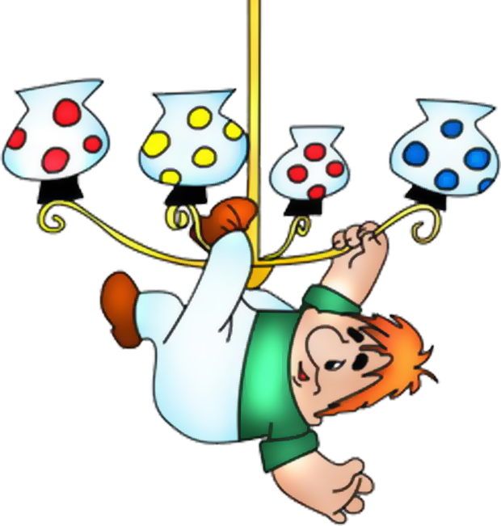
LETTER

Slide 5
Dear friends,
Today I have got a birthday.
Would you like to visit me?
Please come and see me.
Your friend, Carlson.

Slide 6
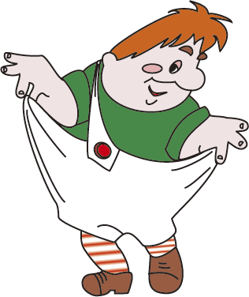
PHONETIC CHARGING
[a:]
[ ʧ ]
Chicken
Chocolate
Cheese
[w]
Why
What
Water
[e]
Egg
Lemonade
Card
Party
Park

Slide 7
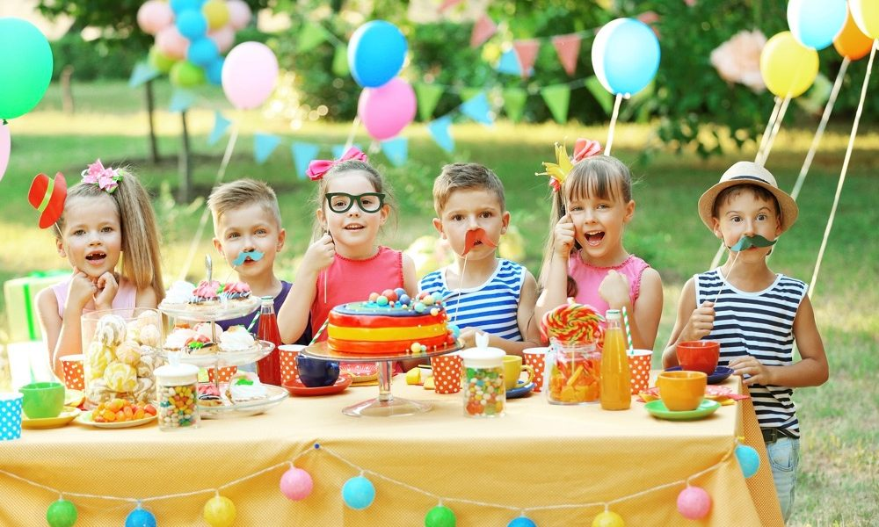
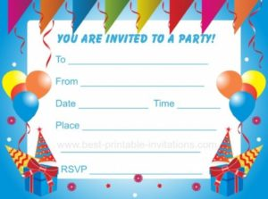
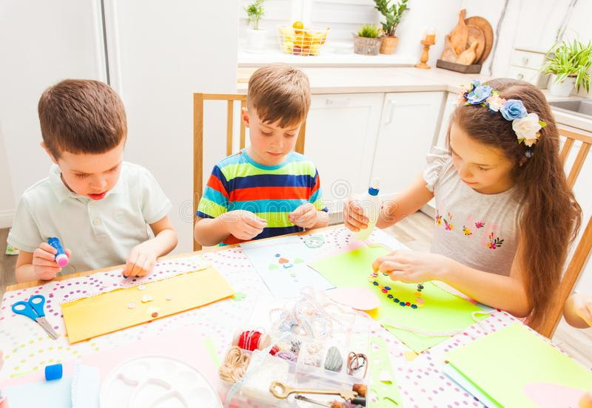
LESSON OBJECTIVES
1.
2.
3.

Slide 8
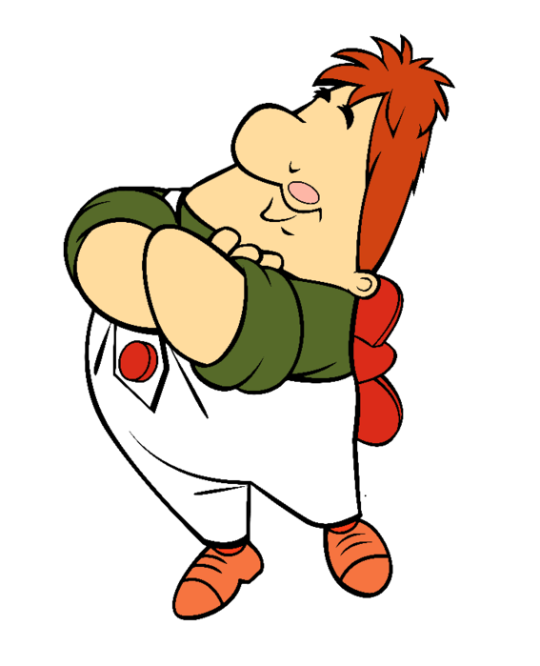
He is offend for us

Slide 9
What would Carlson like to eat for his birthday?
Open the book at page 42

Slide 10
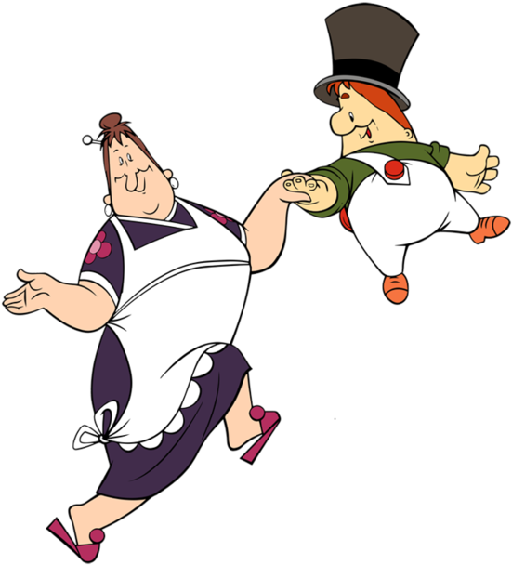
PAIR WORK

Slide 11
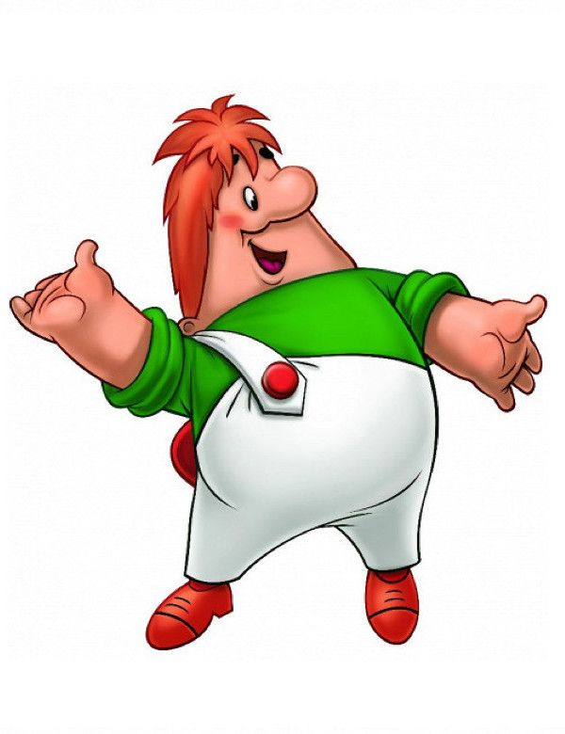
Let's have a rest!

Slide 12
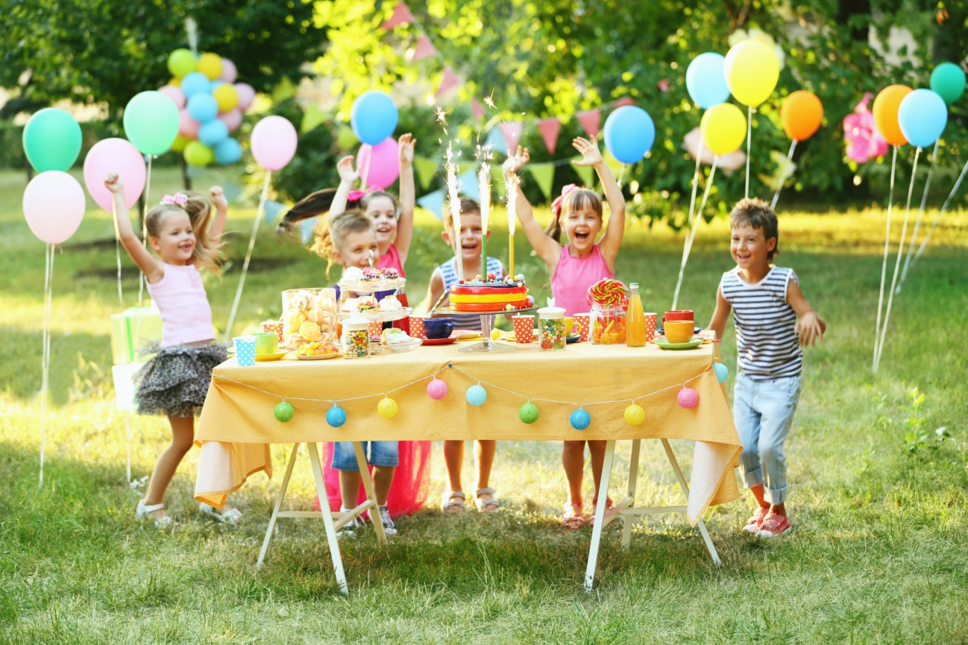
LET'S SET THE TABLE!
(GROUP WORK)

Slide 13
REFLECTION

Slide 14
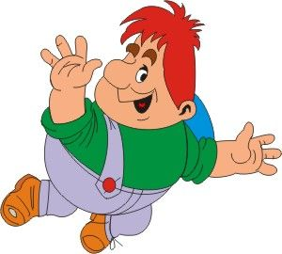
THANK YOU FOR THE LESSON!
GOOD BYE!

Slide 15
1.
CROSSWORD
LET’S CHECK
C
L
6.
P
2.
S
W
C
7.
 |  |  |  | A
3.
 |  | E
8.
4.
 |  | C |  | E
5.
B
G

