Slide 1
W war wall wardrobe warm white window
Where is a white house?
There is a white house.
My wardrobe is opposite the window.

Slide 2
https://www.youtube.com/watch?v=010ovH5hY5Y

Slide 3
My house
Rooms
Furniture
Parts of home

Slide 4
Home
Parts of home
wall
floor
Ceiling
Window
Door
Attic
Garden
garage
Rooms:
Kitchen
Bedroom
Living room
Furniture
Table
Bed
Television
Wardrobe
Clock
Bookcase
shelf

Slide 5
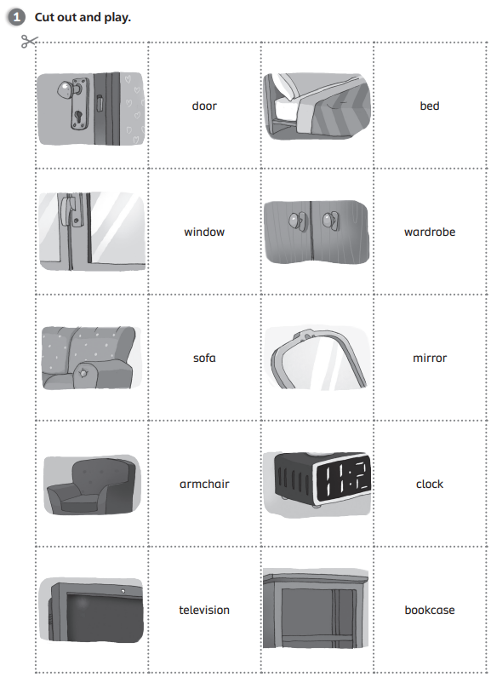
Exercise 1. Answers:

Slide 6
Exercise 2. Answers:
1. in front of
2. next to
3. opposite
4. behind
5. between

Slide 7
Clue № 7
Look in front of the teachers table.

Slide 8
Clue № 6
Сlue№ is between the wardrobe and the wall.

Slide 9
Clue№ 5
Сlue№ is next to the window.

Slide 10
Clue № 4
Next clue is behind the door.

Slide 11
Clue № 3
Сlue№ is on the computer.

Slide 12
Clue № 2
Сlue№ is behind the bin.

Slide 13
Clue № 1
Your surprise is under your table.

Slide 14
At my house we love. At my house we hug. At my house we run on the rug. At my house we eat. At my house we sleep. At my house we walk with no shoes on our feet.

Slide 15
Оцени себя!
Excellent! (5)
Not so good (3)
Good (4)

