Slide 1
Collections

Slide 2
[ au ] [ ai ] One, two. How are you? Three, four. Fine and you? Five, six. What time is it? Seven, eight. It’s late! Nine, ten. Let’s count then!

Slide 3
How many souvenir elephants do I have?
I bought thirteen elephants at souvenir shop.
My daughter gave me four hand-made elephants as a present.
My dad sent me seven souvenir elephants.
My friends gave me eleven souvenir elephants as a present.
35

Slide 4
You have a form . Can you answer these questions?
What is your name?
How old are you?
Where are you from?
What have you got?
What collection have you got?

Slide 5
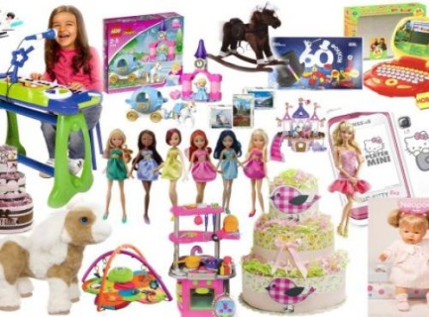
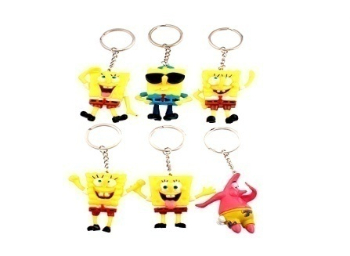
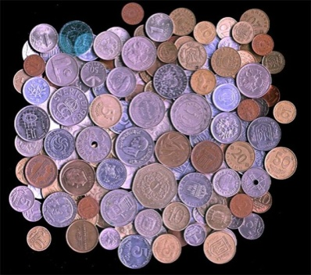
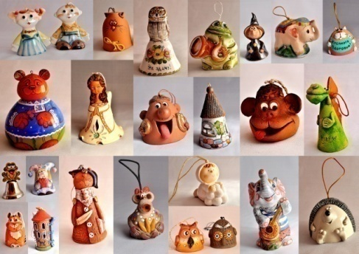
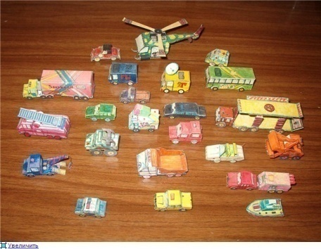
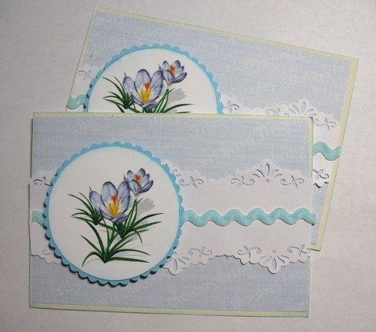
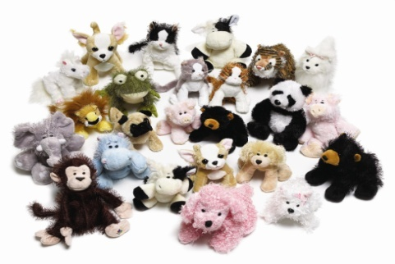
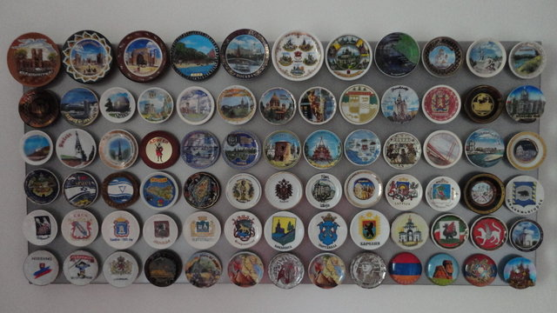
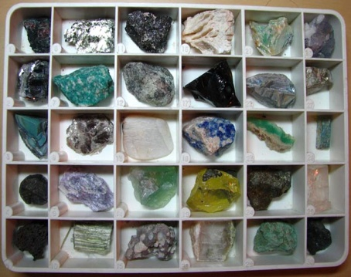
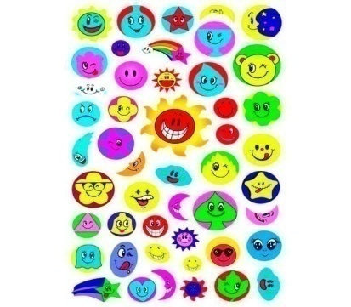
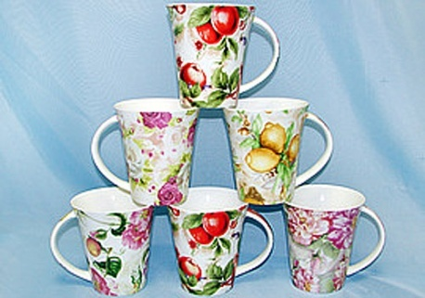
What collection have you got? I’ve got a …
doll
key ring
coin
bell
c o l l e c t i o n
car model
card
toy
magnet
book
stone
mug
sticker

Slide 6
Game
The first line
I’ve got a … collection. What about you?
The second line
I haven’t got a … collection, but I’ve got a …

Slide 7
Remember the words
collection [kə'lekʃən]
stamp [stæmp]
coin [kɔɪn]
album ['ælbəm]
easy ['iːzɪ]
great [greɪt]
to feel [fiːl]
to be proud of [praud]
It makes me happy
[meiks]
коллекция
марка
монета
альбом
легкий
огромный
чувствовать
гордиться
Это делает меня счастливым

Slide 8
Let`s read a story about Tom and his collection.
What is his name?
How old is he?
Where is he from?
What collection has he got?
Where are his stamps from?
Does he like his collection?

Slide 9
What collection have you got? I’ve got a …
doll
key ring
coin
bell
c o l l e c t i o n
car model
card
toy
magnet
book
stone
mug
sticker

Slide 10
Work in groups
Open the folder «Collection»
Find the file named your country
Look at the pictures and fill in the form about your character
Fill in the form:
*How she/he feel about her/his collection
(… is proud of it/ it makes her/him happy)
Choose a person in your group who tells us about her/ him
Name
Age
Country
City
Collection
Quantity (количество)
Feelings*

Slide 11
Fill in a form about of your mum, dad, sister or brother and her/his collection. Write:
name, age, country, city, collection, quantity, feelings.
B. Write a short paragraph about you and your collection. Write, using the same plan.
Read the text and complete sentences 1-3
(ex. 5 p.40)

Slide 12
Do you like the lesson?
How are you now?
I’m fine! I did all my best! Excellent!
Add a toy to toy collection.
I’m OK. I tried as much as I can. Rather good! Add a card to card collection.
I’m not well. I should learn English better. Add a stamp to stamp collection.

