Slide 1
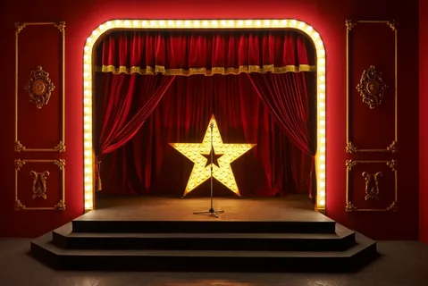
video
write and draw
watch and read
words and grammar land

Slide 2
___ can ===…. .
We can walk.
___ can not ===…. .
___ cannot ===…. .
can not = can’t
We can not walk.
Can ___ === ?
Yes, ___ can.
No, ___ can’t.
Module 4
Sb.p.96 st

Slide 4
video
write and draw
watch and read
words and grammar land

