Slide 1
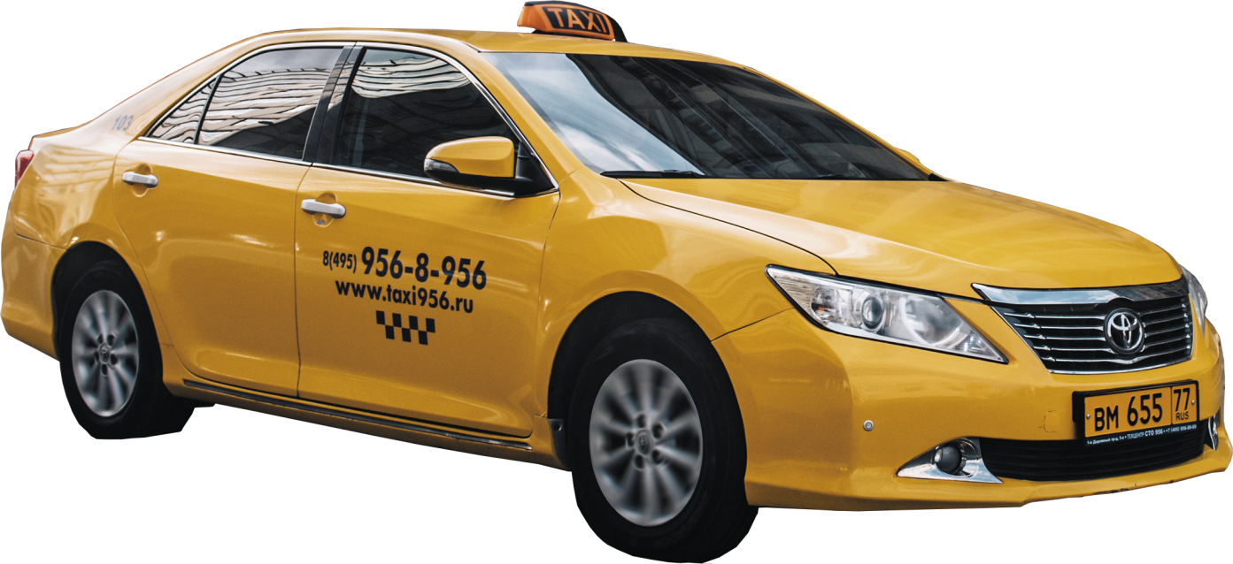
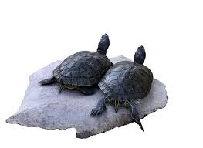
TONGUE TWISTER
LET’S PRACTICE [t]
Two tiny turtles take two taxis to town.

Slide 2
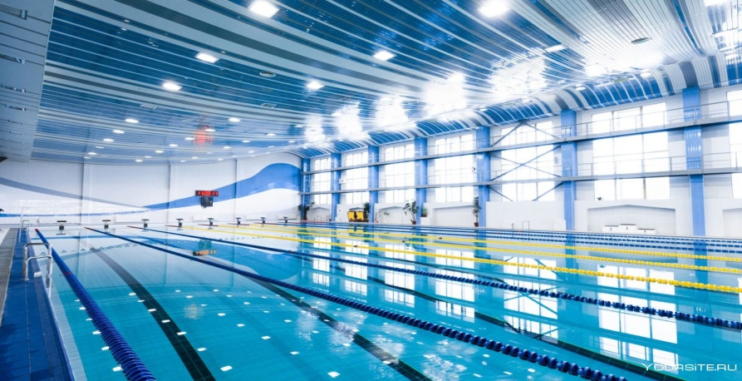
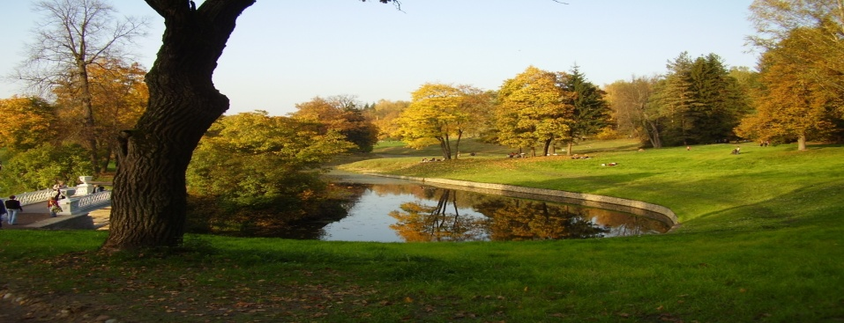
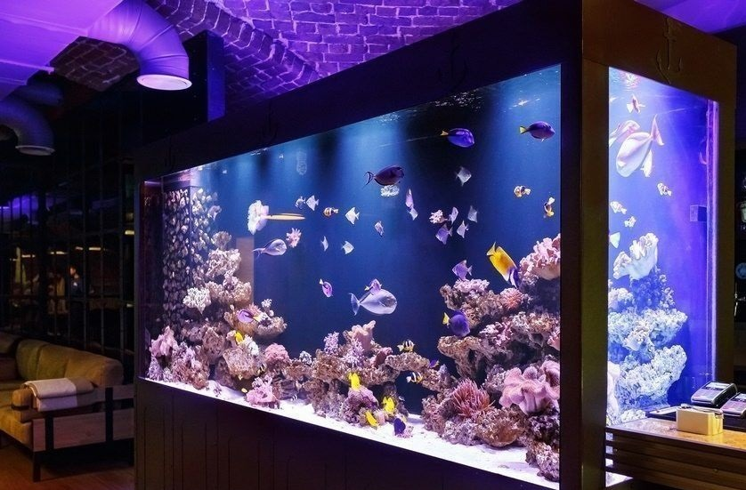
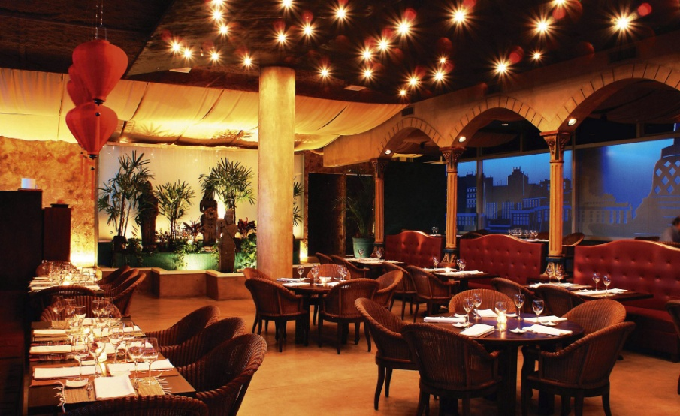
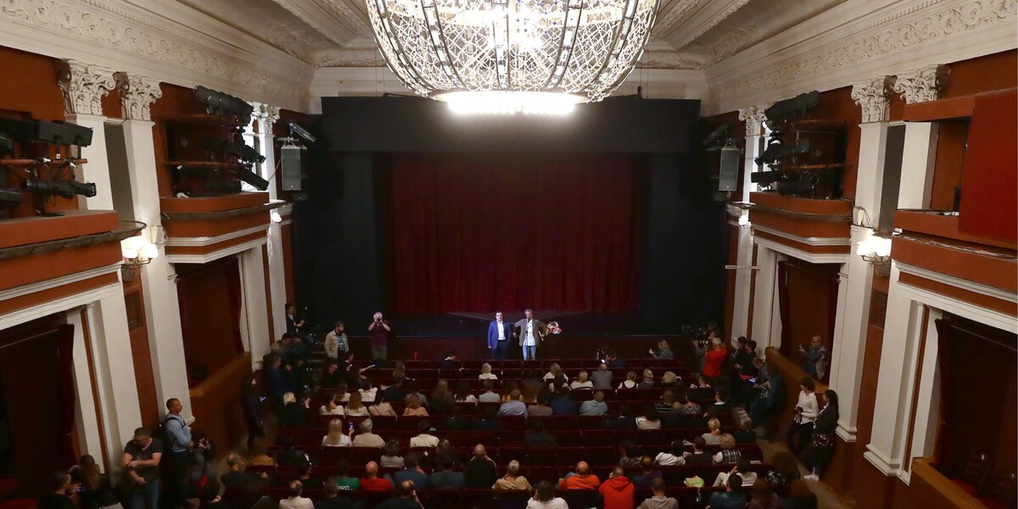
CITY
TOWN
FILM
https://yandex.ru/video/preview/10783769256131995851

Slide 3
The aims of our lesson are:
to learn new words and practice them,
to know more about different places in the town,
to practice listening,
to practice speaking,
to practice reading.

Slide 4
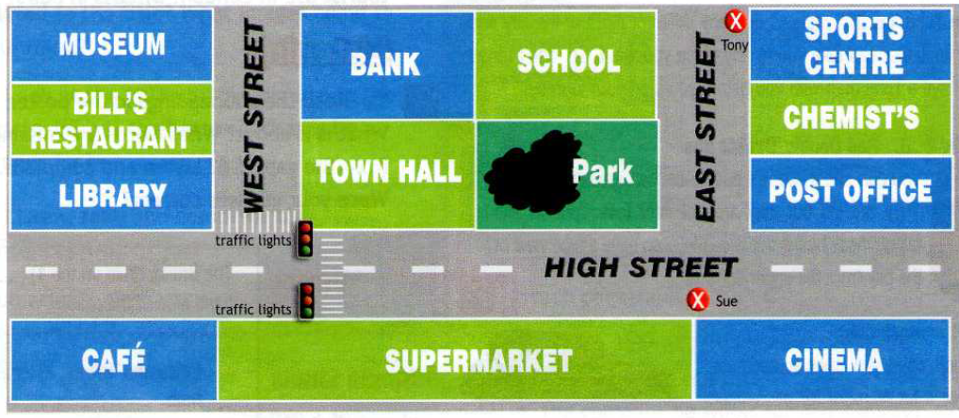

Slide 5
LET’S REVISE THE WORDS
SWIMMING POOL
AQUARIUM

Slide 6
RESTAURANT
THEATRE
PARK

Slide 7
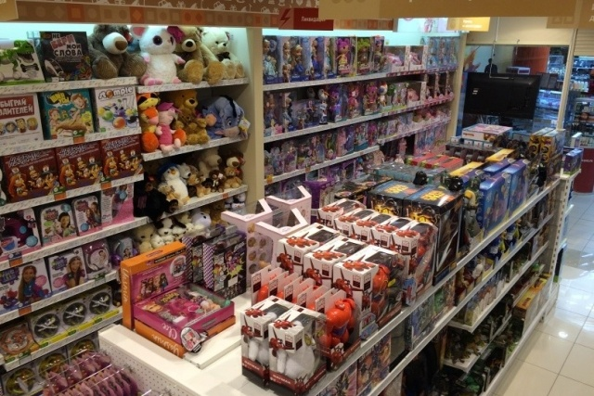
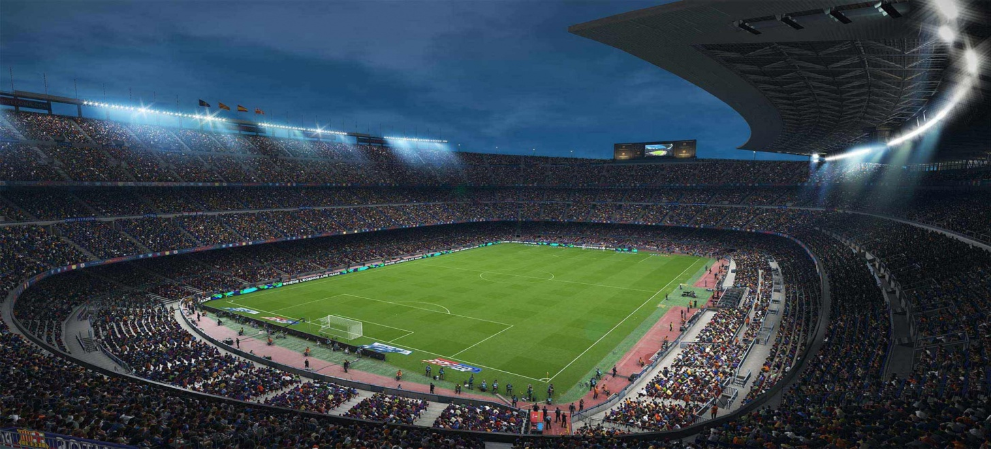
DEPARTMENT STORE
STADIUM

Slide 8
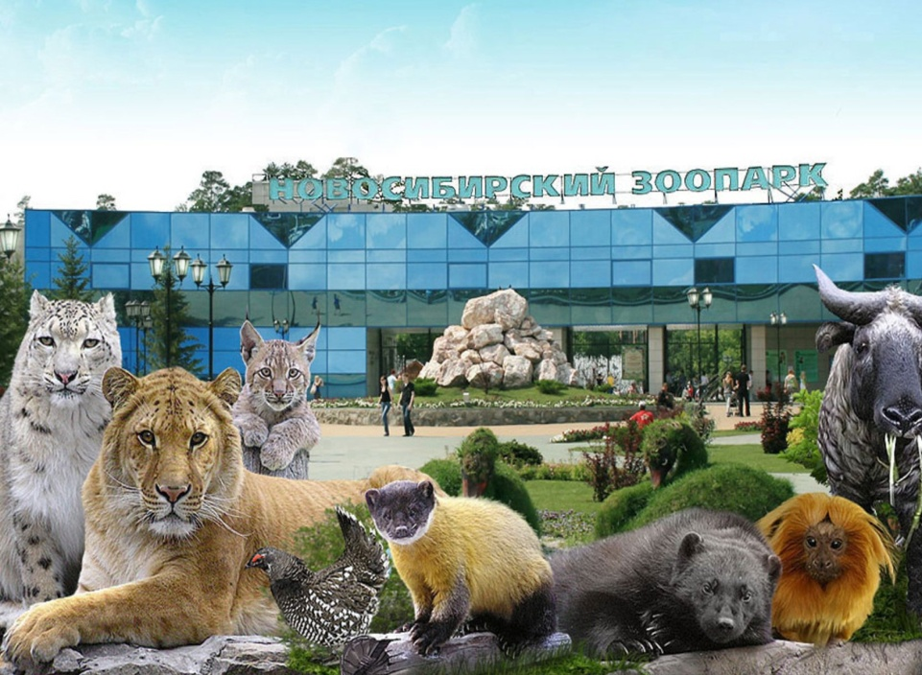
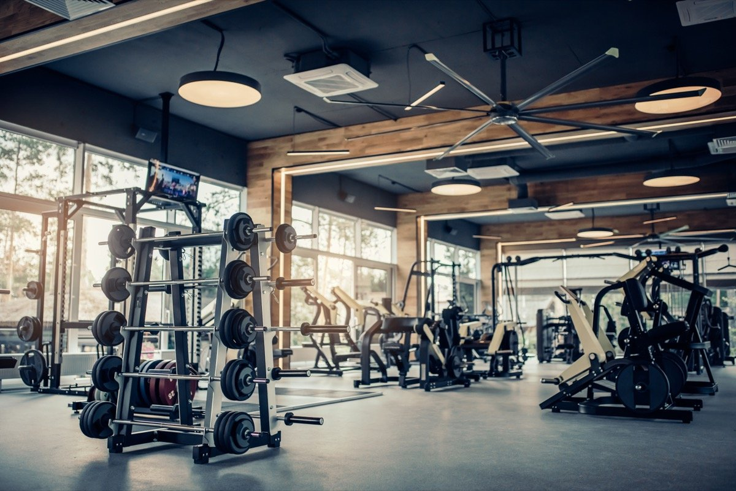
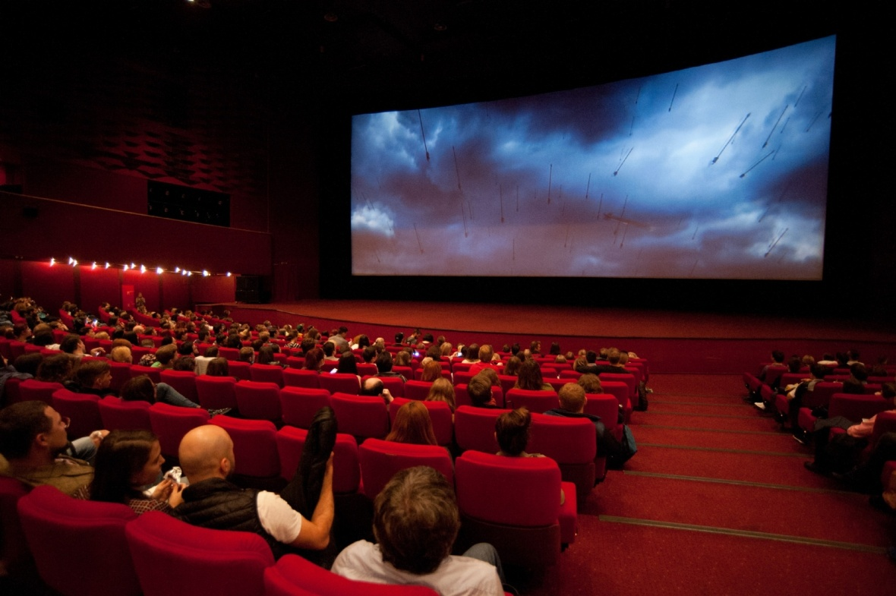
ZOO
LIBRARY
GYM
CINEMA

Slide 9
RELAX-расслабиться
EXERCISE- тренироваться
MEET FRIENDS -встретиться с друзьями
SEE ANIMALS- увидеть животных
BUY THINGS YOU NEED - покупать вещи, которые вам нужны
HAVE A PICNIC - устроить пикник
READ - читать
EAT A SNACK - перекусить
SEE WORKS OF ART -увидеть произведения искусства
WATCH A FILM - посмотреть фильм

Slide 10
FIND A PAIR

Slide 11
WORK IN PAIRS.
MAKE SENTENCES
https://yandex.ru/video/preview/3242878228594126570?translate_snippets=1
Physical minute

Slide 12
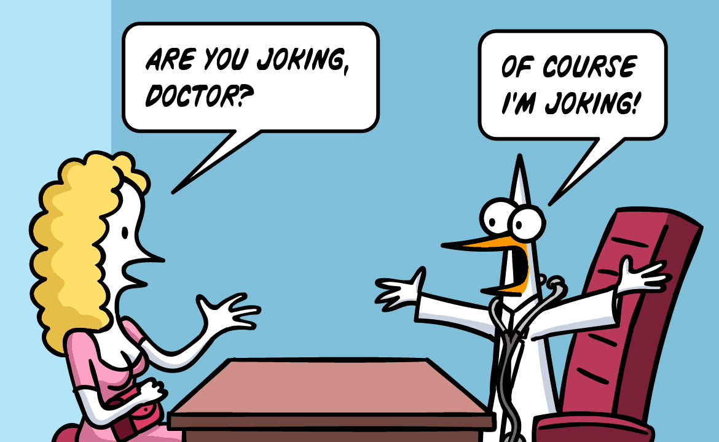
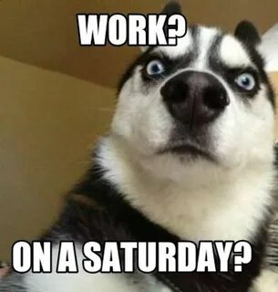
ARE YOU JOKING?
ARE YOU SERIOUS?

Slide 13
LISTEN TO THE DIALOGUE
WORK IN GROUPS

Slide 14
True/False
1.Ann is talking to David.
2.David wants to eating out.
3.Bob thinks Marcel’s is the most expensive restaurant in the town.
4.Castella is a restaurant with lots of people.
5.Antonio’s is a crowded restaurant.

Slide 15
CHECK YOUR PARTNER
1. FALSE
2.TRUE
3.TRUE
4.TRUE
5.FALSE

Slide 16
MAKE UP A DIALOGUE
-What do you feel like doing tonight?
-How about going to the_____________?
-Brilliant idea! I want to______________
-Shall we go to_______________
-Are you joking? It’s the most expensive______in the town.
-How about ____________?
-It’s nice, but here’s always crowded. I want to go to another place.
-How about_____?
-That sound good. Let’s go.

Slide 17
HOMEWORK
REPEAT ALL WORDS P. 78,
PAGE 78 (READ),
MAKE UP 5 SENTENCES ABOUT WHAT PLACES YOU VISITED LAST MONTH.
Повторить и выучить слова и фразы с.78,
чит.диалог с.78;
написать 5 предложений о том,
какие места вы посетили в прошлом месяце, что вы там делали.

