Slide 1
WHAT I WANT TO BE
https://youtu.be/zHxQTQ2-WiQ
https://audience.ahaslides.com/z7ugji2z5x
PROFESSIONS OF MODERN TIME

Slide 2
THE PURPOSE AND GOALS:
Practice the use of vocabulary on the topic "Choosing a profession";
Play a game “Guess a profession”;
Learn the new words on the topic;
Develop speaking skills in situations of "Job interview", "Job search", "Phone conversation".
Help yourself to choose your profession.

Slide 3
WHAT IS THE DIFFERENCE: JOB, OCCUPATION, PROFESSION, CAREER
Profession –
a job that needs a special education and training.
Job –
the regular paid work that you do for an employer.
Occupation –
a job or profession.
Career –
is the series of jobs that a person does in his life.

Slide 4
QUIZ
WHAT JOB IS SUITABLE FOR ME?

Slide 5
 | Yes | No
1. Do you like to travel?
2. Do you prefer to work indoors?
3. Do you like talking to people?
4. Do you prefer to work alone?
5. Are you energetic?
6. Do you like organizing things?
7. Are you patient?
8 Do you like animals?
9. Are you noisy?
10. Do you like to work with your hands?
11. Are you artistic?
12. Do you like working with numbers?
13. Do you like children?
14. Do you like looking after people?
15. Are you calm?
16. Are you musical?
17. Do you like sport?
18. Do you like working at night?
19. Do you mind seeing blood?
20. Do you like talking on the telephone?
 | Yes | No
1. | 10 | 5
2. | 10 | 5
3. | 10 | 10
4. | 2 | 2
5. | 20 | 5
6. | 1 | 0
7. | 5 | 0
8. | 4 | 3
9. | 0 | 5
10. | 1 | 2
11. | 5 | 5
12. | 2 | 2
13. | 2 | 5
14. | 10 | 2
15. | 2 | 10
16. | 4 | 2
17. | 5 | 4
18. | 5 | 7
19. | 1 | 4
20. | 5 | 4

Slide 6
If your score is between 5-45
You enjoy working with people and helping them. You are also a practical person. One of these careers will suit you:
teacher,
doctor,
nurse,
social worker,
psychologist,
zoo keeper,
policeman

Slide 7
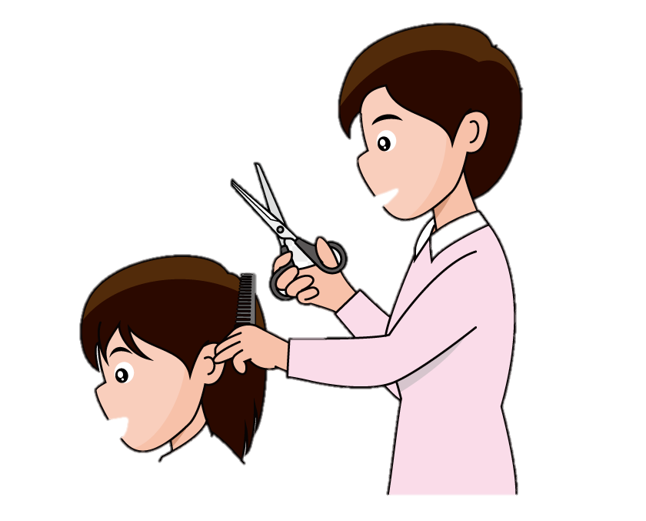
If your score is between 45-90
You like to work quietly and concentrate on the task. You prefer to work on your own. One of these careers will suit you:
laboratory technician,
librarian,
artist,
bank clerk,
hair-dresser,
architect.

Slide 8
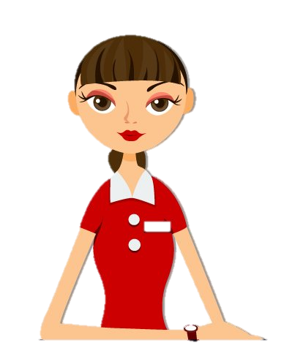
If your score is between 90-135
You like to be very busy. You like to be with people and you like organizing things for them. One of the following careers will suit you:
travel agent,
journalist,
hotel manager,
salesperson,
fireman.

Slide 9
JOB INTERVIEW
WHAT WOULD YOU LIKE TO BE? DO THE QUIZ.

Slide 10
https://youtu.be/-2UHU93KF9k
Human Resource Department - отдел кадров
Interviewer – собеседник
The CV – резюме
Weakness – недостаток
Texas Tech – название компании
Review – отзыв
Apply – обратиться; отправить резюме
To hire - Нанимать на работу
Obvious – очевидно
Experienced employee – опытный работник
FAILED
Will the man be hired?

Slide 11
PROVEBS
READ AND TRANSLATE INTO RUSSIAN

Slide 12
If a job is worth doing it is worth doing well. Если работу стоит делать, то стоит делать её хорошо. Only fools and horses work. Работают только дураки и лошади. The Devil finds work for idle hands to do. Дьявол находит занятие для праздных рук. A bad workman blames his tools. Плохой работник ругает свои инструменты. A woman’s work is never done. Женский труд никогда не заканчивается. All work and no play makes Jack a dull boy. Работа без забавы делает Джека скучным. Hard work never did anyone any harm. Упорная работа никому ещё вреда не принесла

