Slide 1
Good morning,
Children !
Английский язык 3/1 класс. УМК «Brilliamt»
Тищенко Мария Сергеевна
Учитель английского языка
МАОУ «СОШ №108 г.Челябинска».

Slide 2
Green – готовность работать
Yellow – безразличие , отсутствие интереса к работе
Red - волнение

Slide 4
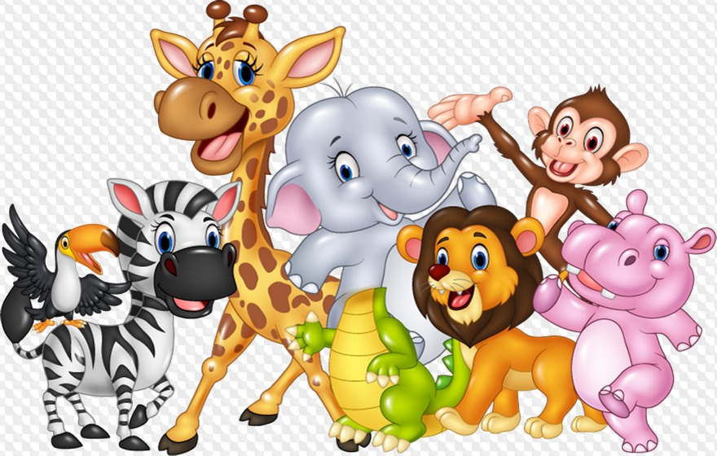
https://learningapps.org/display?v=p826sv4et22

Slide 6
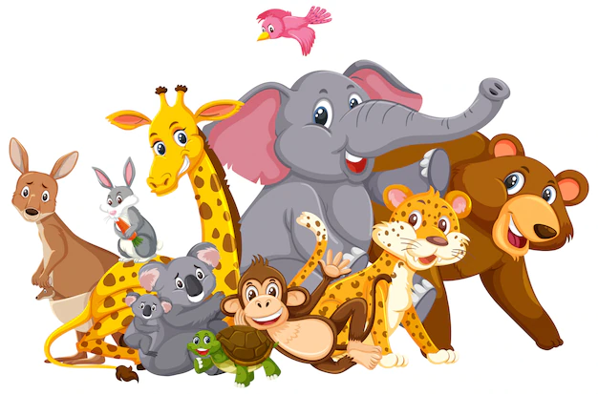
The aims of our lesson are to learn:
Where animals live;
What they can do;
https://learningapps.org/display?v=pxet2h3kn22
https://learningapps.org/display?v=pwwikj84n22

Slide 7
Listen and repeat

Slide 8
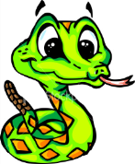
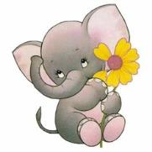
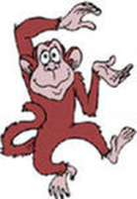
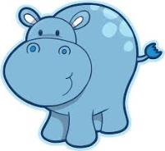
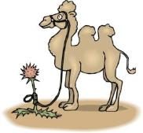
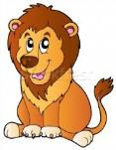
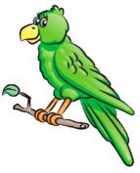
The Animal Song https://www.youtube.com/watch?v=FNdHnlPyCcc
The is the king of the jungle
The is big and strong.
The is very dangerous.
The is very long.
The likes to swing through the branches.
The likes to walk, walk, walk.
The likes to sit in the mud pool all day.
The likes to talk, talk, talk……….

Slide 9
The Animal Song https://www.youtube.com/watch?v=FNdHnlPyCcc
The lion is the king of the jungle
The elephant is big and strong.
The crocodile is very dangerous.
The snake is very long.
The monkey likes to swing through the branches.
The camel likes to walk, walk, walk.
The hippo likes to sit in the mud pool all day.
The parrot likes to talk, talk, talk……….

Slide 11
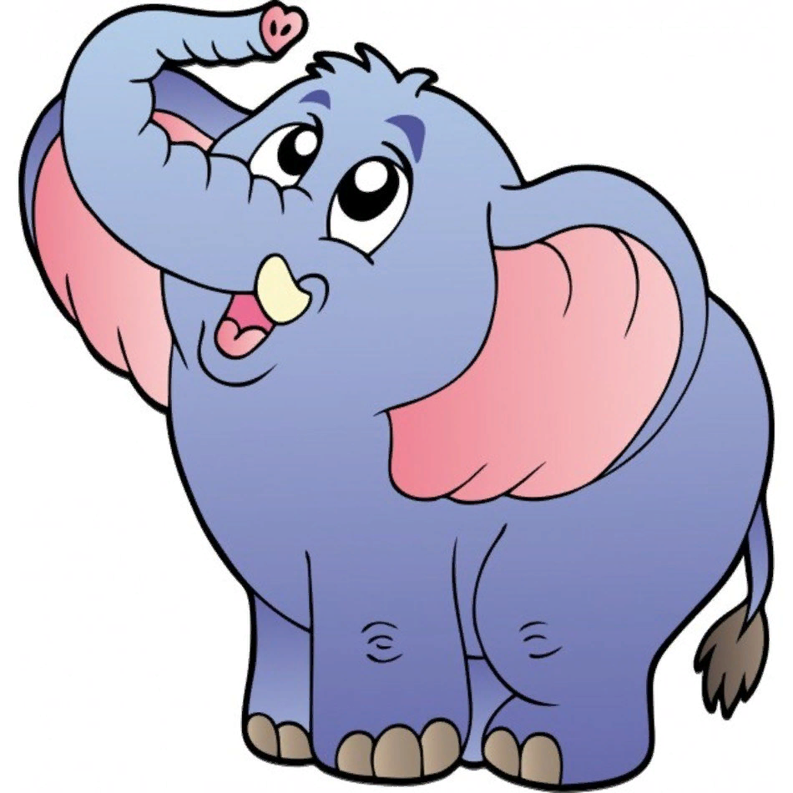
An elephant

Slide 12
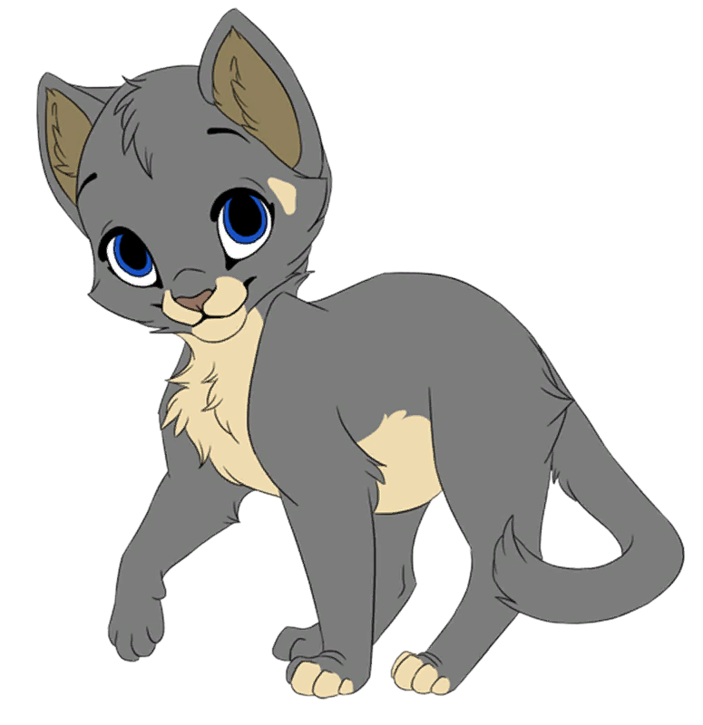
A cat

Slide 13
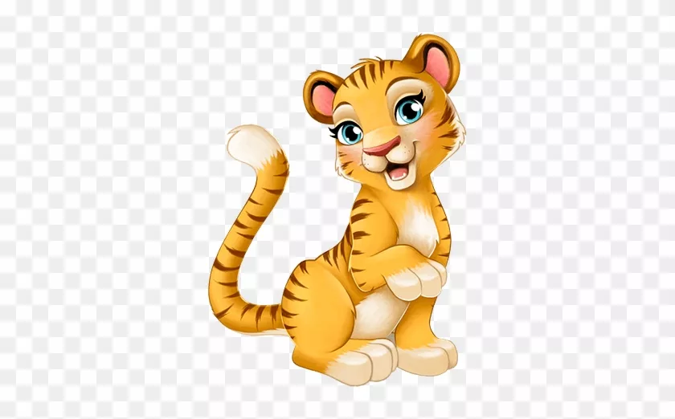
A tiger

Slide 14
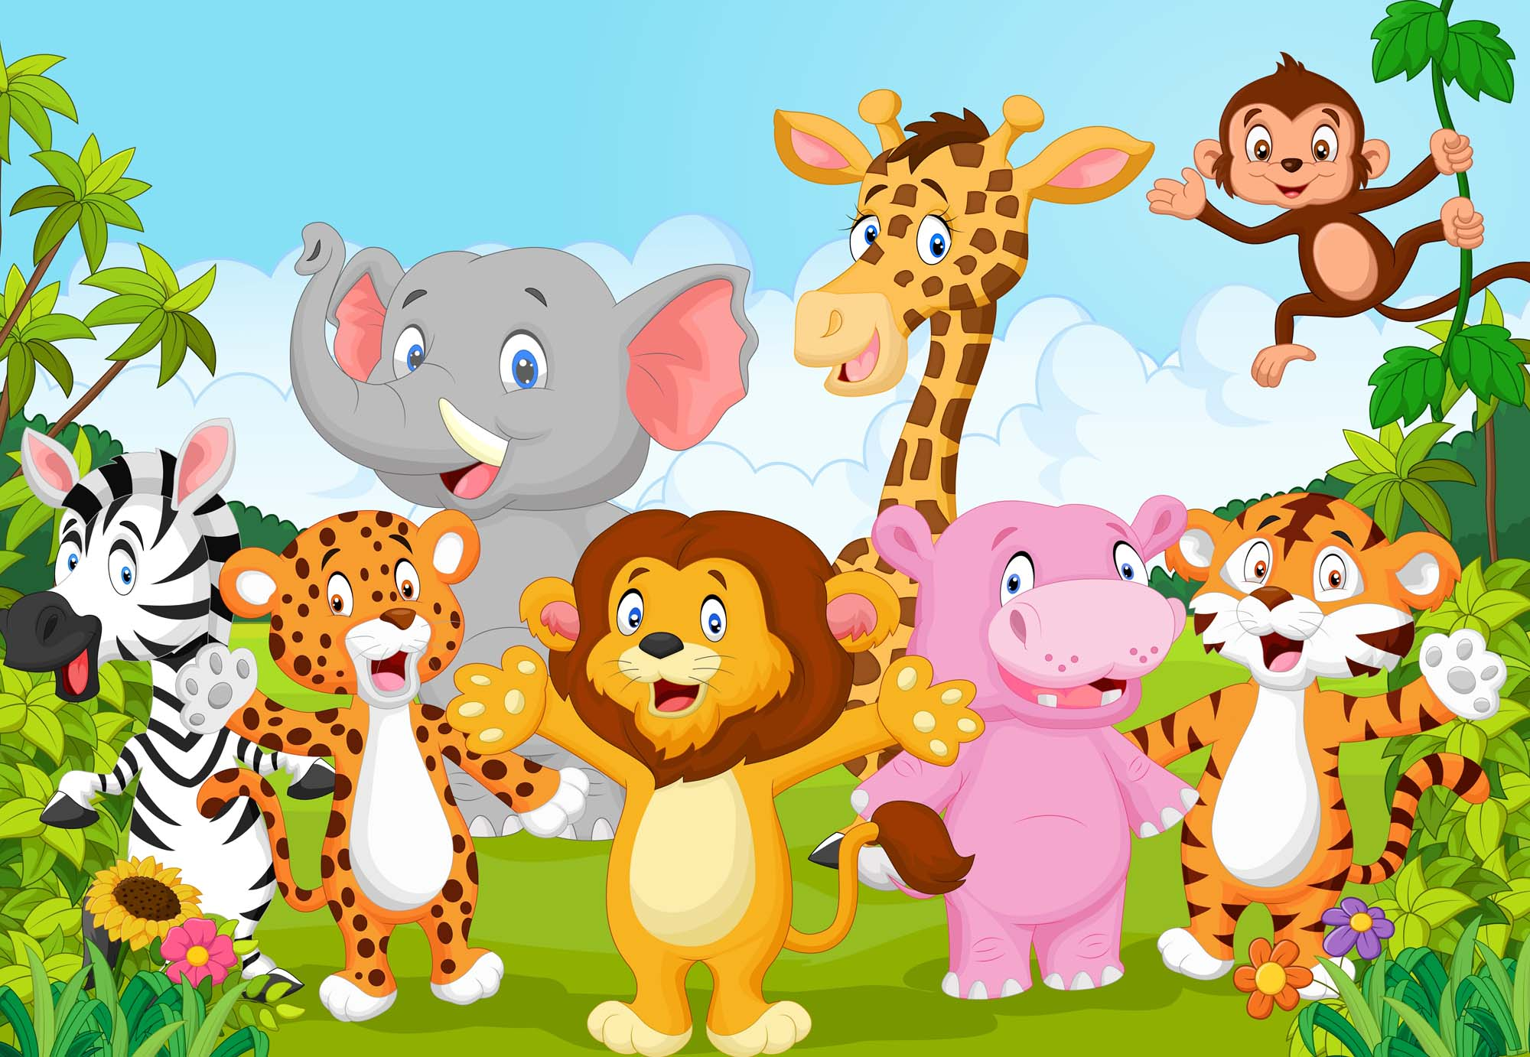
Where can animals live? https://learningapps.org/display?v=p8bquhv1v16

Slide 15
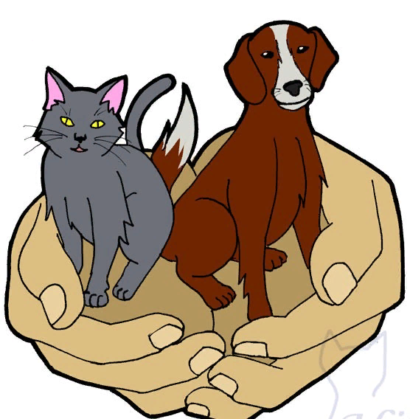
Together let's save the lives of animals!
1. We must protect animals
2. We must feed birds in winter.
3. We mustn't offend homeless animals.
4. We mustn’t tease animals

Slide 16
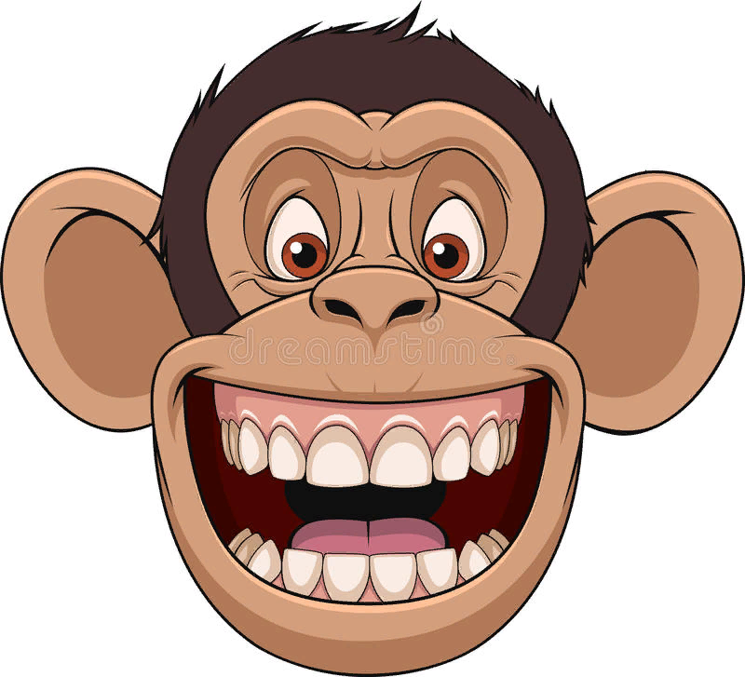
РЕФЛЕКСИЯ

Slide 17
Complete tasks on cards. ( Выполнить задания в карточках)

