Slide 1
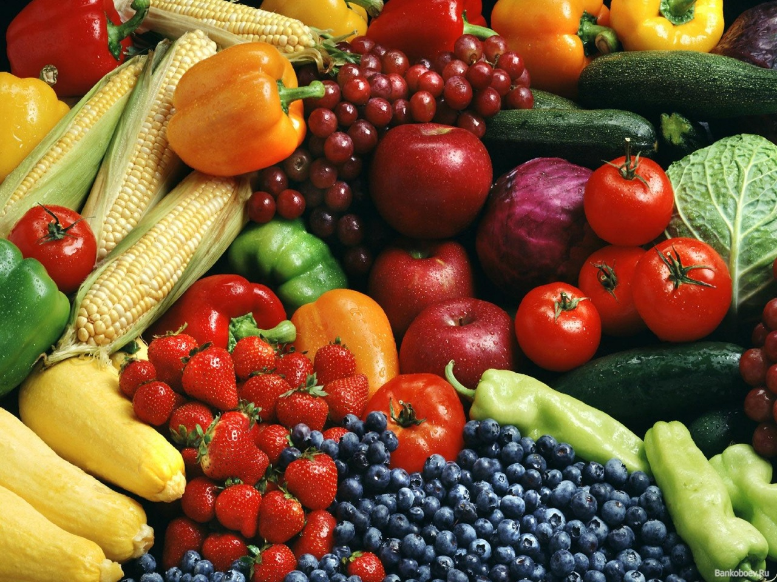

Slide 2
I want to …
learn new words,
remember word,
do exercises,
watch video,
play games,
know about …

Slide 3
Once a week
Two times a week
Three times a week
I want to …

Slide 4
Chew - жевать ;
Waste - терять ,
Talk = speak
On time-

Slide 5
Healthy lifestyle
Sleep early
Eat healthy food
Go to school on time
Wake up early
Eat lunch on time
Eat fruits and vegetables
Sleep 8 hours a day
Eat dinner early
Drink lots of water
Do exercises
every day
Drink 2 glasses
of milk
Do not eat too
much snacks
Wash fruits before eating

Slide 6
Homework
ex. 7 p.129
Prepare a talk about you and your family. Tell what you do to be healthy.
Mark «3» - prepare 6-7 sentences,
mark «4» -prepare 8-10 sentences,
mark «5» - 10-12 sentences.

