Slide 1
Magic

Slide 2
A
B
C
D
E
F
G
H
I
J
K
L
M
N
O
P
Q
R
S
T
U
V
W
X
Y
Z

Slide 3
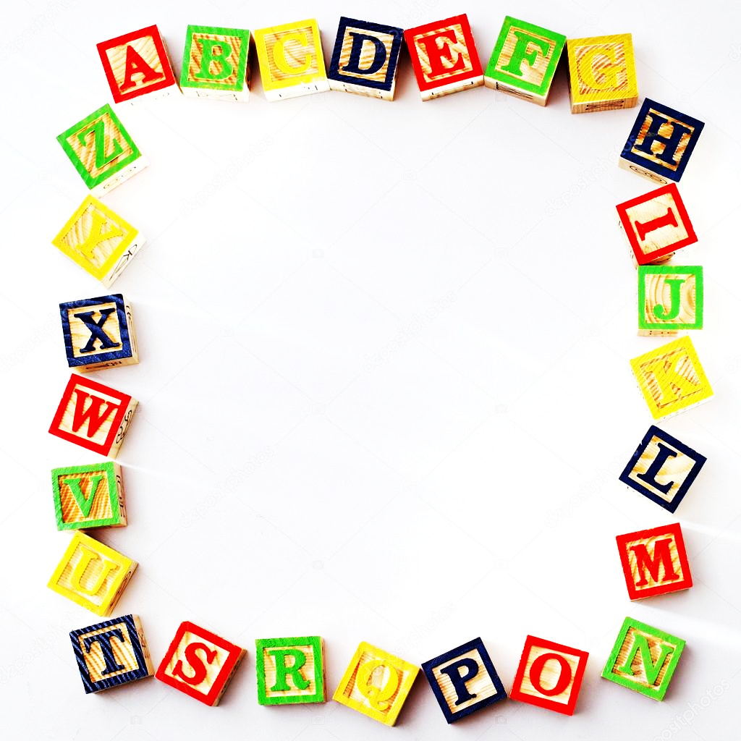
Find out the words with the sound [ɪ:]!
queen
sheep
bed
egg
green
red

Slide 4
Find out the words with the sound [f]!
photo
pin
flag
elephant
dolphin
ink

Slide 5
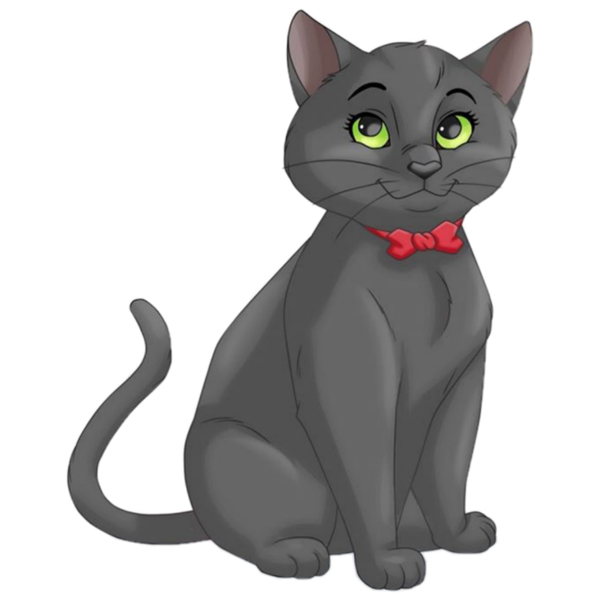
Find out the words with the sound [k]!
pink
chick
pie
room
cat
daddy

Slide 6
Read the words with the sound [e]!
vest
green
queen
leg
sheep
egg
nest
sweet

Slide 7
Read the words with the sound [∫]!
fish
sheep
he
she
cheese
chair
ship
sleep

Slide 8
Answer the question!
How are you?

Slide 9
Answer the question!
What are your names? Say them in the alphabetical order.

Slide 10
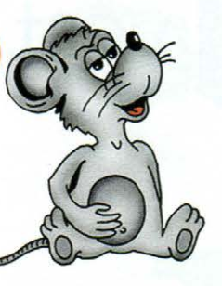
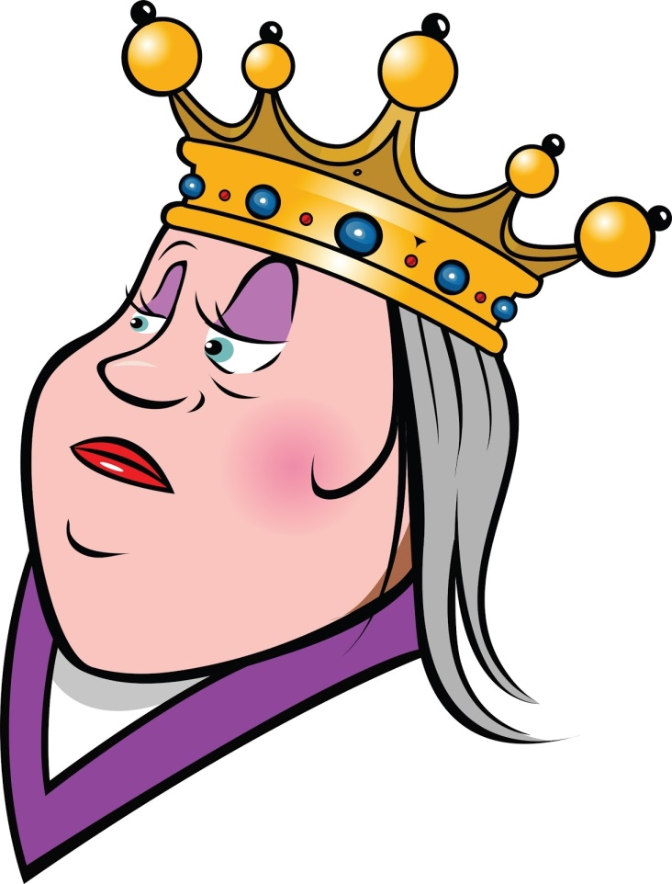
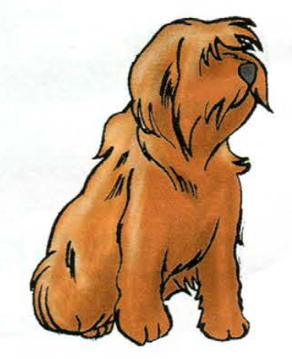
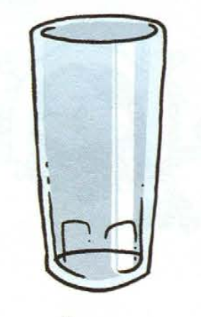
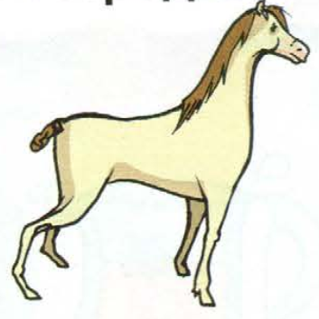
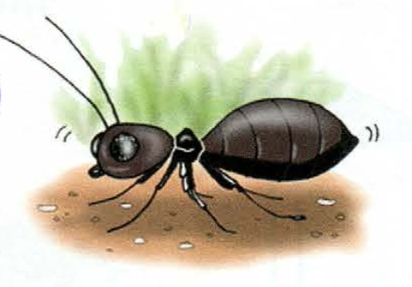
Answer the question!
What’s this? – It’s a/an…

Slide 11
Order the letters!
brother
thimble
otrebr
mibleth
ndiwow
ircah
window
chair
brlaumel
umbrella
grandma
ndragam
chaty
table
yacht
labte

Slide 12
Order the letters!
bedroom
chitken
dremobo
kitchen
apml
idora
lamp
radio
tree house
erte ouhes
living room
morovilign
bathroom
garden
thoorabm
argedn

Slide 13
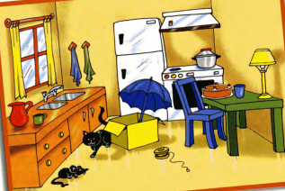
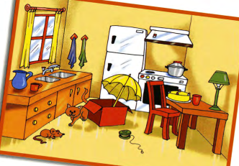
Look and say!
a blue chair
a red chair

Slide 14
Make up the dialogue!
Fine, thanks. Goodbye!
Hello!
Hello!
What’s your name?
I’m Ira. How are you?
Bye!
Fine, thanks. And you?
My name is Gena. What’s your name?

Slide 15
Find, write down and read the words!
manredwindowchairfamilykitchwnshenannyradiofanaxbathtablehegardeninlampsnakeonfootprintssisternapchicksheeptreeink

Slide 16
Find the wards!
d
o
g
a
r
d
e
n
w | q | r | b | a | t | h | d | n | g
i | b | d | x | e | a | b | o | l | a
n | v | r | r | a | d | i | o | a | r
d | j | k | h | s | e | r | r | m | d
o | z | i | c | e | h | g | o | p | e
w | v | t | a | b | l | e | c | o | n
s | d | c | e | r | f | g | l | b | m
x | c | h | a | i | r | e | r | f | b
m | j | e | u | d | h | o | u | s | e
s | d | n | k | f | l | r | t | r | j
w
i
n
d
o
w
b | a | t | h
e
l
a
m
p
r | a | d | i | o
k
i
t
c
h
e
n
s
r
r
h
o
t | a | b | l | e
o
l
m
c
a | i | r
f
h | o | u | s | e

Slide 17
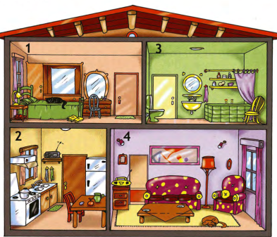
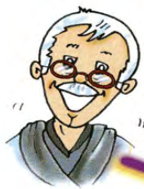
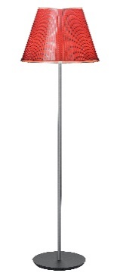
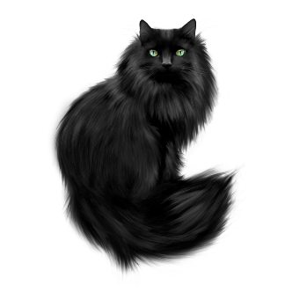
Describe the picture!
This is…
2. She’s in the…
This is…
2. He’s in the…
This is…
It’s …
It’s in/on/under the…

Slide 18
Translate the sentences !
Моя мама находится в доме.
My mummy is in the house.
My lamp is in the bedroom.
Моя лампа находится в спальне.
My brother is in the garden.
Мой брат находится в саду.
I am in the tree house.
Я нахожусь в доме на дереве.
My grandpa is in the living room.
Мой дедушка находится в гостиной.

Slide 19
Miss a turn!

Slide 20
Miss a turn!

Slide 21
Miss a turn!

Slide 22
Bonus
(2x your points)

Slide 23
Bonus
(3x your points)

Slide 24
Dynamic break
Action Songs for kids | The Singing Walrus - YouTube

Slide 25
Translate the sentences !
Моя мама находится в доме.
My mummy is in the house.
Моя кукла находится на кровати.
My doll is on the bed.
Мой папа находится в кухне.
My daddy is in the kitchen.
Я нахожусь в гостиной.
I am in the living room.
My grandma is in the garden.
Моя бабушка находится в саду.

Slide 26
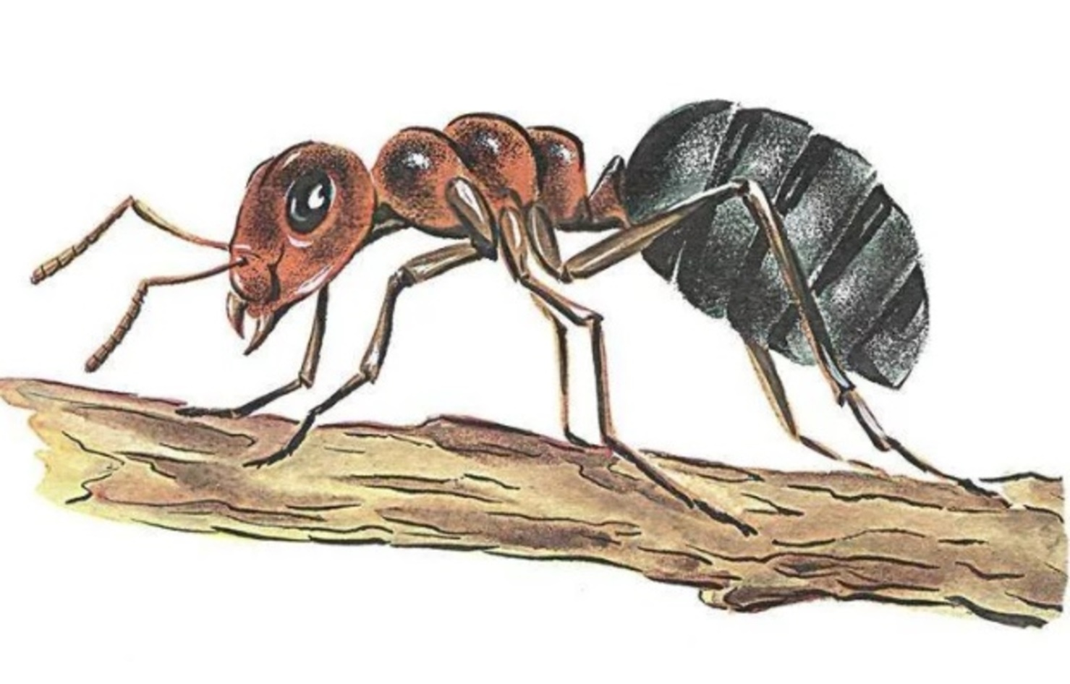
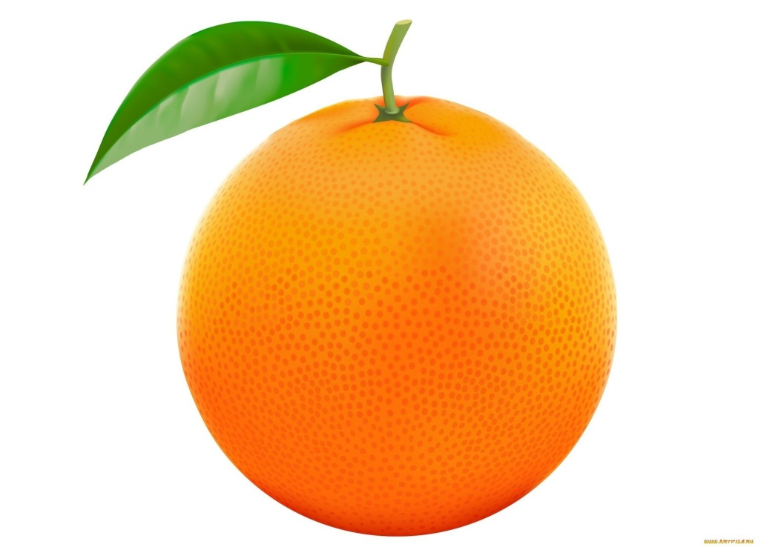
Answer the question!
What’s this? – It’s a/an…

