Slide 1
Save the Earth
Test your knowledge
by Dremluyzhenko
Irina Nikolaevna

Slide 2
What causes environmental problems?
Smoke from industrial chimneys
Recycling things
Sorting out the waste
Saving resources

Slide 3
What are the possible consequence?
Throwing litter
Sorting out waste
Using public transport
Harm to people’s and animal’s health

Slide 4
What environmental problems can cause rubbish in the water?
Air pollution
Water pollution
Deforestation
Destroying factories

Slide 5
What people can’t recycle?
glass
plastic
food
paper

Slide 6
How can’t people save energy?
Watching TV
Turn off light when you needn’t it
Reducing using water
Use the Sun energy

Slide 7
If you are eco-friendly, you get to school…
By car
On foot
By bus
By motorcycle

Slide 8
Acid rain exist because of…
Using computers
Sun’s shining
Fumes from cars
Animals’ living

Slide 9
What can help to save the Earth?
Eating a lot
Making bonfires
Playing computer games
Picking up litter

Slide 10
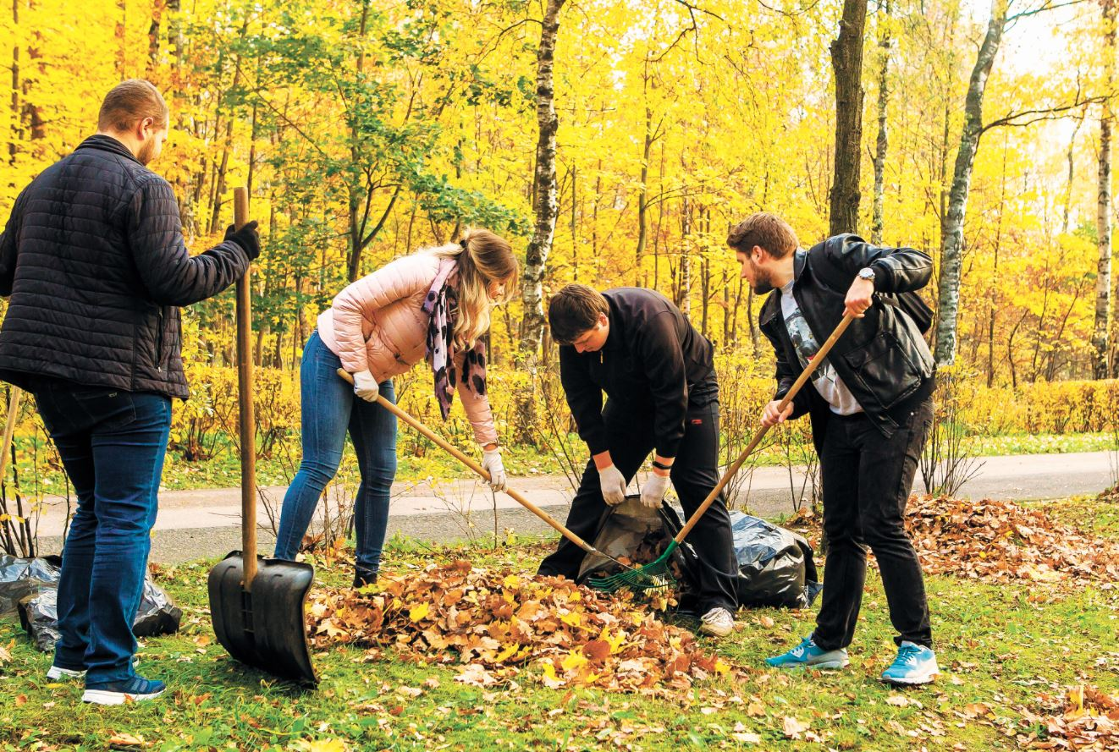
Well done!

