Slide 1
LET’S START!

Slide 2
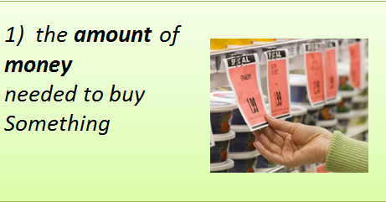
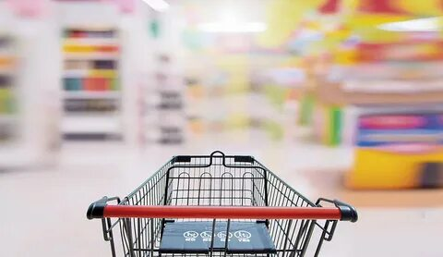
The 21st of October.
Saturday

Slide 3
The 21st of October.
Saturday
price

Slide 4
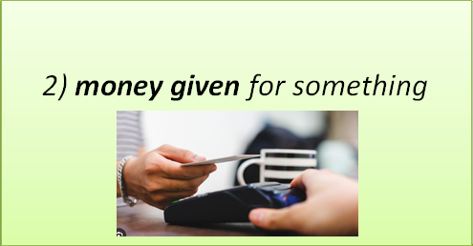
The 21st of October.
Saturday

Slide 5
The 21st of October.
Saturday
payment

Slide 6
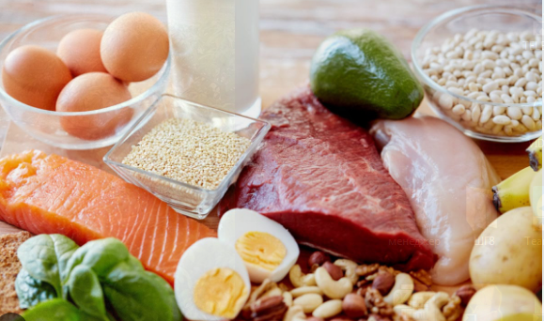
The 21st of October.
Saturday
3) everything for eating

Slide 7
The 21st of October.
Saturday
food

Slide 8
The 21st of October.
Saturday
4) a large metal
basket in shops

Slide 9
The 21st of October.
Saturday
trolley

Slide 10
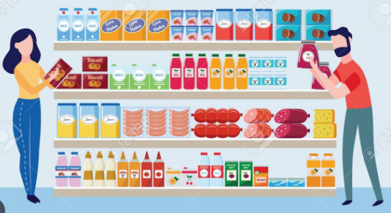
The 21st of October.
Saturday
5) a self-service shop offering a wide variety of food

Slide 11
The 21st of October.
Saturday
supermarket

Slide 12
The 21st of October.
Saturday
6) to get by paying money for

Slide 13
The 21st of October.
Saturday
buy

Slide 14
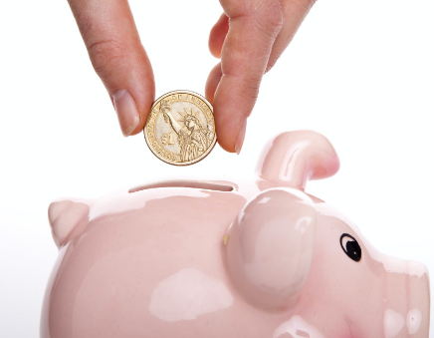
The 21st of October.
Saturday
7) to set aside money for future

Slide 15
The 21st of October.
Saturday
save

Slide 16
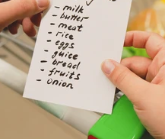
The 21st of October.
Saturday
8) a list of the things
that you
want to buy

Slide 17
The 21st of October.
Saturday
Clever Shopping
1) price 2) payment 3) food 4) trolley 5) supermarket 6) buy 7) save 8) shopping list

Slide 18
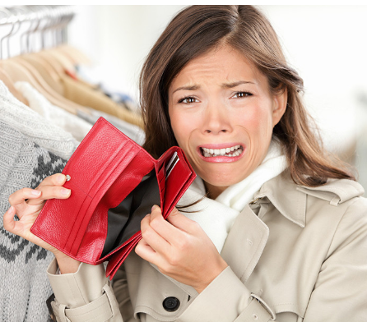
The 21st of October.
Saturday
Clever Shopping
?

Slide 19
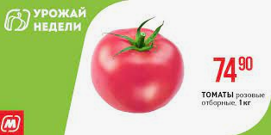
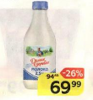
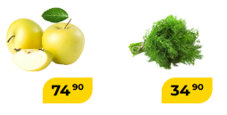
The 21st of October.
Saturday

Slide 20
The 21st of October.
Saturday
1) Flowers are the most expensive.
2) Apples are the cheapest.
3) Tomatoes are the most popular.
4) Milk has the special price.
1
1
1
1

Slide 21
The 21st of October.
Saturday
Task 1
Task 2
Task 3
Balance
4 points
Balance
Balance
difficult
difficult
difficult
easy
easy
easy

Slide 22
The 21st of October.
Saturday
There are different currencies

Slide 23
The 21st of October.
Saturday
You have got 5£. How many rubles will you get if the currency rate is 120 rubles for one pound.
5*120= 600
2

Slide 24
The 21st of October.
Saturday
Task 1
Task 2
Task 3
Balance
4 points
Balance
2 points
Balance
difficult
difficult
difficult
easy
easy
easy

Slide 25
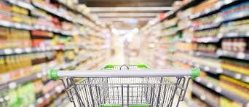
LET’S GO SHOPPING!

Slide 26
The 21st of October.
Saturday
Shopping list
A loaf of bread
A bottle of milk
A box of tea
A kilo of apples
A packet of flour
Let’s go shopping!
You have
600 rubles
and a shopping list

Slide 27
The 21st of October.
Saturday
Group work criteria:
Listen to your classmates
Read English
Write English
Speak English
Help your group
1
1
1
1
1

Slide 28
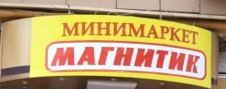
We can/can’t buy all food from our list in this supermarket
We have /haven’t enough money for all food

Slide 29
The 21st of October.
Saturday
Group work criteria:
Listen to your classmates
Read English
Write English
Speak English
Help your group
1
1
1
1
1

Slide 30
The 21st of October.
Saturday
Task 1
Task 2
Task 3
Balance
4 points
Balance
2 points
Balance
5 points
difficult
difficult
difficult
easy
easy
easy

Slide 31
The 21st of October.
Saturday
Clever Shopping
?

Slide 32
The 21st of October.
Saturday
Clever Shopping
Analyze prices
Analyze goods
Choose the best shop
SAVE MONEY

Slide 33
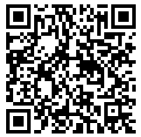
The 21st of October.
Saturday
HOMEWORK:
Choose the best shop to buy clothes

Slide 34
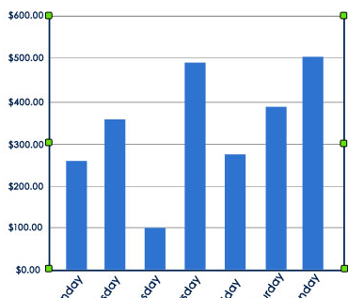
The 21st of October.
Saturday
LESSON PROFIT:

Slide 35
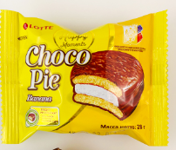
The 21st of October.
Saturday
Total Balance
10-11= “5”
Total Balance
8-9=
“4”
difficult
easy

