Slide 1
урок в 6 классе по теме «Дорожные знаки, правила движения»
Учитель: Баимова Ксения Андреевна
МБОУ «Верхореченская СОШ им.П.И.Благинина»

Slide 2
Look and say. What is this?

Slide 6
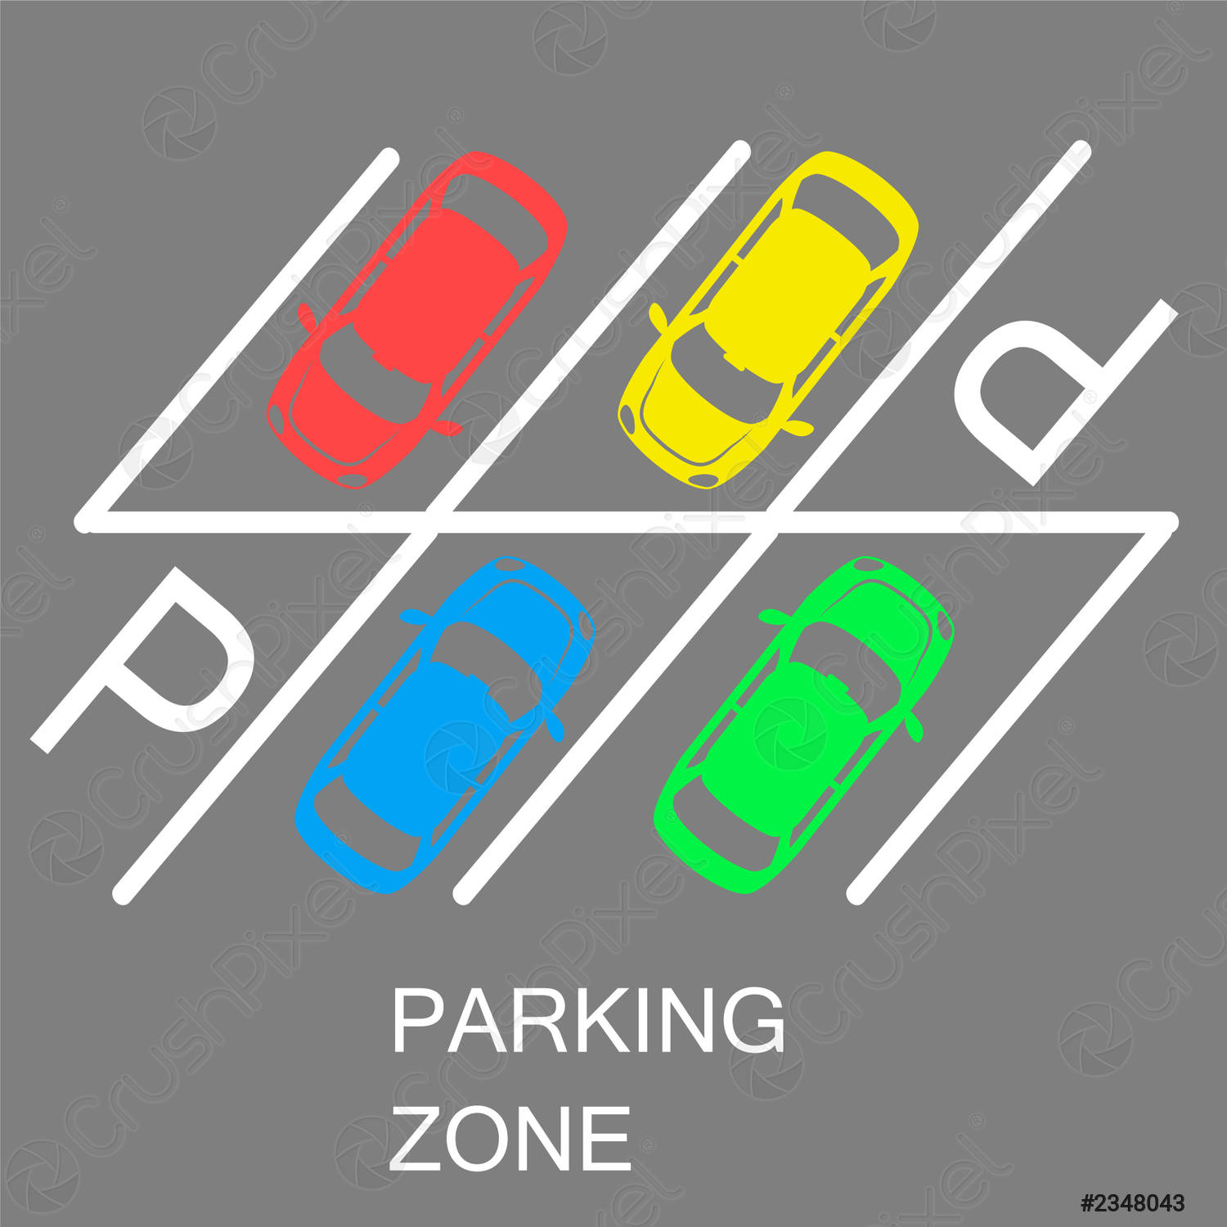

Slide 9
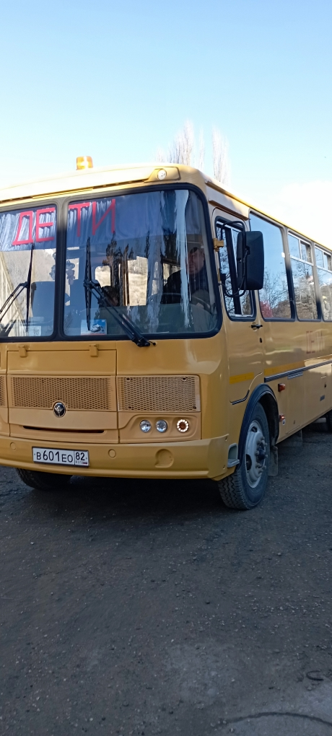

Slide 12
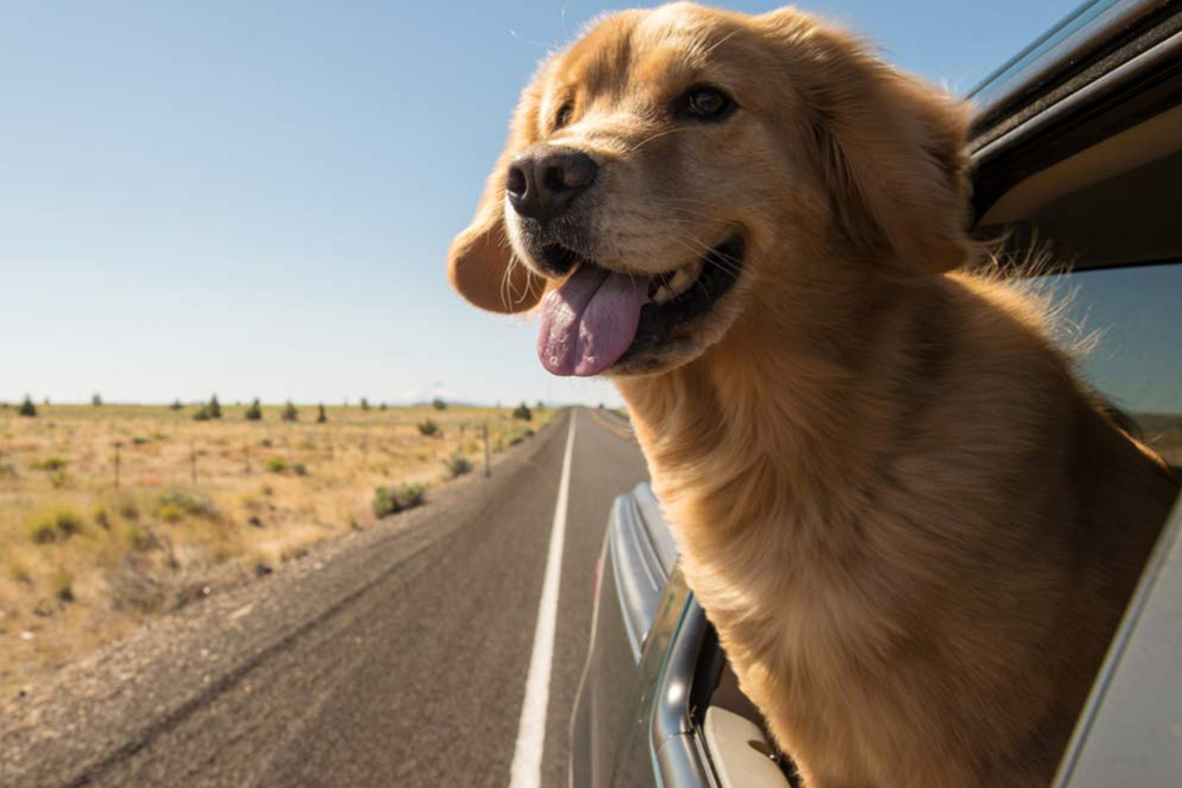

Slide 13
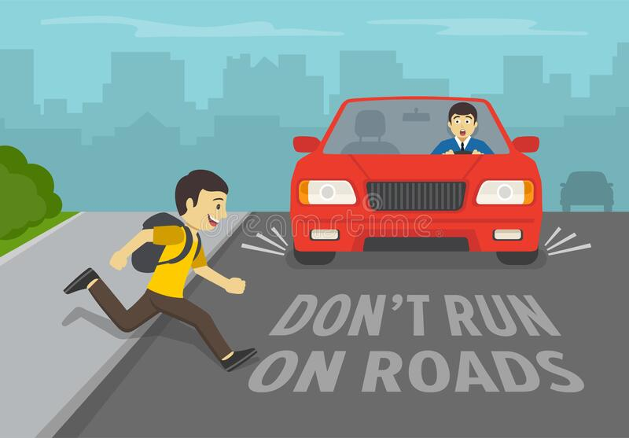

Slide 14
Guess the theme of our lesson. Answer the questions and use the first letters
_ _ _ _ _ _ _ _ _ _

Slide 15
Act out the dialogues

Slide 17
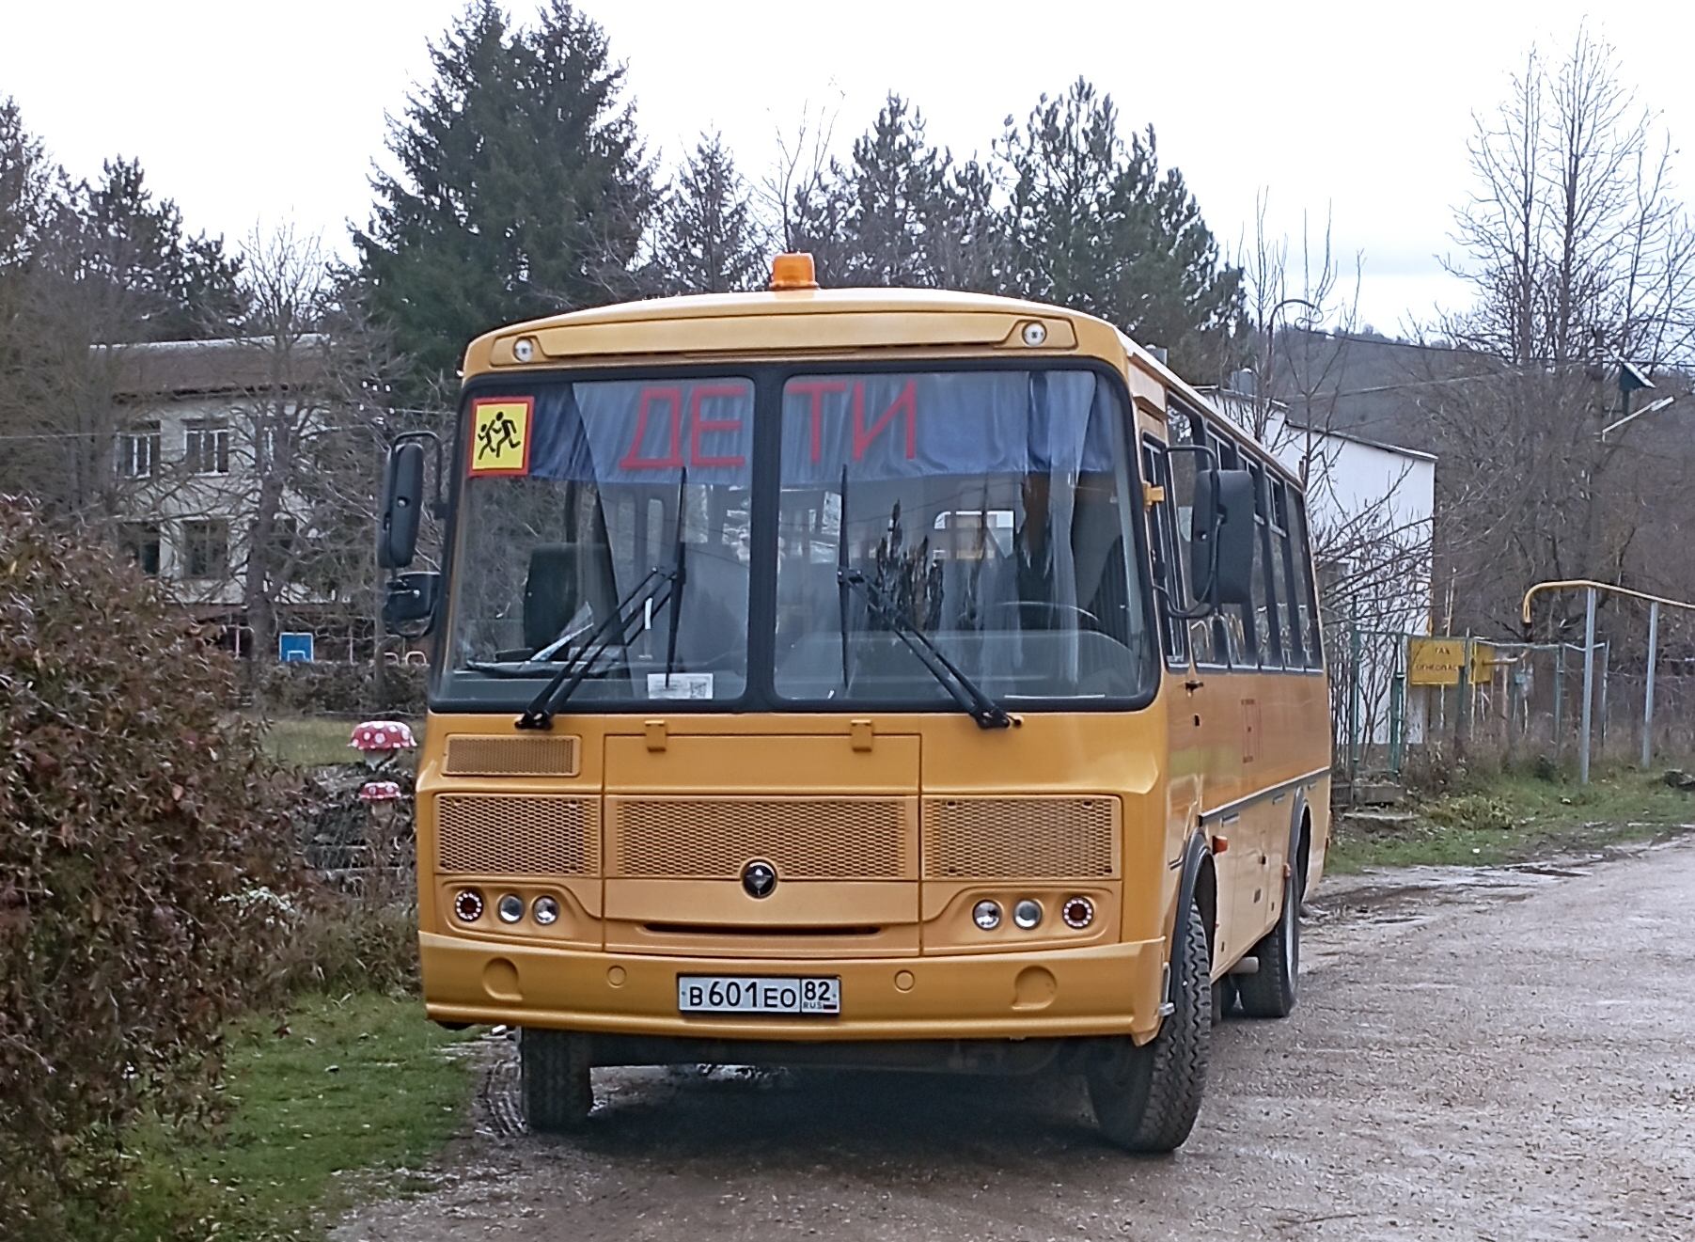

Slide 18
How did you like the lesson?
I think the lesson was interesting
useful
boring /dull
I learnt a lot about …
Now I can talk about …
I need to practice my
vocabulary /speaking/ listening skills
I think I have got…

