Slide 1
Injuries and illnesses
Module 4A

Slide 2
How do you think what is the main topic of our lesson today? Read the following phrases and let’s discuss
Life or death decision
Incredible tale of survival
Against all odds
British mountaineer
21.000 – foot peak
Frostbitten fingers
Cut the rope
Determined not to die

Slide 3
1. Have you (or someone you know) ever had an accident? Say what happened.
2. Where do you think the most accidents happen?
3. Have you ever broken a bone? What happened?
4. What can be done to prevent accidents from happening at home/work or other places.

Slide 4
p. 64 - 65 (Vocabulary) You have to find the correct synonym from the blackboard or try to paraphrase it.
agonising – мучительный
peak, summit – вершина
to be crippled – быть покалеченным
against all odds – несмотря ни на что
pitch black – кромешная тьма
irresistible – непреодолимый
crevasse [krɪˈvæs] – расщелина
ascent [əˈsent] – восхождение
descent - спуск
rope - веревка

Slide 5
Quizlet Module
https://quizlet.com/ru/645864407/4a-flash-cards/?new

Slide 6
Answer to these questions!
Part 1
1. What happened to Simon Yates when he
was 21 years old?
2. When did this story happen?
3. Who is Simon Yates? How is he related to Joe Simpson?
4. Did they have problems in the summit?
5. What can you tell us about Joe?
Part 2
What did Simon decide to do?
Were they able to communicate?
What painful decision did Simon make?
Was Joe killed by this fall?
What was the result of this trip?

Slide 7
Break!

Slide 8
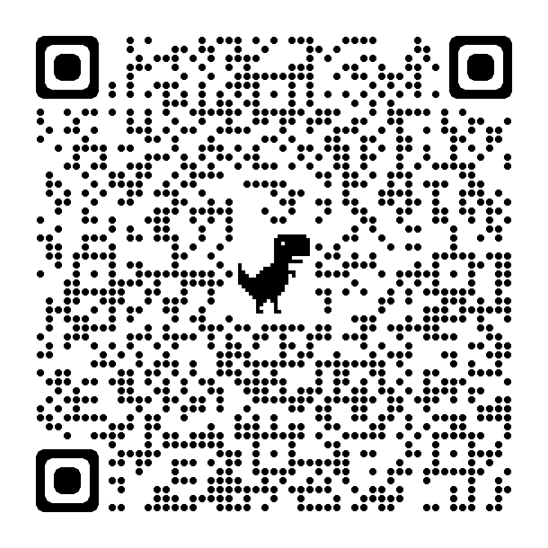
Let’s check your knowledge!

Slide 9
Correct answers
1. bone
2. muscle
3. lip
4. heel
5. hair

Slide 10
https://docs.google.com/forms/d/e/1FAIpQLSdHGPvcq5WO5LKSX4MfwIo53L4aZG1eDngyei_vsV2xzhEYrg/viewform?usp=sf_link
https://docs.google.com/forms/d/1XlaLRQidK5omyAoMDFul441-aZ7_ZtuAr-Pqz_tDAKQ/edit
For me

Slide 11
Your Home task is to write an essay on this quotation: (p.65 ex.9 Words of Wisdom)
“Man cannot discover new oceans unless he has the courage to lose sight of the shore.”
Andre Gide, French writer

Slide 12
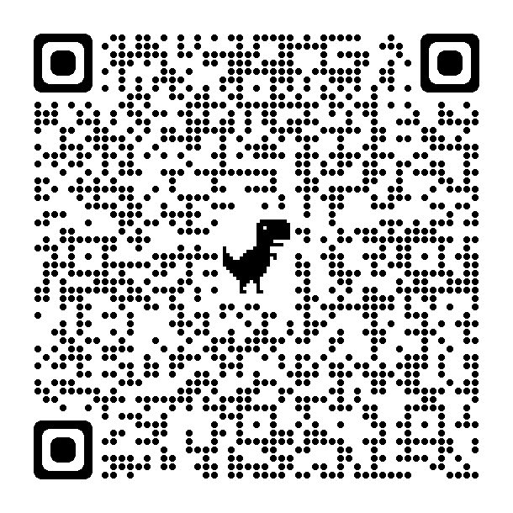
What is your mark?

Slide 13
https://docs.google.com/forms/d/e/1FAIpQLSdK3YErb0568usTJzK8c0ZuhY4UMW_ezdj5UlqzWCcU2zUlxw/viewform?usp=sf_link
https://docs.google.com/forms/d/11hFB4CCuHgXcz1Kvu4f-8wSGGyrNECWqSPcW8Zu-LK0/edit
For me

Slide 14
Thank you for your active work!

