Slide 1


Slide 2


CHILDLINE
PSYCHOLOGICAL ASSISTANCE
COUNSELLOR TRAINING COURSES

Slide 3

CHILDLINE
PSYCHOLOGICAL ASSISTANCE
COUNSELLOR TRAINING COURSES
24 hours a day;
free;
confidential;
accessible;
professional;

Slide 4
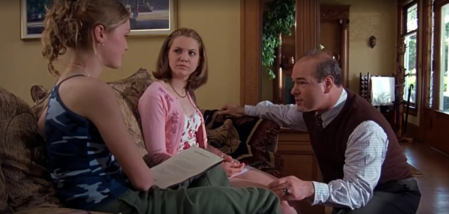

Slide 5


GENERATION GAP
MISUNDERSTANDING

Slide 6
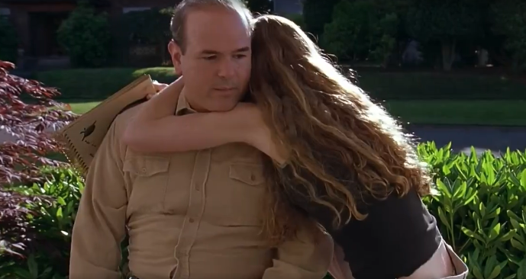

Slide 7
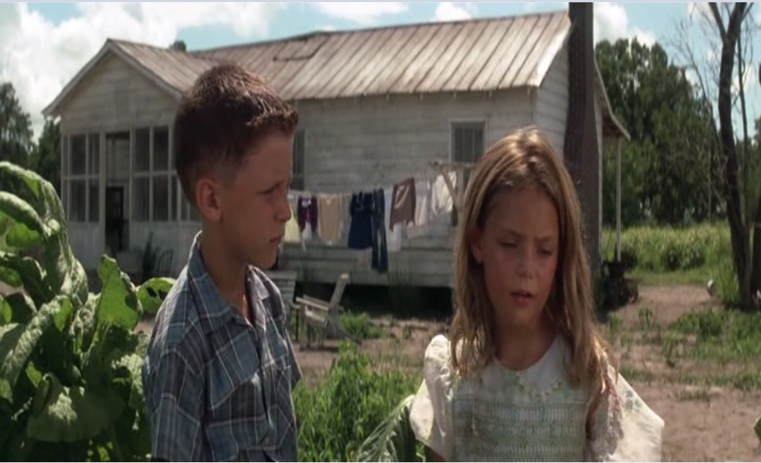

Slide 8

FAMILY VIOLENCE

Slide 9


Slide 10


Slide 11


Slide 12
LOW SELF-ESTEEM

Slide 13
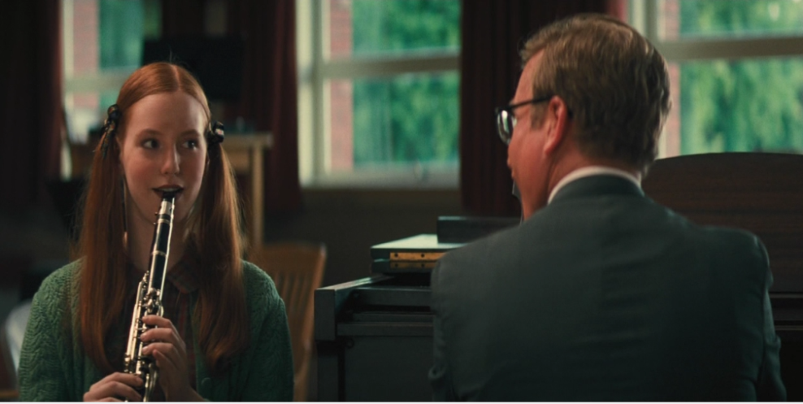

Slide 14
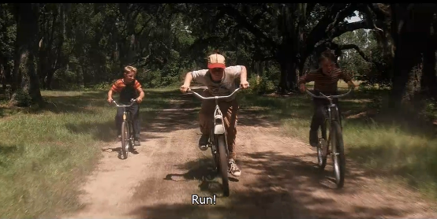

Slide 15

PEER PRESSURE

Slide 16

CHILDLINE
PSYCHOLOGICAL ASSISTANCE
COUNSELLOR TRAINING COURSES

