Slide 1
In the news
Вагнер Елена Сергеевна,
учитель английского языка
МАОУ «СОШ №56 УИМ»
г. Магнитогорска

Slide 2
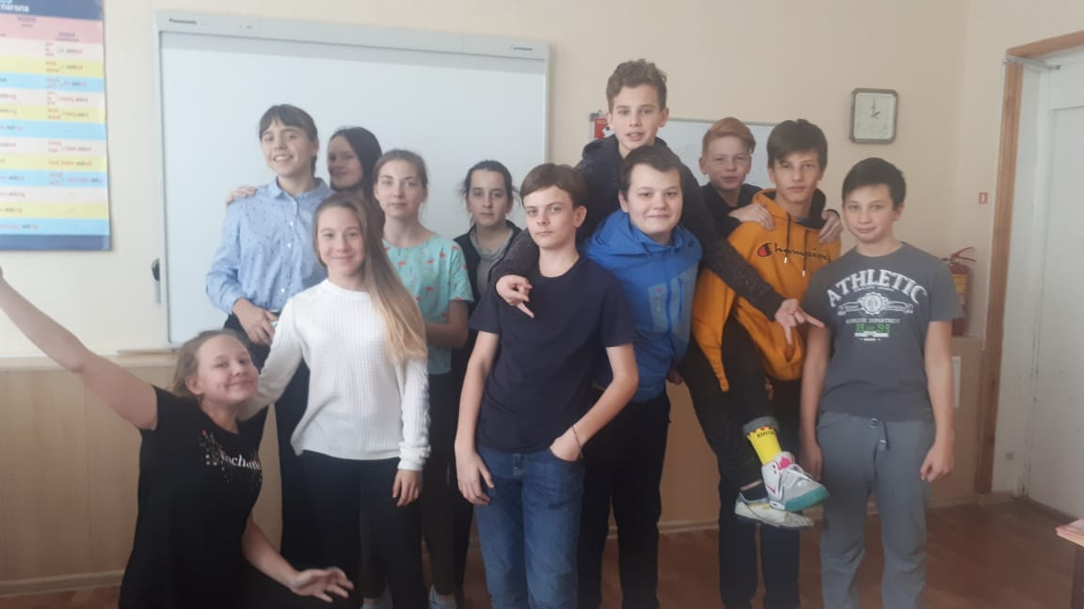
In the news

Slide 3
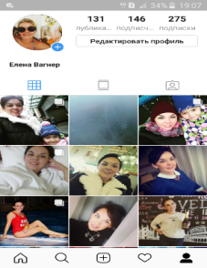
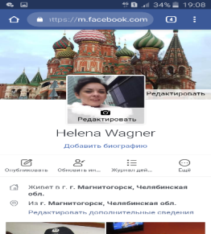
In the news

Slide 4
In the news

Slide 5
In the news
Mass Media
Digital Media
Internet
Mobile phones

Slide 6
In the news
Mass Media
Digital Media
Internet
Mobile phones
Broadcasting Media
Television
Radio

Slide 7
In the news
Mass Media
Digital Media
Internet
Mobile phones
Broadcasting Media
Television
Radio
Outdoor Media
Billboards
Shop windows
Advert in transport

Slide 8
In the news
Mass Media
Digital Media
Internet
Mobile phones
Publishing Media
Newspapers
Magazines
Broadcasting Media
Television
Radio
Outdoor Media
Billboards
Shop windows
Advert in transport

Slide 9
In the news

Slide 10
In the news

Slide 11
In the news

Slide 12
In the news

Slide 13
In the news
1. We / look forward/ to the competition in oratory.
2. Students/ participate/ Russian and literature/ during the week.
3. Journalists/ interview/teachers/ 6 o’clock yesterday/.
4. Our teacher/represent/our class/in the contest/yesterday afternoon.
5. The Parade in honour of Komsomol/ take place/on the Red Square/ Saturday morning.
6. We/write/interesting articles/ yesterday evening.

Slide 14
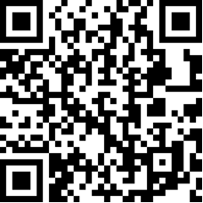
Channel 1 Channel 3

Slide 15
Thank you!

