Slide 1
АT THE WEEKEND

Slide 3
Listen and Repeat
get up | tourist
wash | market
meet carry have breakfast | often usually every day
go to the cinema | at the weekend
watch TV | in the afternoon
favourite | in the morning

Slide 4
Londoners’ Song
Londoners, we are Londoners.
We’re from London town.
When Jenny and Kim, Mark and Rob
Are very good friends.
In the town we love
Londoners, we are Londoners.
We’re from London town.
We are Londoners.
They are from London town.

Slide 5
Choose the right word

Slide 6
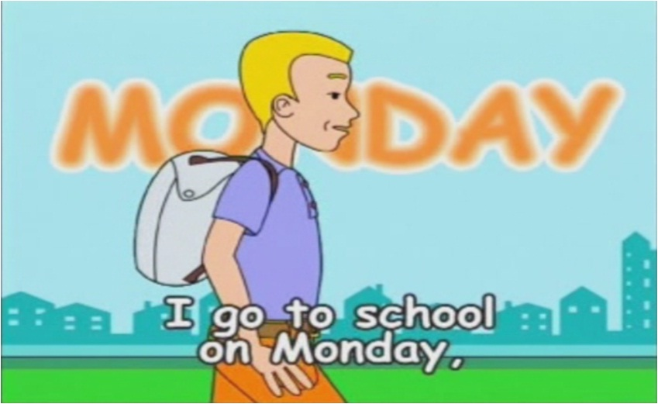
I GO TO SCHOOL ON MONDAY

Slide 7
Сrosses and Noughts
1. My friend are good.
2. There is desks, chairs in the classroom.
3. At Saturday we usually go to the market.
4. My family have dinner at half to 7.
5. Today is twenty-third of October.
6. The boy can use computer.
7. They have got a house big.
8. What favourite things he has got?
9. Kim not can play the piano.

Slide 8
Использованные материалы
1.С.Skinner, S. Thomson In Touch 1 изд. Лонгман 2005г. с.40-41
2. E.Gray, V. Evans Welcome 2 CD-ROM изд.Express Publishing –электронное приложение к учебнику

