Slide 1
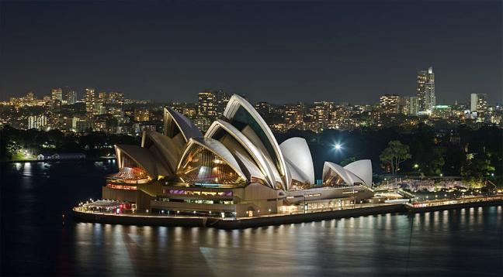
Travelling to Australia
Подготовила:
Учитель английского языка МБОУ «Нартасская средняя общеобразовательная школа» Ильина Е.А.

Slide 2
OUR PURPOSES
Learn new words
Learn to speak about Australia, its sights
Practice reading, listening and speaking

Slide 3
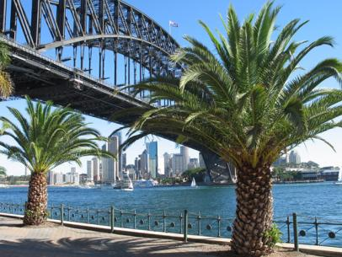
What do you know about Australia?
What is the capital of Australia?
Canberra
Who discovered Australia?
Captain Cook
What city was host of the Olympic Games in 2000)?
Sydney

Slide 4
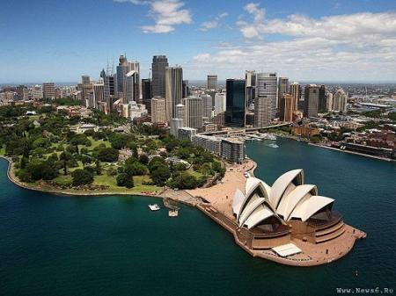
Which two animals can you see on the Australian coat of arms?
Kangaroo and emu
Which city is Australia’s oldest and largest?
Sydney
What is Australian currency?
Australian dollar

Slide 5
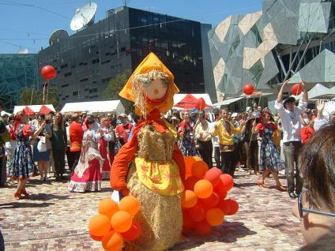
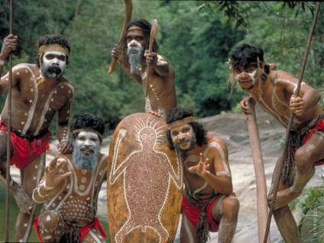
How many nationalities live in Australia?
200
Who are the Australian natives?
Aborigines

Slide 6
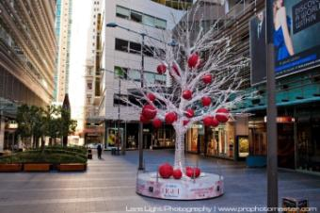
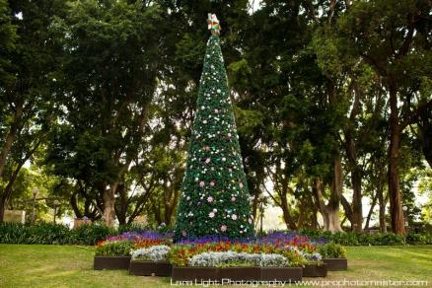
What is the official language in Australia?
English
In which season do Australians celebrate Christmas?
Summer

Slide 7
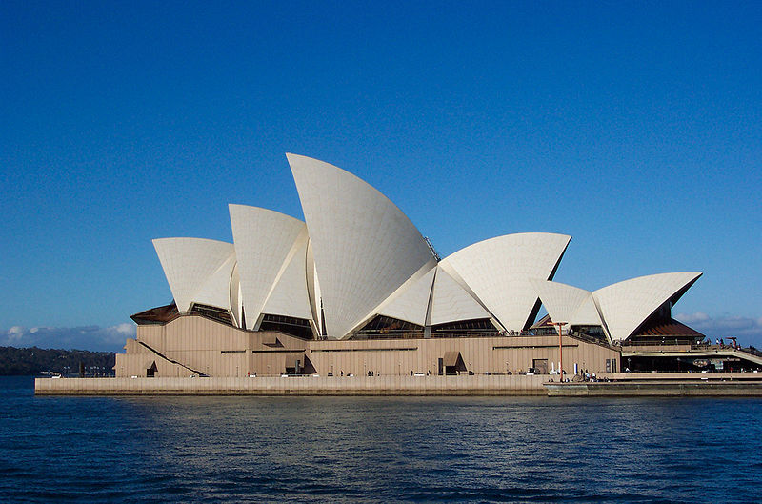
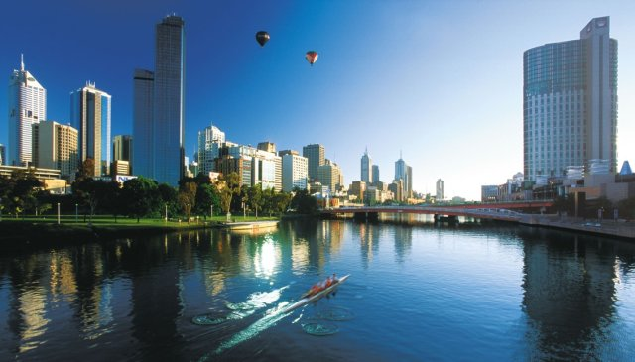
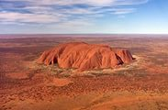
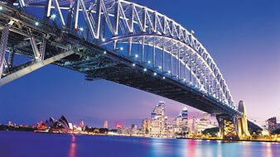
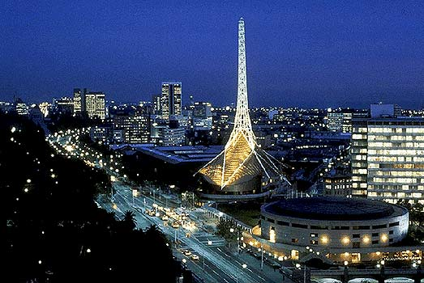
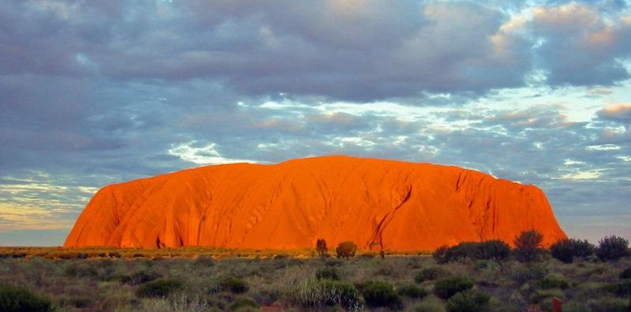
Sydney
Melbourne
Uluru

Slide 8
New words
a full range of - большое количество
tourist attractions – привлекательные для туристов места
to make a reservation – зарезервировать
impressive – впечатляющий
magnificent – великолепный
picturesque – живописный
spectacular – впечатляющий, захватывающий
accommodation – жилье
a package tour – туристическая поездка по путевке

Slide 9
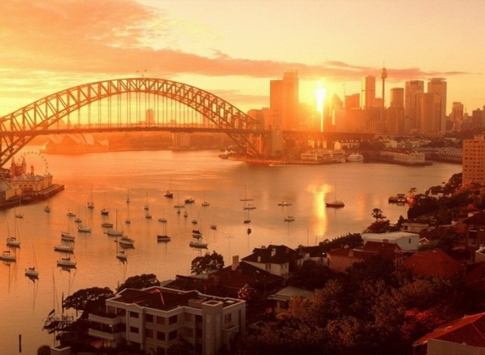
1. to enjoy the beauty of nature
2. to see the art of native Australians
3. to enjoy good music
4. to visit a museum
5. to do sports
6. to find something to do on rainy days
is the place
that gives
a good opportunity...
Sydney

Slide 10
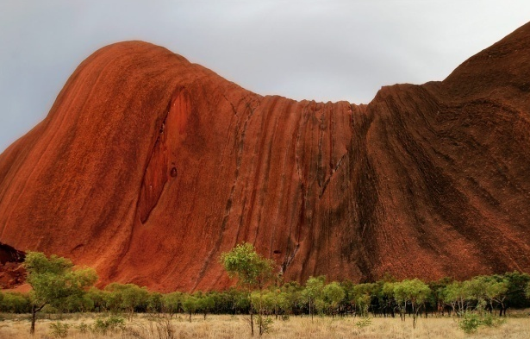
1. to enjoy the beauty of nature
2. to see the art of native Australians
3. to enjoy good music
4. to visit a museum
5. to do sports
6. to find something to do on rainy days
is the place
that gives
a good opportunity...
Uluru

Slide 11
1. to enjoy the beauty of nature
2. to see the art of native Australians
3. to enjoy good music
4. to visit a museum
5. to do sports
6. to find something to do on rainy days
is the place
that gives
a good opportunity...
Melbourne

Slide 12
Keys
Text A | 1 2 3 6 | Text B | 1 | Text C | 4 5 6

Slide 13
Give your classmate a mark
Reading
without mistakes-1 mistake/ без ошибок – 1 ошибка | 5
2 mistakes/ 2 ошибки | 4
3 and more mistakes/ 3 и более ошибки | 3

Slide 14
Listening What is discussed in the dialogue?
1. number of people travelling
2. dates of the trip
3. type of hotel
4. way of paying for the trip
5. information about available flights
6. place(s) to visit
7. way of paying for meals
8. length of the visit
9. client’s name and address

Slide 15
Listening Keys
1. number of people travelling | +
2. dates of the trip | +
3. type of hotel
4. way of paying for the trip | +
5. information about available flights | +
6. place(s) to visit | +
7. way of paying for meals
8. length of the visit | +
9. client’s name and address

Slide 16
Give yourself a mark
Listening
without mistakes-1 mistake/ без ошибок – 1 ошибка | 5
2 mistakes/ 2 ошибки | 4
3 and more mistakes/ 3 и более ошибки | 3

Slide 17
SPEAKING
LANGUAGE SUPPORT
FOR TRAVEL AGENT | FOR TOURIST
Can I help you, sir/ madam? OK, you could start in … It’s one of the…cities / places in … . We have some good packages. When do you want to travel? Are you going to travel alone? Will you pay by credit card or by cash? | Yes, please. I’m going to... That sounds … . That’s … . / No, thank you. …. , around the… . Yes, alone. / No, I’m going to travel with … . Well, I’m going to pay by…

Slide 18
Give your classmates a mark
Speaking
without grammar mistakes/ 1 mistake - без ошибок/ 1 ошибка fluent English/ беглый английский, emotional speaking/ эмоциональная речь, correct intonation/ правильная интонация | 5
1-2 grammar mistakes/ 1-2 ошибки, fluent English/ беглый английский, emotional speaking/ эмоциональная речь, the right intonation/ правильная интонация | 4
3 and more mistakes/ 3 и более ошибок, not fluent / речь не беглая not emotional / речь не эмоциональная | 3

Slide 19
During Today’s Lesson I Have
learnt…
remembered….
It was interesting for me…
It was difficult for me …

Slide 20
Homework
Write a letter about a trip to Australia:
Dear __________ ,
I am in Australia now. I am full of impressions….
Sincerely yours,
or\ или : ex. 4B, p. 68 (find synonyms to words)
…….

