Slide 1
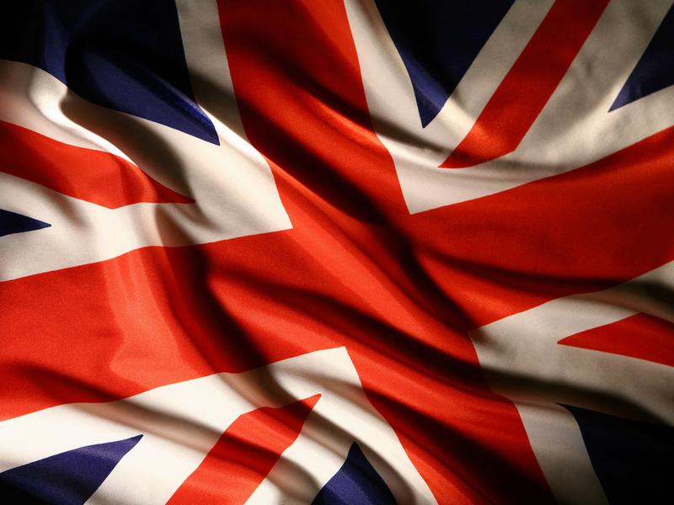
Do you know..?

Slide 2
WELCOME to our
Teenagers’ COMPETITION !!!
Today we are going to:
Communicate with each other
Have fun☺))
Answer many questions
Find out the winners;)))

Slide 3
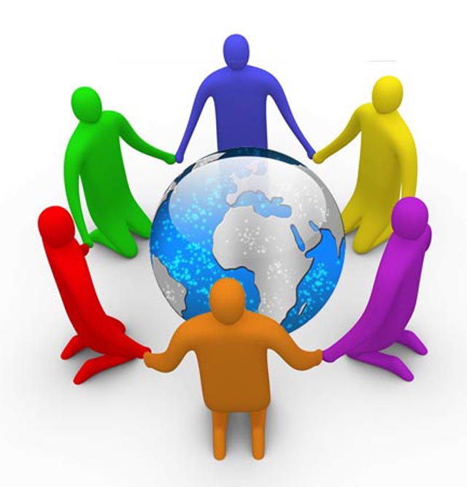
The first task is: “Describe your group”
1. Our team’s name is…
2. Our motto is…
3. We are…

Slide 4


Slide 5
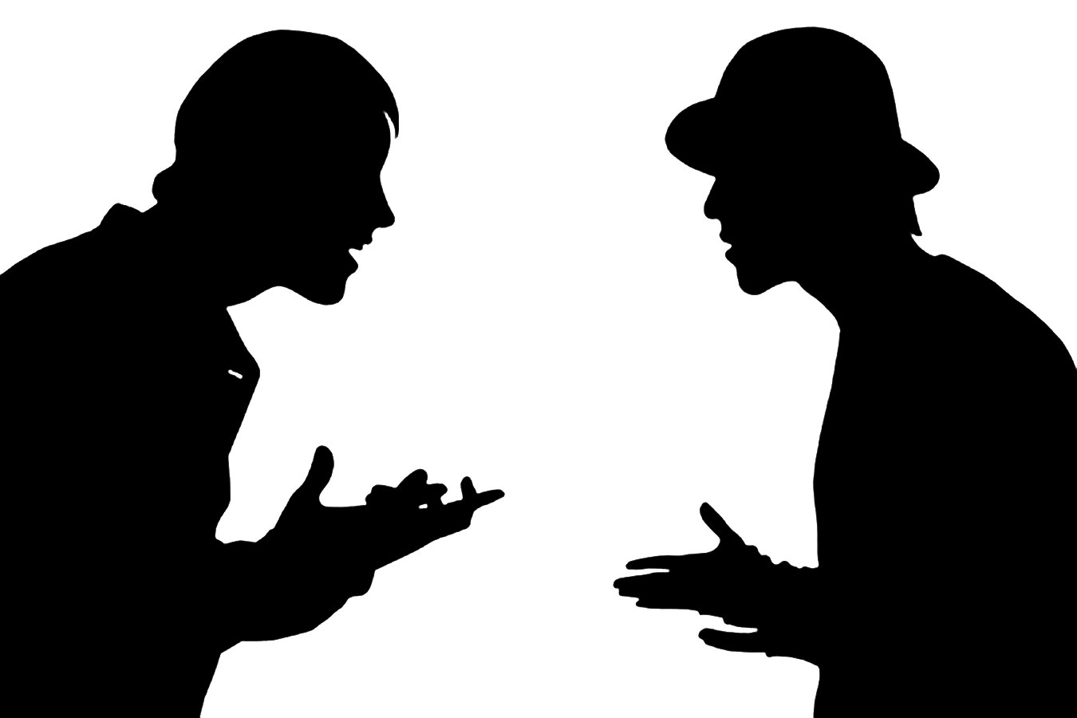
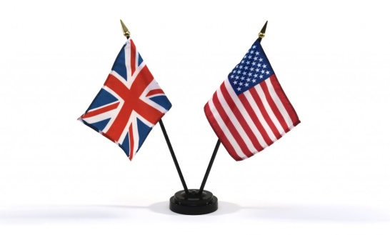
AGREE / DISAGREE with the statements

Slide 6
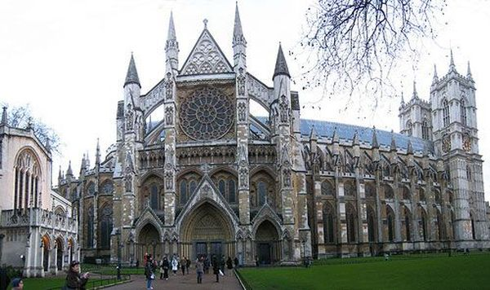
Westminster Abbey is a church, where many famous people were burried. Now it is used for the religious ceremonies, isn’t it?

Slide 7
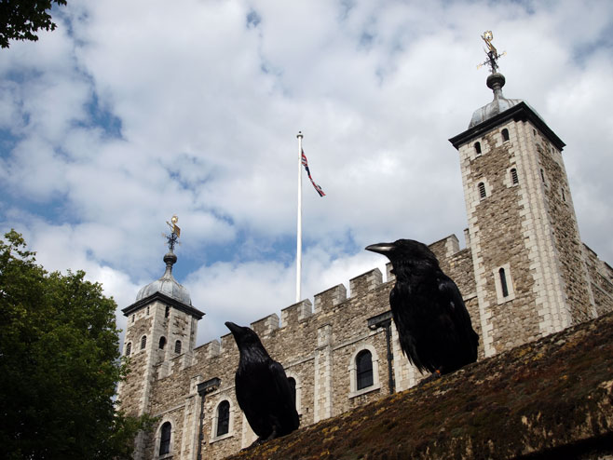
The black ravens live in Westminster Abbey, don’t they?

Slide 8
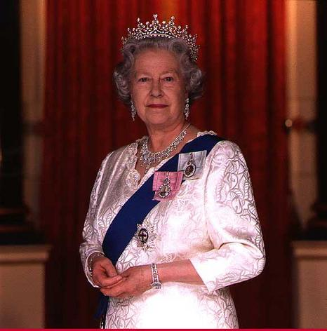
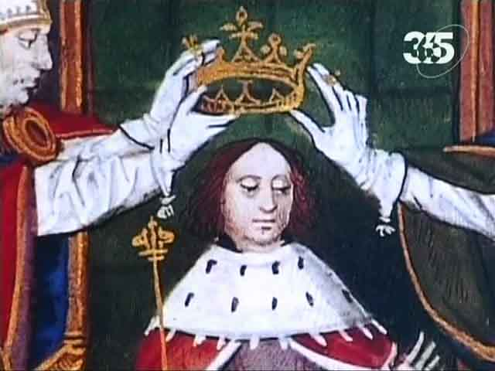
The English kings and queens are crowned in the Houses of Parliament, aren’t they?

Slide 9
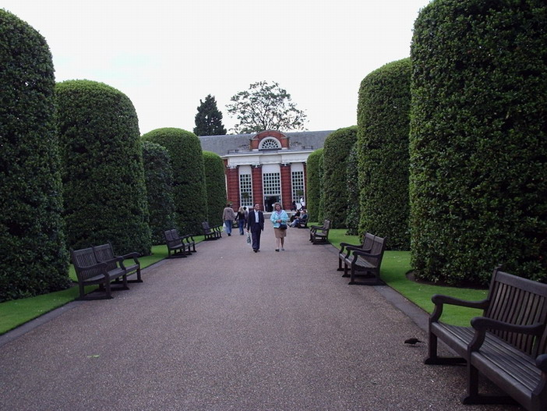
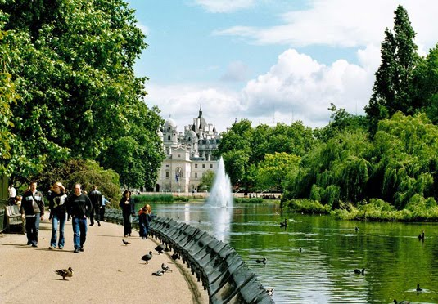
All the parks and gardens in London are free for people, aren’t they?

Slide 10
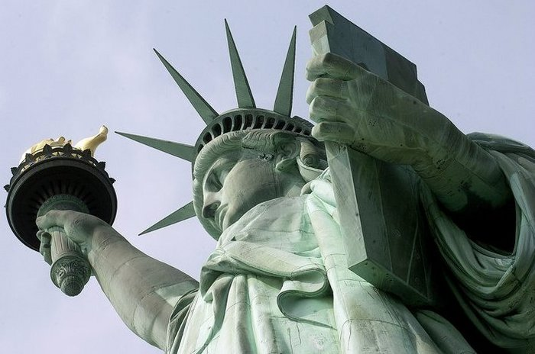
The Statue of Liberty is situated in Washington D.C., isn’t it?

Slide 11
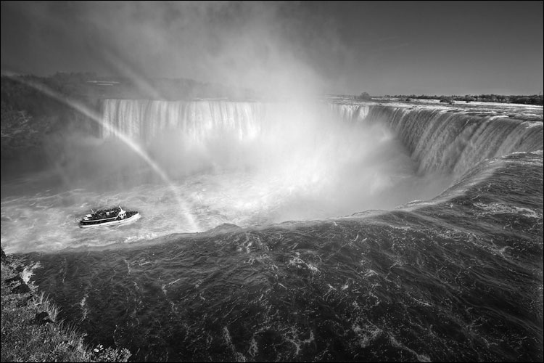
The Niagara Falls is the most powerful river in the USA, isn’t it?

Slide 12
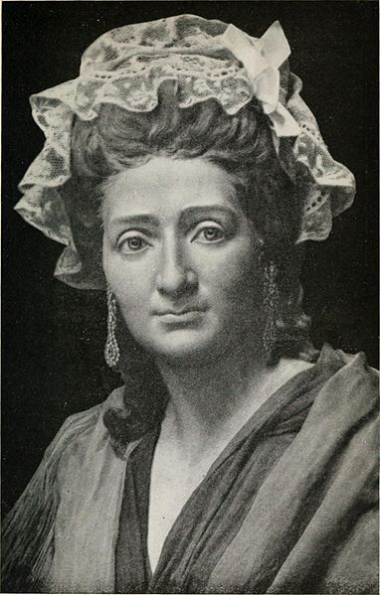
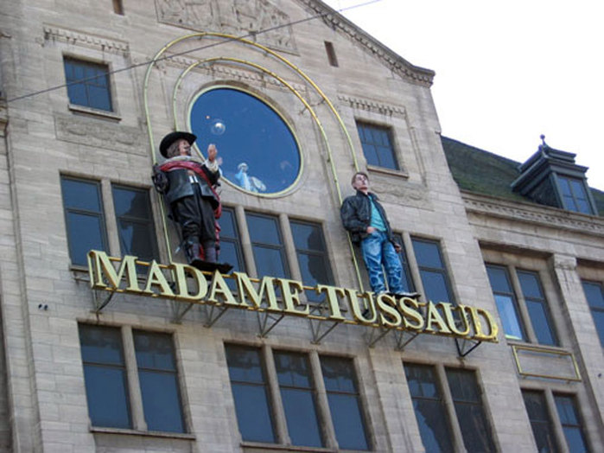
Madame Tussaud’s Museum has a large collection of women’s clothes, hasn’t it?

Slide 13
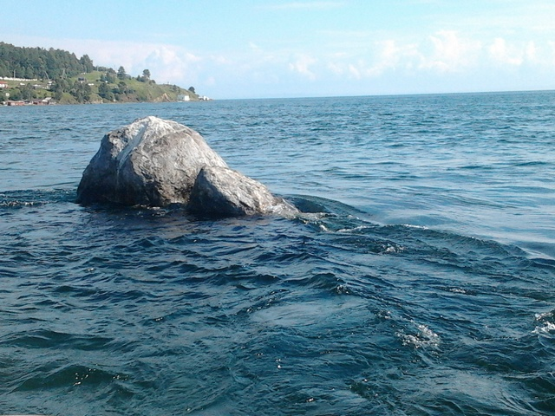
Lake Baikal – is the deepest and the cleanest lake in the world, isn’t it?

Slide 14
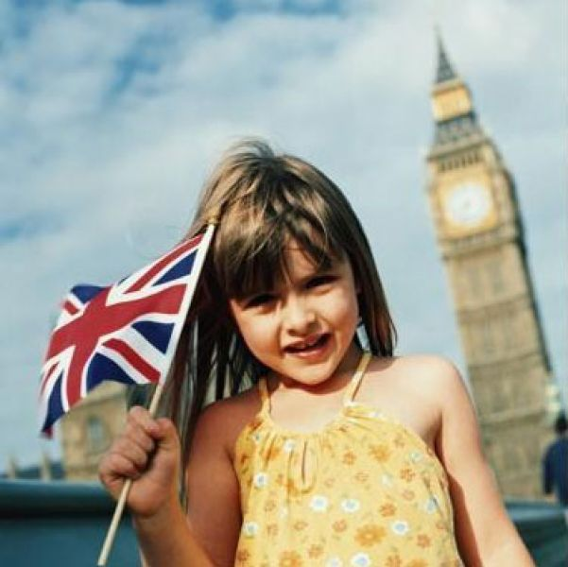
One of the official symbols of the UK – is the flag. It is called the Union Jack, isn’t it?

Slide 15
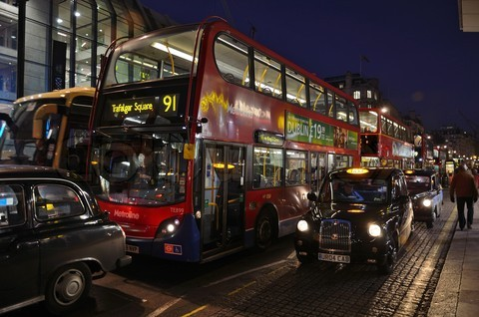
The red double-decker buses and the black cabs are the most popular public transport in London, aren’t they?

Slide 16
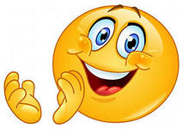
Thanks a lot

Slide 17
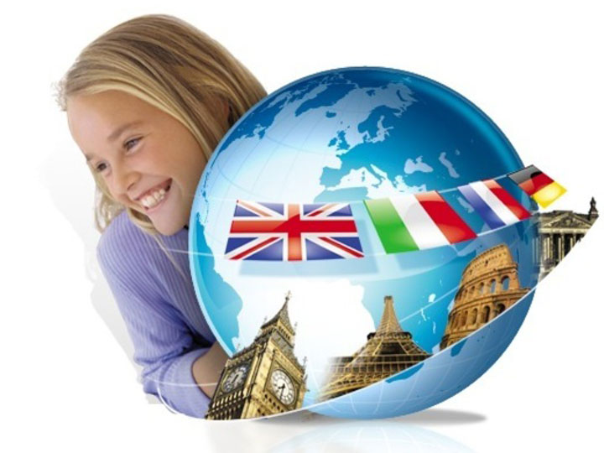
What
Where is it?
Who

Slide 18
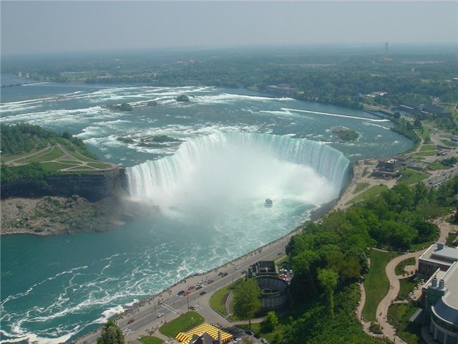
It is Niagara Falls. It is situated in the USA

Slide 19
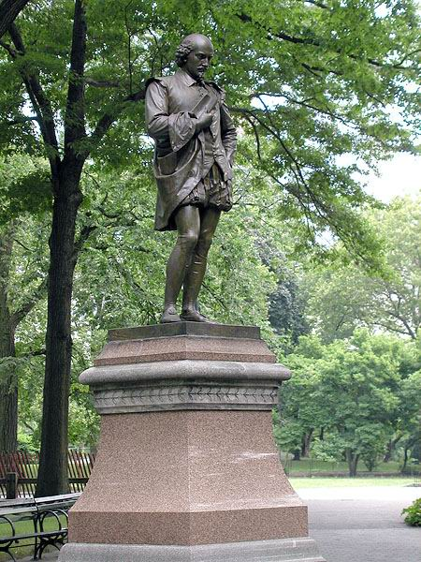
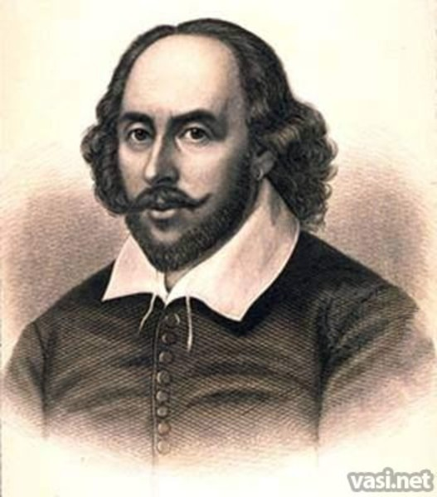
His name is William Shakespeare. He is a famous English poet, playwriter and actor.

Slide 20
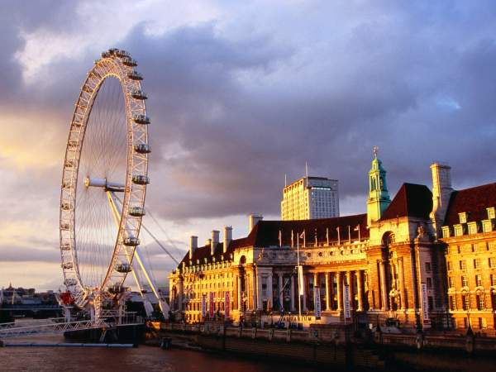
This is the London Eye. It is situated in London, on the river Thames.

Slide 21
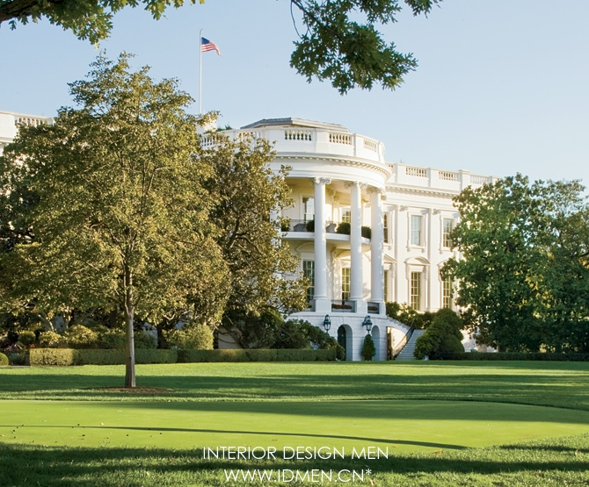
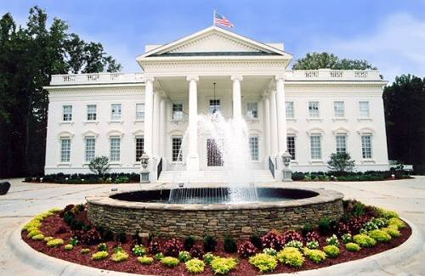
It is the White House, the official residence of the American President. It is situated in the USA.

Slide 22
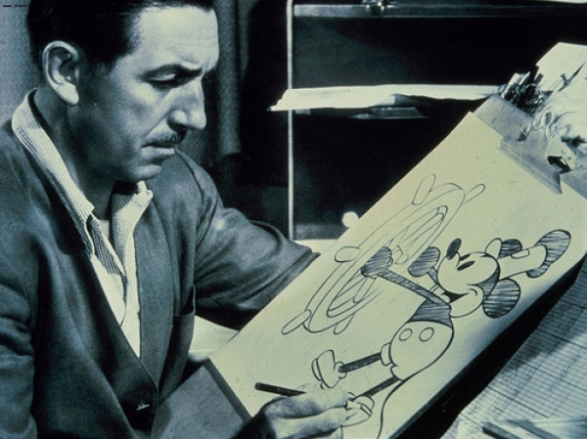
His name is Walt Disney. He was a famous animator, cartoonist, producer and director.

Slide 23
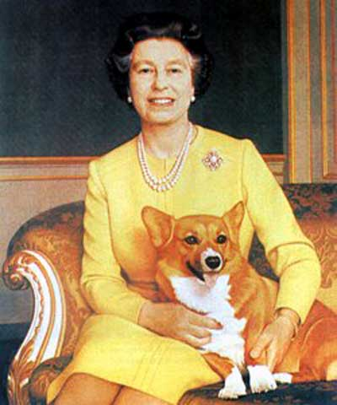
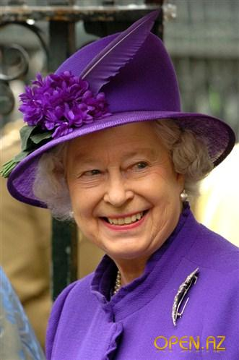
Her name is Elizabeth II. She is the Queen of the UK.

Slide 24
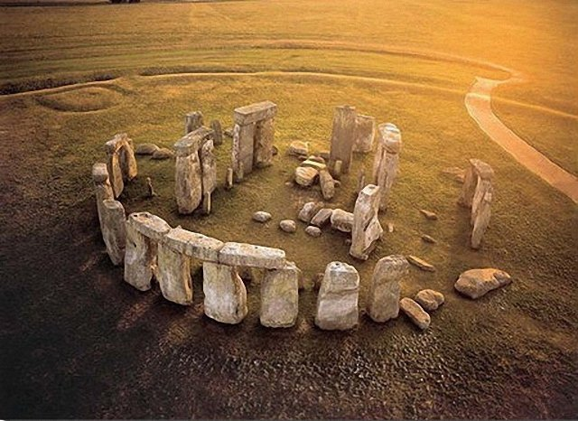
It is Stonehenge. It is situated in the UK.

Slide 25
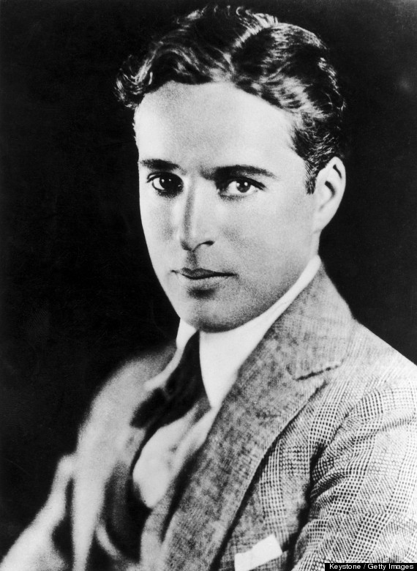
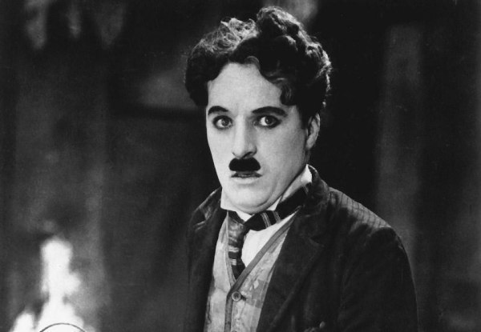
His name is Charlie Chaplin. He is a great American actor.

Slide 26
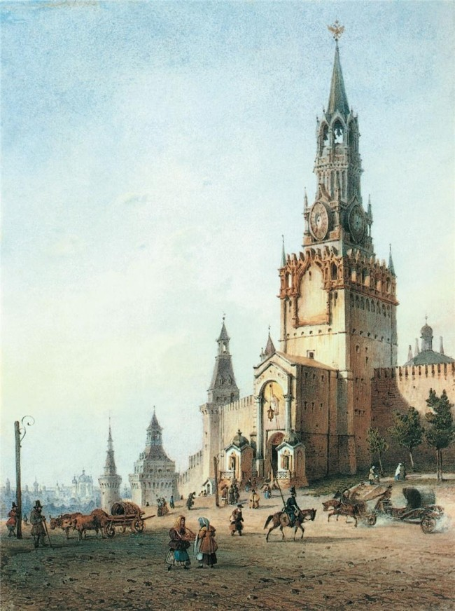
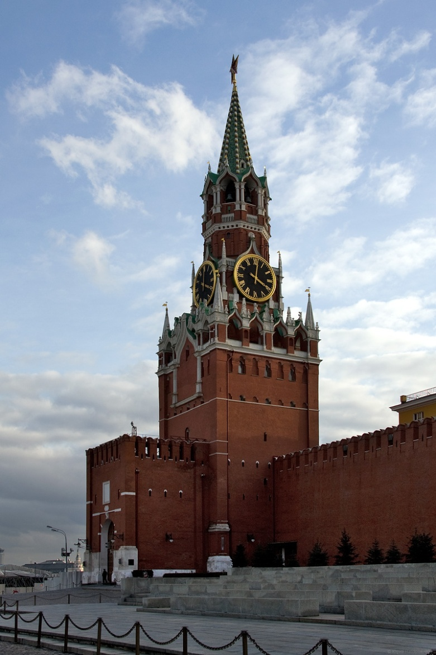
The Spasskaya Tower is the part of the Kremlin. It is situated on Red Square, in Moscow.

Slide 27
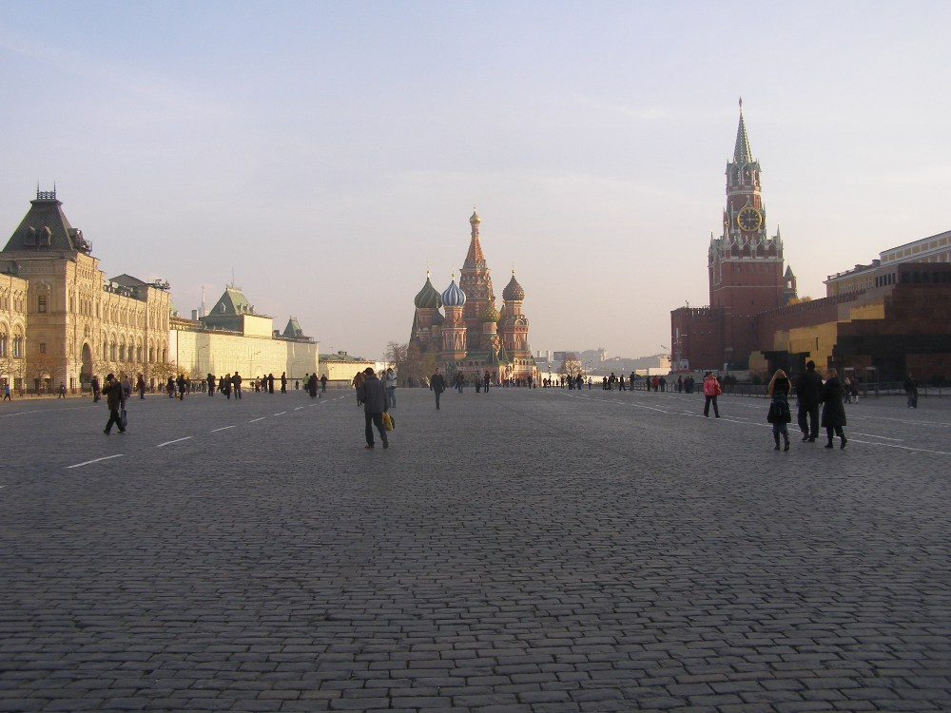
One of the most important event, the War Parade, takes place on Red Square every year.

Slide 28
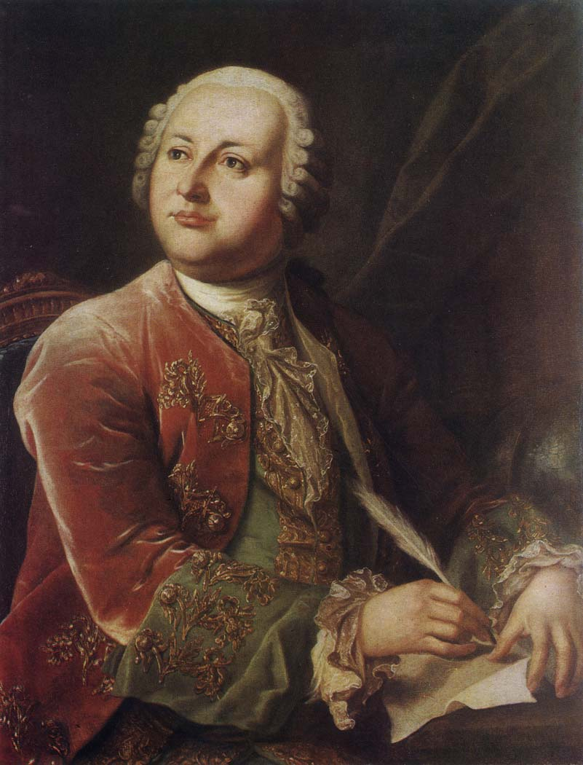
Michael Vasilyevich Lomonosov was the great Russian scientist, poet, physics, chemist. He was the founder of Russian science.

Slide 29
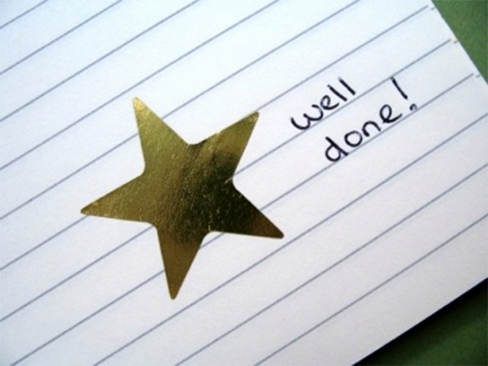

Slide 30
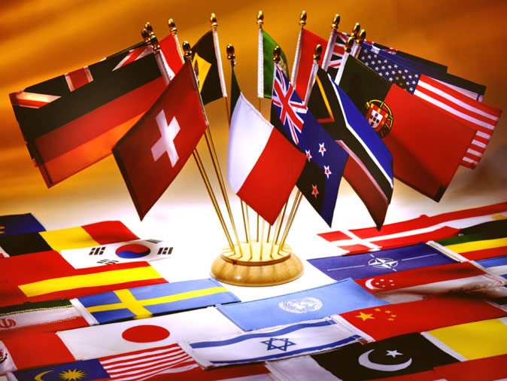
“Match the word and its definition”

Slide 31
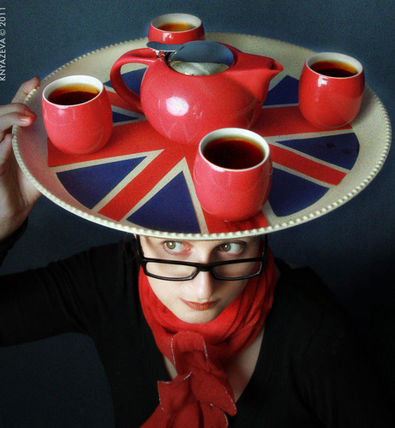
Traditionally English tea is… a) strong black tea with lemon b) strong black tea with milk c) green tea

Slide 32
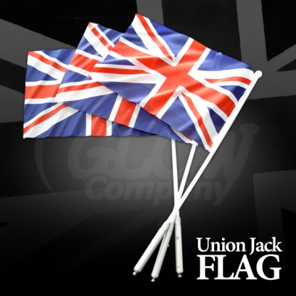
The famous flag Union Jack is the symbol of… a) the USA b) Wales c) the UK

Slide 33
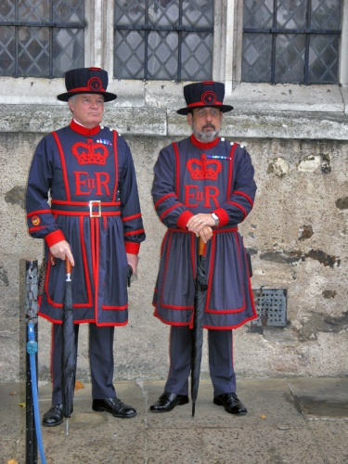
Beefeaters – are the people, who… a) prefer eating beef and vegetables b) visit their relatives every weekend c) persons, who take care of the black ravens

Slide 34
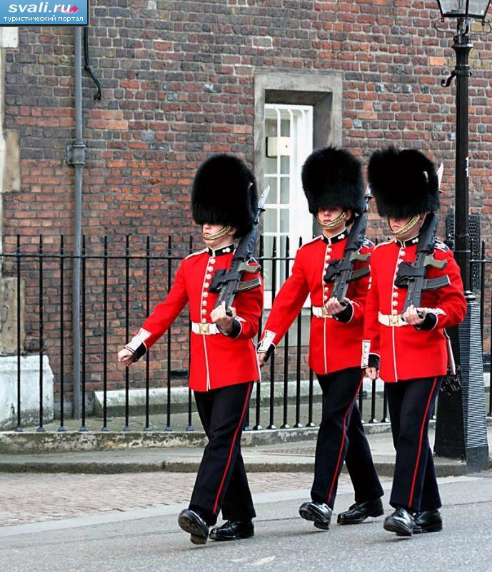
These persons are always stand at the Buckingham Palace and guard its gates. a) They are foreigners from other countries b) They are the Royal Guards c) They are Londoners, who take care of this architectural monument

Slide 35
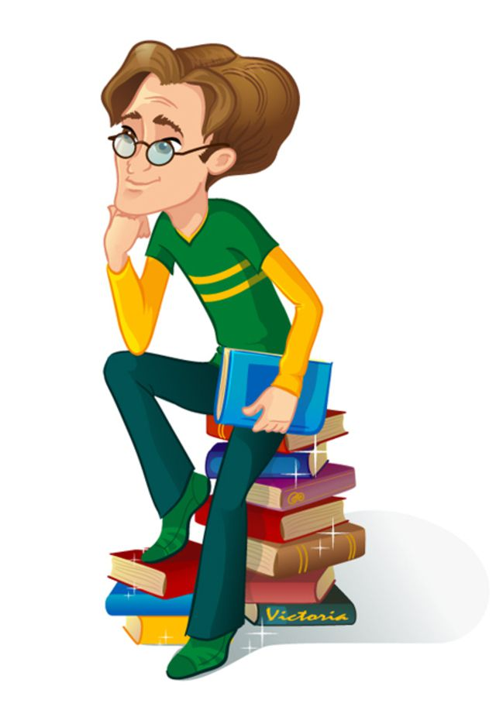

English language is also called “the language of the sky and the sea” because… a) it is very popular b) Every pilot and ship’s captain must speak it c) many people want to speak it

Slide 36
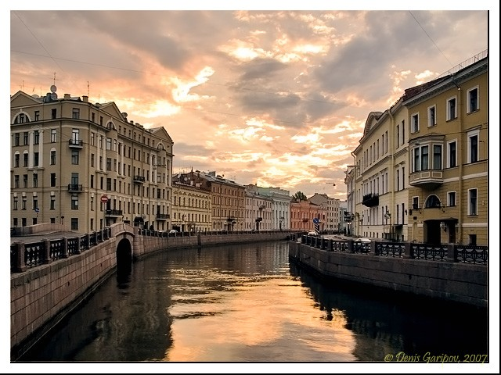
The famous nature wonder, when the sky is not dark at midnight, is called… a) Milky Way b) Dark Hole c) the White Nights

Slide 37
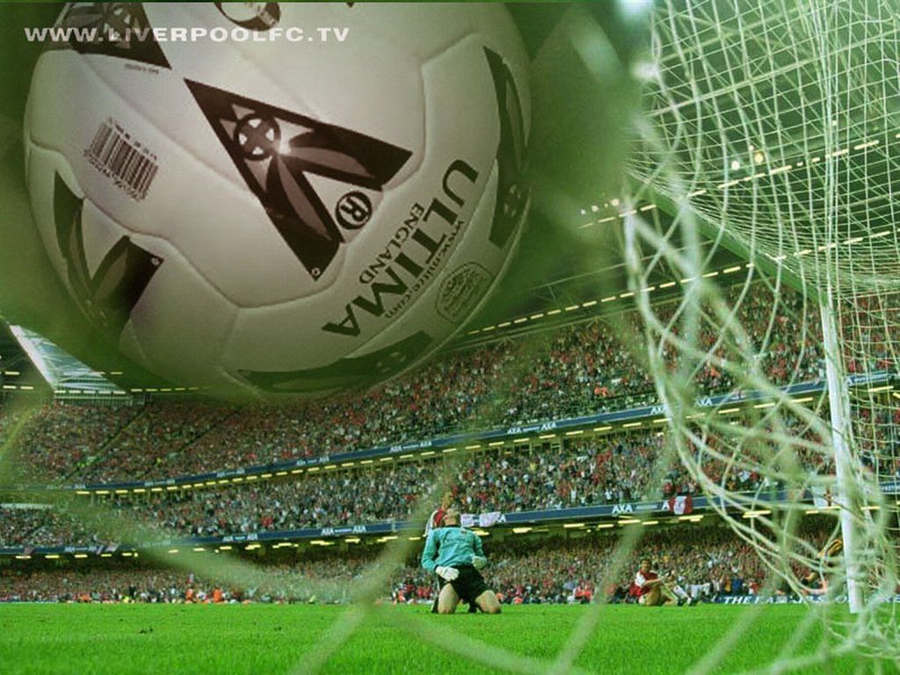
The football’s birthplace is… a) Russia b) Scotland c) England

Slide 38
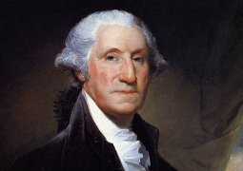
George Washington was the first President of the USA. You can see his portrait… a) on the American flag б) on TV с) on the money banknote

Slide 39
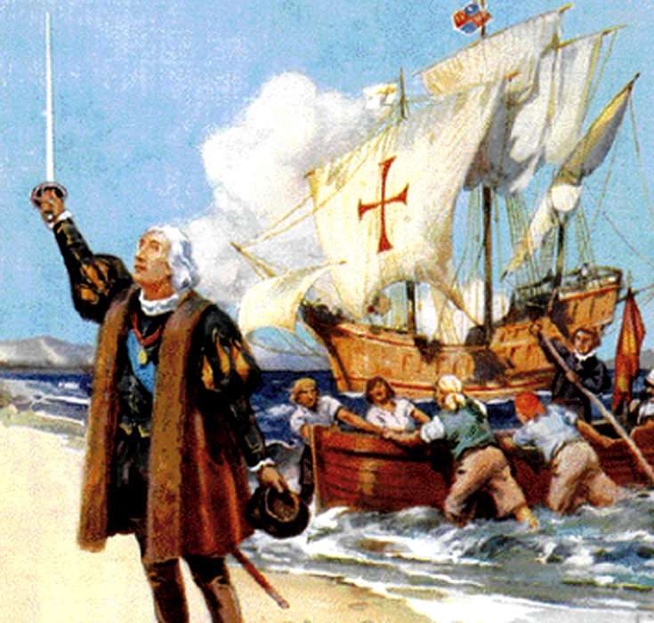
Look at the picture and name this man, who discovered America in the fifteen century.
Christopher Columbus
b) George Washington c) Fernando Magellan

Slide 40
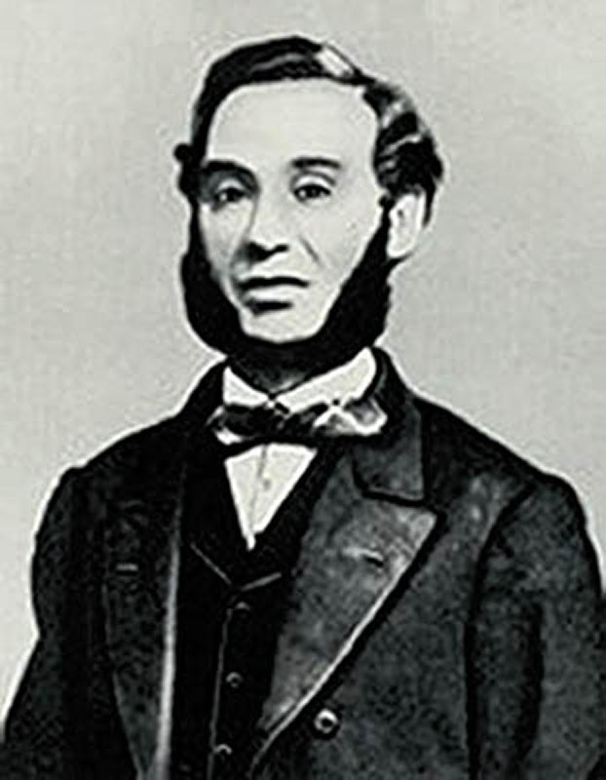
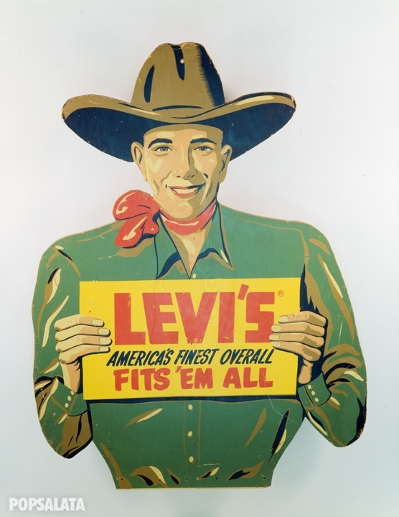
In the middle of the 19 century in the city of San Francisco there lived a tailor called Levi Strauss. He made… for the cowboys.
a) the first smoke pipe b) the first jeans
c) the first hat

Slide 41
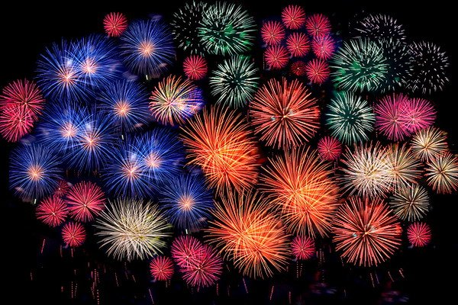
Thank you !!!

Slide 42
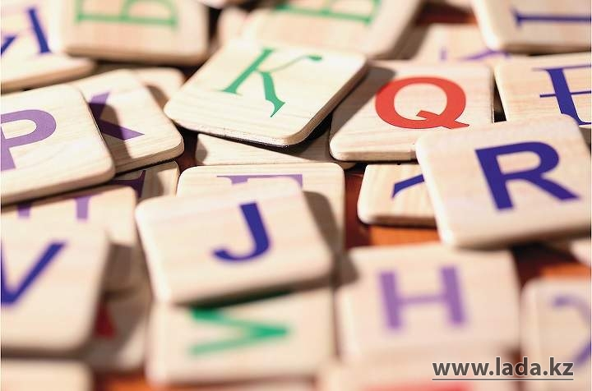
“they say…” (proverbs and statements)

Slide 43

The voice of one man is a voice of no one

Slide 44

A great ship needs deep waters.

Slide 45

There's no place like home.

Slide 46

The more, the merrier.

Slide 47

Better an egg today than a hen tomorrow

Slide 48

Talk is cheap, silence is golden.

Slide 49

Score twice before you cut once.

Slide 50

Like father, like son.

Slide 51

All's well that ends well.

Slide 52

Rome wasn't built in a day.

Slide 53

NICE WORK!!!

Slide 54


“Find out…”

Slide 55

Use this plan…
The capital of … is…
The main cities are…
The main rivers are…
The most famous places of interest are…
The main traditions (holidays and meals) are…
The most famous people are…

Slide 56

Let’s meet our winners

Slide 57


Slide 58


