Slide 1
Game

Slide 2
Round 1
“Introduction”

Slide 3
Round 2
“Go on”

Slide 4
Round 3
“Hurry after the leader”

Slide 5
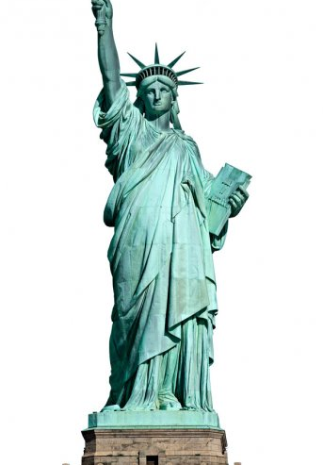
1. After Summer comes…

Slide 6
2. The author of the book “Lord of the rings”

Slide 7
3. The date of Independence day

Slide 8
4. Who always says “Elementary Watson”?

Slide 9
5. How are you?

Slide 10
6. After Monday comes…

Slide 11
7. The date of St. Patrick’s Day

Slide 12
8. The official languages of Canada

Slide 13
9. The author of the book «Harry Potter»

Slide 14
Round 4
“Proverbs and sayings”

Slide 15
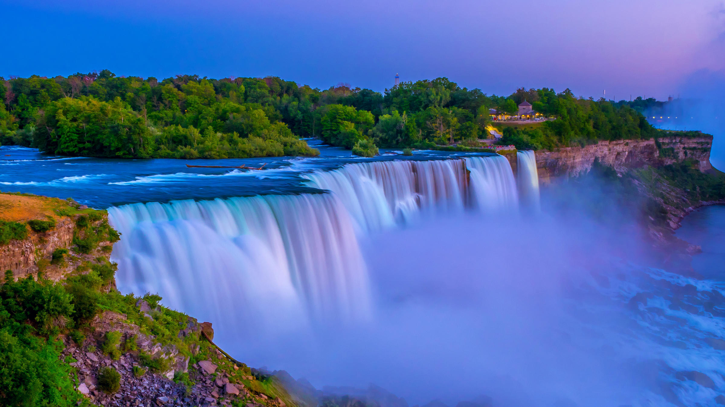
Actions speak louder than words
After a storm comes a calm
Barking dogs seldom bite
A cat in gloves catches no mice
Curiosity killed the cat
The devil is not so black as he is painted
Don’t wash your dirty linen in public
Don’t teach a fish to swim
Empty vessels make the greatest sound
First catch your hare than cook him
Не выноси сор из избы
После бури приходит затишье
Без труда не вытащишь и рыбку из пруда
Не учи ученого
Не так страшен черт, как его малюют
Не убив медведя, шкуру не делят
Пустая бочка пуще гремит
Не бойся собаки брехливой, а бойся молчаливой
Любопытной Варваре на базаре нос оторвали
Не по словам судят, а по делам

Slide 16
Round 5
“Captain’s Competition”

Slide 17
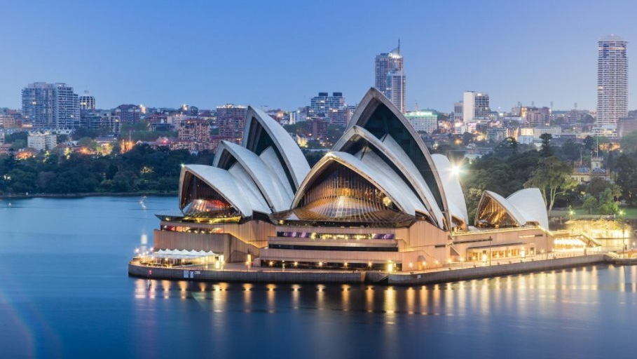
1. What is the capital of Australia?
(Canberra)
2. What British band sang the song “Yesterday”?
(Beatles)
3. Who is known as the «king» of rock and roll?
(Elvis Presley)
4. What countries does the UK consist of?
(England, Scotland, Wales, North Ireland)
(Captain Cook)
5. Who discovered Australia?
6. What is the most popular clock in London?
(Big Ben)
7. What place is the center of the American film
industry?
(Hollywood)
(Canada)
8. Where is the Niagara Falls situated?
9. What country was bungee jumping invented in?
(New Zealand)

Slide 18
Round 6
“Who is in the picture?”

Slide 19
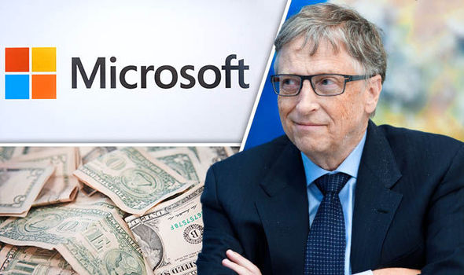
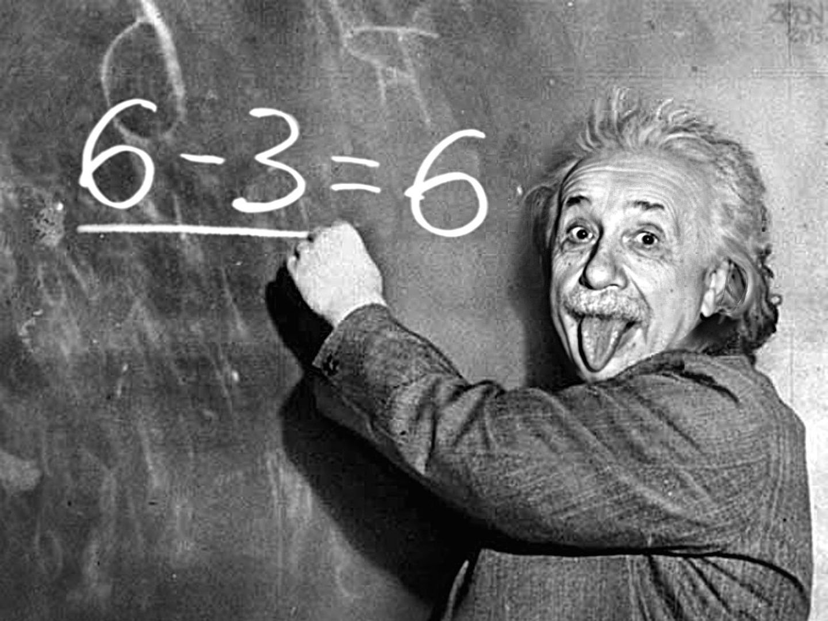
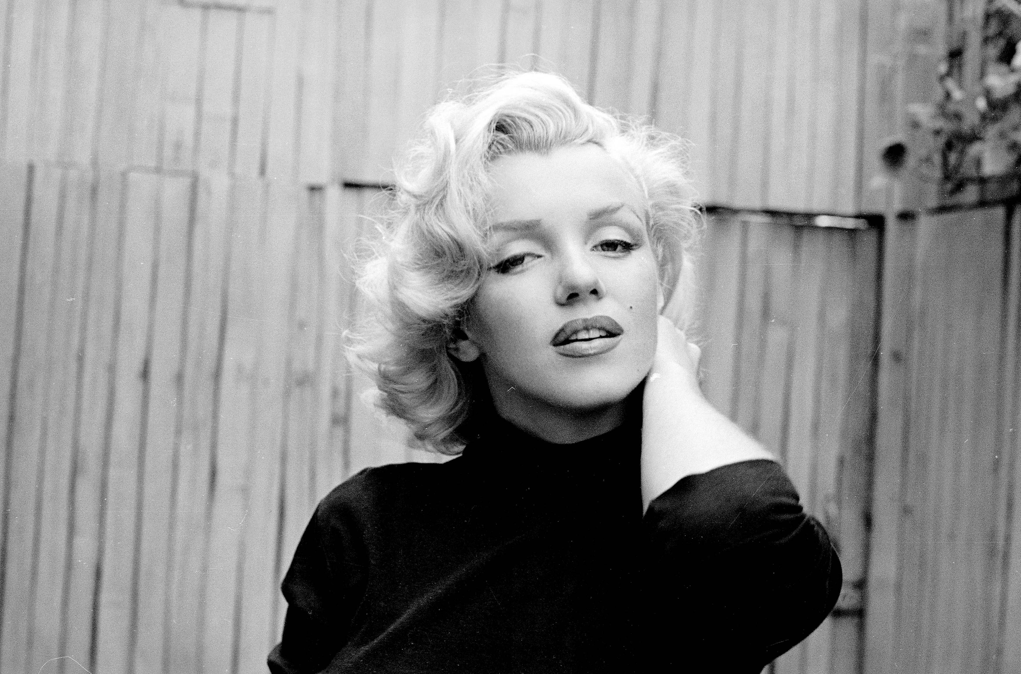
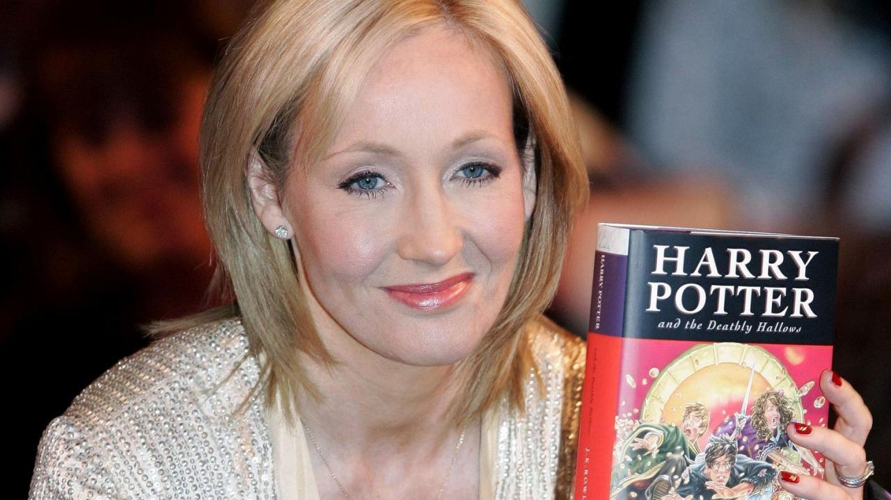
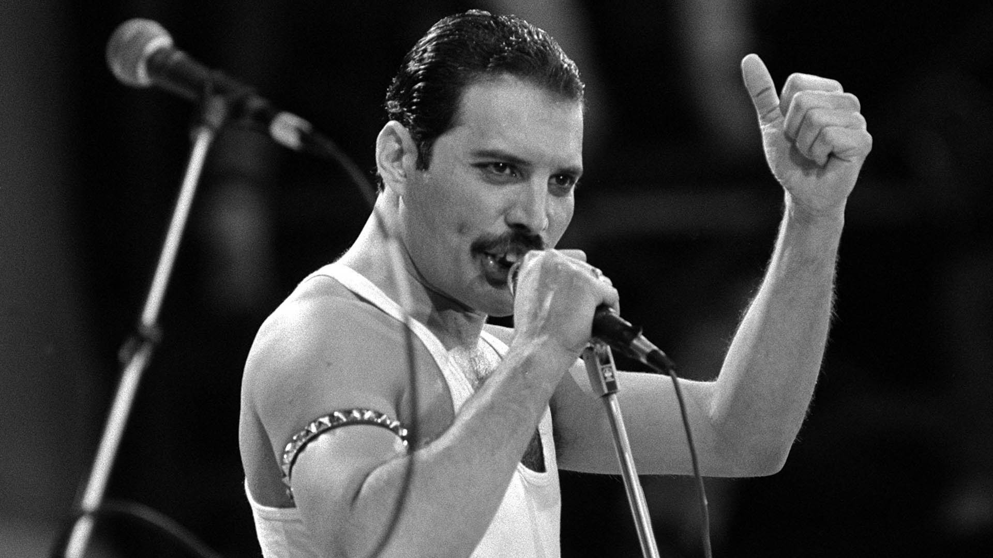
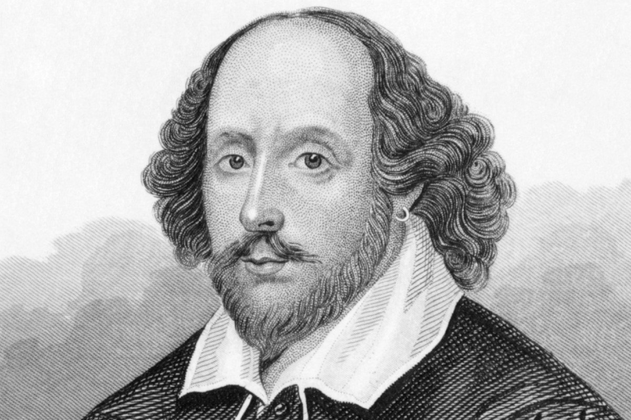
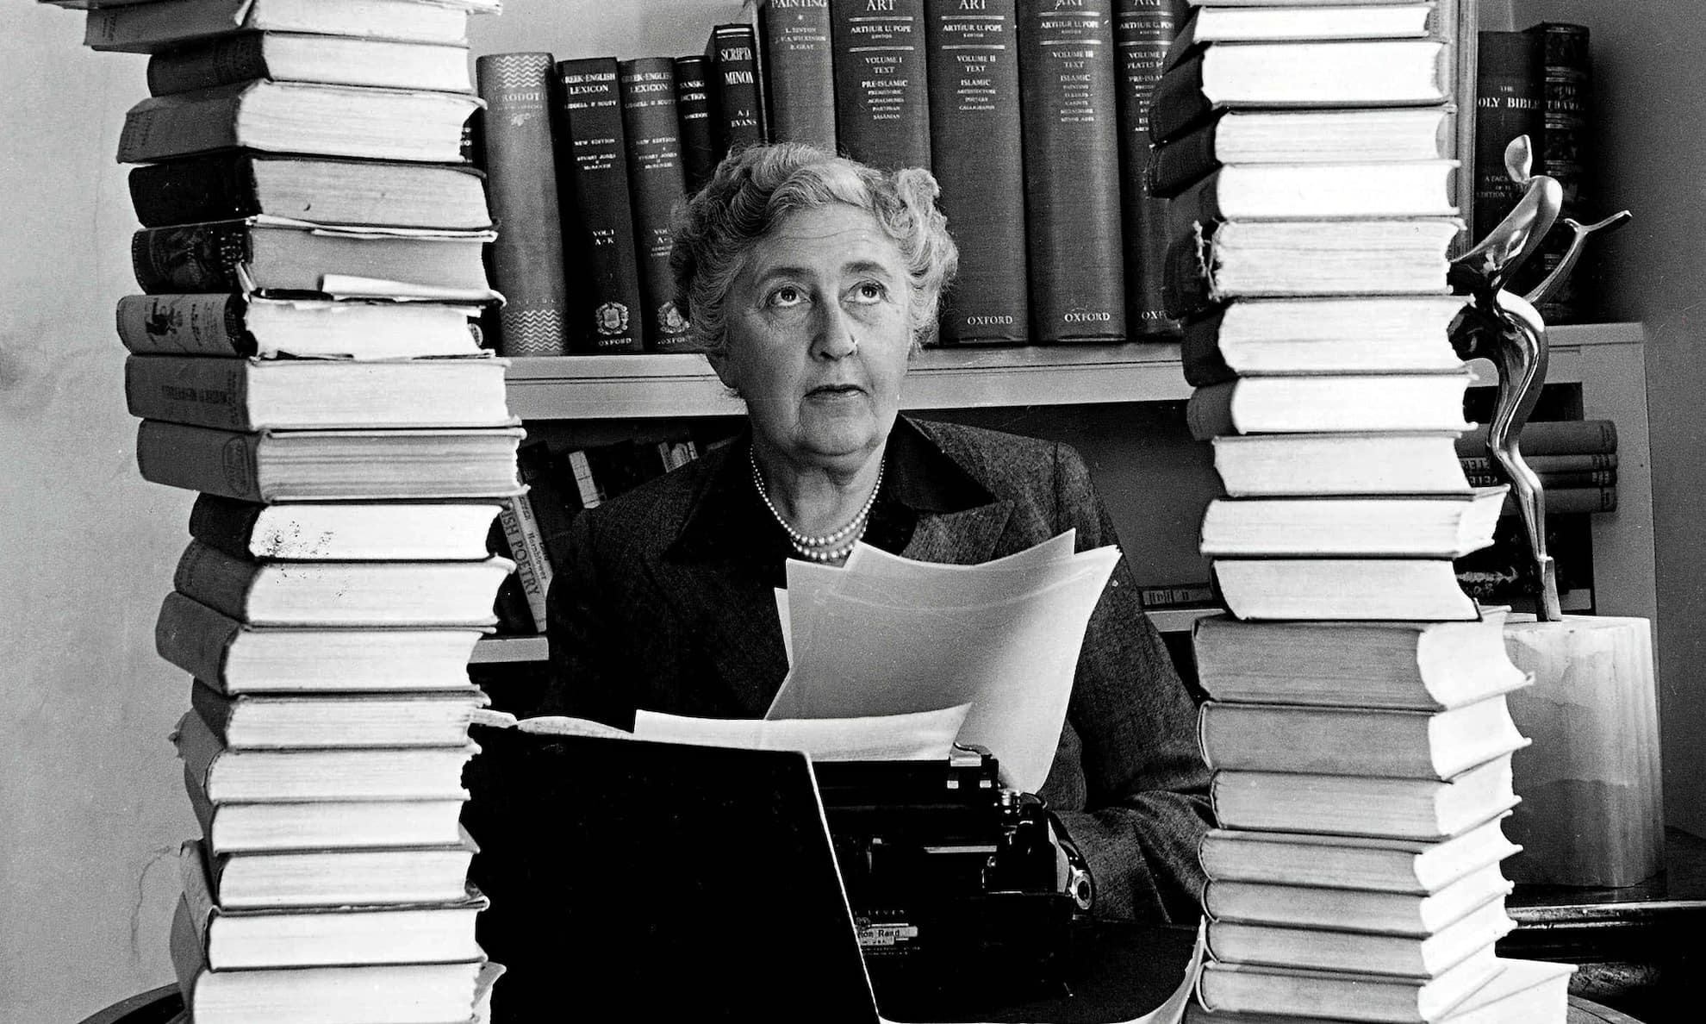
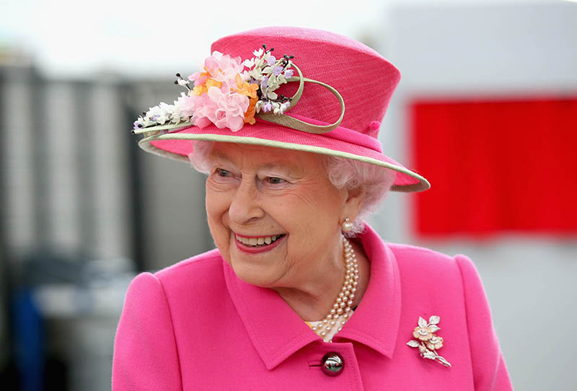
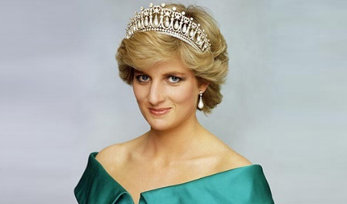
Bill Gates
Albert Einstein
Marilyn Monroe
Winston Churchill
JK Rowling
Freddie Mercury
William Shakespeare
Agatha Christie
Elizabeth II
Princess Diana

Slide 20
Round 7
“The quiz”

Slide 21
1) Put all these English-speaking countries from the largest to the smallest one:
A: India
B: Australia
C: New Zealand
D: the USA

Slide 22
2) What do the Englishmen say to congratulate each other before New Year?
А: hello
B: happy New Year
C: trick or treat
D: how are you?

Slide 23
3) How many stars are there on the New Zealand’s flag?
А: 3
B: 4
C: 5
D: 6

Slide 24
4) Who lived in Baker Street, 221 “b”?
А: Tom Sawyer
B: Sherlock Holmes
C: Oliver Twist
D: Elizabeth II

Slide 25
5) Which of these cities is the capital of the USA?
А: Washington D.C.
B: New York
C: Los Angeles
D: Hollywood

Slide 26
6) Band “The Queen” came from …
А: Cardiff
B: London
C: Cambridge
D: Liverpool

Slide 27
7) What is the name of “Iron Lady”?
А: Madonna
B: Margaret Thatcher
C: Angelina Jolie
D: Princess Di

Slide 28
8) What is it “London Eye”?
А: bridge
B: castle
C: prison
D: big wheel

Slide 29
9) Who was famous woman wrote detectives?
А: Marie Curie
B: Agatha Christy
C: Jane Austen
D: Charlotte Bronte

Slide 30
Round 8
“The detective”

Slide 31
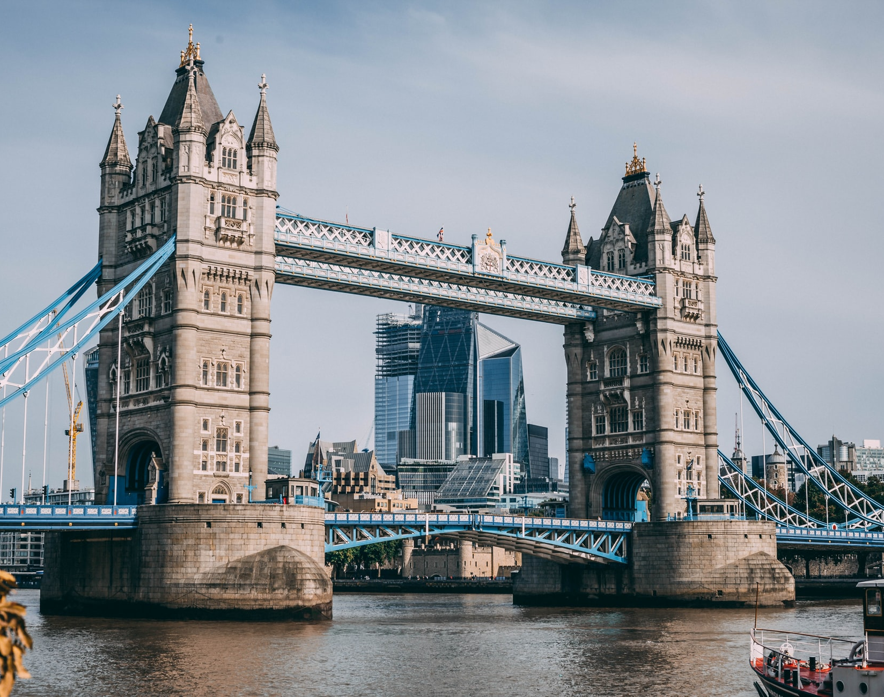
1. Chicago, an American animator, a film producer, he created the most famous mouse.
(Walt Disney)
2. American, a business magnate, he created his first car when he was 30, a talented mechanic.
(Henry Ford)
3. New York, the 3rd place in Forbes, the Internet, Facebook.
(Mark Zuckerberg)

Slide 32
Summing up
the results

Slide 33
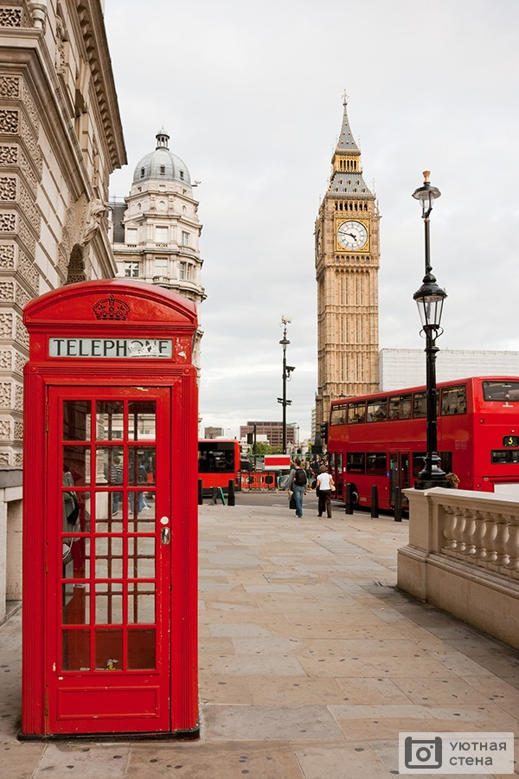
Thank you! Have a nice day!

